Slide 1
Department of Kinesiology, Athletics, & Dance
Spring 2016 Program Review

Slide 2
Mission of the Department of Kinesiology, Dance & Athletics
Promote physical activity as an essential component in achieving educational goals, lifelong learning and self-development.
Provide a variety of courses in fitness, dance, individual and team sports that will develop fitness components, a sense of body awareness, positive attitudes, and pride in individual and team achievement.
Develops future educators and professionals in the field of kinesiology, athletics, dance and fitness via our degrees.
Aims to inspire our students to believe in themselves and strive for excellence in personal growth, health and wellness.

Slide 3
Table of Contents
Curricular Changes
Progress report: Prior Action Plan
Impact of Staffing Changes and Resource Applications
Data
SLO's, PLO's
Strategic Action Plans

Slide 4
Curricular Changes
Added a web assisted course component to the Fitness Center courses
Leveled all our Physical Education Credit courses due to Title V changes.
Updated the courses according to the curriculum schedule.
  In spring 2015, all of the dance and the team classes were updated.
Created and currently offering Kinesiology AA degree and one Kinesiology Transfer degree.
Created Team 184 for out of season Varsity student-athlete men's and women's soccer
  Team 141 can now be utilized just as a soccer activity course.
Added 2 Kinesiology course with the plan of offering in the next academic year: "Stress Management" and "Lifetime fitness and Nutrition"

Slide 5
Progress Report: Prior Action Plans
Facilities – Building One and our Athletic Fields
  Renovated soccer field and baseball field
  Updated gym bleachers
  Building One - no updates as of November 2015
Curricular Offerings- increase general population classes
  Leveled current offerings
  New lecture courses: KIN 107, 110

Slide 6
Degrees
Name
Kinesiology Transfer Degree
Kinesiology AA Degree
Dance Degree (State Approval Process)
“Dancer and Choreographer” industry Projected growth of 5% by year 2024
(Department of Labor and Statistics) http://www.bls.gov/ooh/entertainment-and-sports/dancers-and-choreographers.htm
“Athletic Trainer” industry Projected growth of 21% by year 2024
(Department of Labor and Statistics)
http://www.bls.gov/ooh/healthcare/athletic-trainers.htm
“Exercise Physiologist” industry Projected growth of 11% by year 2024
(Department of Labor and Statistics)
http://www.bls.gov/ooh/healthcare/exercise-physiologists.htm

Slide 7
Impact of Staffing Changes and Resource Allocations:
Staffing Changes:
  Women's Soccer- reinstated
  Women's Tennis - reinstated
    Increase of total athletic participation from 106 to 161
  Division Assistant- centralized administrative presence
  New Division Dean – provides administrative oversight

Slide 8
Current Faculty and Staff
Full-time Faculty
  Mike Garcia – Athletic Director/Fitness Professor
  Ana Miladinova – Fitness/Dance Associate Professor
  Erik Gaspar – Kinesiology Assistant Professor/ Men’s Soccer Head Coach
  Katie Osborne – Kinesiology Assistant Professor/ Women’s Soccer Head Coach
Adjunct and Classified Faculty
  Nick Carr- Classified/ Fitness Adjunct Professor
  Cindy Jimenez- Athletic Trainer/ Adjunct Professor
  Tony Lucca- Adjunct Professor/ Head Baseball Coach
  Vera Quijano- Dance Adjunct Professor
  Annie Roake - Dance Adjunct Professor
  Rick Velasquez, - Adjunct Professor/ Women's Golf and Tennis Head Coach
  Mike Reynoso- Adjunct Professor/ Men's Basketball Head Coach
  Matt Lee- Division Assistant

Slide 9
Impact of Staffing Changes and Resource Allocations:
Resource Allocations:
  District renovated soccer/baseball fields
    Increased student participation
    Increased community awareness

Slide 10
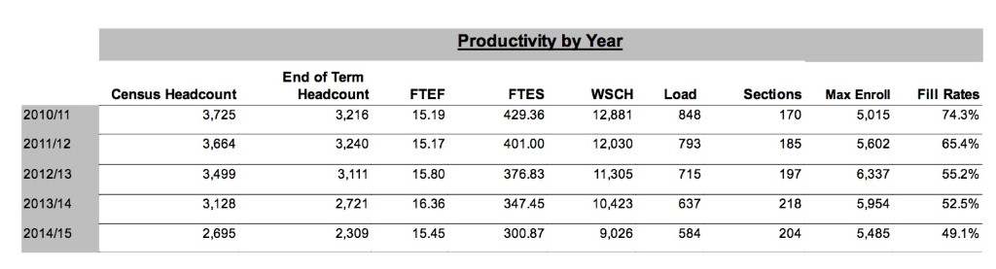
DATA
Although there was a slight decrease our LOAD is higher than the college average
Notes:
The Load has also decreased from 584 in 2013/14 to 584 in year 2014/2015. However, the load is still slightly higher compared to the college wide load which is 488 in 2014/15.

Slide 11
SLO's and PLO's
With the help of our new coordinator Erin Moore, we are in the process of updating SLO's and PLO's in Tracdat. As a department we expect o have our data up to date by June 2016.

Slide 12
Strategic Action Plan
Expand Curricular Offerings
Hire Full time basketball, volleyball coaches
Hire Part-Time Fitness and Dance Instructors
Update Department Websites
Building 1
  As a department that will be the primary user of building one it is imperative that we are proactivity involved in the planning for swing space and building design.

Slide 13
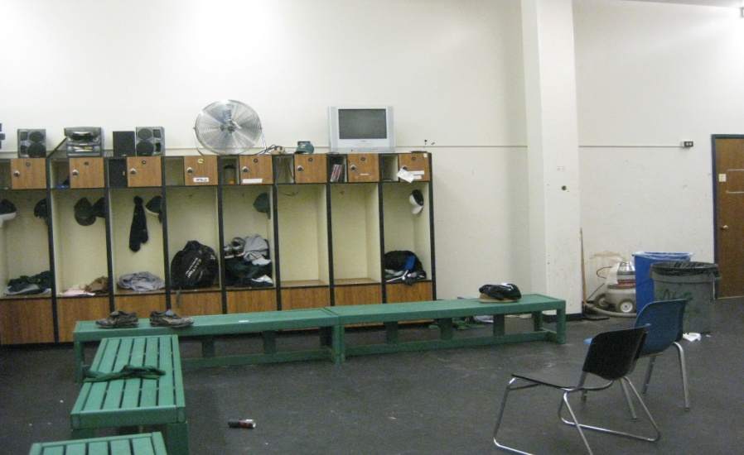
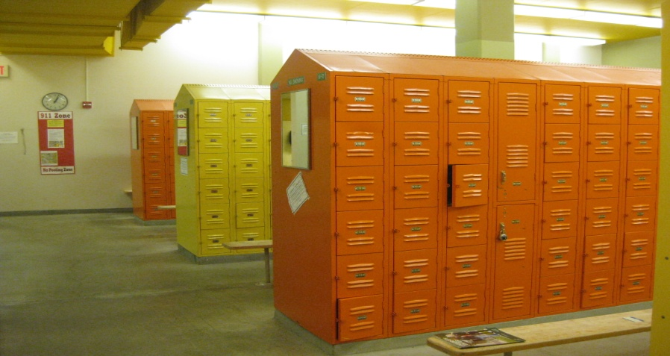
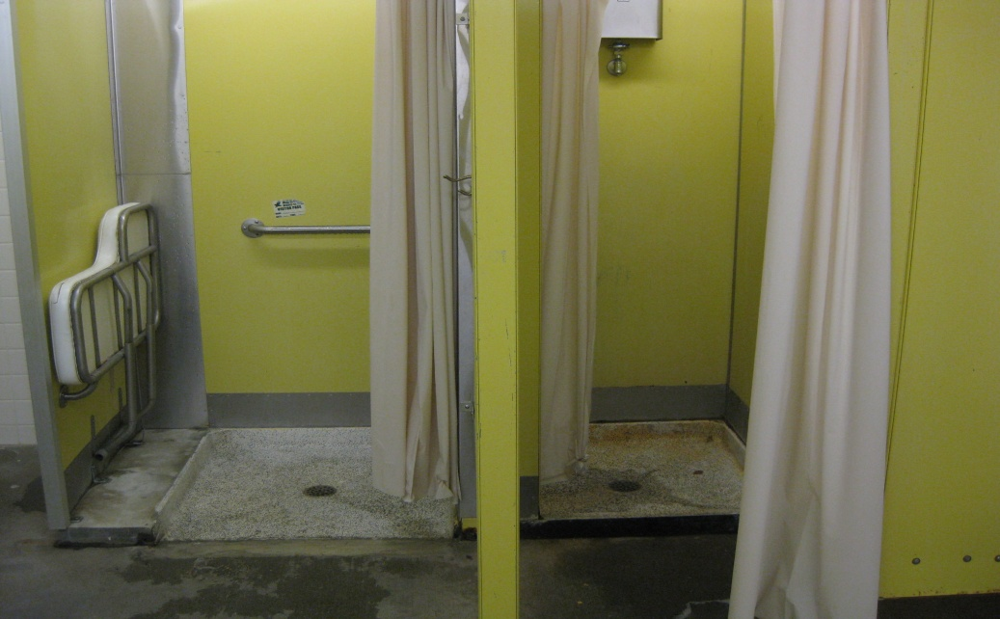
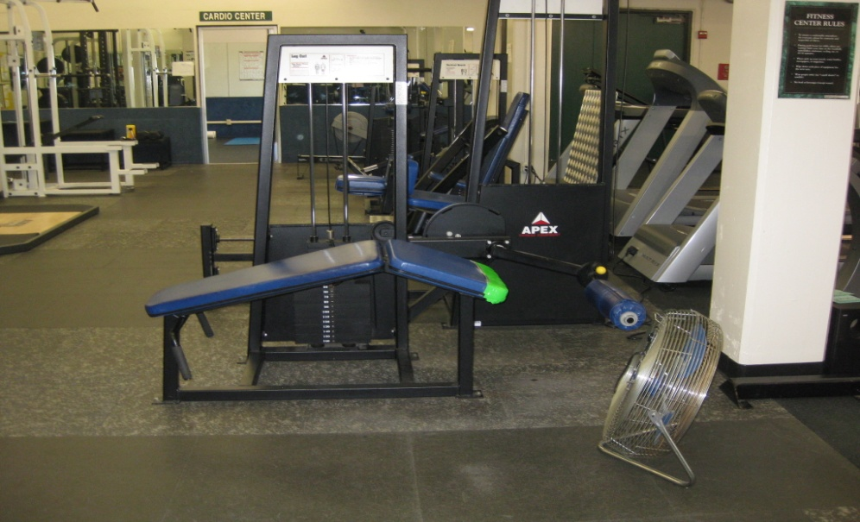
Why New Building 1?

Slide 14
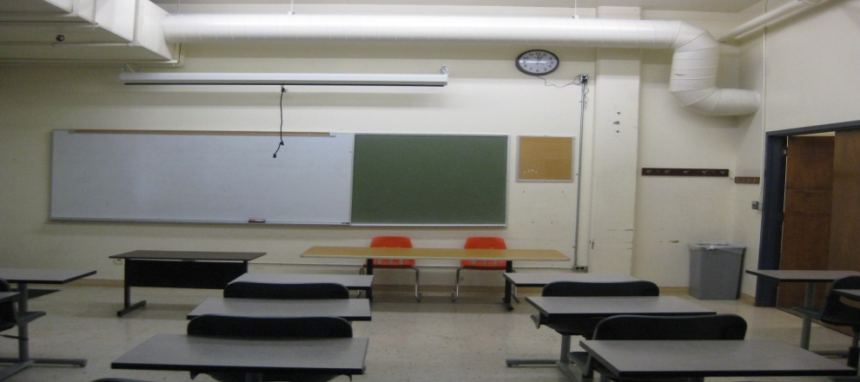
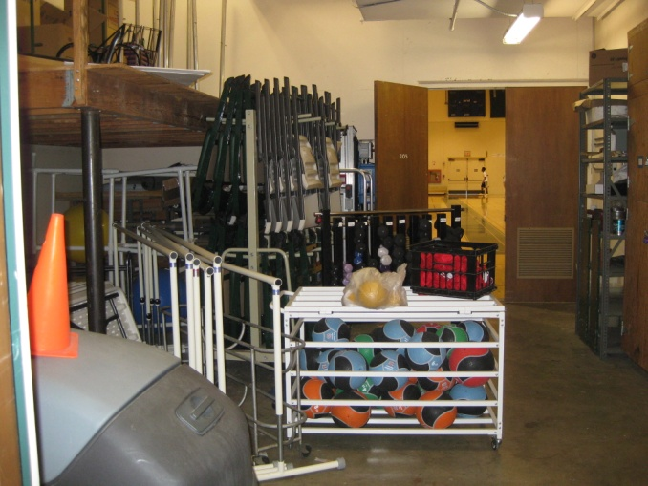
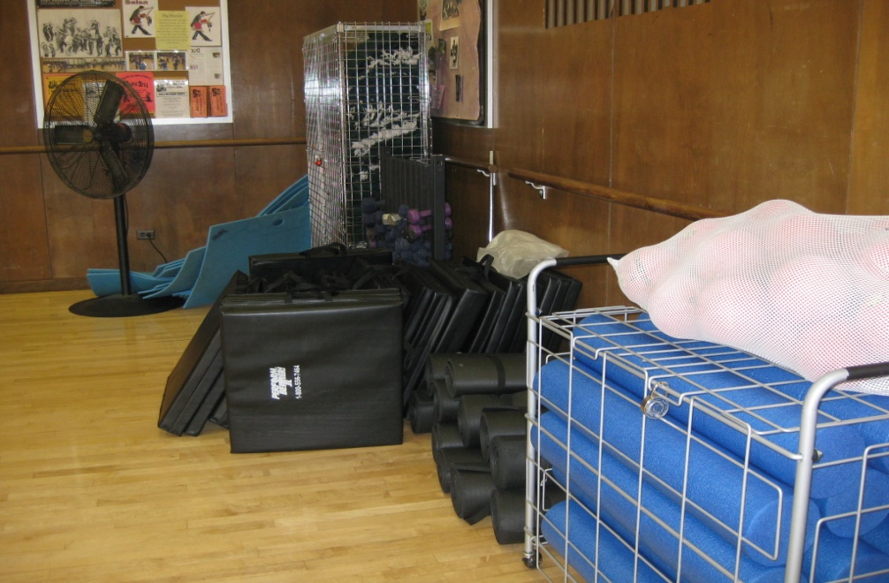
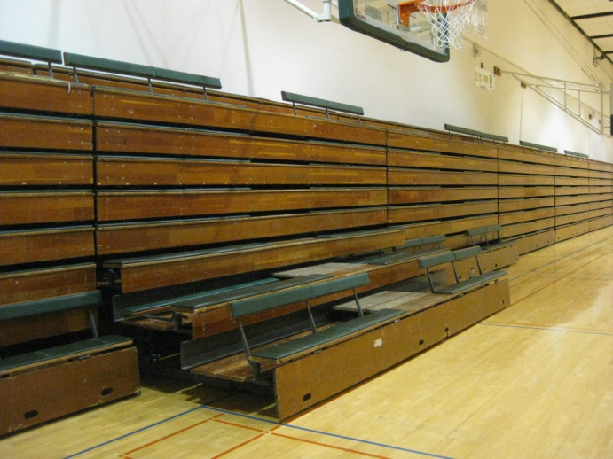
Why New Building 1?
Notes:
Need of extra storage space
Need space for instruction
Up to date facility to attract students and viewers who come to see the games

Slide 15
Thank you!

