Slide 1
Proactive Registration
Trish Guevarra & Mónica Reynoso

Slide 2
Goals
Provide an overview of the development of Proactive Registration
Highlight the processes entailed in the collaborative effort
Demonstrate the institutional impact of this successful effort
Provide recommendations on how to continue growing

Slide 3
Overview
2006 – ESL lead an initial effort to register their students both on and off-campus and provided wrap-around support
Spring 2015: Math and English faculty replicated the registration effort as a means to increase enrollment in Basic Skills courses leading to Intrusive Registration
Fall 2015: Intrusive Registration changed to Proactive Registration
  Expanded effort to include Basic Skills English, Reading, Math, and ESL courses 1 and 2 levels below transfer
    24 classes participated

Slide 4
Purpose of Proactive Registration
Population Served: Continuing students enrolled in Basic Skill courses 1 and 2 levels below transfer
  Math – 811, 110, 120, 190
  English – 826, 827, 836, 847
  ESL – 914, 924, 400
  Reading – 826, 836
To increase the retention and enrollment of students enrolled in Basic Skills courses by providing registration support

Slide 5
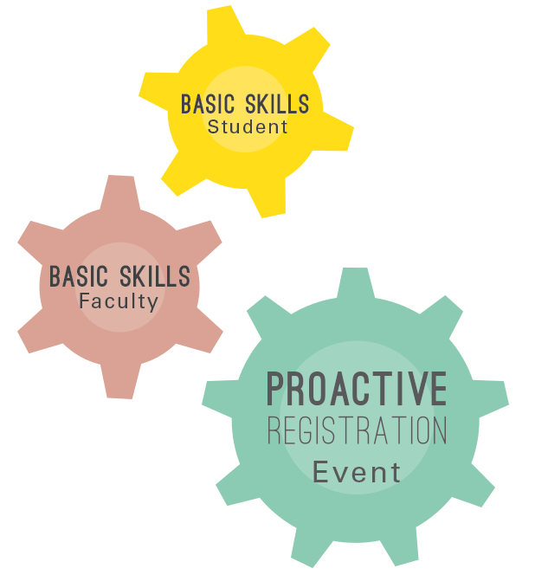
Process At-a-Glance
Pre-Planning:
Planning meetings with all stakeholders
Trainings for staff and student support team
Work with BSI faculty and RSVP for registration
Classroom visits to prepare students for registration
Day Of:
Registration/Pre-evaluation
Passports/Post- Evaluations
Academic materials
Wrap Around Support:

Slide 6
Impact Analysis
Spring 2015
Participated in the Proactive Registration event | 129
Registered for Summer 2015 | 42 %
Registered for Summer & Fall 2015 | 32 %
Registered for Fall | 65%
Not Registered | 24 %
Fall 2015
Participated in the Proactive Registration event | 372
Registered for Spring 2016 | 99%
Registered at the Proactive Registration event | 43%
Registered for Spring 2016, prior to attending the event | 48%
Need help completing their registration | 2%

Slide 7
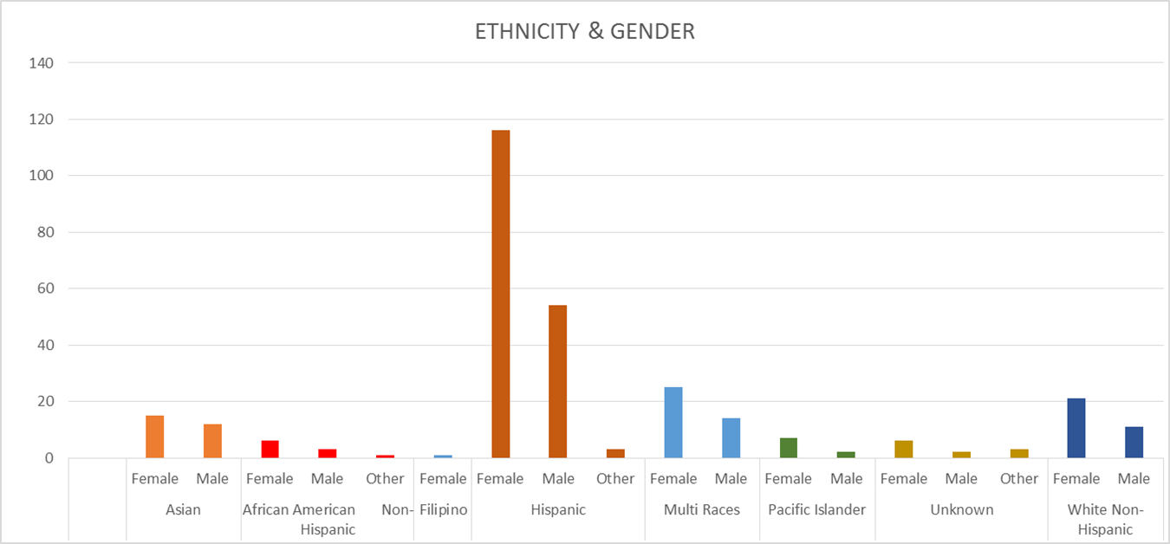
Disaggregated Data

Slide 8
Impact
Academic
  Increased registration for Math Jam and Word Jam to strengthen their re-entry
  Doubled the number of course offerings such as Math190 courses
Campus Support
  Increased collaboration between departments, staff, student workers, and faculty
  Night students need more support
Registration
  Implemented additional reminders to students about registration dates
Retention
  Created a Proactive Retention Team consisting of retention specialists, counselors, and program services coordinators to triage the issues students face prior to registration
  Possible automatic emails to students if they drop a Math or English course

Slide 9
Upcoming
Proactive Registration: Thursday, May 12 – Wednesday, May 18th in the Learning Center
36 classes participating
Over 600 students

