Slide 1
Theatre Arts 2016: Strengths
  Reliable enrollment in GE & IGETC courses offered every semester: Acting & Intro to Theatre. These courses are generating student interest in fine & performing arts.
Theatre Arts Department Productions:
  Enrollment is up now that we’re rehearsing x3 a week (but that presents its own challenges!)
  Attracting committed students who are dedicated to the high standards of the department. (We added 4 weeks of rehearsal to the Crucible!) Students engage in team-building, creative problem solving. Leaders emerge.
  Cross-curriculum with English, History. Student Matinees!
  Attracts students to other courses (anecdotal: “I saw the show last semester and I thought it was great, wanted to get involved.”)

Slide 2
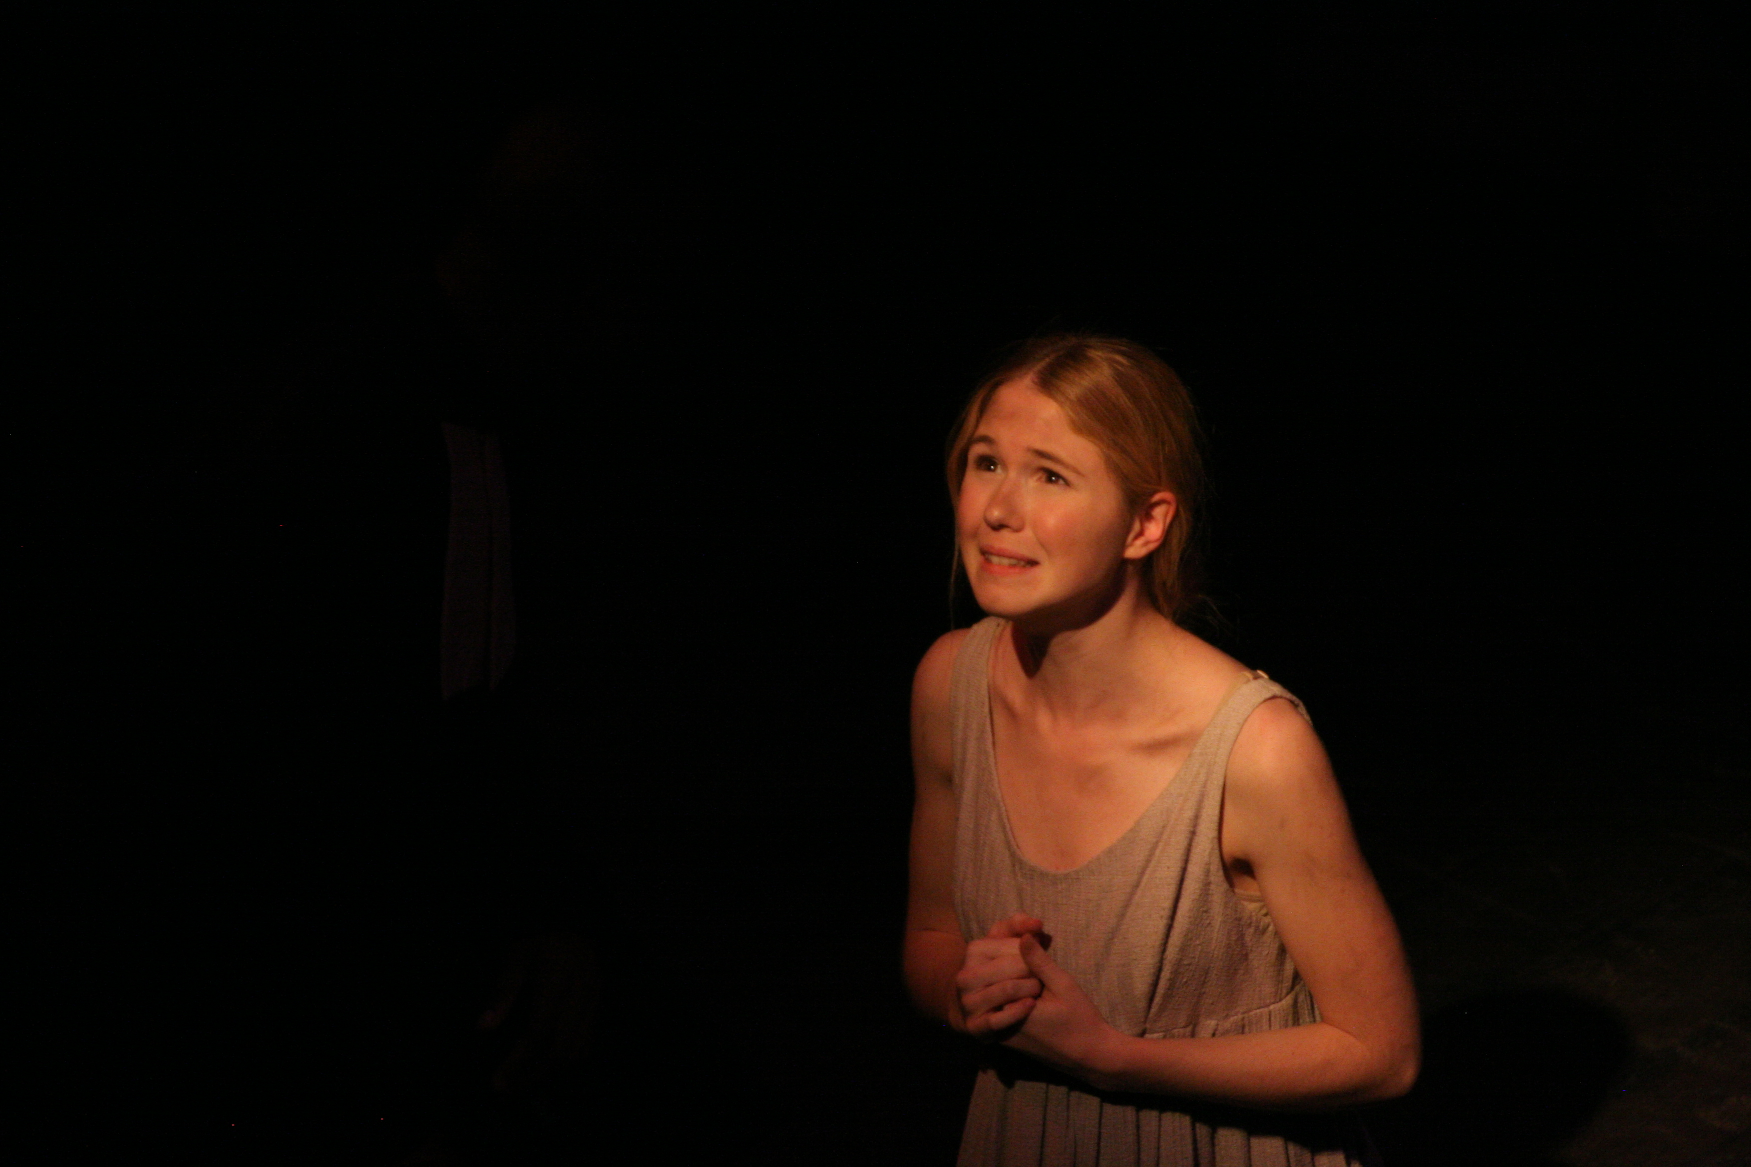
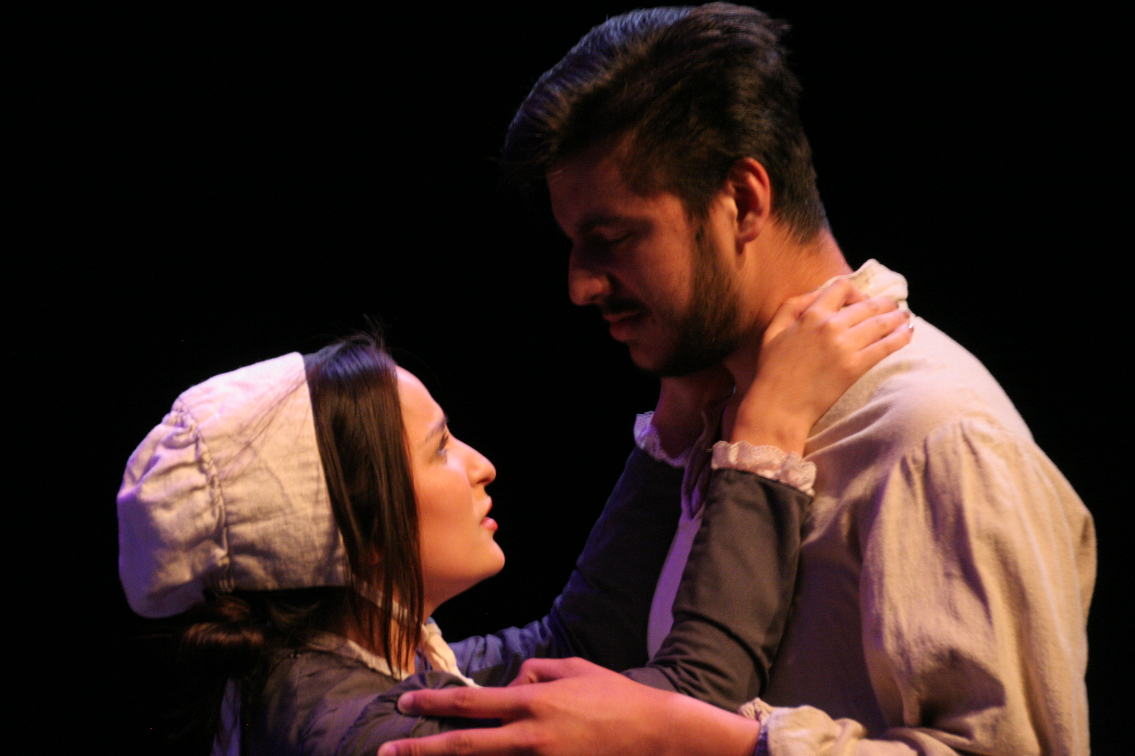
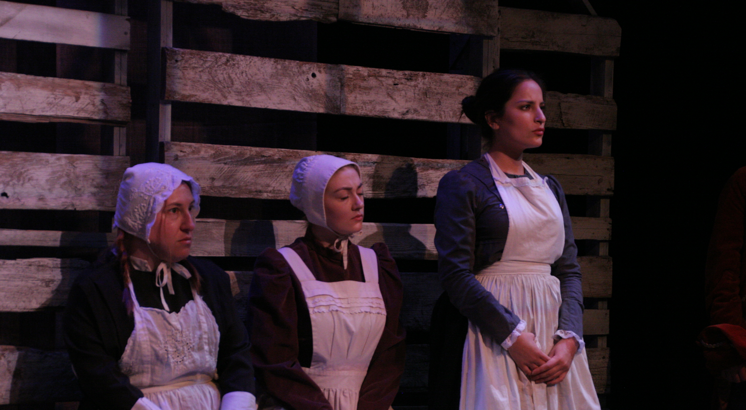
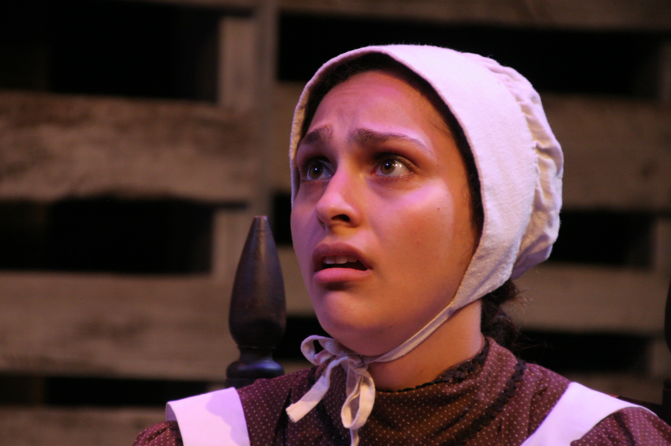

Slide 3
Theatre Arts 2016: Challenges
  Low enrollment in non-GE/IGETC courses. Lower college enrollment overall + emphasis on moving students through the college more efficiently
No longer a real program; students can no longer earn their AA or AA-T
  NON-GE & IGETC courses regularly canceled: Script Analysis, Intermediate/Advanced Acting, Play Development Lab, Technical Theatre Production.
We need to attract more audience members to the Theatre Arts Department productions.

Slide 4
Theatre Arts 2016
Action plan: short term
Get DRAM 150 approved for GE: In process.
Attract more students and audience members to Theatre Arts productions: continue to offer productions that can cast 12 - 16 students. Integrate music & dance!
Participate as leaders in the Arts Task Force to mobilize college-wide awareness & support of the Theatre Arts program, including an active marketing plan. Working now with Megan, Mayra, & Jose: update materials, increase outreach to local high schools, to downtown, and to lifelong learners!
Persist in getting administrative support for a Fine and Performing Arts Coordinator to facilitate and support curriculum development, planning, community outreach, and marketing.
Participate in the Arts Honors Certificate: Fall 2016 = Curriculum Committee, Spring 2017 = offer first course.
Work with the counselors to clarify and strengthen the message to students about the value of art classes for their education and careers. First meeting: Tues 5/10.

Slide 5
Theatre Arts 2016
Action plan: long term
Develop a Certificate in Dramatic Writing by offering classes in Playwriting, Screenwriting, and Writing for Television; Complete UCLA’s Professional Program in Writing for Television in preparation for the development of this certificate.
Try to get other “selective” courses approved for GE / IGETC.
Create internships with local and SF theatre companies to offer students a pathway to a career in the performing arts. (three “Crucible” students working with FoolsFury Theatre in SF for their 2016 summer theatre festival!)
Document student success stories!
  Max Tachis: Prolific local actor and playwright - City Lights Theatre Co, Renegade Theatre Experiment.
  Alisha Ehrlich, BA in Theatre and Performance Studies, U.C. Berkeley, and SAG-eligible actress.
  Meghan Souther, Technical Manager at the Marsh Theatre, San Francisco.

Slide 6
Theatre 2016 Responses to SPOL
Community, employment, and technology needs did not seem to be addressed as much as they could have.
  The Fine & Performing Arts Task force will be creating a resource packet of brochures and online materials demonstrating the relevance of arts in multiple career fields.
It makes sense to do an interdisciplinary initiative with the business department to increase marketing for theater arts while giving credit to students in business courses.
  Yes! Perhaps enroll these students in DRAM 300.1? (May need to revise COR.) Or cross-list a course?
The program should be assigned a seasoned staff as a mentor to train the full-time staff in PLO implementation.
  Yes! And a Fine and Performing Arts Coordinator wuld be enormously helpful here.

