Slide 1
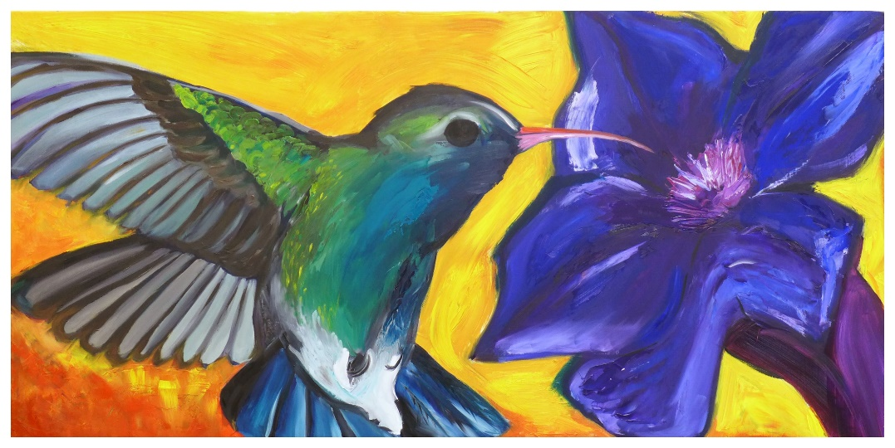
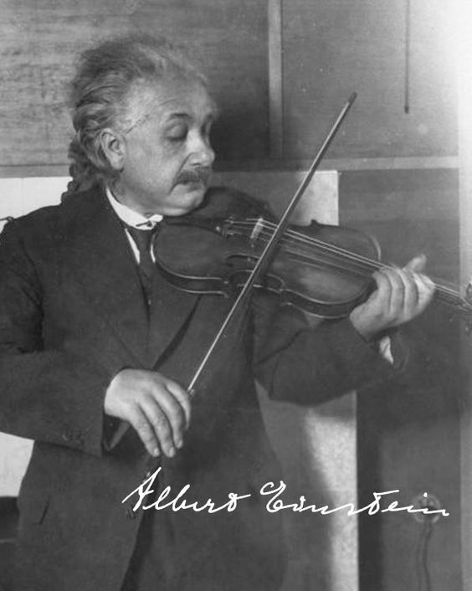
Arts Task Force Report #1
Reinvigorating and promoting the arts align
tightly with the college's mission statement and institutional learning outcomes
Equity
Recommended actions for the 2016-17
academic year
Resources/Career Info/Publicity
Community Relations and Development
Curriculum and Scheduling
Next steps

