Slide 1
Engineering Program Review
Cheri Markt and
Amelito Enriquez
May 5, 2017

Slide 2
Outline
Focus on feedback from Program Review:
Staffing Changes
Department Metrics
New Engineering Department Focus

Slide 3
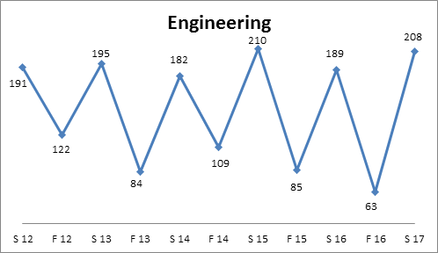
Department Statistics
Engineering Headcount
2015 / 2016 | Engineering Department | Goal
Enrollment | 282
Load | 457 | 525 min
Success Rate | 81.2% | 70%
Retention Rate | 86.5% | 84%

Slide 4
Transition Phase
Staffing, Roles & Responsibilities
Professor Enriquez
Retiring teaching June 2017
Retiring grant support August 2018
Professor Markt
Teaching 7 lectures and 5 labs
Professor Rhodes (Biology)
PI for NSF S-STEM and GANAS grants
Professor Hoffman & Professor Lapuz (Math)
Running Summer Engineering Teaching Institute (SETI)
Professor Langhoff (Engineering-Skyline)
Leading ASPIRES program, internships & research

Slide 5
Engineering Program Goals
1) Real world projects incorporated into curriculum
 | 2016/2017 | 1 year | 5 year
Intro to Engineering | Waterfall vs Agile | Lean tool | Green Belt Training Certification*
Statics | Solid Works Simulation Design Review* |  | Create a separate lab for Static Simulations
Dynamics |  | Solid Works Simulation Design Review* | Create a separate lab for Dynamic Simulations
* Industry Engagement: Lockheed Martin, Nuclear Power Plant Consultant, … and more

Slide 6
Engineering Program Goals
1) Real world projects incorporated into curriculum
 | 2016/2017 | 1 year | 5 year
Circuits and Devices | Wearable Device Project Poster Presentation* Tour of Flex*
Material Science | Tour of Stanford Nano Fab* | Honors Research Project at Stanford* | Product based Quality Engineering Report*
Engineering Graphics |  | Formal Design Review* | Metrology, Manufacturing Processes
* Industry Engagement: Flextronics, Stanford Nano Fab

Slide 7
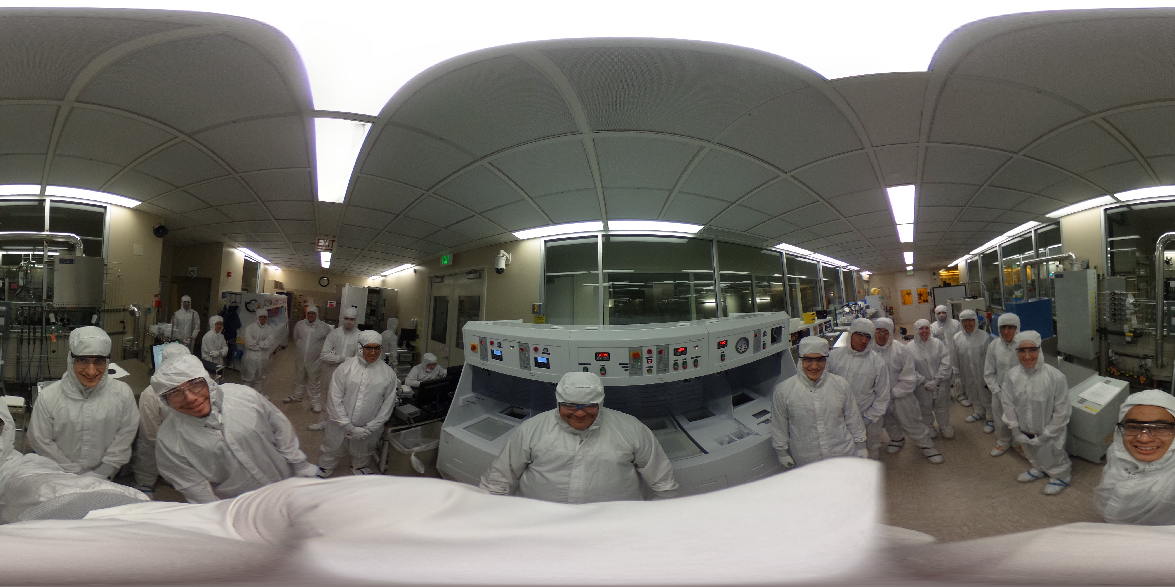
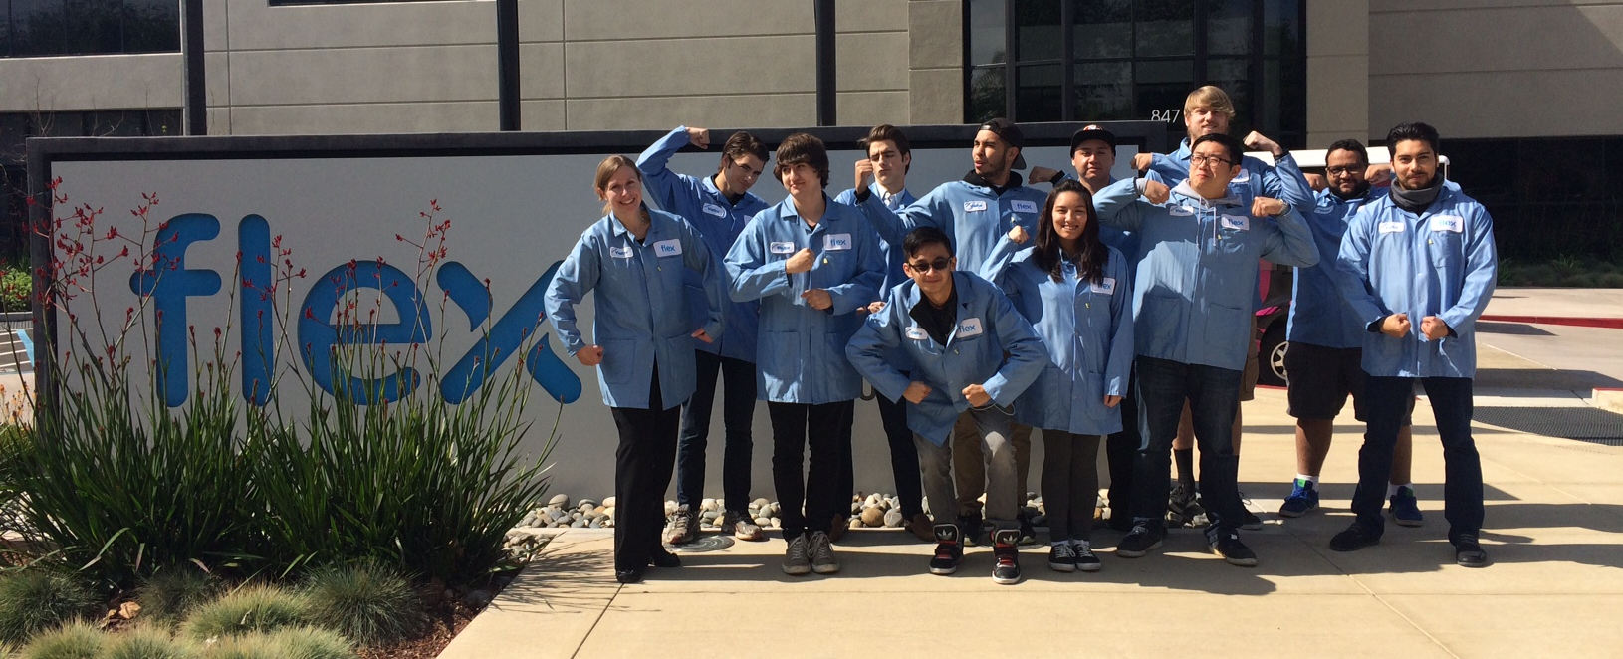

Slide 8
Engineering Program Goals
2) Close equity gaps
 | Access Rate Engineering | Access Rate Canada | Equity Gap
Female Students | 19.3% | 61.8% | -42.5%
Hispanic Students | 21.6% | 34.2% | -12.6%
Institute for Women in Trades, Technology and Science (IWITTS) Training:
Female Students especially value:
Context- why are we learning these skills? Who benefits from the technology/ product?
Additional access to lab equipment, extended exposure
Female role models
Learning how to find help (students either excel or drop out)

Slide 9
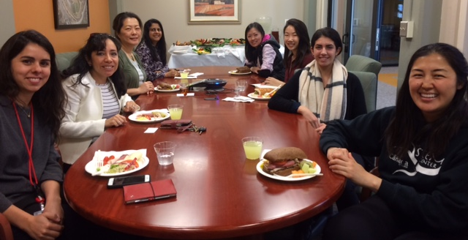
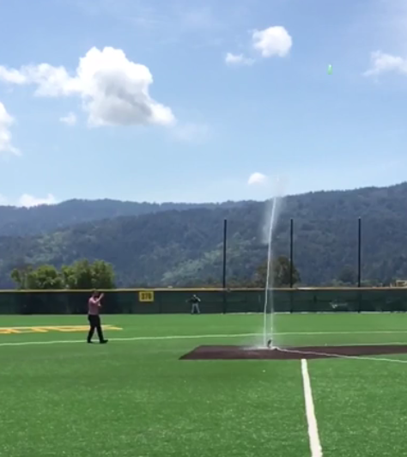
Engineering Program Goals
2) Close equity gaps
 | 2016 / 2017 | Future
Context | Industry based projects
Access to Lab Equipment |  | Dedicated Lab Space
Role Models | Visit Math 225 * Women Mentoring Lunch
Access to help | Include resources on first day of class | Facilitate study groups
* Industry Engagement: Nasa, Hensel Phelps, Oracle

Slide 10
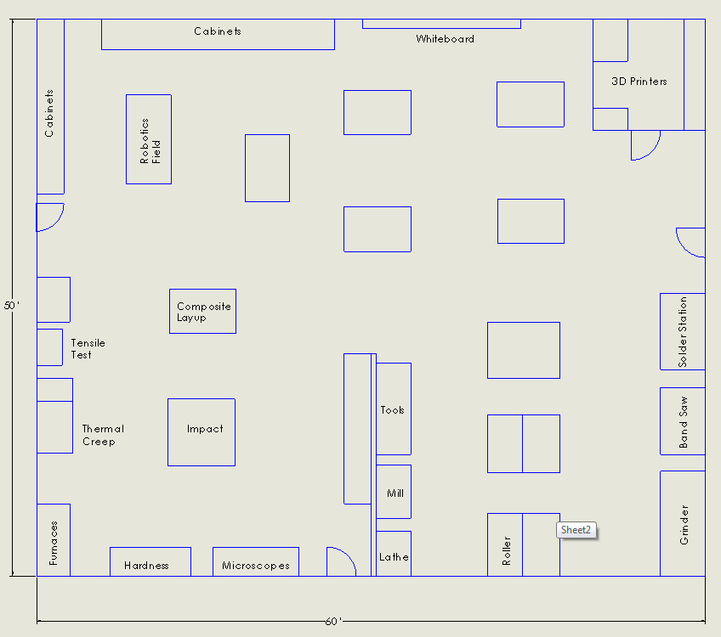
Engineering Program Goals
2) Close equity gaps: Dedicate Engineering Lab
ENGR 100
Robotics Challenge
Wind Turbine Design Project
Design Club
Robotics
3D Printing
Projects
Robotics
3D Printing
ENGR 270
Test Equipment
Fabrication Processes
ENGR 210
Fabrication
Quality / Inspection
Test
Fabrication
* Industry Engagement: Prelim Tesla, other Test, Process and Industrial Engineering roles

Slide 11
Any Questions?

