Slide 1


Slide 2


Human Services Program Summary
Program Overview
Contribution to College Mission and to the District
Program Strengths
Program Challenges
Advisory Board
Response to Program Review Feedback
Action Plan 2017-2018
New Marketing Efforts

Slide 3
Overview of the Human Services Program
Established in 1998. Designed to train County of San Mateo Human Services worker and students in strength-based approach.
Structured with certificate ladder to A.S. including the following Certificates of Achievement: Human Services, Community Health Worker, Promotor Education and Employment Project and the Family Development -Area of Specialization.
Core Courses: Introduction to Human Services, Introduction to Counseling and Interviewing, Introduction to Case Management

Slide 4
Contribution to the Mission of the College & the District
We are a career/occupational program that encourages transfer and “works in cooperation with business, industry…and public services agencies.” Our program cultivates in our students the ability to think critically and creatively and communicate effectively.”
We educate students “in the strength- based philosophy of helping individuals and families in need…producing future practitioners…who are committed advocates for their clients, teaching and empowering the populations they work with…in our diverse local communities.”

Slide 5
Program Strengths
Motivated, enthusiastic, committed students
Faculty who are experienced practitioners in the field
Community relationships of long duration
The only community college-based Human Services program in the county
Strong Workforce Program funding

Slide 6
Program Challenges
Many students have multiple day-to-day challenges and have received
services themselves. They often need additional support to succeed.
Classes are taught by 4 adjunct professors. There is no program
coordinator or full-time faculty.
With the advent of a new administration, the jobs picture for our
graduates is unpredictable.
Declining enrollments in recent academic years.

Slide 7
Response to Program Review Feedback
Though it had “great info about program,” make Executive Summary
more concise. I wrote it. I can tweak it!
Faculty must meet and dialogue about implementing new program
strategies based on the results of SLO’s, PLO’s. Very necessary and
will be done in August, 2017.

Slide 8
Action Plan for 2017-2018
Decrease student equity gap by recruiting more African American and Pacific Islander males through marketing, specifically at Menlo Park center.
Expand and enhance Advisory Board to be a better resource and bridge to the community.
Pursue greater partnerships with community to enhance internship opportunities.

Slide 9
Action Plan Continued…
Identify positions and skills in the field where there is increased employment demand, and incorporate these elements into course offerings.
Present Patient Navigator Certificate and expanded Family Development Certificate to Curriculum Committee.
Continue to pursue merger with Early Childhood Education Program.

Slide 10

Advisory Board Meeting
Attended by representatives of: El Concilio, Hip Housing, RSVP
All in agreement to re-build committee membership and community connections
Discussion about low enrollment
Explored local criminal justice opportunities, non-profit consortiums and possible hybrid structure for courses.
Next meeting October, 2017

Slide 11
New Marketing Efforts
  To increase enrollments and community engagement we’ve been focused on new marketing efforts, most of which are funded by the Strong Workforce Grant.
  New support staff for the Business, Design, and Workforce Division on campus and at the satellite campus at Menlo Park’s JobTrain facility (Alex and Jonathan).
  New program brochures, postcards, and other marketing collateral.
  New logo for Menlo Park made by Cañada’s marketing department.

Slide 12


New Program Brochures

Slide 13

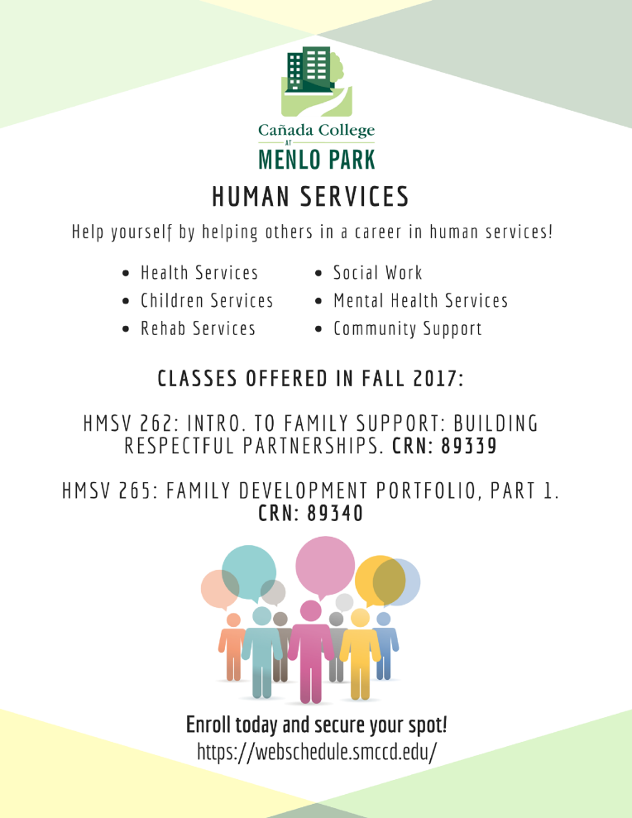


New Menlo Park Logo and Program Advertisements

Slide 14
Questions?

