Slide 1



Notes:
UCSF’s Neurodiagnostic leadership team is looking to partner with other Bay Area Neurodiagnostic leaders to discuss the rapid changes in EEG Technology and the future of the EEG Technologist profession.
The 2016 Bay Area EEG Technologist Survey is the first step in kicking off this collaborative effort.
UCSF sponsored the survey and engaged Romanoff Consulting to conduct the survey.

Slide 2
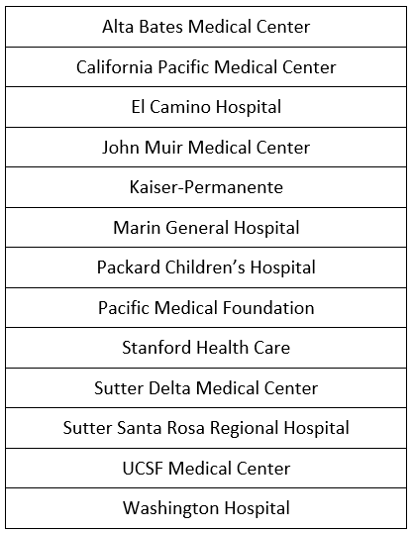
EEG Technologist Survey Participants

Slide 3
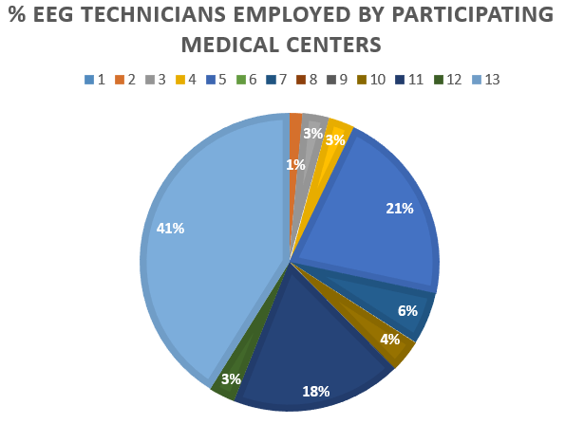
Staffing Levels
Notes:
Each slice of the pie, coded by a number in the key, represents a medical center. Three organizations dominate the number of EEG Technologists employed, while all other organizations employ 1-6%, with some medical centers not employing any full time EEG Technologists.

Slide 4
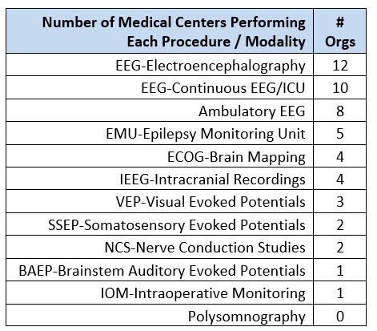
Procedures / Modalities Performed
Notes:
Each bar represents a medical center, coded by a number, and the bar height represents the number of procedures / modalities performed in each Medical Center.
Medical Centers appear to fall into one of two groups: either they perform three or less of the procedures, or seven or more.
Seven organizations perform two to three of the procedures / modalities.
All of those seven organizations perform only the following procedures: EEG-Electroencephalography, EEG-Continuous EEG/ICU, Ambulatory EEG.
Four organizations perform seven or more procedures / modalities.
One medical center performs 11 of the 12 types of EEG procedures surveyed.

Slide 5
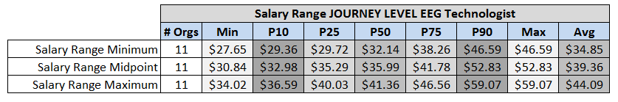
Compensation – Salary Ranges
Notes:
There is a large spread in journey level EEG Technologist salary ranges amongst the participating organizations – differing by over $20 per hour.
11 organizations provided data on their Journey Level EEG Technologist salary range. Displayed is the average salary range data for the following variables:
Salary Range Minimum
Salary Range Midpoint
Salary Range Maximum
% Increase from Range Minimum to Midpoint
% Increase from Range Midpoint to Maximum

Slide 6
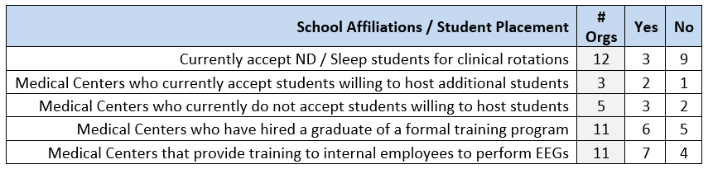
Clinical Training Affiliations
Affiliations with Formal Training Programs
Institute of Health Sciences, KPSAHS (Kaiser Permanente School of Allied Health Sciences)
De Anza College for ECG
Larry Head Institute
Orange Coast College
Bellevue College
LaBoure
Notes:
Six medical centers hired a graduate of a formal training program of the 11 that reported data. The most common formal training program that four organizations listed was the Institute of Health Sciences and the Kaiser Permanente School of Allied Health Sciences (KPSAHS). Other training programs listed were Stanford Hospital, the Larry Head Institute training program, and the Orange Coast County EEG Technology Program.
Student Placement in Clinical Rotations
Three organizations accept ND / Sleep students for clinical rotations and nine do not. Five reported they would be willing to host additional students and four did not answer. Medical centers interested in hosting more students reported they are willing to accept one to two students per semester.

Slide 7
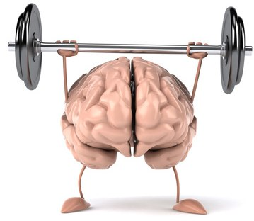
Credentialing &
Educational Requirements
Stacey Austin, BSCTE, R EEG/EP T., RPSGT, RST
Educational Design Consultant

Slide 8
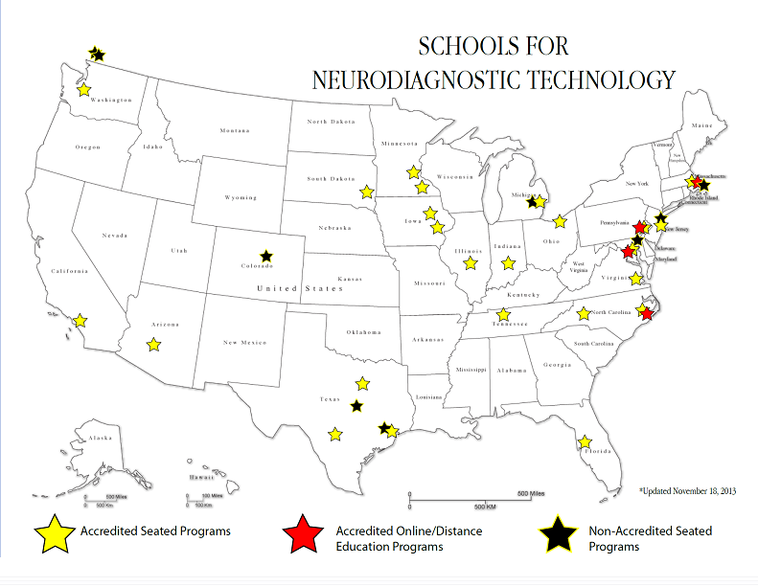
Current State – What’s at Stake?
The West coast and CA are behind the curve, and may soon be left behind
Imbalance between educational opportunities between East and West coasts
Orange Coast College – two year wait list
Bellevue College in Washington turns away 50% of applicants due to space limitations

Slide 9

ABRET EEG Eligibility Pathways | Pathway I |  | Pathway II | Pathway III | Pathway IV
 | CAAHEP NDT Program |  | Formal NDT Education | Employed in Neurodiagnostics with Associate’s Degree or RPSGT | Employed in Neurodiagnostics
 | Current CPR/BCLS certification |  | Completion of Program (Programs must apply for recognition) | 1 year clinical EEG experience (1) | 2 years clinical EEG experience (1)
 | Part 1 Exam (After enrolled at least 6 months in program) (3) |  | Documentation of 100 EEGs following completion of the program. | Documentation of 150 EEGs post 1 year experience (1) | Documentation of 200 EEGs post 2 years of experience (1)
 | Part 2 Exam (Following completion of program) |  | Current CPR/BCLS certification | Current CPR/BCLS certification | Current CPR/BCLS certification
 |  |  | Part 1 Exam | 30 EEG ASET Credits (2) | 60 EEG ASET Credits (2)
 |  |  | Part 2 Exam | Part 1 Exam | Part 1 Exam
 |  |  |  | Part 2 Exam | Part 2 Exam
2015-2017 |  | -----------------------Entering the field-------------------------- |  |  | Must be in the field as of 2015
2018 |  | -----------------------Entering the field-------------------------- |  |  | XXXXXXXXXXXXXXXXXXXXX Pathway Expires

Slide 10
Current State – What’s at Stake?
Uphill climb
National Shortage of credentialed and formally trained ND Technologists in the field
Staffing shortages impact patient safety and quality patient care outcomes
Aging workforce heading towards retirement
Increased demands on skill set
Tightened standards of practice in organizations in terms of demonstrating training and competency
Credentialing requirements are changing
  Phase-Out of Pathway IV
  Requirement of A.S. degree

Slide 11
Supporting California and the Bay Area through an NDT Associate’s Program
Ensure a pipeline of qualified, credentialed candidates
Hub of training for Northern California and the west coast
Position the Bay Area as a center of excellence in Neurodiagnostic services
Provide best-in-class didactic, clinical, and laboratory training to Neurodiagnostic students, utilizing proven curriculum
Exposure to multiple modalities including EEG, EP, IOM, NCV, LTM, EMU, Sleep
Supported by a network of area hospitals, like you, that provide clinical rotation sites for students
Notes:
What is needed is an AAS program for ND in the Bay Area

Slide 12
Optimal Program Structure
Potential program start date of Fall 2017 with first graduates completed spring 2019, including credentialing period
Three-year program including pre-requisites
Hours of instruction/hours of study
  Approximately 700 didactic hours of instruction
  Approximately 1,000 hours of clinical experience
  It is recommended that students spend 2-3 hours of study for every hour of in class instruction

Slide 13
Optimal Program Structure
Hours clinical rotations approximately:
  1st year Spring semester 12-16 per week
  1st year Summer semester 24 hours per week
  2nd year Fall semester 12-16 per week
  2nd year Spring semester 36 per week
Approximately a total of 1,000 hours of clinical experience

Slide 14
Things to think about…
Participation on advisory committee
Which community college will you partner with?
Number of clinical sites willing to accommodate students
How many students will each site accept at a time?
Type of program: AS/BS?
What add-ons for accreditation (EP/IOM/LTM/PSG)
Possible techs willing to teach part-time
Potential candidates for a Medical Director
Donating Equipment: With an enrollment of 14 students will need 8 EEG and 8 EP machines
Marketing

Slide 15
THANK YOU!

