Slide 1
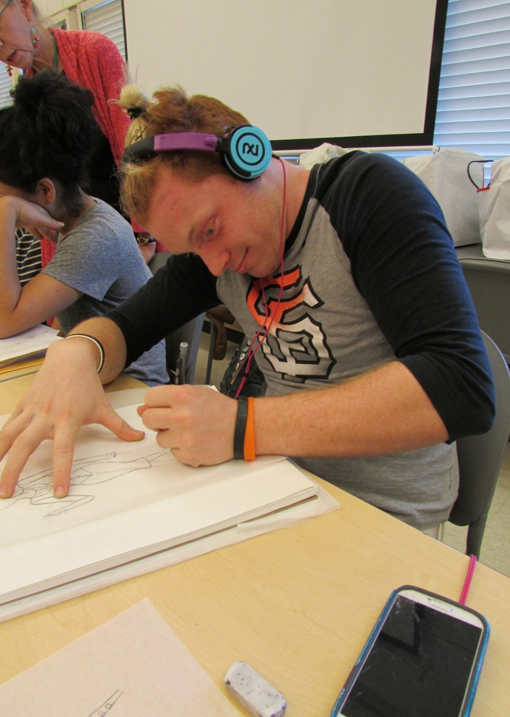
Fashion Design and Merchandising

Slide 2
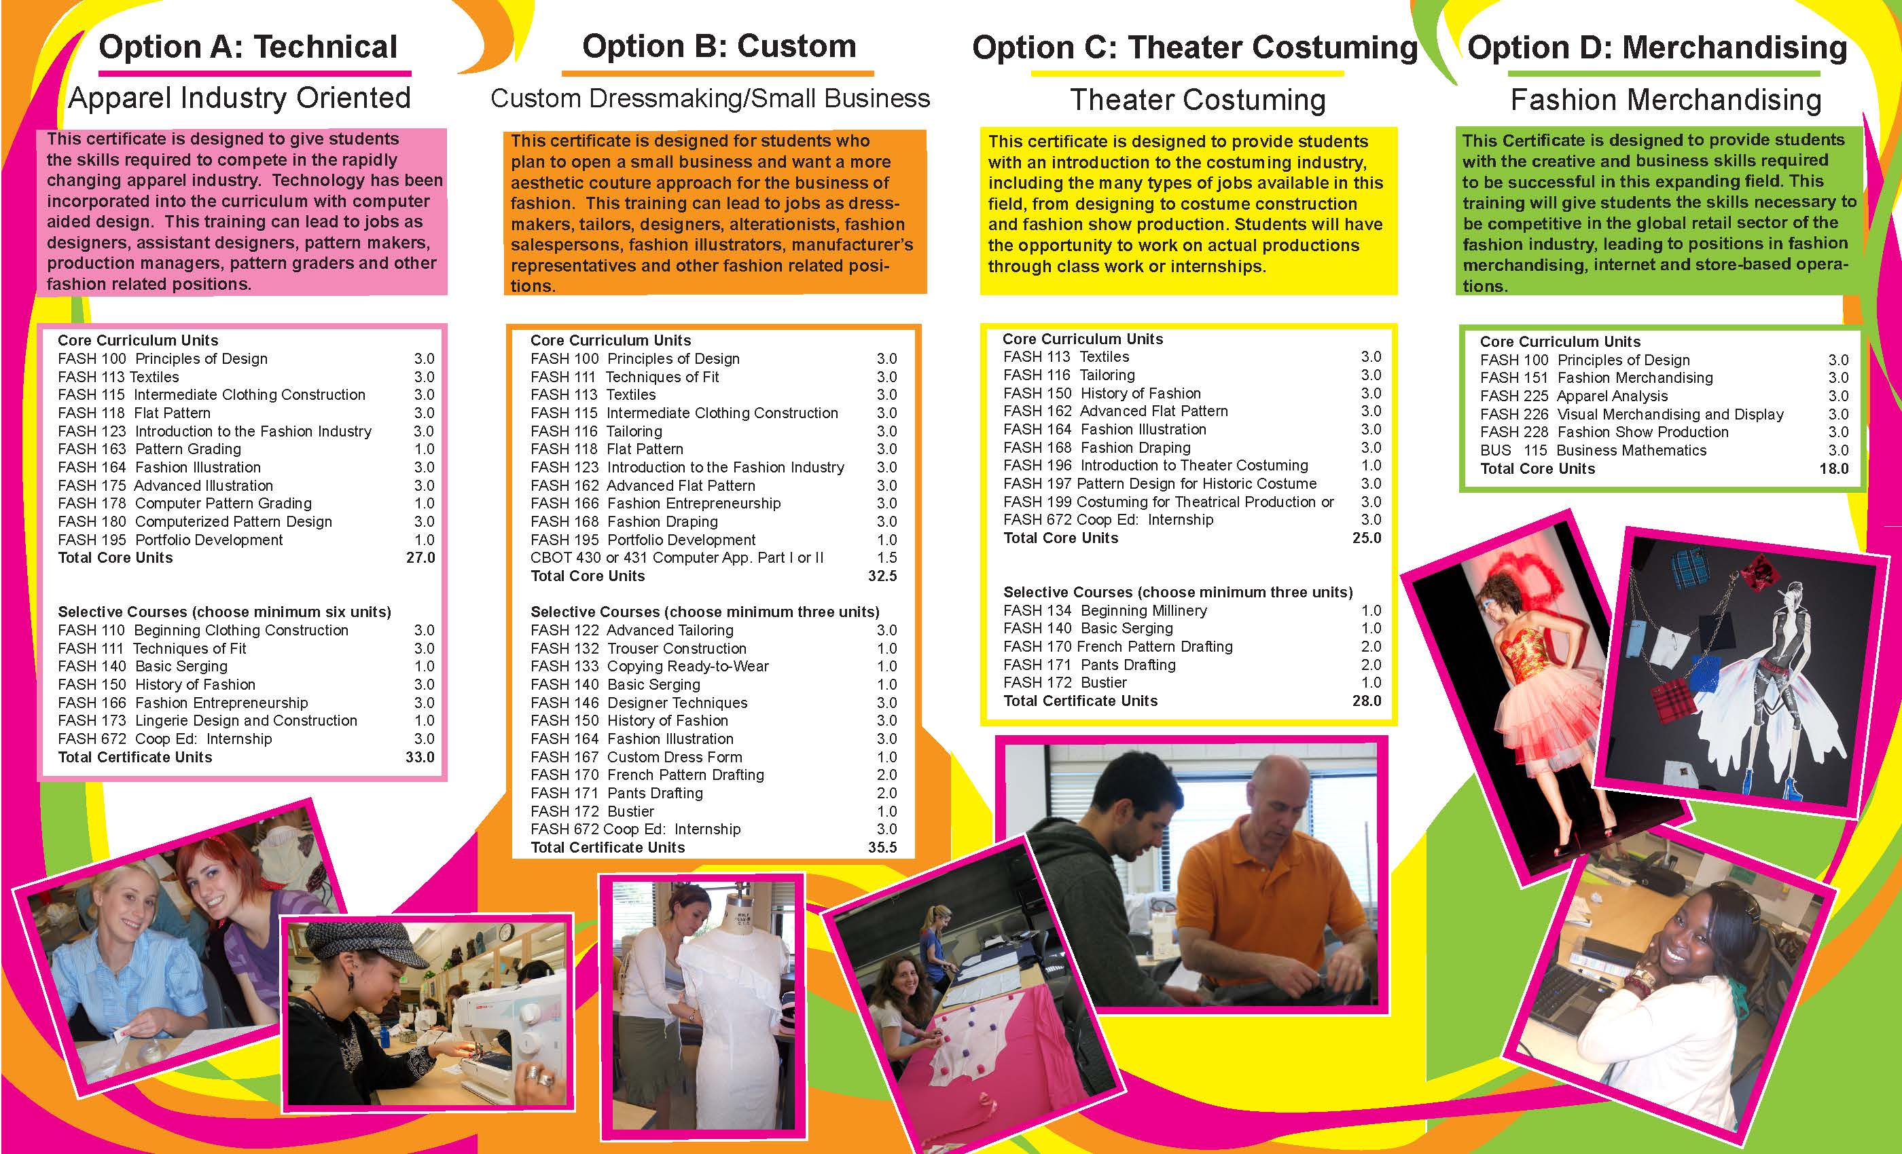

Slide 3
Program builds skills -- Illustration, construction, pattern making
With an understanding of:
how to sell clothing
how to start a fashion business
how to costume plays & movies
global aspects of the apparel industry
changing environmental standards for textile production

Slide 4
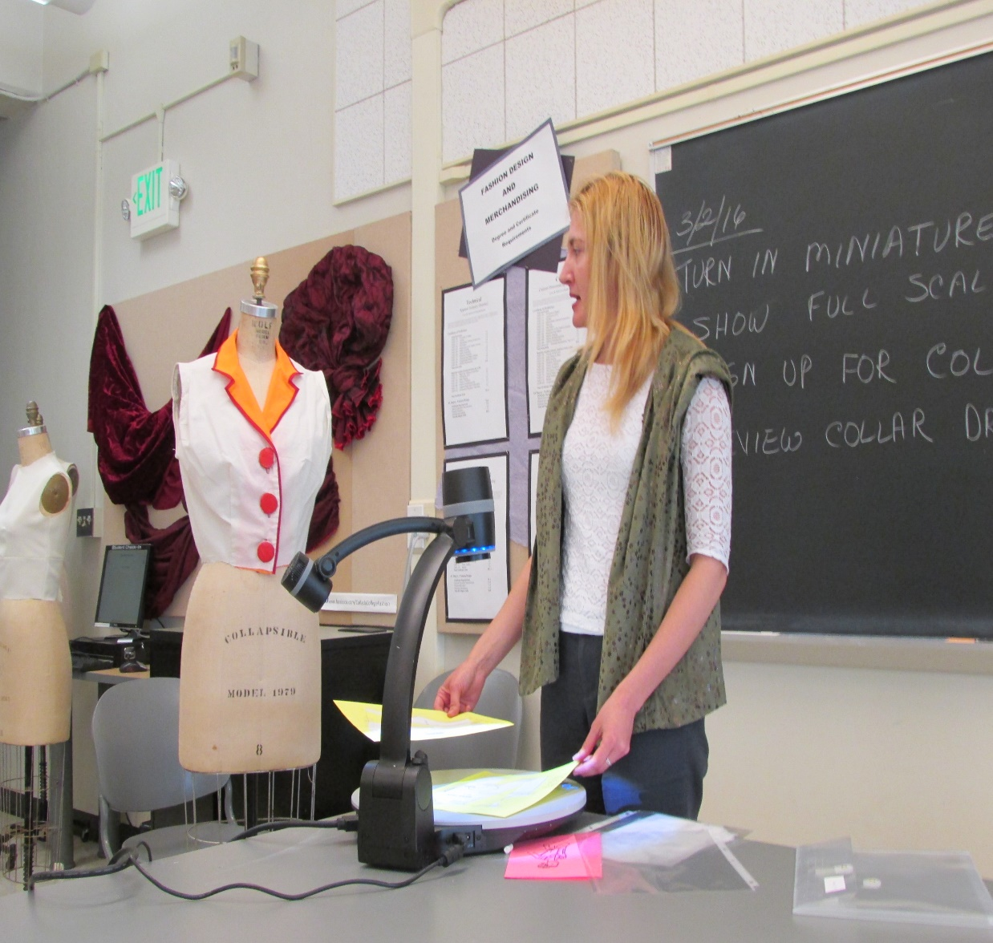
The program requires the use of “soft skills”
Management of time &
money
How to organize their lives
Communication skills
Research skills

Slide 5
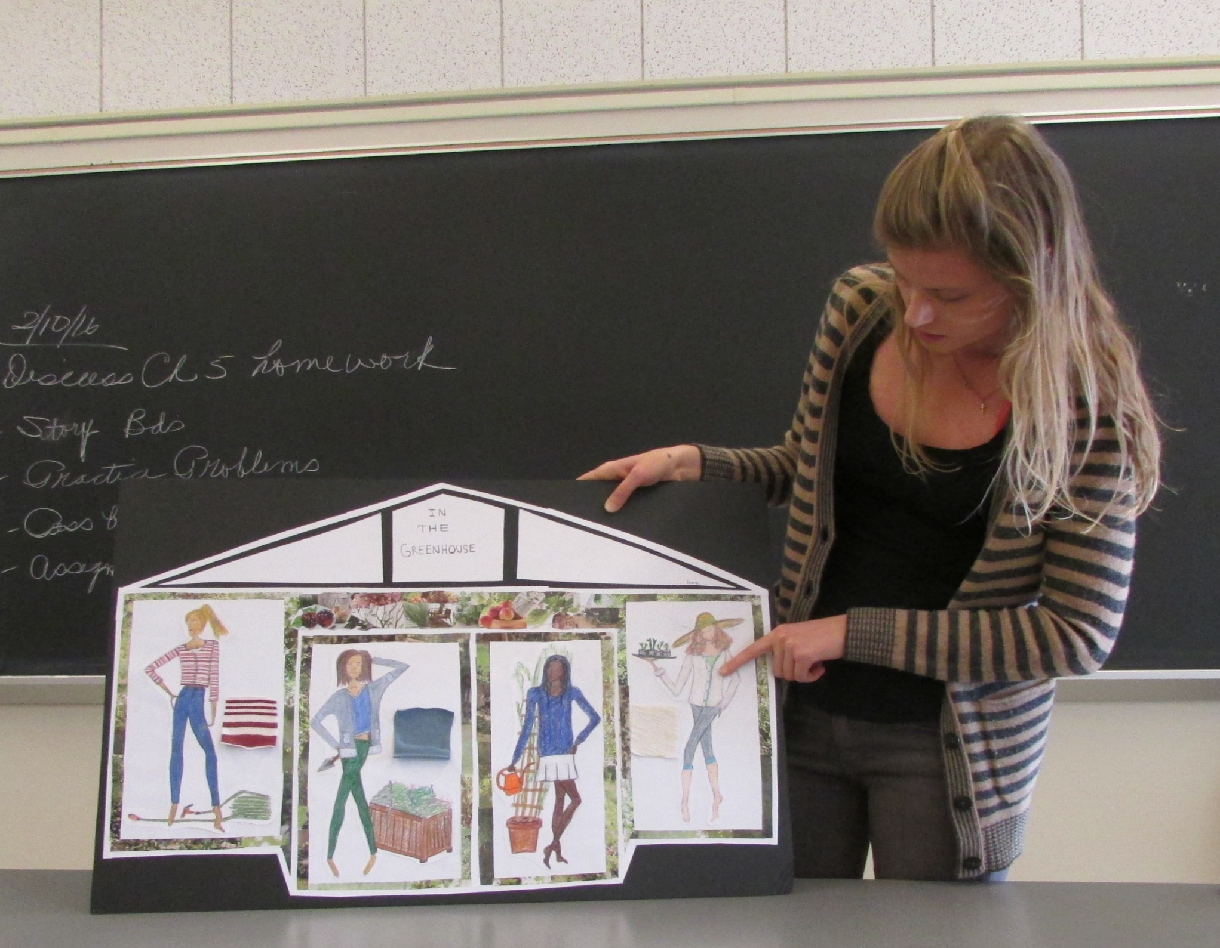

Slide 6
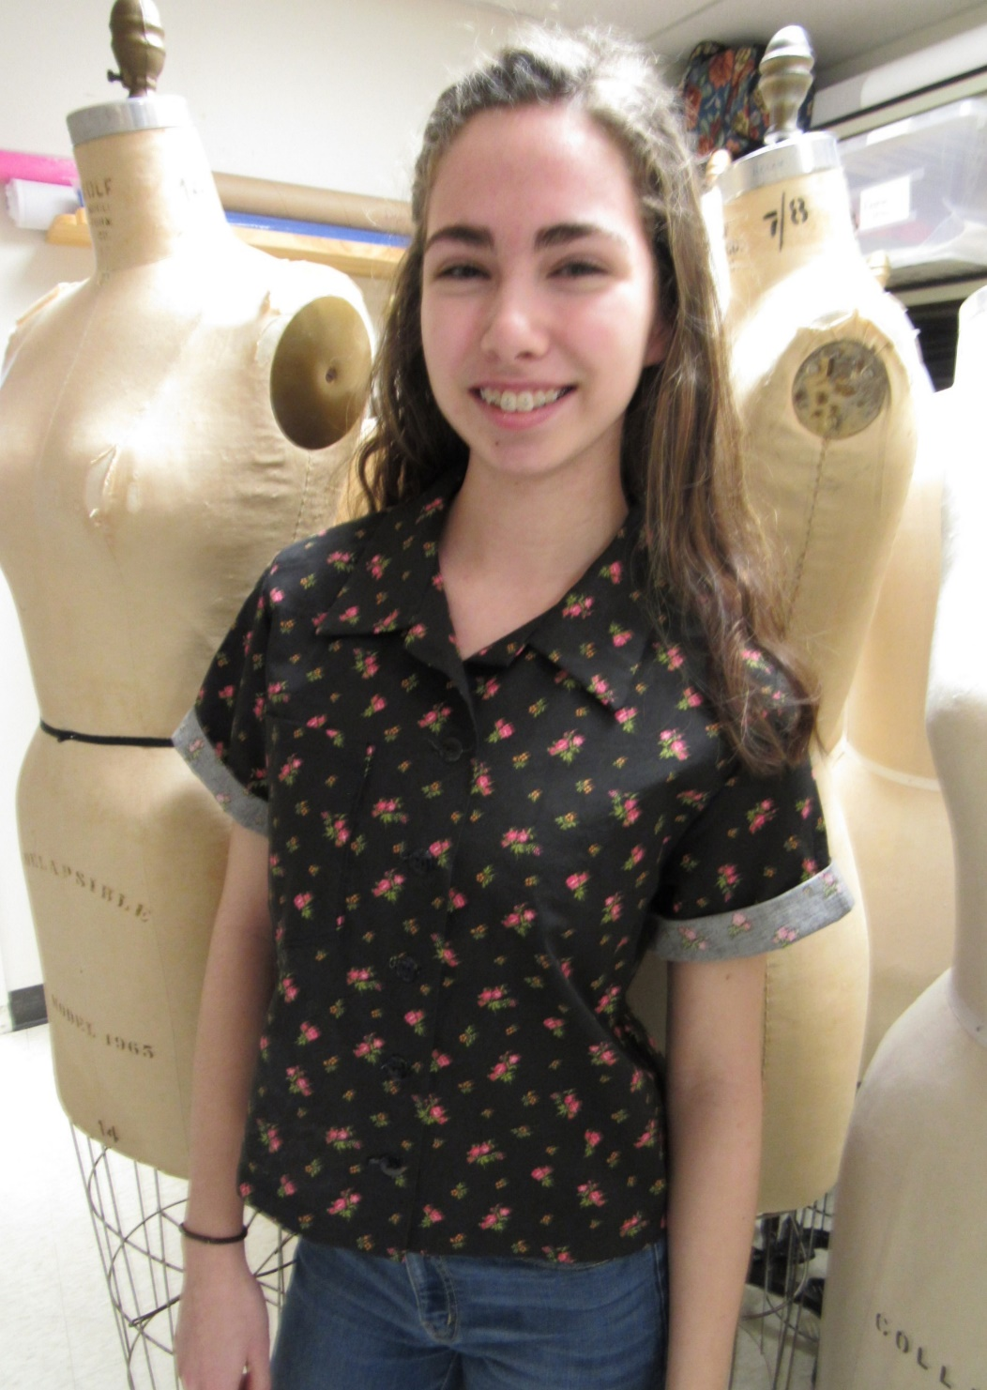
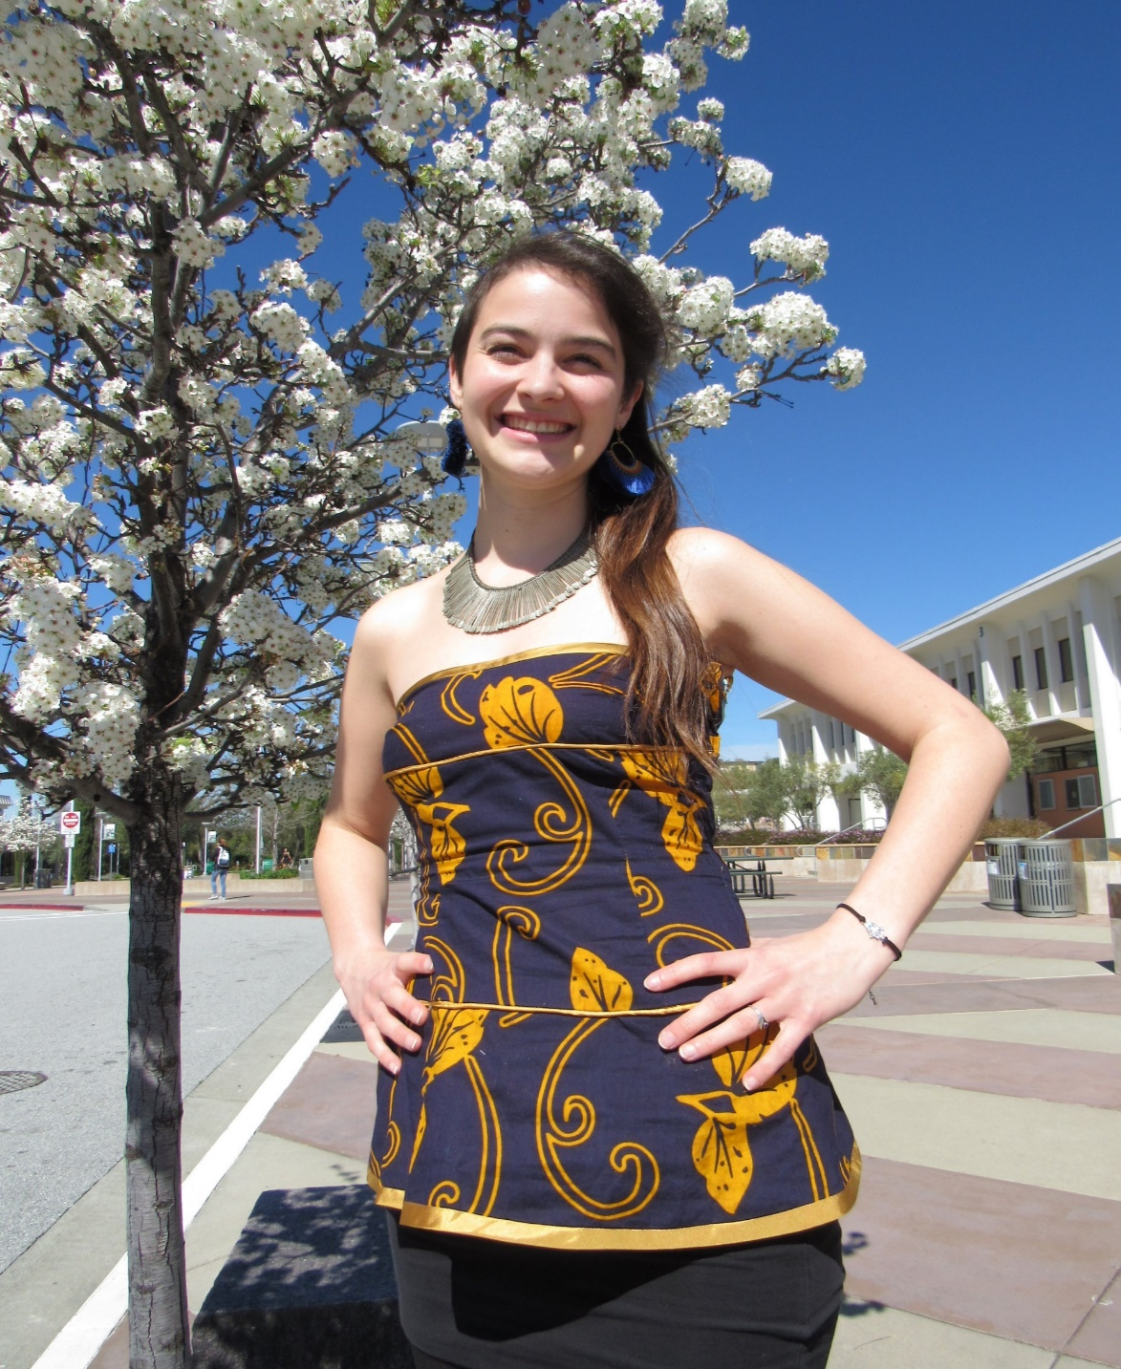
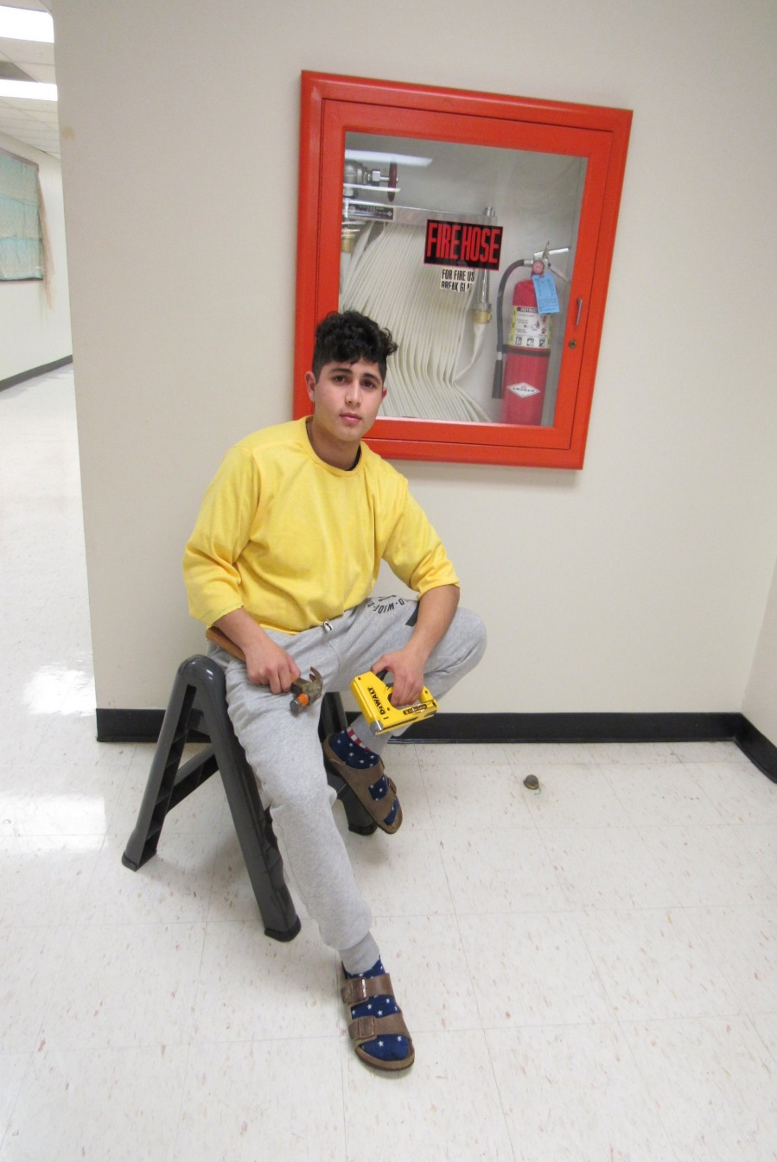

Slide 7
Courses incorporate academics:
Math/geometry – pattern making & sewing
History – how clothing illustrates what was going on during different time periods
Science required for understanding textiles
Social implications of clothing – Current movement for gender blending
Technology – computerized designing, pattern making

Slide 8
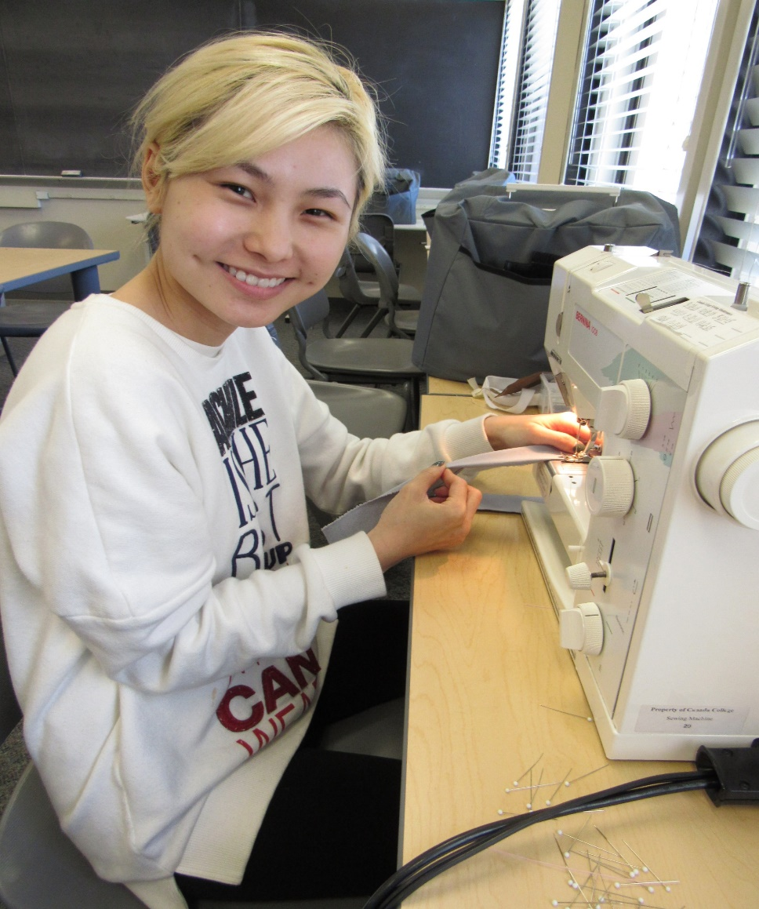
Promotional methods – internet presence
web site, facebook, blog, Instagram
Flyers in stores
Speaking at high schools
Attending professional groups to
talk about the program
Happy students that tell others

Slide 9
Program success due to:
Team work of faculty & assistants
Faculty specialties in many aspects of fashion
Flexible scheduling for day, night, weekend
& a few summer classes
Extensive lab times for dropping in to
complete work
Active Advisory Board

Slide 10
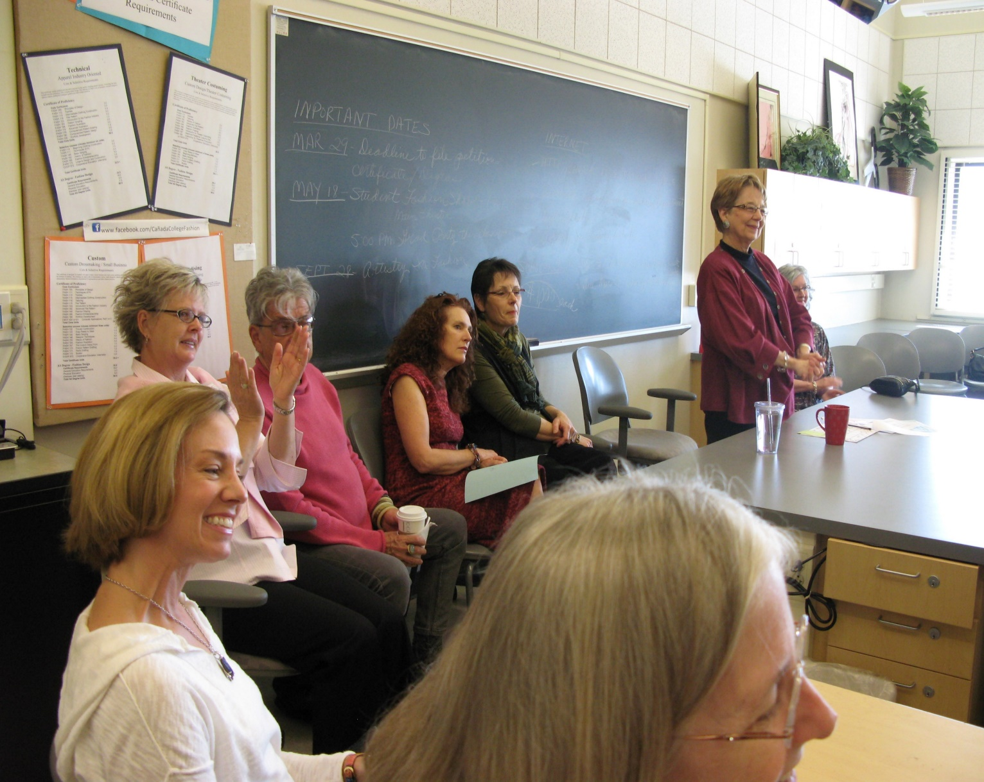
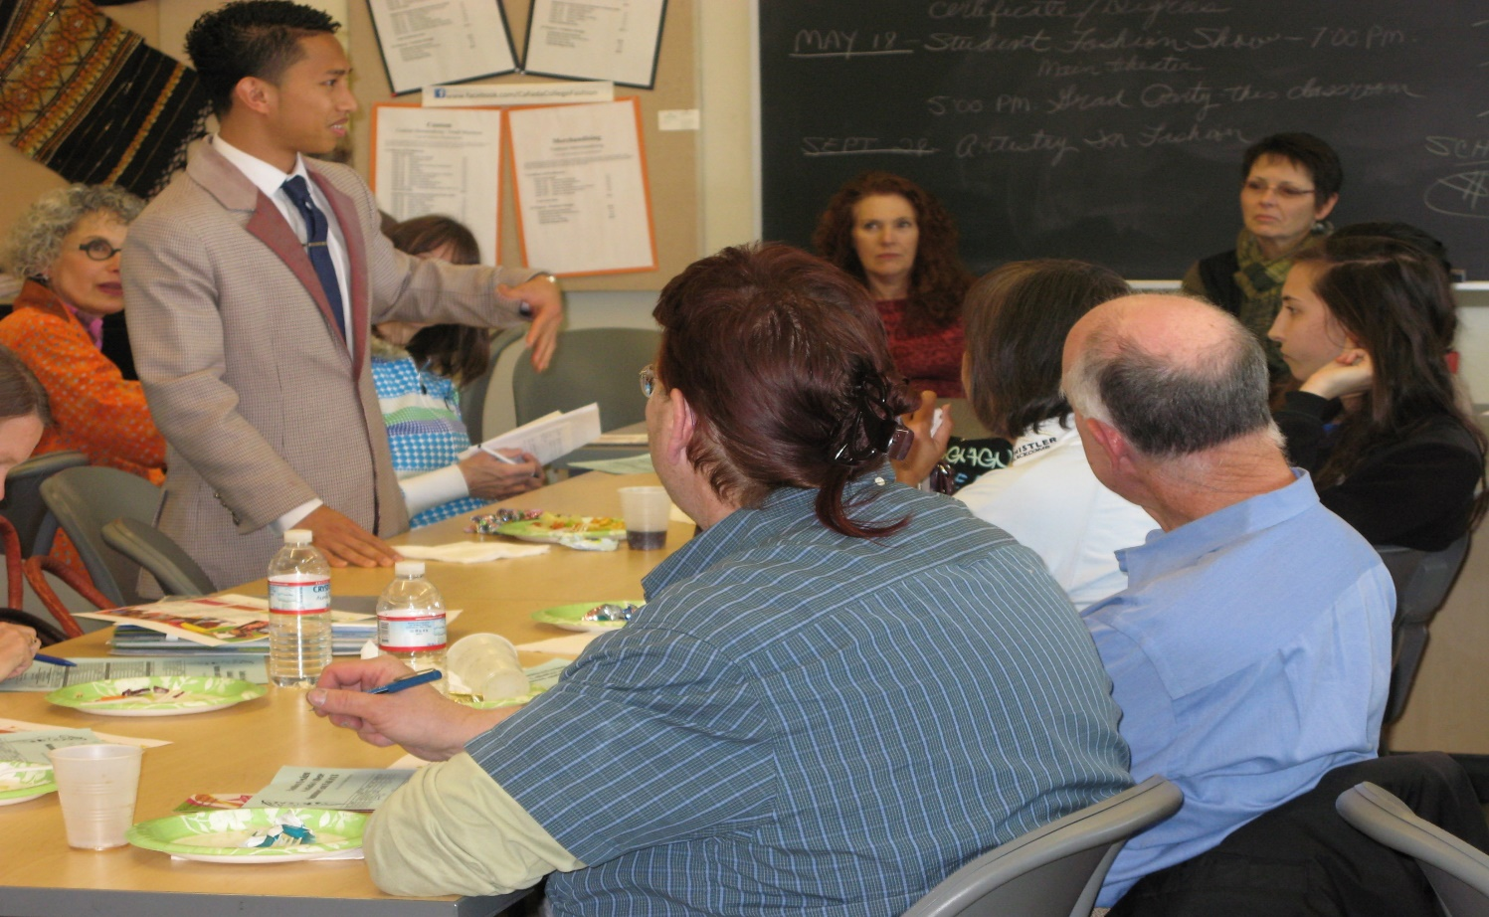
Assisting with decision making for student schedules – Curriculum parties – advising

Slide 11
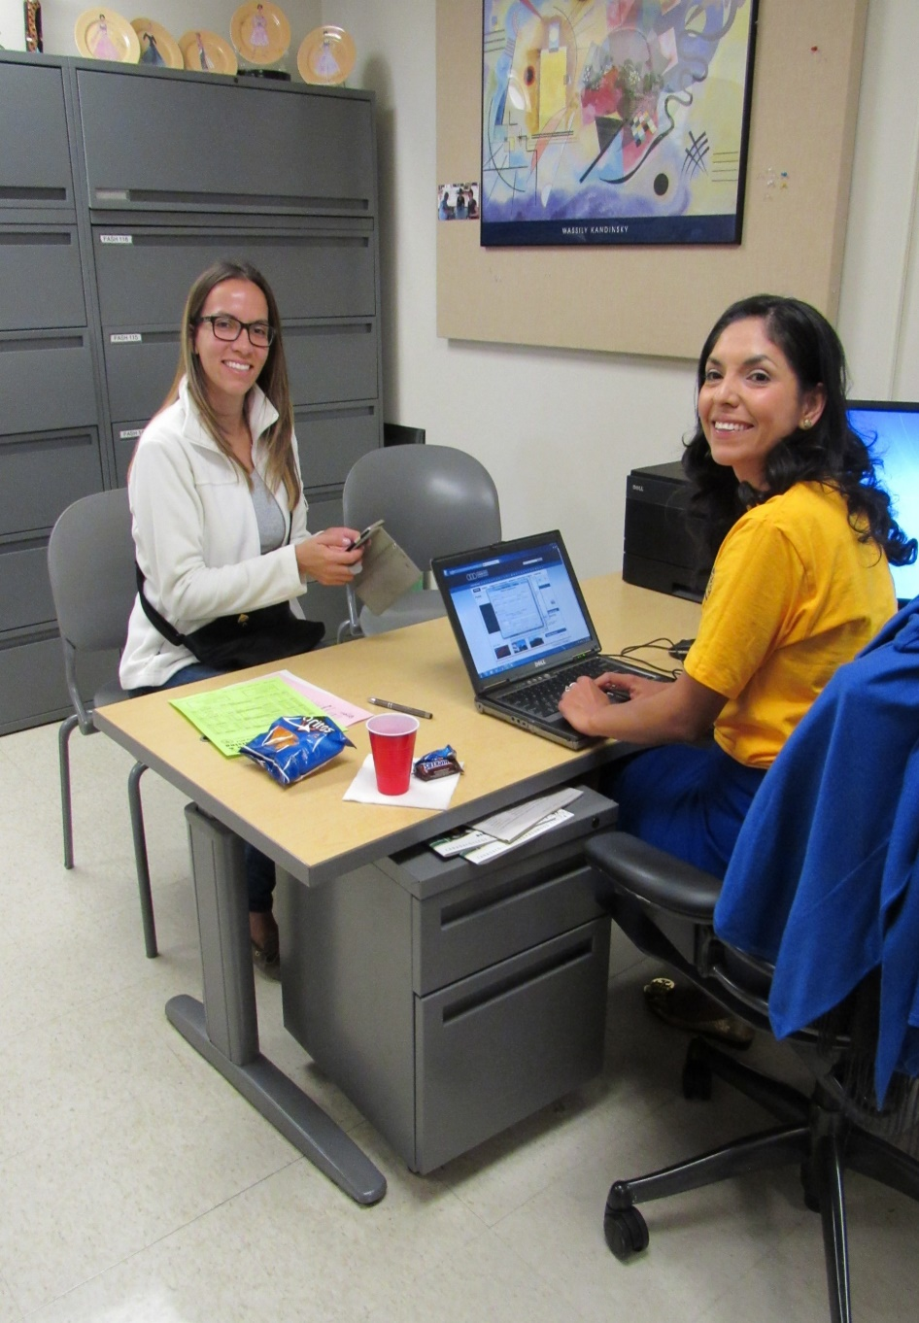
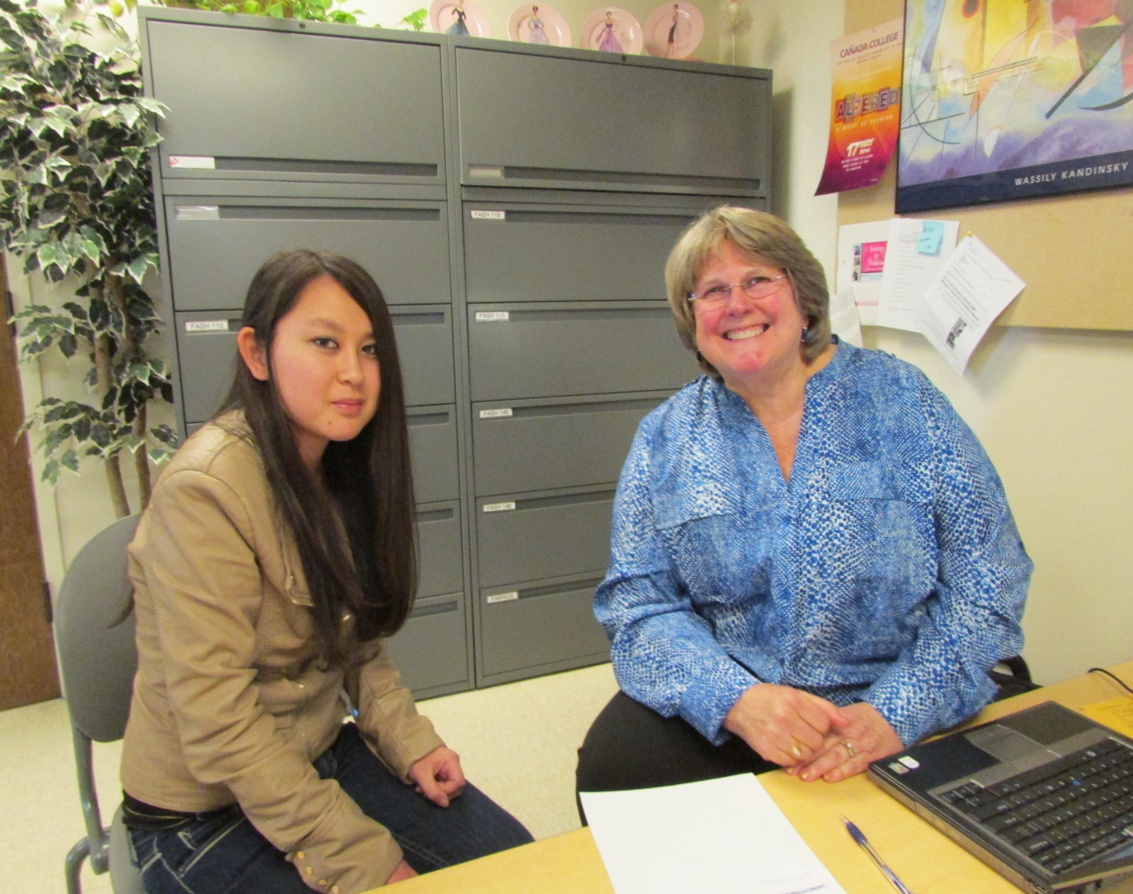
Curriculum Party- counselor making appointments

Slide 12
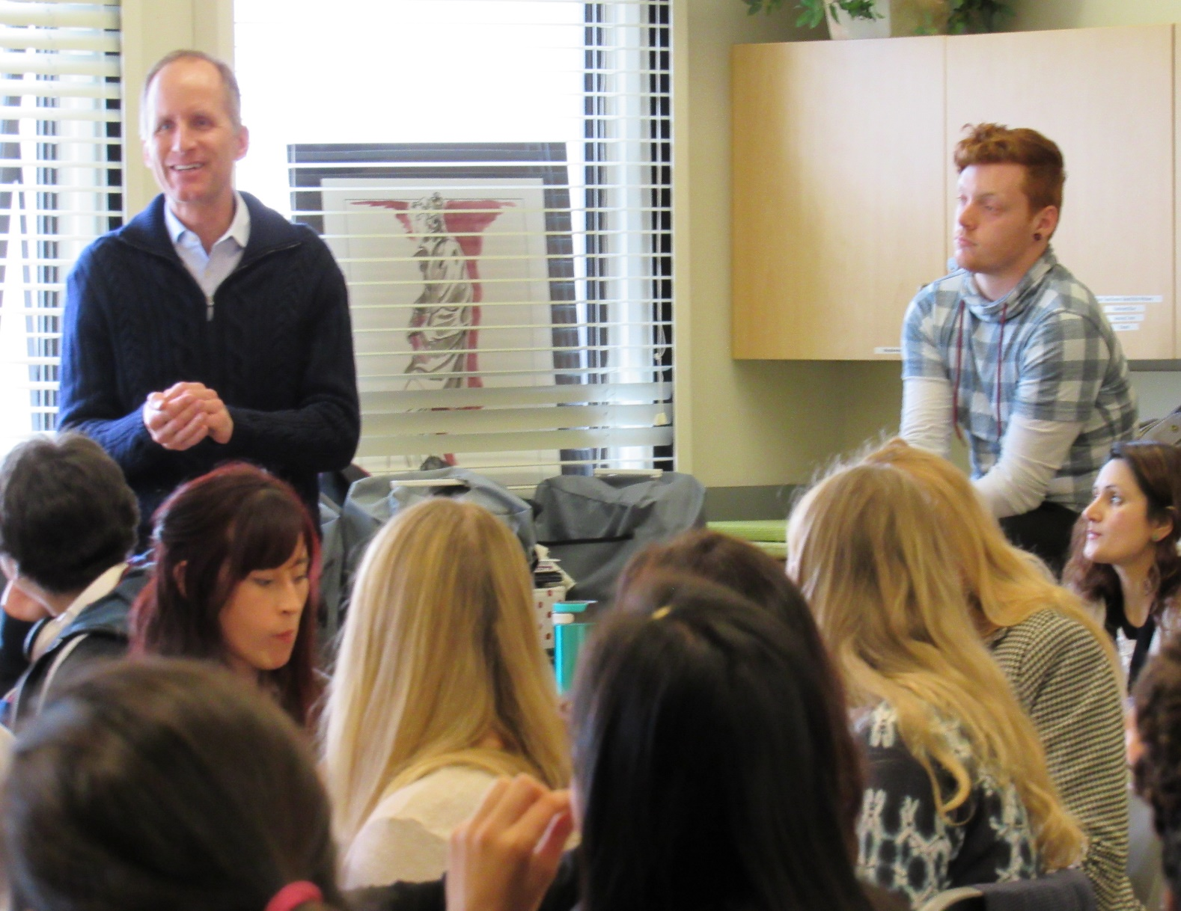
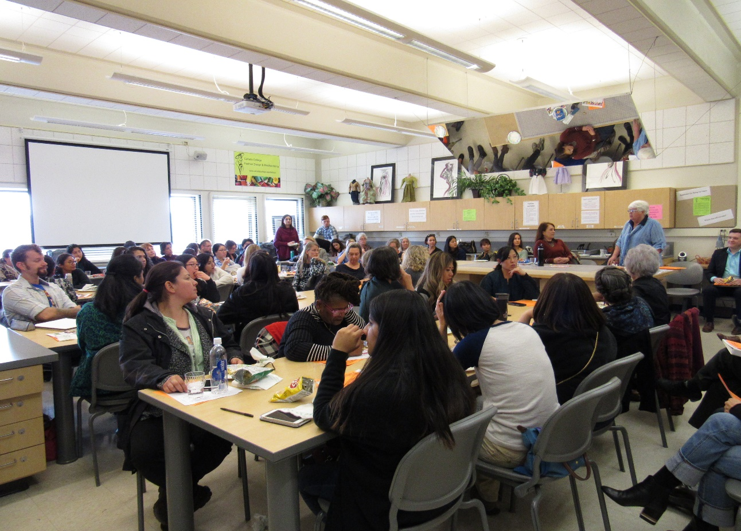
Other speakers present

Slide 13
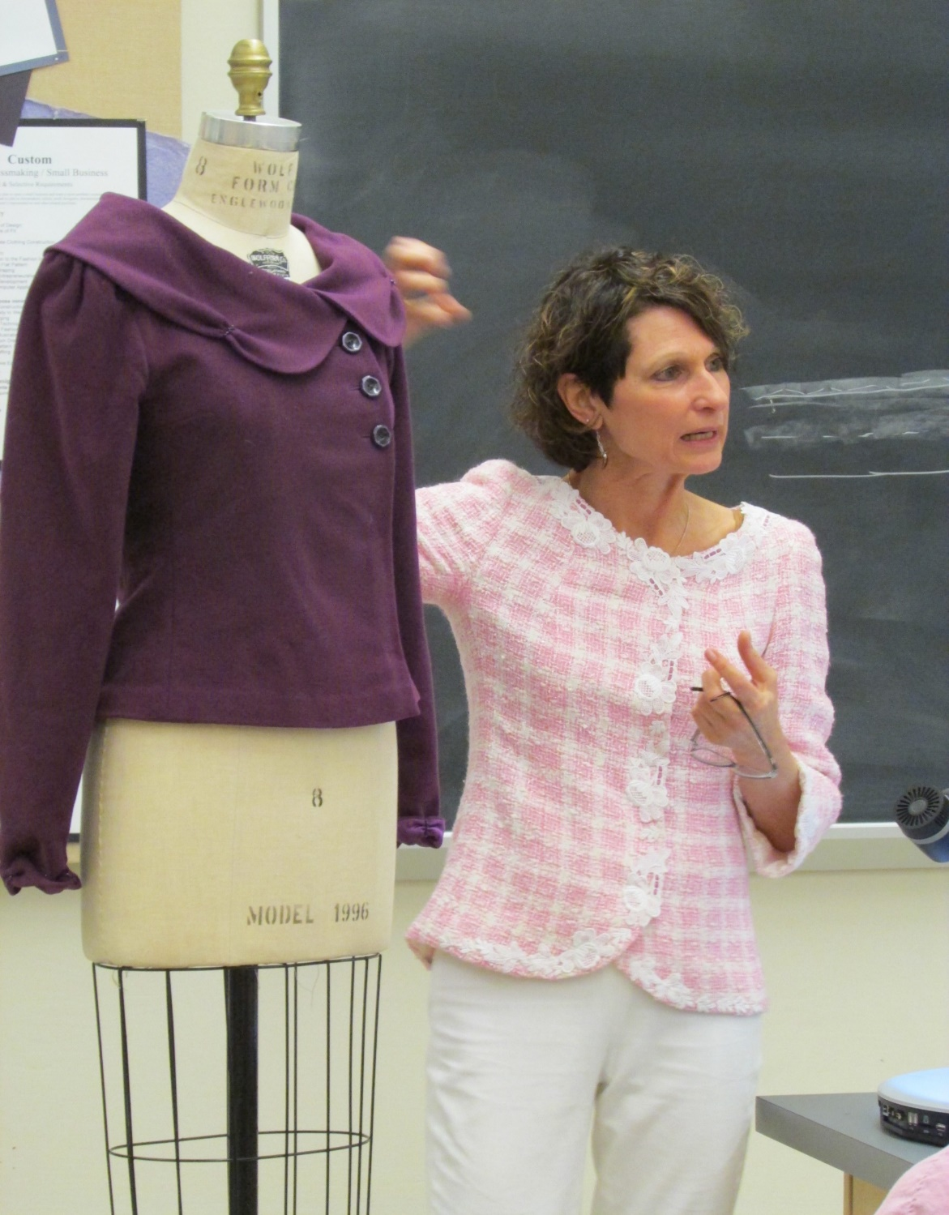
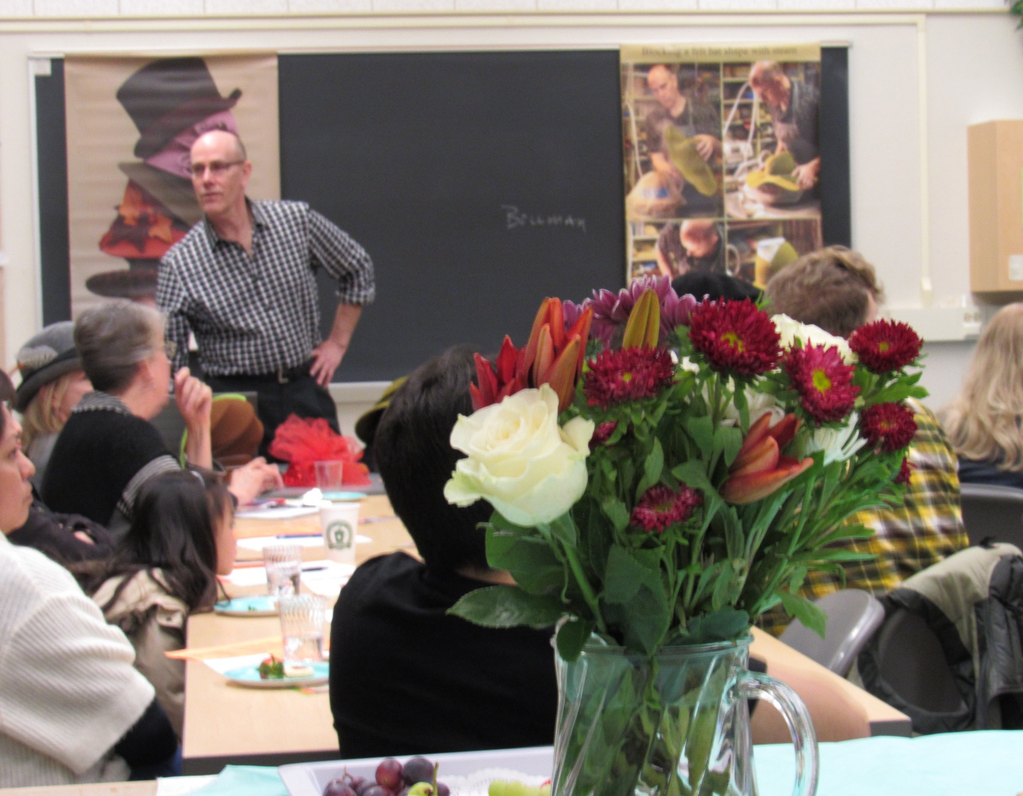
Special events that bring the community to Cañada

Slide 14
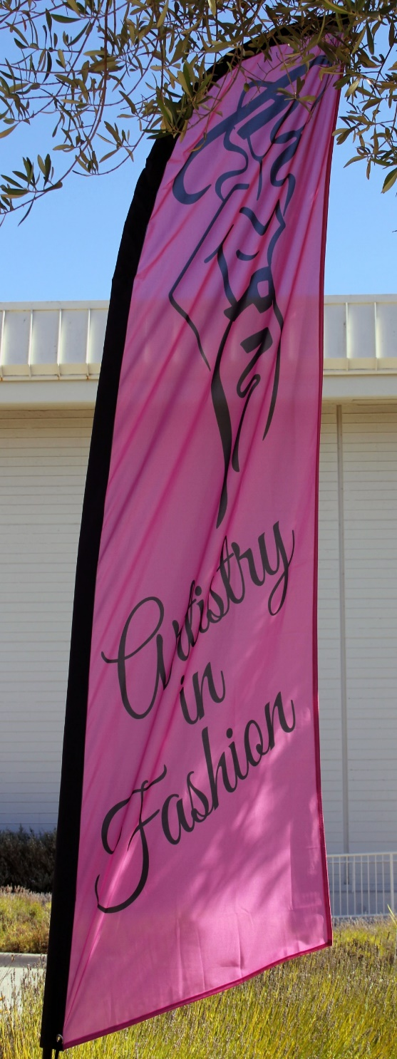
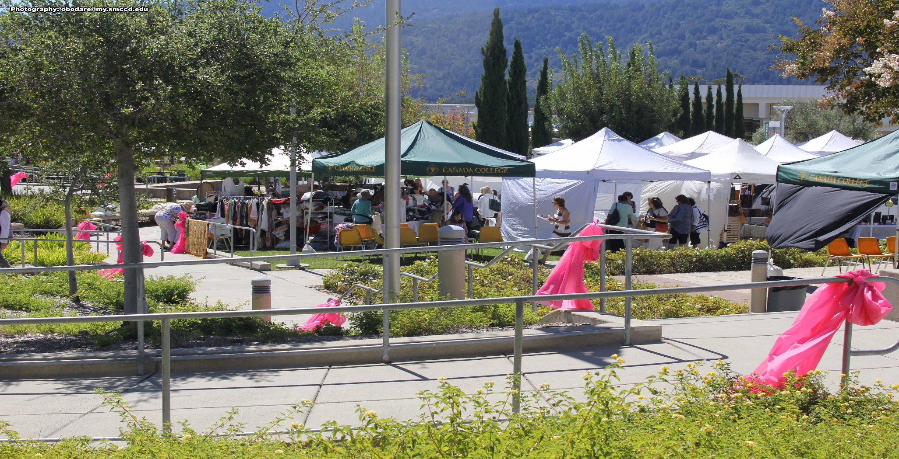
Annual Artistry in Fashion – September
Brings about 1000 people to our campus
Provides funds for many $1000 scholarships

Slide 15
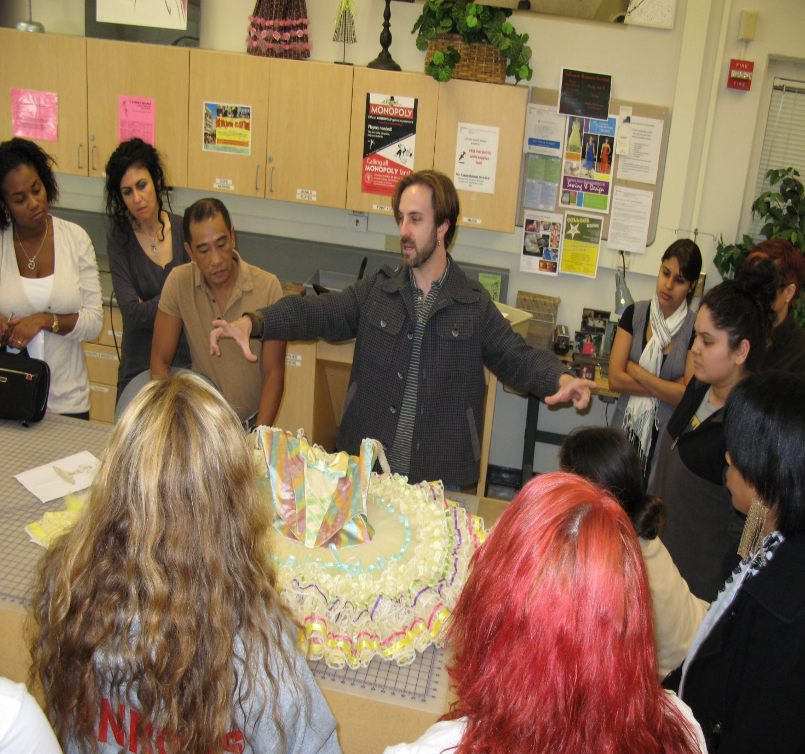
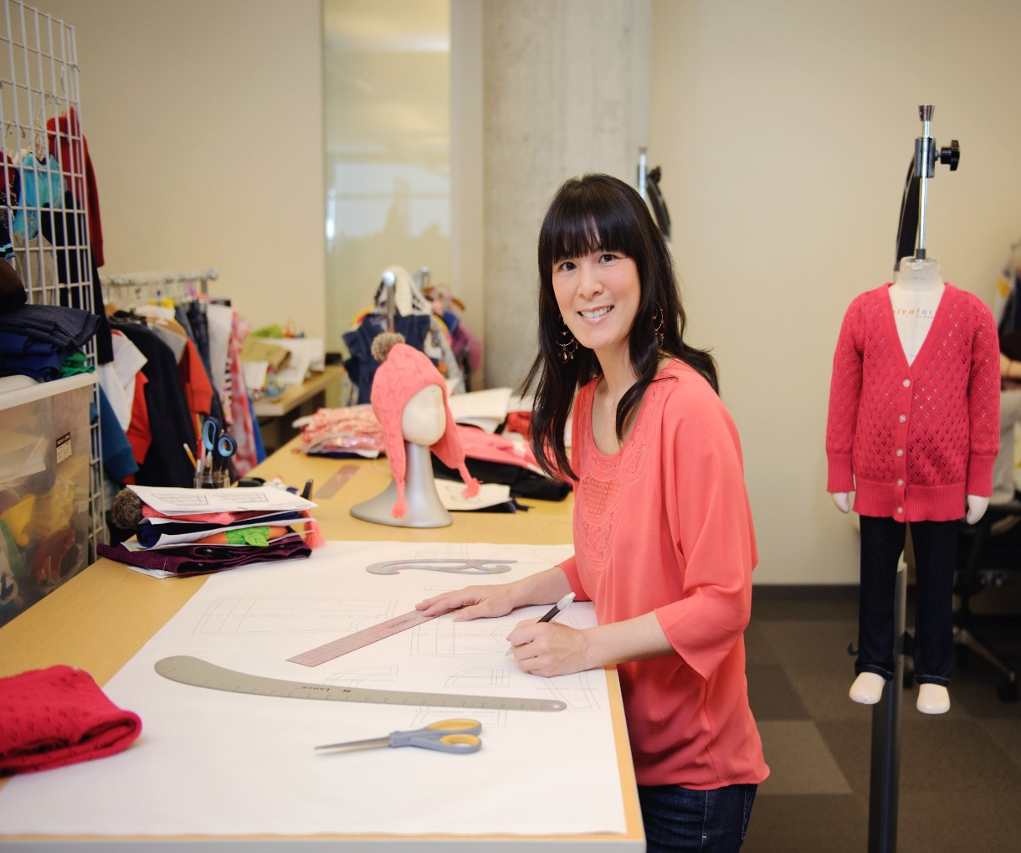
Feature the success of former students
Business making ballet clothing
Old Navy Technical Designer

Slide 16
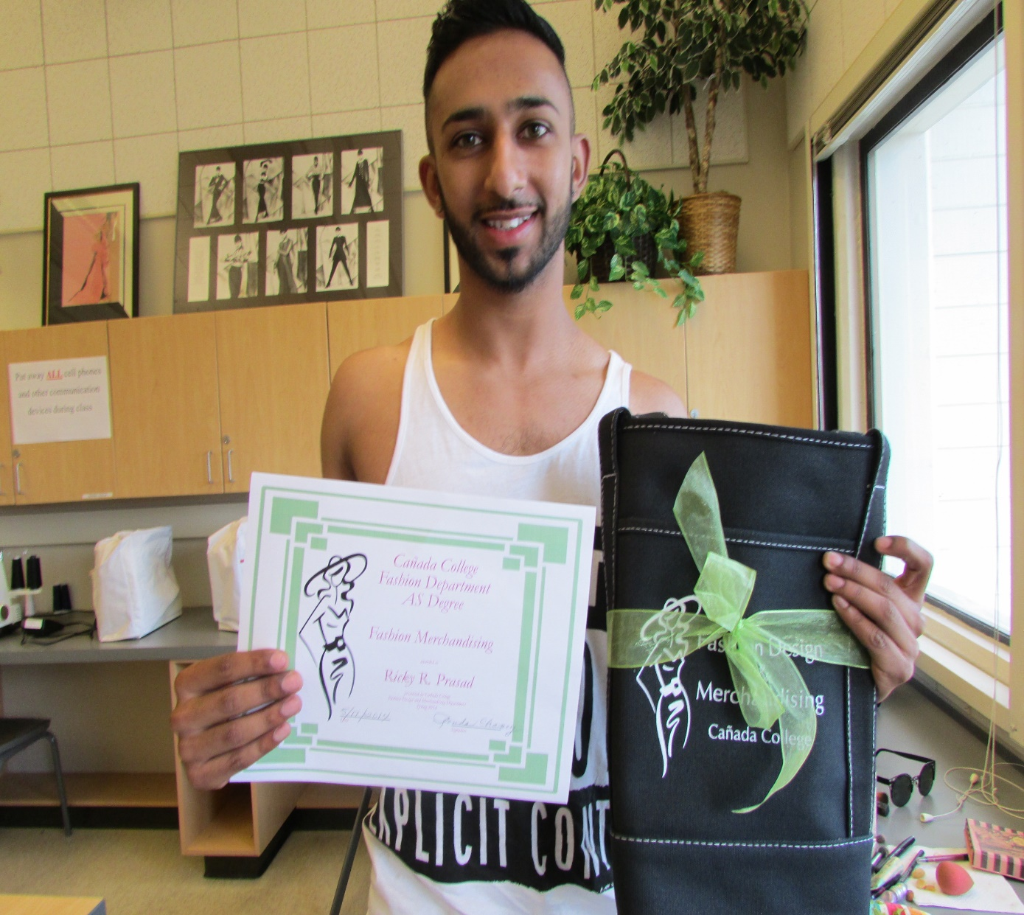
Celebrate Student Successes

Slide 17
Response to Program Review Comments
We will report PLO results on a more regular basis
(capstone course – FASH 162)
SLO assessment – better reporting for course modifications after SLO results are determined.
FASH 151 online course – after the first online offering the face to face instruction had better success.

Slide 18
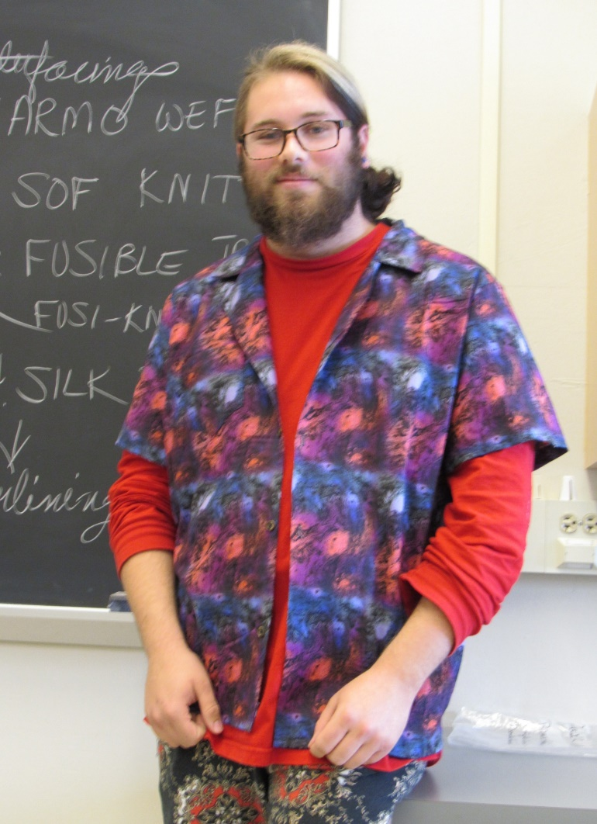
Challenges/Opportunities:
Continue with good enrollment & completion
Maintain upgrade with computerized
patternmaking software & hardware
Students not able to complete
certificates/degrees in 2 years

