Slide 1
IPC Achievements
2023 - 2024

Slide 2
Program Reviews
Provided feedback on 13 program reviews!
  Approved new rubric for Library and Learning Center
  First time organizing groups beforehand
  Lessons learned:
    Don’t add folks to groups the day of
    Organize groups earlier
    Have orientation at the beginning of the semester on how to give feedback to program reviews

Slide 3
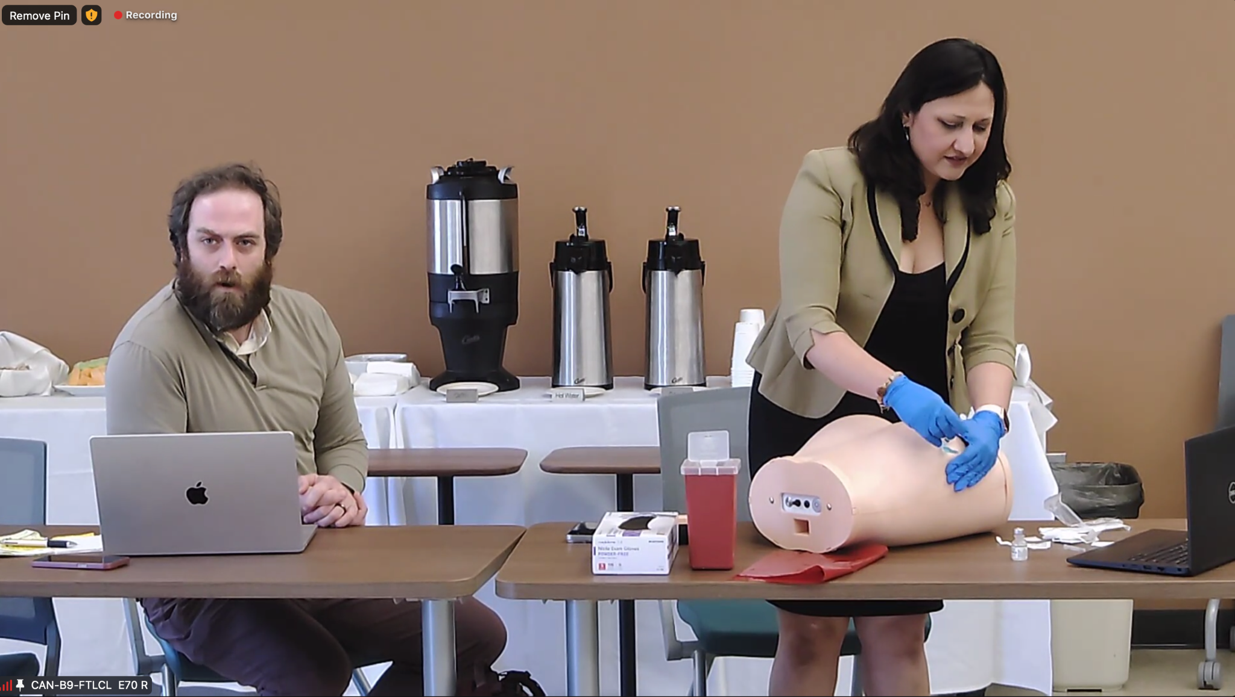
Program Review Presentations

Slide 4
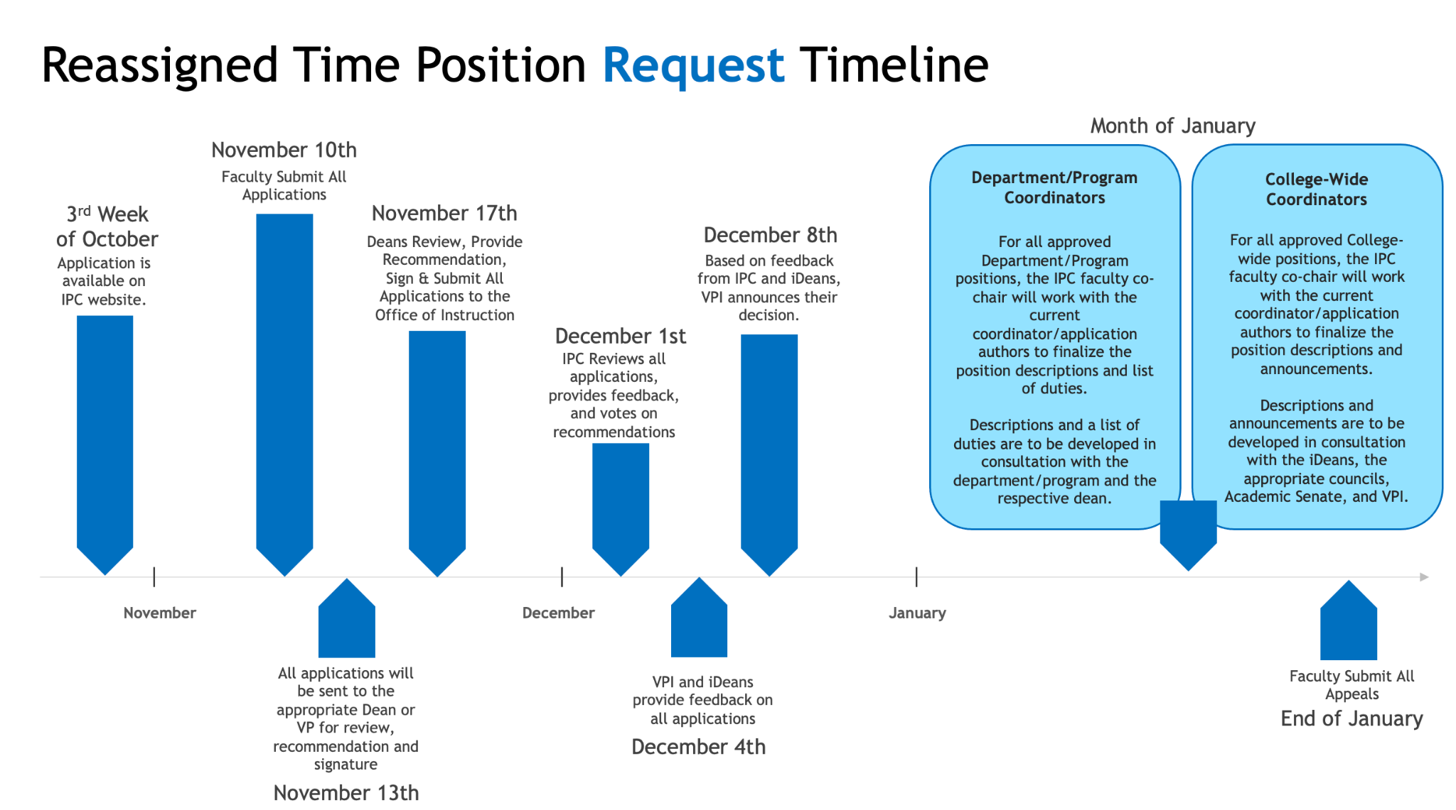
Reassigned Time Applications
Provided recommendations on 18 Reassigned Time Applications
  Plus two out of cycle revision requests

Slide 5
Improved Reassigned Time Process
Improved communication with faculty, deans, and business office
Improved business processes with the help from the VPAS Office
Better planning on reassigned time and faculty load
Continue great collaboration with the Academic Senate

Slide 6
And More!
Dual Enrollment Faculty Handbook/Student Handbook
AB1705 Update
Professional Development Plan
Technology Plan
Distance Education Plan
UMOJA Updates
MESA Updates
Course Modalities and Success
Faculty Teaching and Learning update
SLO and PLO Assessment Plan Update
Curriculum and State Initiatives

