Slide 1
Comprehensive Program Review
23/24 Presentation
Kinesiology, Athletics, & Dance Division
March 15, 2024

Slide 2
Strategic Alignment
Federal / State mandates:
Equity in Athletics Disclosure Act (EADA), R-4 Statement of Compliance /Title IX, California Community College Athletic Association (CCCAA)
SMCCCD Board Goals:
Develop and Strengthen Educational Offerings, Interventions, and Support Programs that Increase Student Access & Success
Increase the number of students who utilize support services that enable them to stay in school and succeed.
Systematically evaluate the effectiveness of existing programs in all areas and develop, strengthen or eliminate programs to support student success.
Establish And Expand Relationships With School Districts, 4-year College Partners, And Community-based Organizations To Increase Higher Education Attainment In San Mateo County
Expand student services, student clubs and learning communities for the benefit of all students but especially underrepresented or other at-risk students.
Increase Program Delivery Options, Including the Expanded Use of Instructional Technology, to Support Student Learning and Success
Expand program delivery options, including accelerated completion options, for all students including online students, e.g., College for Working Adults; short-term classes; intersession classes; cohort classes; and continuing, corporate and community education
Share data and information, especially about student success, with community partners
Ensure Necessary Resources Are Available To Implement This Strategic Plan Through Sound Fiscal Planning And Management Of Allocations. Protect Community-supported Status And Undertake The Development Of Innovative Sources Of Revenue That Support Educational Programs Beyond That Which Is Available From Community And State Allocations.

Slide 3
Strategic Alignment to the Cañada College Master Plan
Goal #1 Student Access, Success, and Completion
Strategic Initiative 1.5 - Develop new Kinesiology, Athletics, & Dance programs and certifications in collaboration with the Community Fitness operations in Building 1 such that students have access to on-site job training and workforce development opportunities that effectively prepare them for health and fitness-related employment in the region.
Interestingly, Our minority student-athletes have a higher success rate (82%) and retention rate (92%) compared to the campus as a whole (success rate of 70% and retention rate of 86%).
Goal #2 Equity-Minded and Antiracist Division Culture
Create and sustain an inclusive, antiracist, and equity-minded division culture
Strengthen the division culture of assessment and improvement to ensure programs effectively serve students and close equity gaps
The college has a strong commitment to promoting equity, inclusion, diversity, and access. Among the student-athlete population, 71% to 79% are non-white or Hispanic students, which is similar to the overall campus diversity.
Goal #3 Community Connections
Strategic Initiative 3. 6 - Collaborate with community organizations to host summer camps, events, and other activities and programs that help triple the number of high school students on campus during the summer and on Saturdays during the academic year, particularly students who may not be college aware or on track to be college ready.
Goal #4 Accessible Infrastructure and Innovation
Ensure Building 1 “Kinesiology and Wellness” is accessible to our students
Provide advance and forward-thinking programming to students

Slide 4
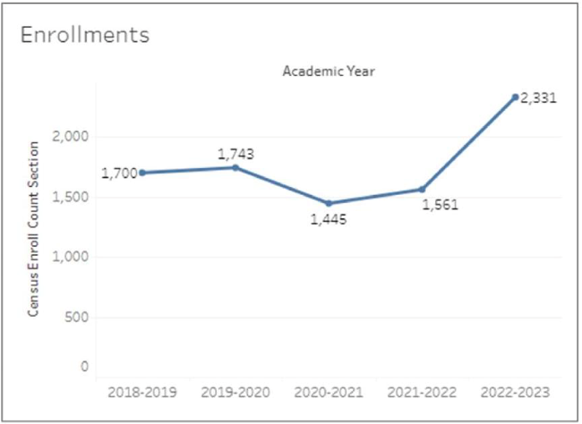
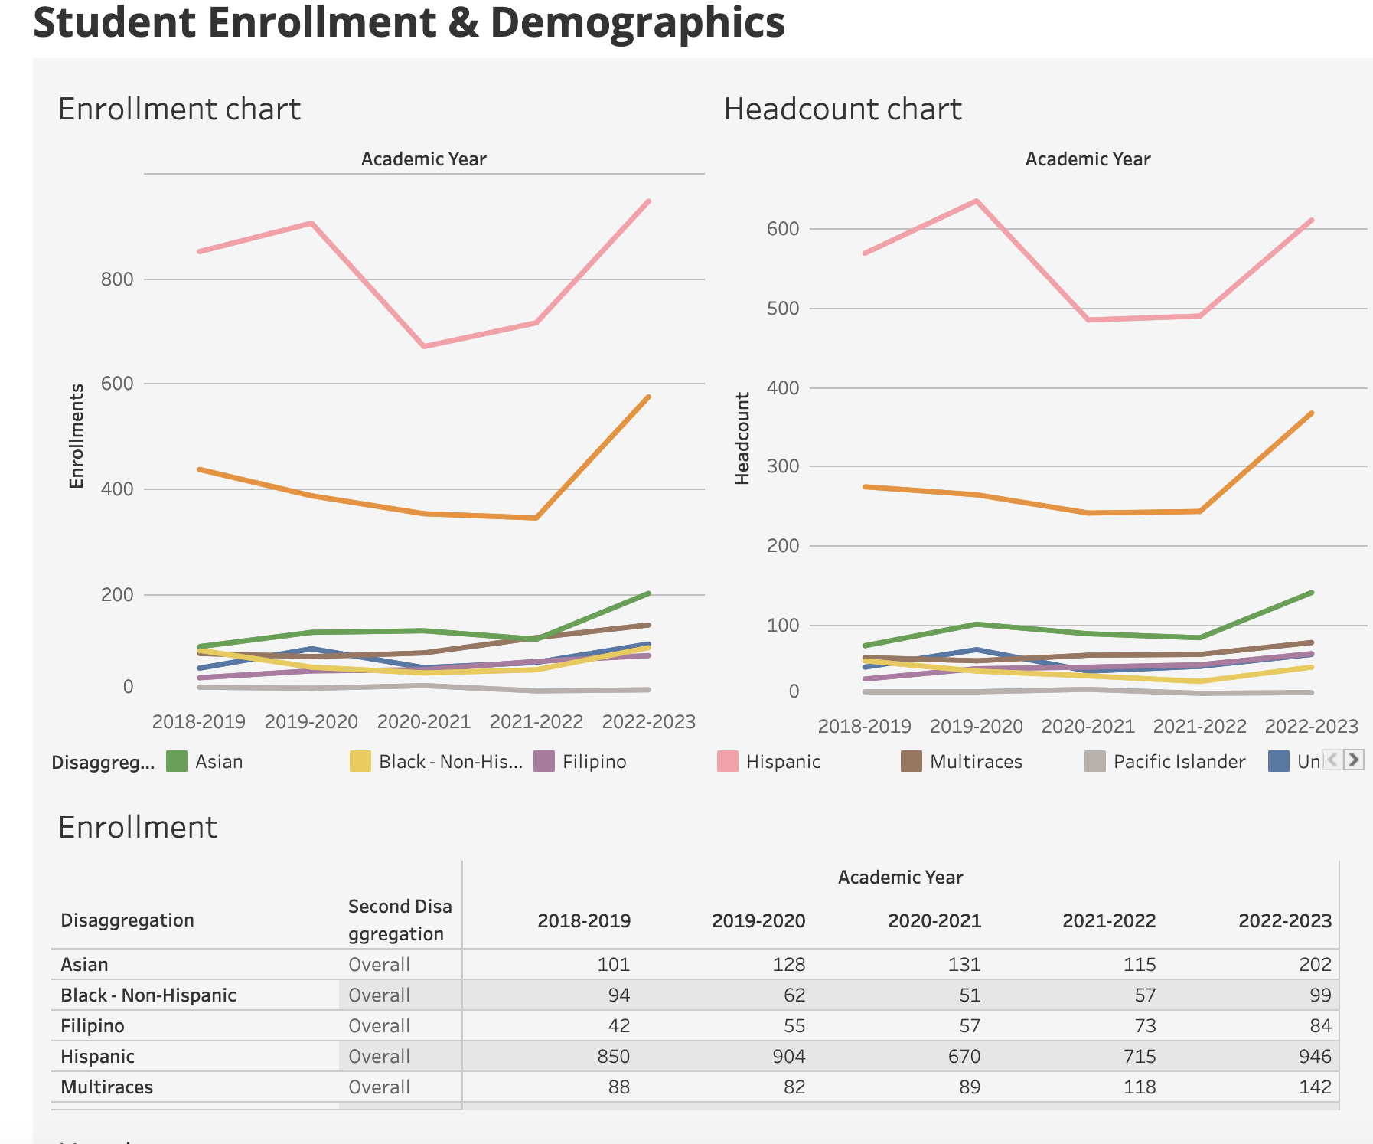
Enrollment
Enrollments increased from 1445 to 2331 enrollments over the 5 years (about 37% increase)
With additional staffing, we will have an opportunity to set standards and create programming to serve the increase in students and student-athletes, while simultaneously supporting the foundations of our programming and revitalizing sports.
Notes:
Who Are We Serving:
Data from the last 5 years consistently reports that 60% of our Total Unduplicated headcount are Female, between 18-22 years of age.
48% of KAD self-identify racially and ethnically – 28% as LATINX, 15% ANNAPISI, 5% BIPOC population
Enrollment:
63% identified as female students even with less female sports. Not typical in athletic departments. We have an opportunity to set a new standards and create programming to serve those athletes / students with additional staffing==> supporting the foundations of our programming and revitalizing sports.
Race/Ethnicity:
As enrollment dips, KAD consistently serves Nearly 50% Latinx students and nearly a quarter Black/African American students.
Percentage of under 18 students has increased since 15-16 from 10% to 15%. Changing the trajectory from lifelong learners to demographic of students trying to matriculate or perhaps go on to four year schools with athletic scholarships. Need to have those resources for them, such as PSCs, Sports Information Directors, to go along the dedicated faculty and staff

Slide 5
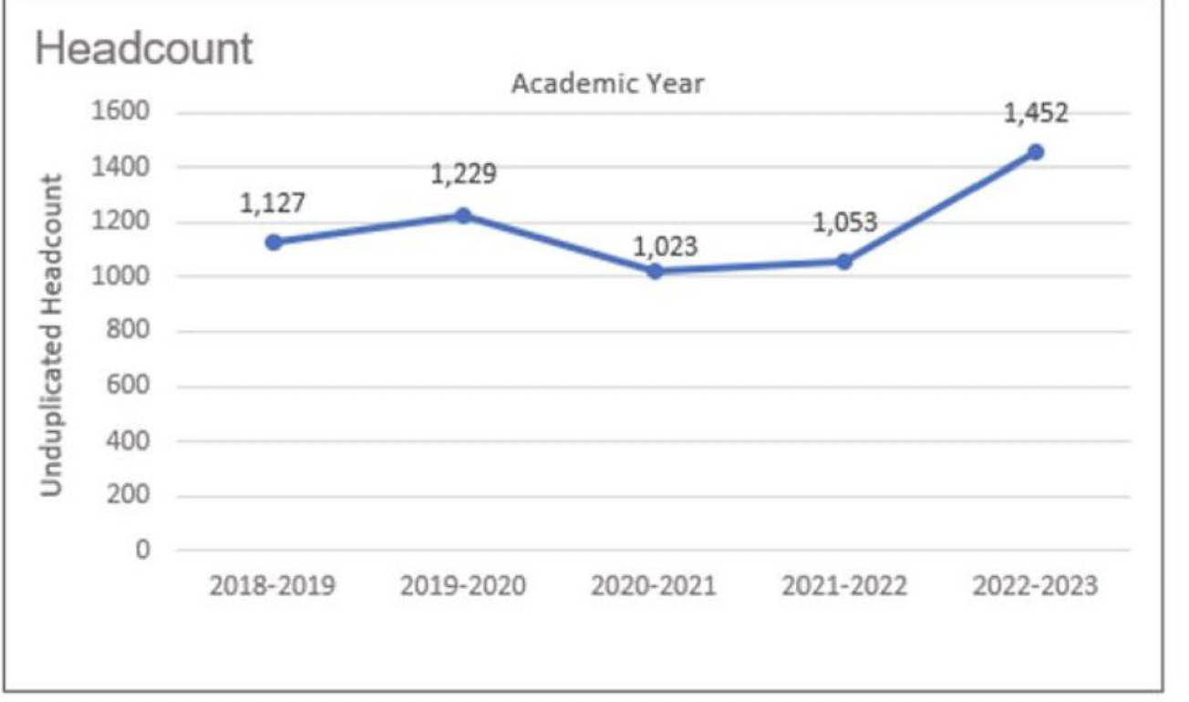
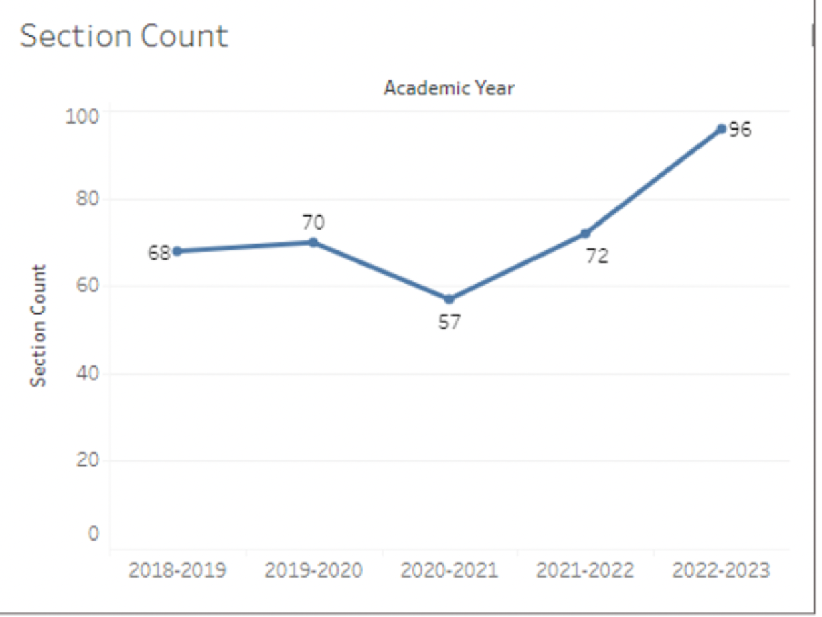
Headcount
Headcount increased from 1127 to 1452 (about 23%) for 5 years
We are serving about 207 athletes and 76 kinesiology majors
Number of sections and offerings increased from 68 to 96 sections
The amount of class offerings indicates additional need for staffing to support our courses, programs and athletes such as instructional support, class promotion, athletics support, equipment.
Notes:
Who Are We Serving:
Data from the last 5 years consistently reports that 60% of our Total Unduplicated headcount are Female, between 18-22 years of age.
48% of KAD self-identify racially and ethnically – 28% as LATINX, 15% ANNAPISI, 5% BIPOC population
Enrollment:
63% identified as female students even with less female sports. Not typical in athletic departments. We have an opportunity to set a new standards and create programming to serve those athletes / students with additional staffing==> supporting the foundations of our programming and revitalizing sports.
Race/Ethnicity:
As enrollment dips, KAD consistently serves Nearly 50% Latinx students and nearly a quarter Black/African American students.
Percentage of under 18 students has increased since 15-16 from 10% to 15%. Changing the trajectory from lifelong learners to demographic of students trying to matriculate or perhaps go on to four year schools with athletic scholarships. Need to have those resources for them, such as PSCs, Sports Information Directors, to go along the dedicated faculty and staff

Slide 6
Productivity-Effectiveness
Across all demographics, KAD students are finding greater success and retention from the College average.
KAD reports a Success Rate of 80.3% in year 2022/23
KAD reports a Retention Rate of 88.8% in year 2022/23
Both higher than College average

Slide 7
From Last Program Review till NOW
Goal #1 Increase enrollment by extending academic programming through the utilization of KAD’s facilities to host youth events.
We have hosted successful youth events (men’s basketball/Redwood City Together and women’s soccer/Red Star Soccer Club) but do have the capacity to do more as we are understaffed. We need more support staffing the requested events and pushing the connections with the community. (Ski week camp)
We have requested that the rental process be made more flexible and transparent to better serve our division. We have had meetings with organizations that could potentially benefit our division, but due to our prices and rigid process, we lose the rentals to other programs and facilities. We are also aware that the athletic departments at the other two colleges in the district have more control over their processes and the revenue that comes from rentals.
Notes:
Mission Statement:
The Kinesiology, Athletics, and Dance (KAD) Division is committed to fostering a learning-centered environment, ensuring equitable access for a diverse community of students. The KAD Division is positioned to provide a range of academic programming and workforce preparation that meets today’s industry standards. While the KAD Division adheres to all institutional planning initiatives and priorities, KAD faculty, staff, and administration will continue to challenge itself on becoming the preeminent instructional pathway to success for its students and student athletes.

Slide 8
From Last Program Review till NOW
Goal #2 Review and strengthen KAD Division operations by evaluating resources, policies, and procedures to support programmatic growth
Assistant Coach Pay
Transportation
Gymnasium
Faculty and Classified Staffing
Athletic Facilities maintenance and upkeep
Notes:
Mission Statement:
The Kinesiology, Athletics, and Dance (KAD) Division is committed to fostering a learning-centered environment, ensuring equitable access for a diverse community of students. The KAD Division is positioned to provide a range of academic programming and workforce preparation that meets today’s industry standards. While the KAD Division adheres to all institutional planning initiatives and priorities, KAD faculty, staff, and administration will continue to challenge itself on becoming the preeminent instructional pathway to success for its students and student athletes.

Slide 9
On the Horizon in KAD Division
AB 928 is a legislative act known as the Student Transfer Achievement Reform Act, which supports the CalGETC program and will become effective in fall 2025.
Staffing increasing KAD Division faculty and Staff
Gymnasium & Pool Limitations and the effects on achieving strategic goals
Fitness Professional Certificate of Achievement

Slide 10
Our Classes
AB 928 is a legislative act known as the Student Transfer Achievement Reform Act, which supports the CalGETC program and will become effective in fall 2025.
One of the major changes brought by AB 928 is the removal of Area E (Lifelong Learning and Self-Development) from the general education requirements for CSUs. This change could have significant consequences for the KAD division as many of its course offerings fall under Area E. While we are uncertain about how AB 928 will affect the division, we believe that there is cause for concern. Therefore, we are seeking support from the college and district to address this statewide issue.
Notes:
Mission Statement:
The Kinesiology, Athletics, and Dance (KAD) Division is committed to fostering a learning-centered environment, ensuring equitable access for a diverse community of students. The KAD Division is positioned to provide a range of academic programming and workforce preparation that meets today’s industry standards. While the KAD Division adheres to all institutional planning initiatives and priorities, KAD faculty, staff, and administration will continue to challenge itself on becoming the preeminent instructional pathway to success for its students and student athletes.

Slide 11
To Keep up and Maintain…Solutions are Required
KAD Staffing requests
Instructional Aide II
Sports Information Director
Program Services Coordinator
Equipment Manager
Assistant Coach Pay
Faculty Hires
Gymnasium & Pool Limitations
Goal #2 Review and strengthen KAD Division operations by evaluating resources, policies, and procedures to support programmatic growth.
Notes:
Mission Statement:
The Kinesiology, Athletics, and Dance (KAD) Division is committed to fostering a learning-centered environment, ensuring equitable access for a diverse community of students. The KAD Division is positioned to provide a range of academic programming and workforce preparation that meets today’s industry standards. While the KAD Division adheres to all institutional planning initiatives and priorities, KAD faculty, staff, and administration will continue to challenge itself on becoming the preeminent instructional pathway to success for its students and student athletes.

Slide 12
Fitness Professional Certificate of Achievement
Certification Program - Our division has discussed and had specific meetings to review the current core program of the existing (and currently banked) Fitness Professional Certificate of Achievement.
This includes ensuring all course content addresses the knowledge base required of a certified professional.
In collaboration with Community Fitness, we will offer hands-on experience as part of the program in the form of internships, mentorships, and/or paid student employment.
Notes:
Mission Statement:
The Kinesiology, Athletics, and Dance (KAD) Division is committed to fostering a learning-centered environment, ensuring equitable access for a diverse community of students. The KAD Division is positioned to provide a range of academic programming and workforce preparation that meets today’s industry standards. While the KAD Division adheres to all institutional planning initiatives and priorities, KAD faculty, staff, and administration will continue to challenge itself on becoming the preeminent instructional pathway to success for its students and student athletes.

Slide 13
Thank You / Any Questions?

