Slide 1
Learning Center
Ron Andrade
March 1, 2024

Slide 2
Learning center staff
Ron Andrade Director of Student Support
Nariman Ayesh Instructional Aide (writing center)
Daniel Bresnahan Instructional Aide (writing center)
Vince Fitzgerald Instructional Aide (writing center)
Jonathan MacSwain Instructional Aide
Sierra Moreno Instructional Aide (writing center)
Jason Ramos Instructional Aide (stem center)
Haley Sheetz Instructional Aide (writing center)
Julian Taylor Tutor Coordinator
Godfrey Watson Instructional Aide

Slide 3
Learning Center Services
In person tutoring
Virtual tutoring
Embedded support
Group study
Quiet study spaces
Computer lab
Hybrid & online study pods
Textbook and resource reserve
Writing center
Stem center *now with mesa!
Technology support
Test proctoring

Slide 4
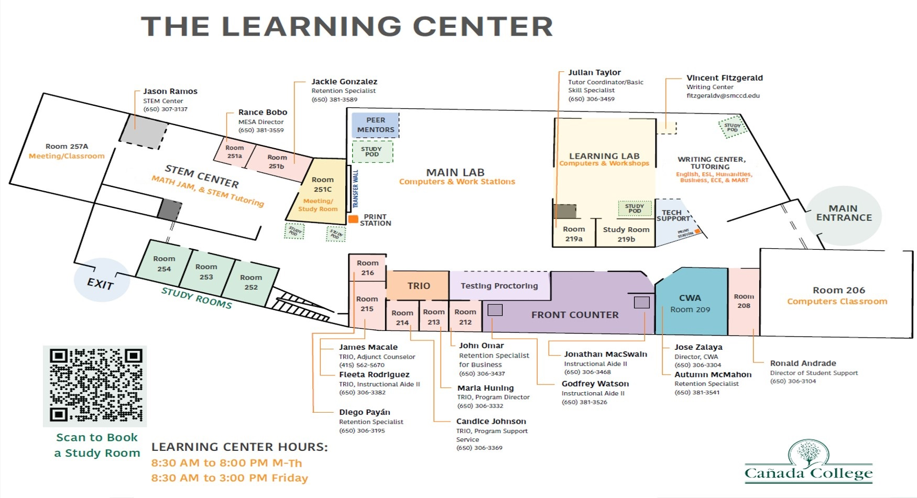

Slide 5
Learning Center courses
LCTR 100 – Effective Tutoring & Practicum
LCTR 139 – The Research Paper from A to Z
LCTR 140 – Professional Writing
LCTR 698 – Supervised Tutoring/Acad. Assistance
LCTR 810 – Study Skills
LCTR 822/823 – Grammar Trouble Spots
LCTR 840/841 – Vocabulary Improvement

Slide 6
Learning center usage
Spring ‘24
656 unique visitors
3132 unique visits

Slide 7
Tutor Support
50 tutors
13 embedded
55 different courses
Accounting
Anthropology
Biology
Chemistry
Communication Studies
Computer Science
Economics
English
Engineering
Environmental Science
ESL
Math
Oceanography
Philosophy
Physics
Psychology
Spanish

Slide 8
access

Slide 9
Mission Statement
It is the mission of the Cañada College Learning Center to provide energetic, competent and friendly academic and related assistance to all Cañada students, regardless of the focus of their work at Cañada. Assistance includes peer and professional tutoring, workshops and technological support. We approach our work with passion, professionalism and creativity; our students with admiration and patience; and our colleagues with respect and a commitment to shared goals and values.

Slide 10
More to come
Kick off mesa – open house reception
Expand embedded tutoring
Increase outreach and raise awareness
Continue collaboration with college retention and engagement work
Support for ab 1705 with academic support resources

Slide 11
Questions…?

