Slide 1
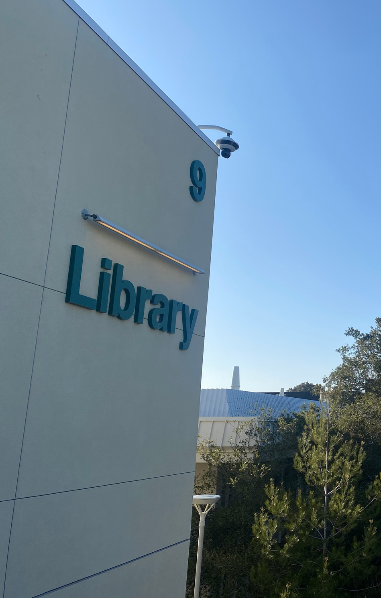

CAÑADA LIBRARY
PRESENTATION

Slide 2
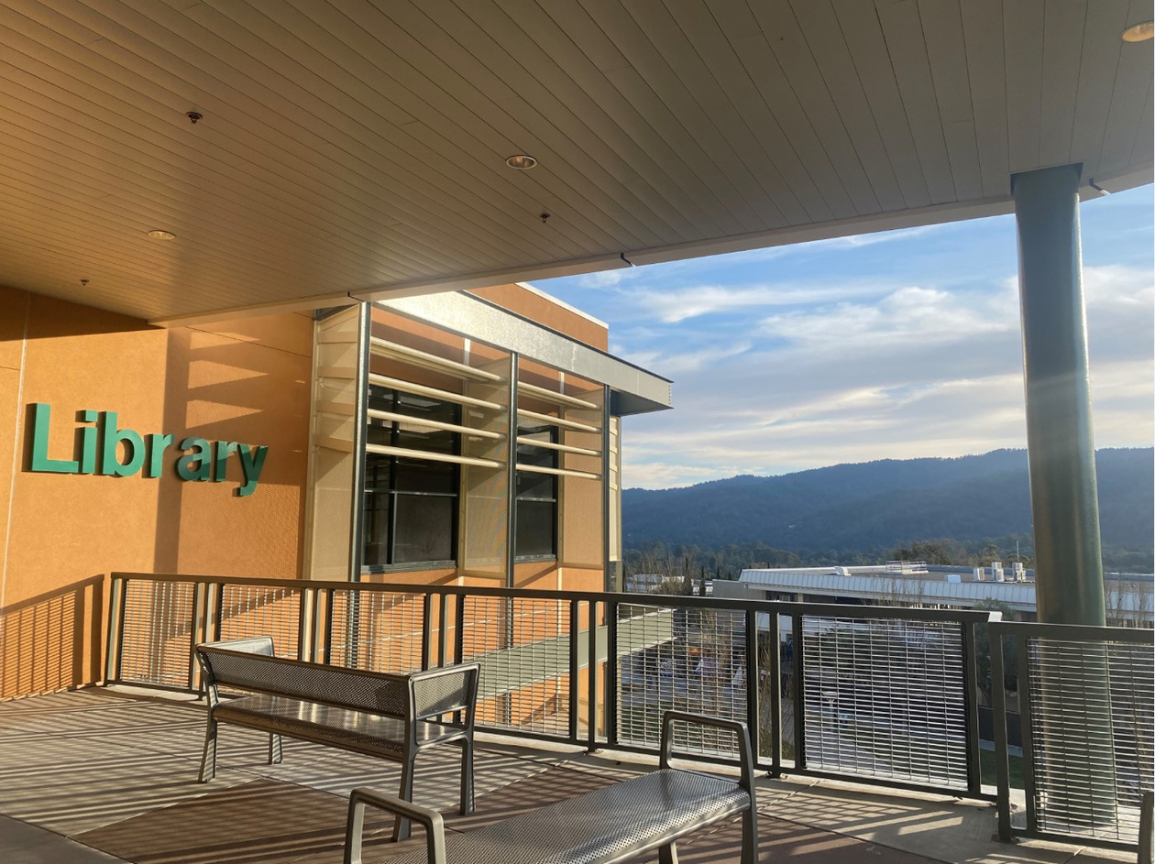
WHO WE ARE: LIBRARIANS
Librarians teach information literacy in a
classroom, group or one-on-one setting. We collaborate with faculty to provide course-
integrated library instructional sessions. These include how to search library databases, evaluating resources, ethically using resources, and more.
We also provide bilingual workshops, in-person and online reference assistance, create instructional materials such as videos, online research guides, and more. We provide access to online resources including library databases, eBooks, and streaming films.

Slide 3

WHO WE ARE: LIBRARY SUPPORT SPECIALISTS
Library Support Specialists provide access to necessary physical material including
textbooks, circulating books, a very popular graphic novel collection, laptops, Chromebooks,
WiFi hotspots, graphing calculators, phone chargers, DRC tablets with assistive technology,
headphones with built in microphones, and San Mateo County Park passes.
Besides ordering, cataloging, and processing reserves for the Library, they also catalog and process reserves for the Learning Center. Furthermore, they train and supervise our student workers, who help students sign up for study room, print, and check out material.

Slide 4
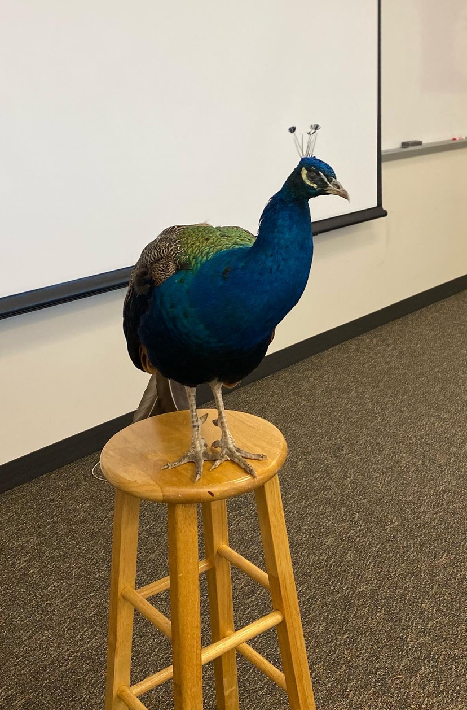
OUTREACH AND COMMUNITY EVENTS
  Therapy Dogs, and sometimes a peacock, each semester for Finals
  Movie screenings with Q&A
    Sansón and Me March 19th, 6pm to 9pm in the Grove!
  Puzzles, coloring, button making and soon Cricut
  Partnering with Peninsula Public Libraries as part of their Comic Art Fest
  Tabling at welcoming events
  Super Saturday support for Spanish speaking students

Slide 5
Accomplishments
Redesigned Library Website
New Library Management System
Starting Online Reference and Instruction Options
Noche de Familia and Super Saturday Participation
Awarded Vending Commission Award for Anti-stress Activities
Offer ACCEL, Interior Design, EOPS/CARE, and DRC Tech Support
Support Cañada de Noche
Documentary Screening in Spring 2023
Increasing Technology Loan Program
Supporting ZTC/OER Program
Adding More Library Databases

Slide 6
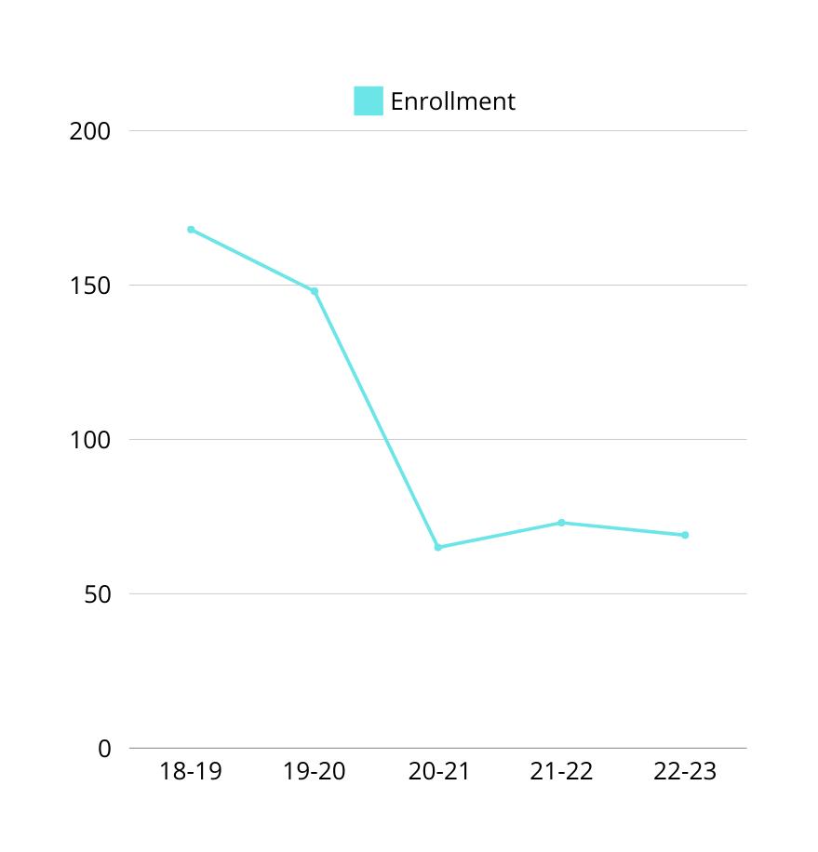
LIBR 100: ENROLLMENT
Enrollment in Library Science was down 58.9% in 2022-2023 compared to five years ago in 2018-2019. Library Science enrollment was at a five-year high in 2018-2019 with 168 enrollments and a five-year low of 65 enrollments in 2020-2021.
Since the 2019 uncoupling from ESL 400 due to enrollment and registration concerns, LIBR 100’s enrollment and number of sections has dropped.
We have also moved to all online, asynchronous, courses and made LIBR 100 a late start class. This gives the Librarians more time to market and recruit students to LIBR 100 through class visits, email outreach to other faculty, etc.

Slide 7
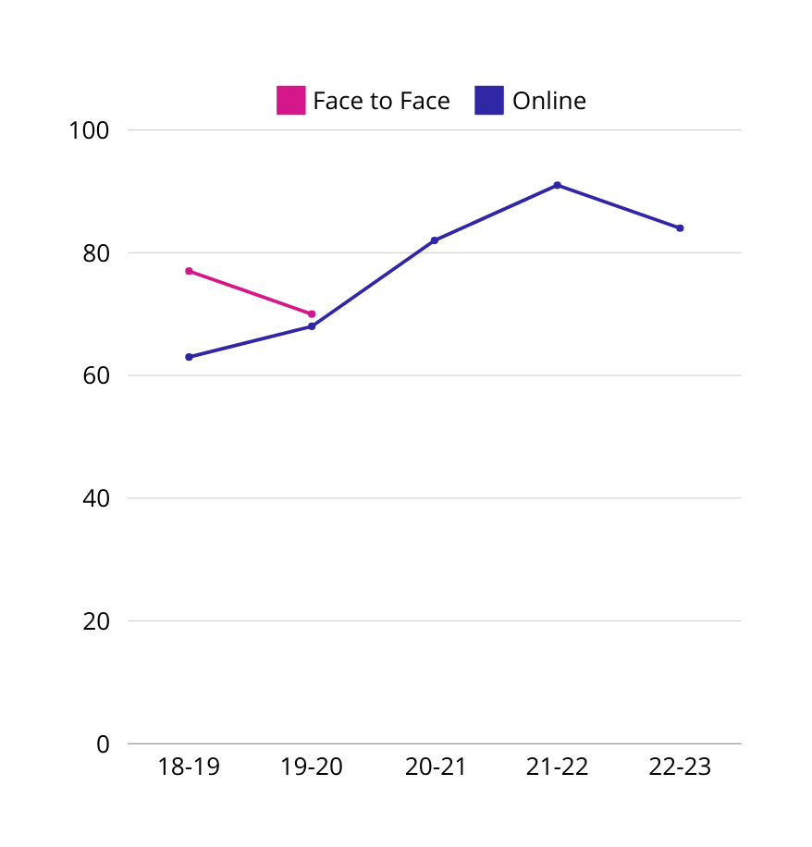
LIBR 100: ONLINE SUCCESS RATE
Our success rate for our online courses is higher than for our in-person courses. LIBR 100 classes have been primarily offered online for the last five academic years.
When face-to-face sections were offered, the success rate was slightly higher than online success. However, the most recent success rates in online Library Science sections surpassed the face-to-face success rates by five or more percentage points.
This could be because students don’t miss classes in an asynchronous online course and are able to make up work from previous weeks.
Since we have moved to all online courses, we will continue to work with students and student support programs to ensure our students' success.

Slide 8
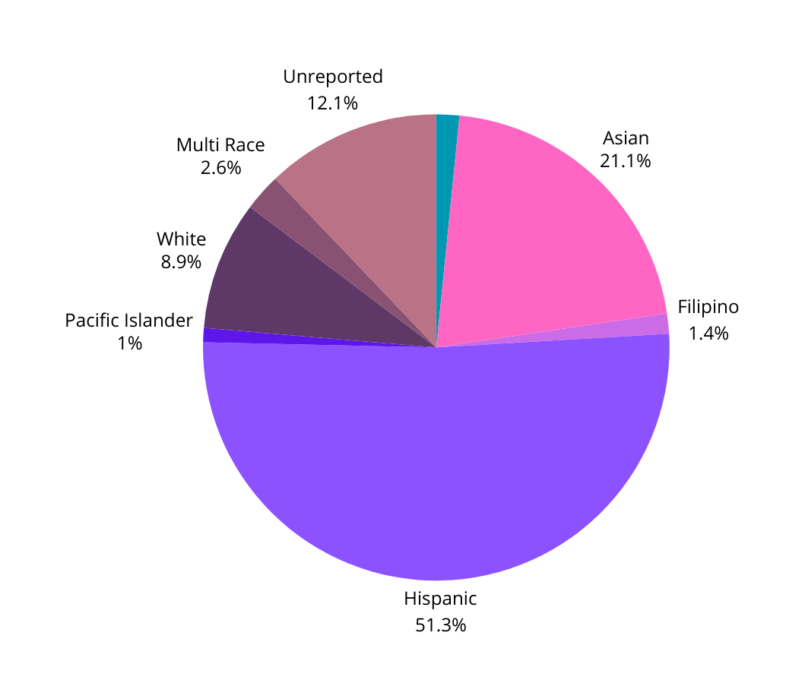
LIBR 100: RACE AND ETHNICITY
HEADCOUNT 18/19 - 22/23

Slide 9
LIBR 100: RACE AND ETHNICITY
SUCCESS RATE
 | African American | Asian | Filipino | Hispanic | Pacific Islander | White | Multi Race | Unreported
LIBR 100 (18/19-22/23) | 88% | 85% | 43% | 74% | 80% | 78% | 92% | 82%
College (22/23) | 64.8% | 83.7% | 71.9% | 64.6% | 59.1% | 78.5% | 74.3% | 70.6%
The success rate for Filipino students was very low, 43%. While we only had 7 Filipino students in the last five years enrolled in LIBR 100, this is still a concerning success gap. Looking for professional development around Filipino students might help the Librarians address this gap. We are also increasing our resources related to Filipino students, in Spring 2023 we purchased an online encyclopedia, The SAGE Encyclopedia of Filipina/x/o American Studies, we also purchased a handful physical books about Filipino Americans or written by Filipino Americans. Finally, Fall 2023 is the first year we’ve included a display on Filipino American History Month.
Similarly, Hispanic identifying students had the second lowest success rate at 74%. This is higher than the College average success rate for this population. In the long term, we’d like to explore adding a Spanish language section of LIBR 100.

Slide 10
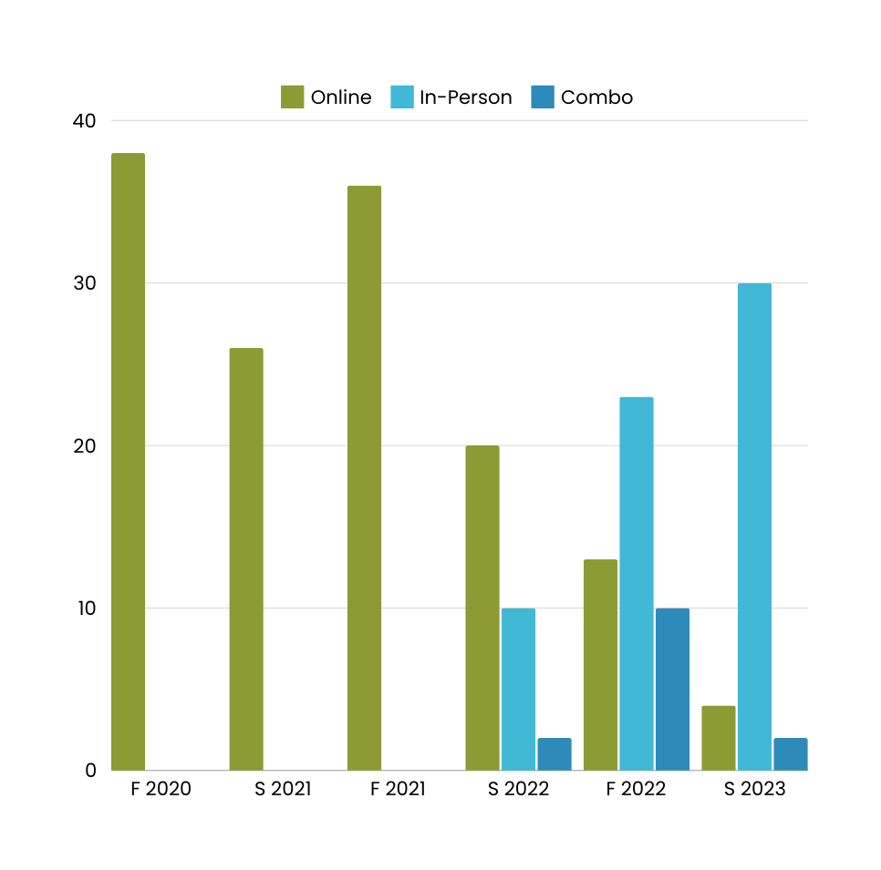
Instructional Support
Instruction Modality
Covid-19 allowed us to add Zoom and combo in-person and online as forms of delivery of instruction. By Spring 2023 we taught mostly in-person, but still provide other modes.
Instructional sessions include:
  Individual student sessions (Spanish or English)
  Course integrated library instructional sessions
  Workshops
  10–15-minute tours of the library space or website
  Creation of resource guides, Canvas modules and/or videos.

Slide 11
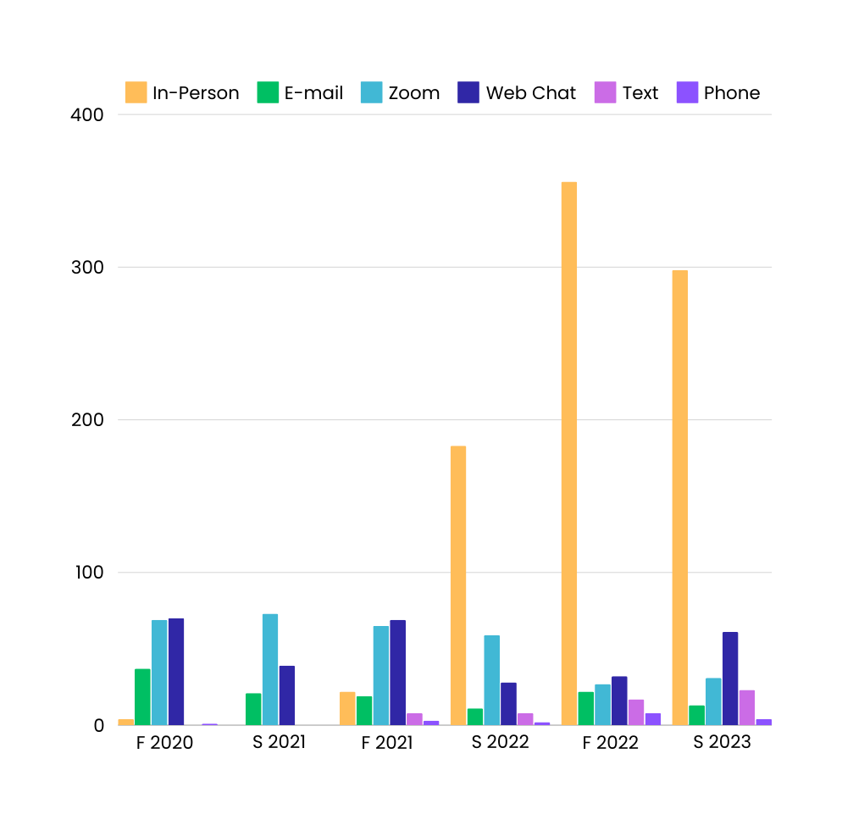
Reference Modality
Reference Support
We have added Zoom, web chat, and text chat options for reference appointments.
Reference support includes:
  Reference questions such as databases, articles and other resources.
  Technology help
  Basic information help

Slide 12
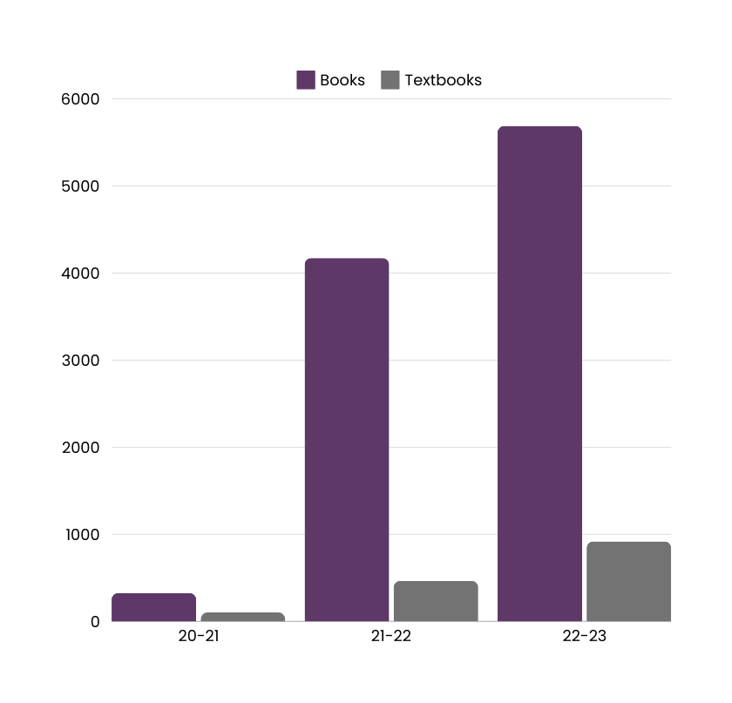
Circulation
Circulation: Books and Textbooks
Circulation of physical books is up since reopening of campus.
Facts about our collection:
  67% published before 2000
  Does not meet the research needs of students due to age
  Updating our physical collection ensures that it reflects our Latinx and AANAPISI students.

Slide 13
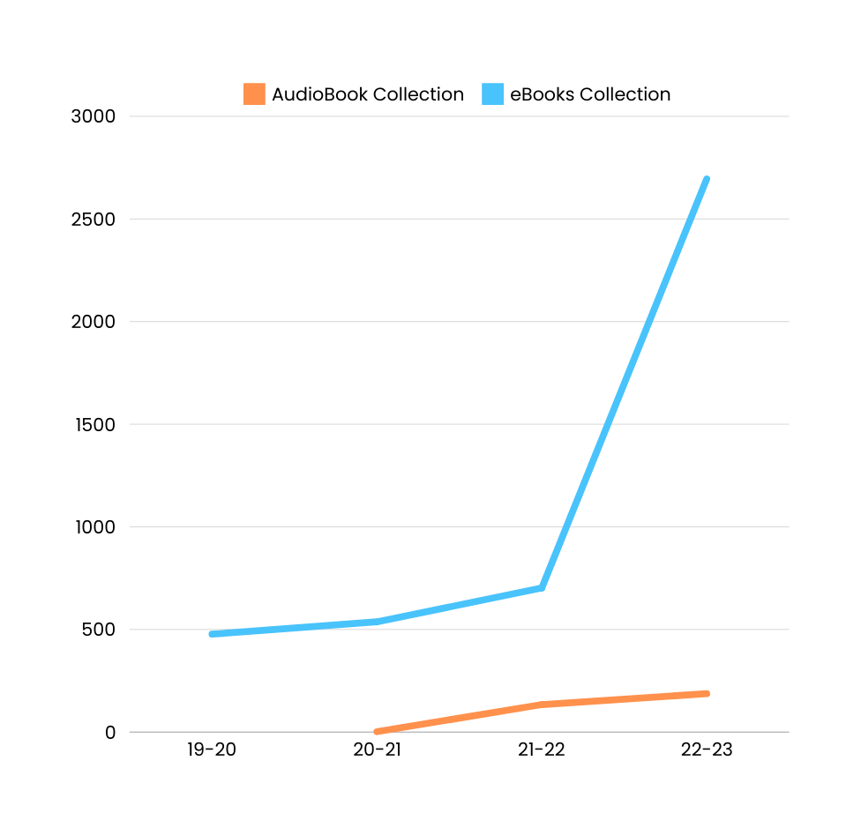
Circulation: eBooks and audiobooks
CCCCO ZTC Implementation Grant allowed us to purchase more eBooks and audiobooks.
Due to licensing we often need to purchase multiple copies of the same title to meet student needs.
Support the growth of ZTC courses.

Slide 14
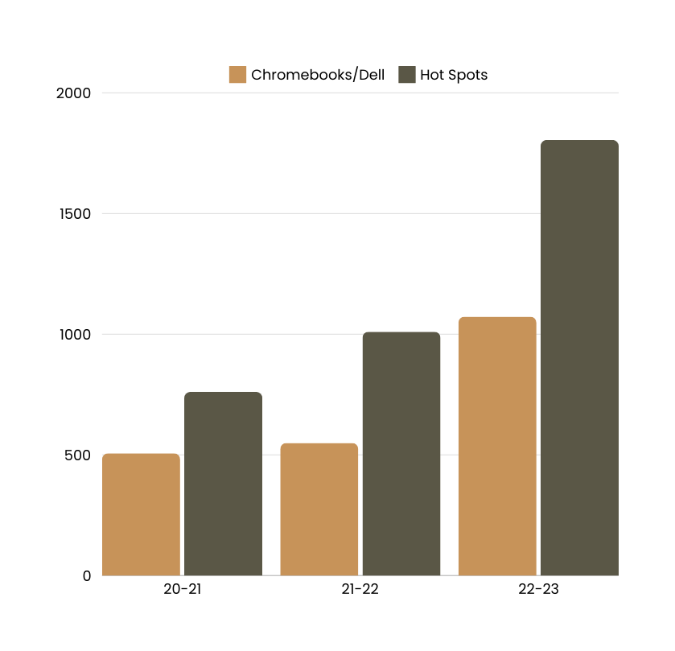
Circulation
Circulation: Technology
We have added 1,036 new Chromebooks, laptops, and Wi-Fi hot spots over three years.
Supports our goal to “help bridge the income equity gap and provide students with resources needed to complete their course work. “
Demand is so high, we have consistently run out of Hot Spots every semester.

Slide 15
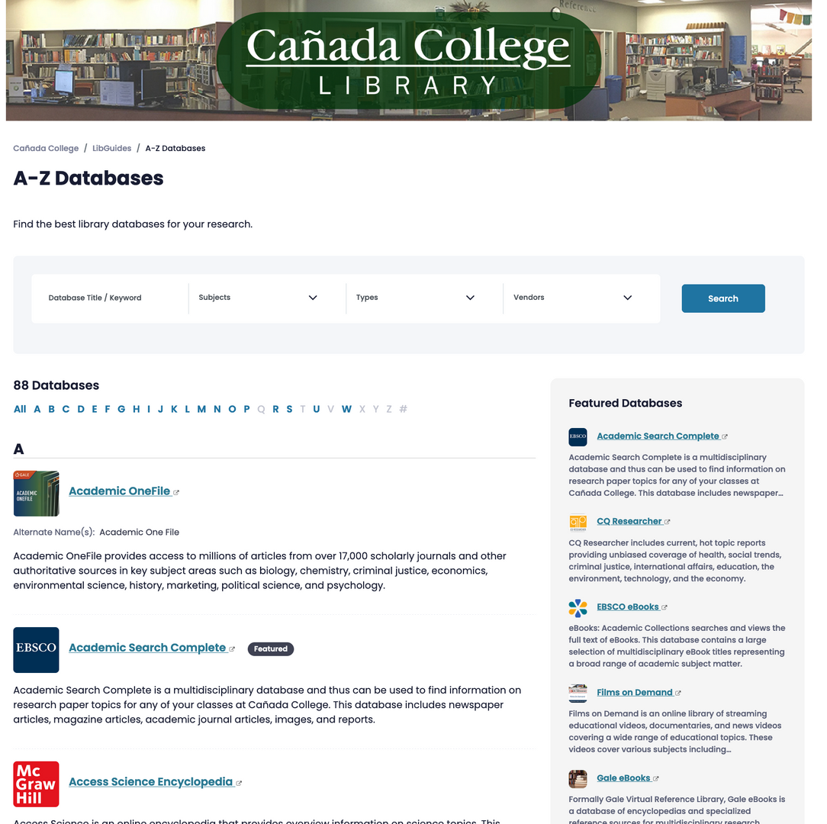
Circulation: eResources
Library Database Use | Library Database Use | Library Database Use
Year | Total Number of Searches | Full Text Requests
2019-2020 | 88,962 | 38,377
2020-2021 | 66,834 | 51,784
2021-2022 | 56,160 | 47,186
2022-2023 | 250,736 | 113,160

Slide 16
Circulation: eResources
Top 5 Databases by Searches 2022-2023 | Top 5 Databases by Searches 2022-2023 | Top 5 Databases by Searches 2022-2023 | Top 5 Databases by Searches 2022-2023
Database Name | Vendor | Searches | Full Text Requests/Views
Opposing Viewpoints | Gale | 9,367 | 4,169
Kanopy | Kanopy | 8,096 | 2,752
Academic Search Complete | EBSCO | 7,118 | 7,031
JSTOR | ITHAKA | 6,764 | 8,694
Academic OneFile (Gale) | Gale | 6,283 | 6,196
Top 5 Databases by Full Text Requests/Views 2022-2023 | Top 5 Databases by Full Text Requests/Views 2022-2023 | Top 5 Databases by Full Text Requests/Views 2022-2023 | Top 5 Databases by Full Text Requests/Views 2022-2023 | Top 5 Databases by Full Text Requests/Views 2022-2023
Database Name | Vendor | Searches | Full Text Requests/Views | Users
Wall Street Journal | Wall Street Journal | N/A | 28,844 | 736 users
New York Times | New York Times | N/A | 21,181 | 443 users
JSTOR | ITHAKA | 6,764 | 8,694
Academic Search Complete | EBSCO | 7,118 | 7,031
Films on Demand | InfoBase | 1,032 | 6,651

Slide 17
Other Stats
Study Room Bookings | Study Room Bookings
Year | Number of Bookings
2019/20 | 626
2020/21 | 0
2021/22 | 979
2022/23 | 3,946
LibGuide Usage Statistics | LibGuide Usage Statistics
Year | Views
2018-2019 | 37,319
2019- 2020 | 41,301
2020-2021 | 88,009
2021-2022 | 72,127
2022-2023 | 59,615
Website Traffic | Website Traffic
Year | Views
Aug 2020 - Jul 2021 | 26,345
Aug 2021 - Jul 2022 | 28,846
Aug 2022 - Jul 2023 | 38,315
Book Scanner Use 2023 | Book Scanner Use 2023
Jan | 199
Feb | 78
Mar | 27
Apr | 94
May | 8
Jun | 128
July | 3
Aug | 81
Sept | 149
Total | 767

Slide 18
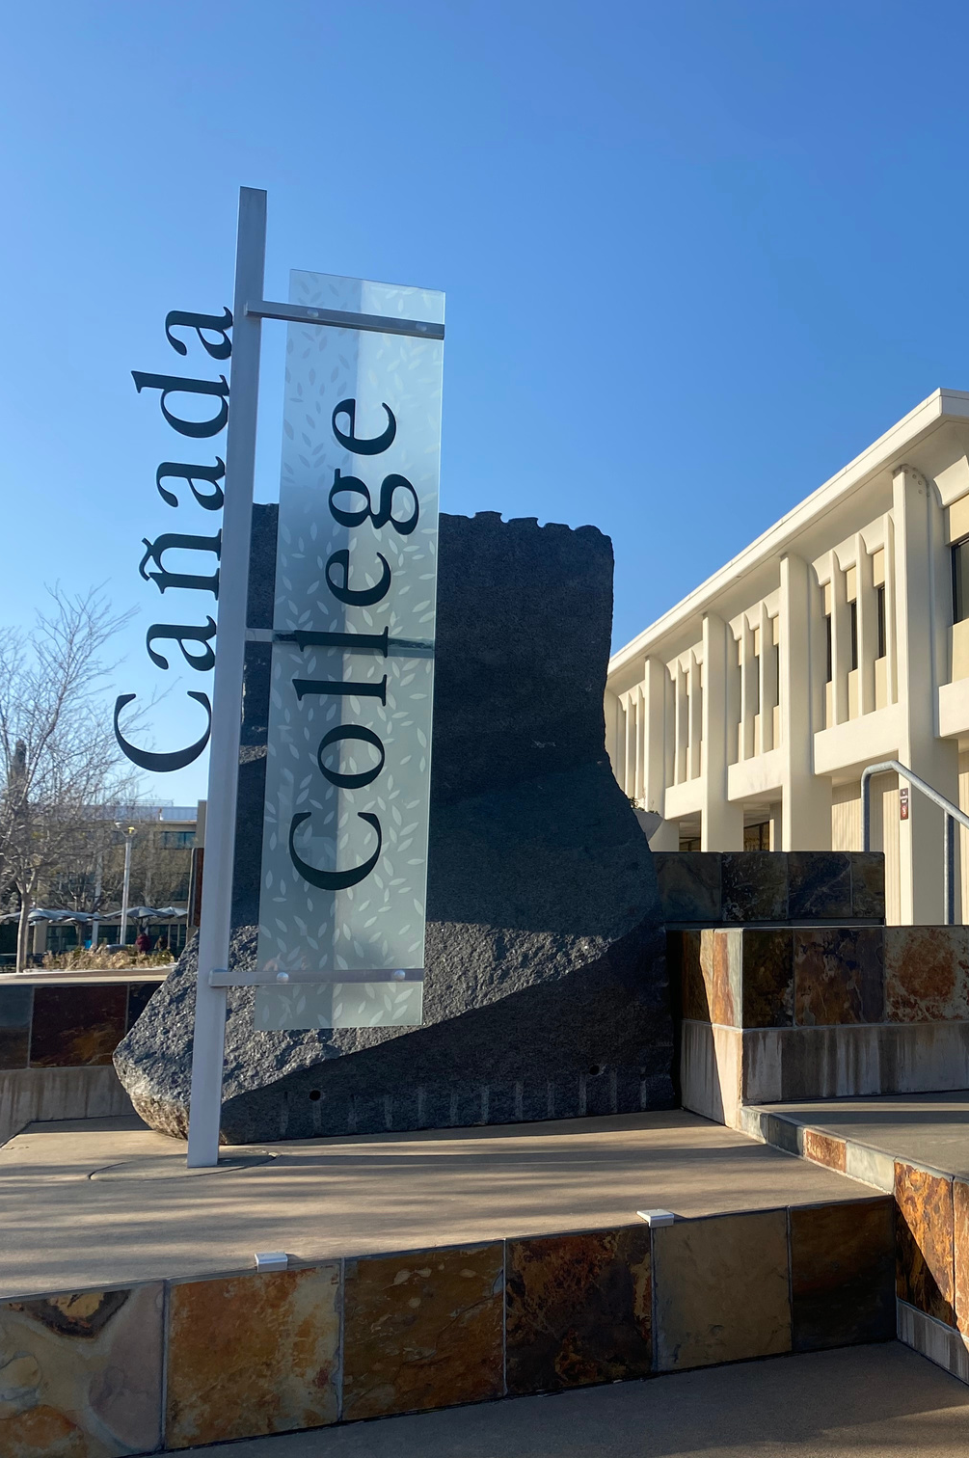
FUTURE GOALS
  Alleviate textbook costs for students by supporting the College’s ZTC efforts.
  Create a welcoming and comfortable library space that supports student learning and increases student on-campus engagement.
  Help bridge the equity gap by providing students with resources needed to complete their course work.
  Support curriculum and student learning through information competency instruction
  Provide resources and services to help build an anti-racist college.

