Slide 1


Medical Assisting Program
Review
March 2024
Dr. Ritu Malhotra
Faculty and Program coordinator

Slide 2

Agenda
Overview of program
Job outlook + Demand
Value of the program
Journey so far and continued Strategies
Enrollment trends
Recruitment and continuation of Clerkship training and community Partnership
To Aid further success
Questions

Slide 3
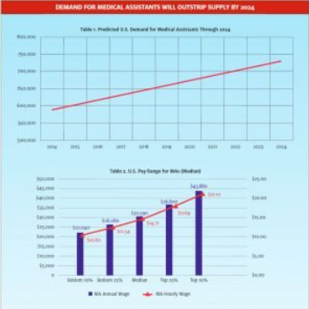
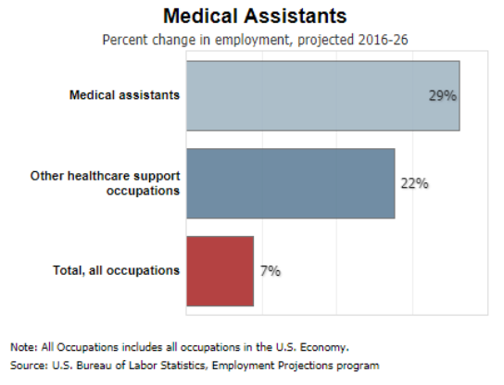
Demand for Medical Assistants
Medical assistant graduates play a crucial role in healthcare
They are at the core of urgent care’s clinical support workforce.
They support physicians/healthcare professionals with clinical and administrative tasks .
Lower costs
Improve quality of patient care and outcomes
Demand for Medical Assistants will outstrip supply by 2024
According to the Bureau of Labor Statistics, the job outlook for MA’s is estimated to increase by 19% which is much faster than the average occupation from 2021-2031

Slide 4

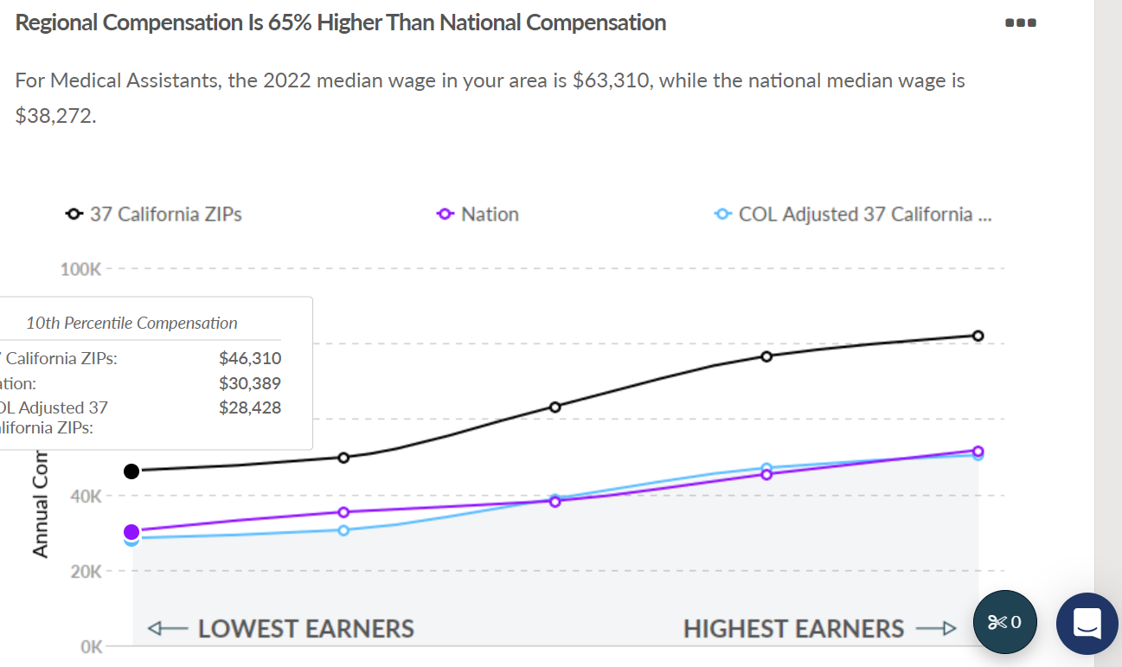
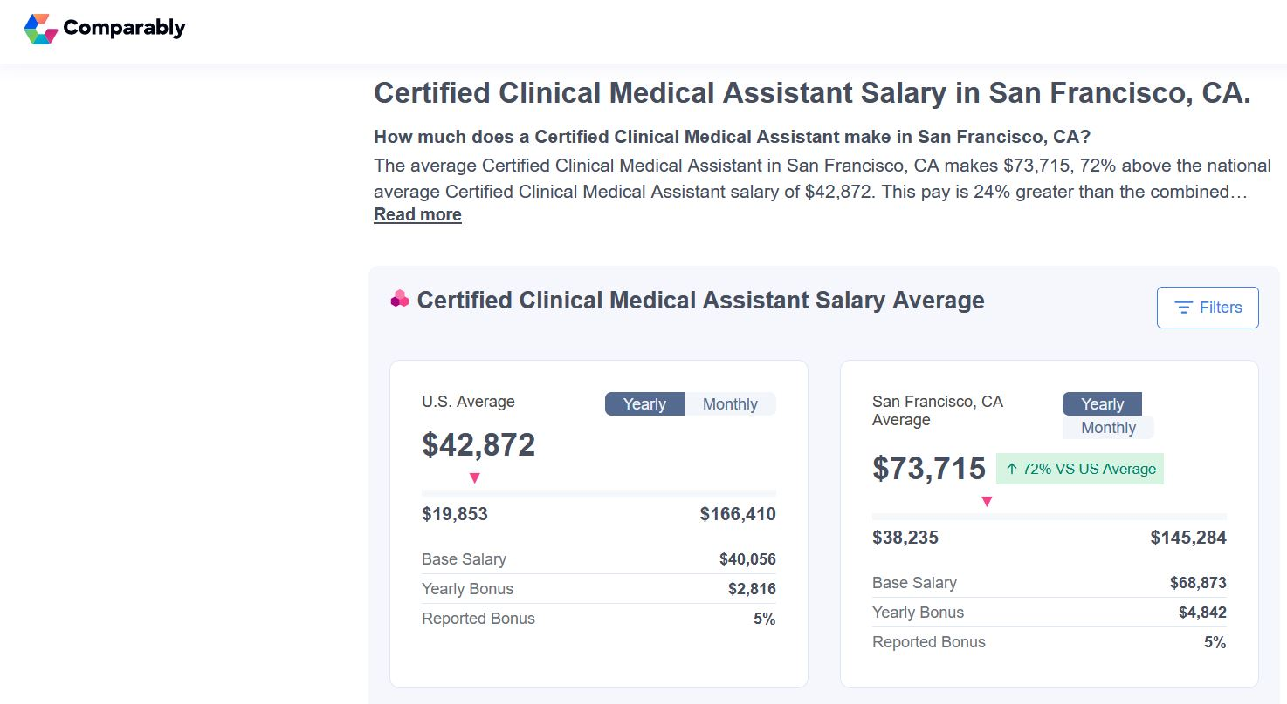
Job Outlook
Regional compensation is 65% higher than national compensation
https://www.comparably.com/salaries/salaries-for-certified-clinical-medical-assistant-in-san-francisco-ca

Slide 5

Value of the program
The medical assisting program at Cañada College is not just about education; it's about transformation.
WE CHANGE LIVES!
We serve a diverse student body..
It is an invaluable entry point into a healthcare career
Graduates from the program receive a versatility in opportunity.
Serve as a stepping stone in pursuing further education
  Future Career Pathways :
      Registered Nurse
      Radiology Technician
      Ultrasound Technician
      Anesthesia Technician
      Physician Assistant
      Nurse Practitioner

Slide 6
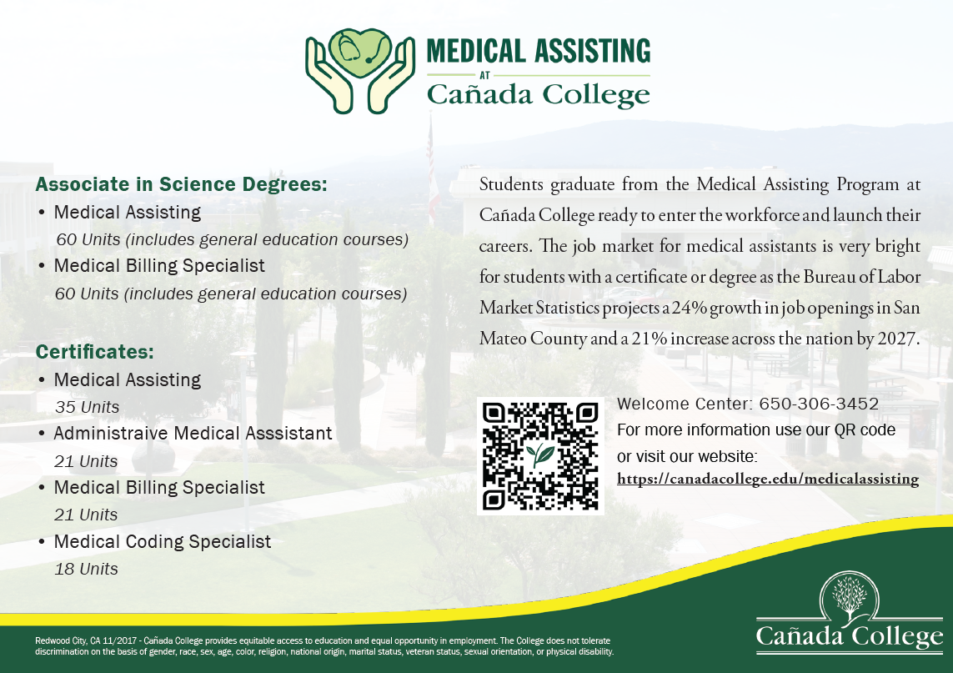
Degree and certificate offerings

Slide 7
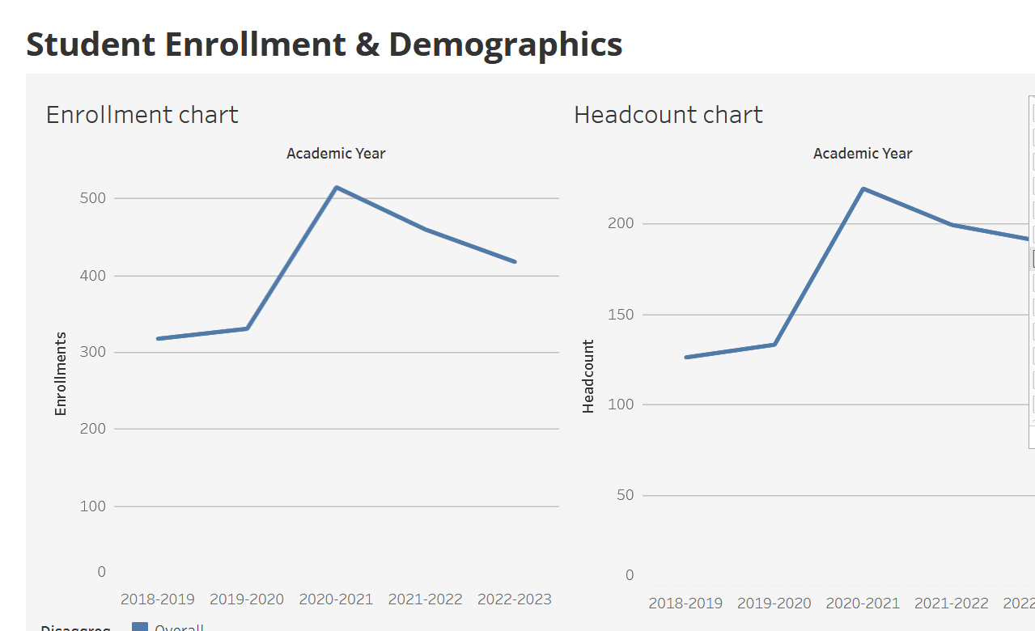
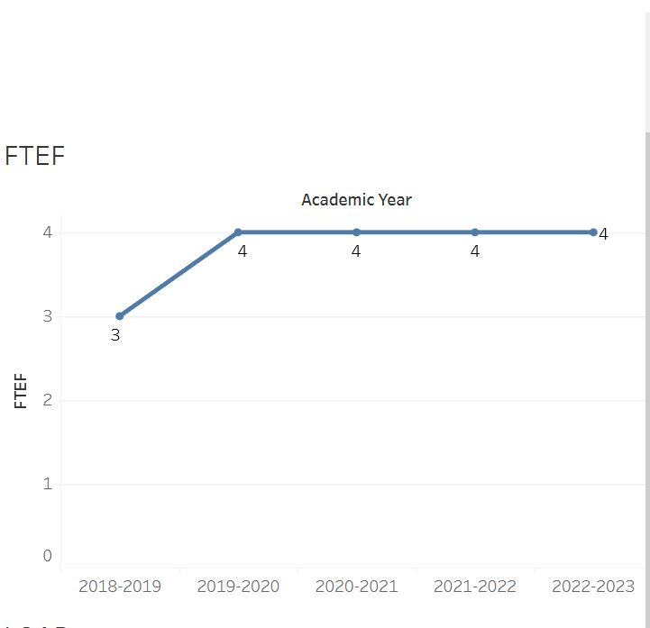
Program’s enrollment trends
Impressive Growth in enrollment: Almost 35% increase in enrollment rates since 2018
Notable Increase in Headcount: Impressive increase of almost 52% since 2018.

Slide 8

Continued Program Strategies
STRATEGIES Implemented and need ongoing implementation
-Flexible course scheduling
-Blend Instructional delivery and assessment methods.
-telehealth training
-virtual learning resources/
-simulation-based training

Slide 9






Clerkship Training and Partnership
Stanford -University Healthcare Alliance
Kaiser Permanente
Sutter Health
Bay Area Vascular
Peninsula Urology Center
Old Samaritan House
Concentra

Slide 10

To Aid Further Success
  To increase enrollment and student support -
  Latest equipment
  Curriculum expansion
  New hires( faculty and assistants)
  Technology Integration and additional software
  Increased professional development opportunities
  Student Support Services (tutoring, mentoring, and career counseling)
  Marketing and outreach

Slide 11
To aid Further success
  Immediate support –
    Course scheduling
      Increased flexibility to include evening and weekend classes
      Online and Hybrid Courses: to address remote learning needs,
      Accelerated Programs: shorter completion time
    Continued partnership and contracts with clerkship training sites.
    Additions to program: Phlebotomy and EKG Technician
    Develop bridge programs for adult school pathways for ESL students.
    Simulation lab and virtual learning devices

Slide 12
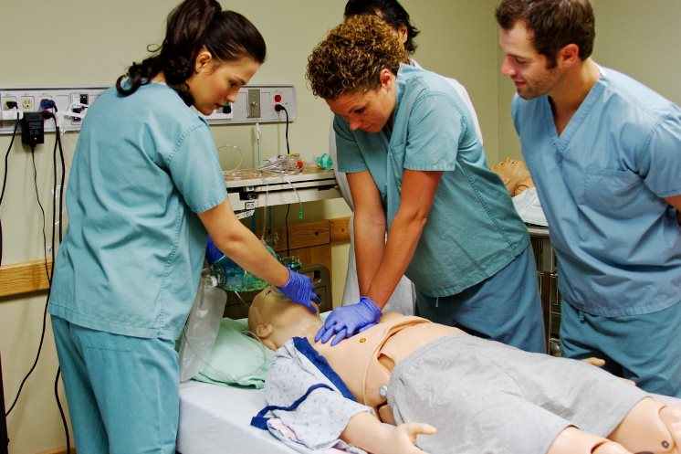
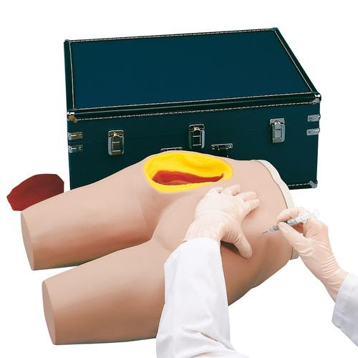
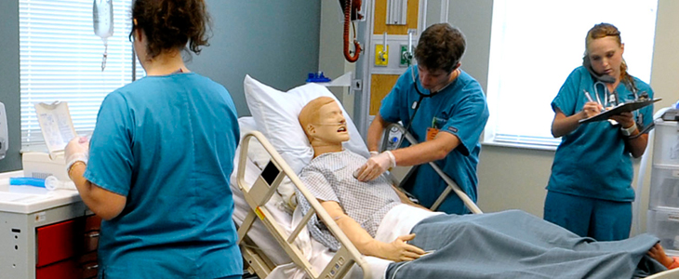
Simulation Lab

Slide 13


Questions

