Slide 1
Creating a Cohesive Process Anniqua Rana, Ellen Young, and Jacky Ip

Slide 2
The charge
The process
The guiding principles

Slide 3
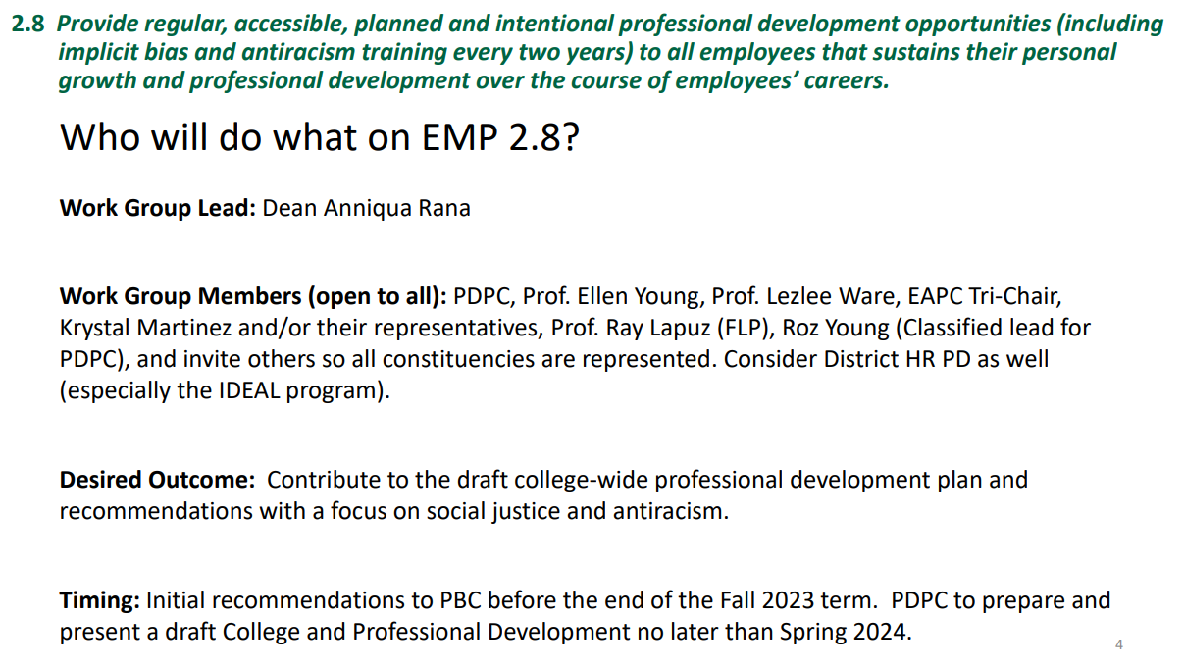
The charge

Slide 6
The process
Fall 2023
Identify Professional Development opportunities on campus
Identify gaps and respond to them in the plan
Create the plan outline to present to PBC
Spring 2024
Expand plan with details
Finalize plan
Submit to shared governance committees
Discussion:
Who else should be included?
Suggestions about process.

Slide 7
The Individual and the Team
Equity and Antiracism Planning Council
Classified
Cañada Tuition
Professional Development Conference
pda.training
Faculty
Administrators
Professional Development Conference
FTLP & FLP
QOTL, POCR, and ZTC
Professional Development Conference

Slide 8
Intersections
Staff
Administrators
Faculty
April/Oct Flex

Slide 9
The guiding principles
Increase individual and organizational capacity in alignment with the college’s dedication to social justice and racial equity in transforming lives.
Provide access to learning opportunities and resources for all employee groups.
Provide opportunity for all employees to be current and successful in their jobs.

Slide 10
non-linear, iterative process

Slide 11
Suggestions and Comments

