Slide 1
Radiologic Technology
March 2024

Slide 2
Radiologic Technology Program
Mission
The mission of the Radiologic Technology Program at Canada College is to provide a high-quality vocational education to members of our diverse community who seek a career in the Radiologic Technology profession.
The Radiologic Technology program enables students to develop the skills necessary for gainful employment through clinical training, fosters students’ academic success through lectures and laboratory exercises, and provides a professional labor pool to match the needs of our community.

Slide 3
Radiologic Technology Program Overview
1st class graduated in 1970
Accredited by:
  Joint Review Committee on Education in Radiologic Technology (JRCERT)
  California Department of Public Health, Radiation Health Branch (CDPH-RHB)
25 month cohort (7 weeks vacation)
  18 or 20 students accepted once a year
    Approximately 38 total (first and second year students)
  10 Affiliated Clinical Sites
  4 clinical rotations per students
  1850 hours of clinical experience.
Notes:
Rafael
This program came to Cañada College when it first opened graduating it’s first class in 1970.

Slide 4
Organizational Chart
Rafael Rivera
Full Time Program Coordinator/Faculty
Lezlee Inman
Full Time Clinical Coordinator/Faculty
Adjunct Clinical Coordinators
Shivani Buch
Jennifer O’Laughlin
Christine Langley
Krissy Bassett
16 Clinical Instructors
(Hospital Personnel)
Faculty
Martin Partlan
PART TIME FACULTY
Jennifer O’Laughlin
Sandy Frojelyn
Alejandra Valencia
Part-Time Office Assistant
Notes:
Rafeal - Part-time faculty teach one course per academic year
Pam - Clinical assignments based on adjuncts’ work schedule

Slide 5
Entrance Criteria
I.
High School Graduation
Transfer Level Math. Recommended MATH 200
Chemistry (CHEM 192 or CHEM 410)
Human Anatomy (BIOL 250)
Reading and Composition (English 100)
Human Physiology (BIOL 260)
Interpersonal Communication (COMM 130)
Applicants must be at least 18 yrs. Old.

Slide 6
Entrance Criteria
II. Essay
III. Two Letters of Recommendation.
IV. General Education Requirements
V. Volunteer Experience
VI. Basic First Aid and CPR
VII. GPA

Slide 7
Radiologic Technology Program Curriculum
Summer Intersession
RADT 400 Orientation to Radiologic Technology
Fall Semester
RADT 408 Perspectives in Radiology
PHYS 405 Applied Radiographic Physics
RADT 410 Radiographic Positioning
RADT 418 Clinical Education I
Spring Semester
RADT 415 Radiation Protection and Biology
RADT 420 Radiographic Positioning II
RADT 428 Clinical Education II
RADT 430 Principles of Radiographic Film Production
Summer Intersession
RADT 438 Clinical Education III
Notes:
Rafeal

Slide 8
Radiologic Technology Program Curriculum
Fall Semester
RADT 435 Imaging Equipment and Quality Control
RADT 438 Clinical Education III
RADT 440 Advanced Imaging Modalities and Specialize Procedures
RADT 441 Sectional Anatomy
Spring Semester
RADT 442 Radiographic Pathology
RADT 448 Clinical Education IV
RADT 450 Registry Review
RADT 458 Clinical Education V
RADT 474 Venipuncture for Contrast Media Administration
Summer Intersession
RADT 468 Clinical Education VI

Slide 9
Program Costs
Enrollment Fee: $46 per unit
  Non-Resident Tuition Fee: $307 plus $2 per unit capital outlay fee (PLUS $46 per unit Enrollment Fee)
Parking Permit: $58 per semester ($29 for summer)
Health Fee: $21 ($18 for summer)
Student Representation Fee: $2
Student Body Fee: $15
Books and Supplies: $1600, approx. 2-year cost (all radiology textbooks are used in several courses each semester throughout the program)

Slide 10
Program Costs
Enrollment Fee: $46 per unit*
  Non-Resident Tuition Fee: $307 plus $2 per unit capital outlay fee (PLUS $46 per unit Enrollment Fee)
Parking Permit: $58 per semester ($29 for summer)
Health Fee: $21 ($18 for summer)
Student Representation Fee: $2
Student Body Fee: $15
Books and Supplies: $1600, approx. 2-year cost (all radiology textbooks are used in several courses each semester throughout the program)
Notes:
*Students who reside in San Mateo County will have their enrollment fees waived for the Spring 2023 semester (except for International Students and Non-Resident or Out-of-State students as described below; but see exceptions for Undocumented students). There are no minimum or maximum units required. Depending on documented financial need, students may also be exempted for paying the student body fee, student representation fee, student union fee, inclusive access fee(s), and materials fees associated with the course*. If

Slide 11
Program Success
American Registry of Radiologic Technologists (ARRT) of 92.9% Pass Rate. Five year average
  Employment Rate of 96.8% (Twelve months after graduation). Five year average.
Completion Rate of 100% for 2022.
https://www.canadacollege.edu/radtech/index.php
Notes:
Pam - This position will help to ensure the continuation of the success of the program, such as: one hundred percent (100%) pass rate on the American Registry of Radiologic Technologist (ARRT) examination, ARRT currently has over 300,000 registrants; one hundred percent (100%) pass rate on the RHB Fluoroscopy examination, and a job placement rate six months after graduation of eighty-six point one eight percent (86.18%).
We have seen a decline in our attrition rate for the past couple of years. With the addition of this position, faculty could spend the needed time with students to provide them the support required for successful completion of the program.

Slide 12
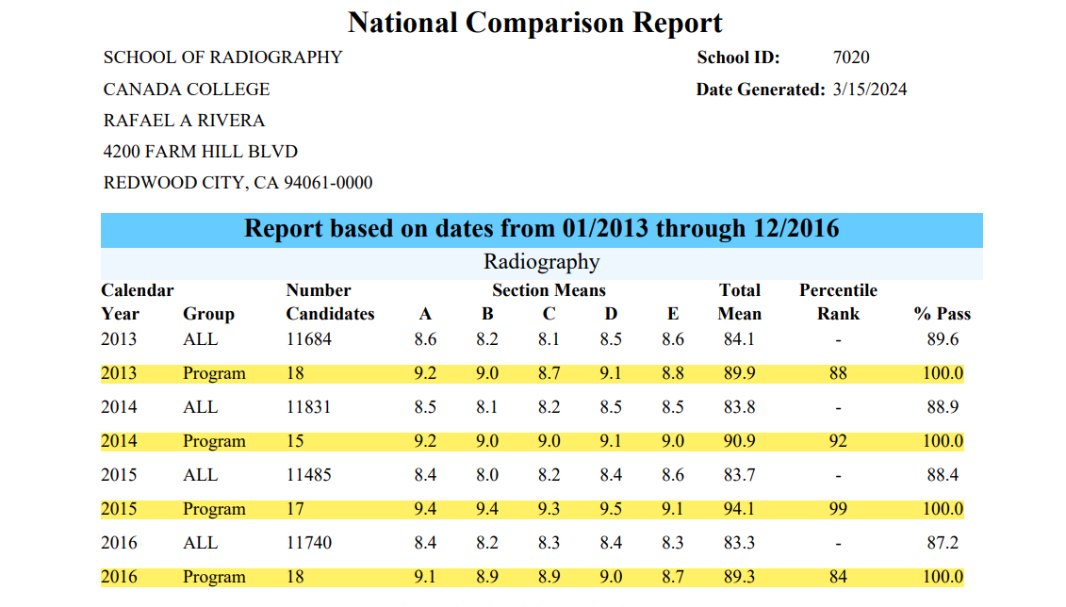
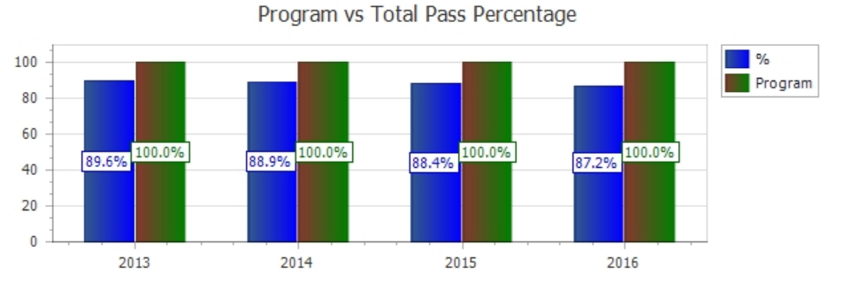

Slide 13
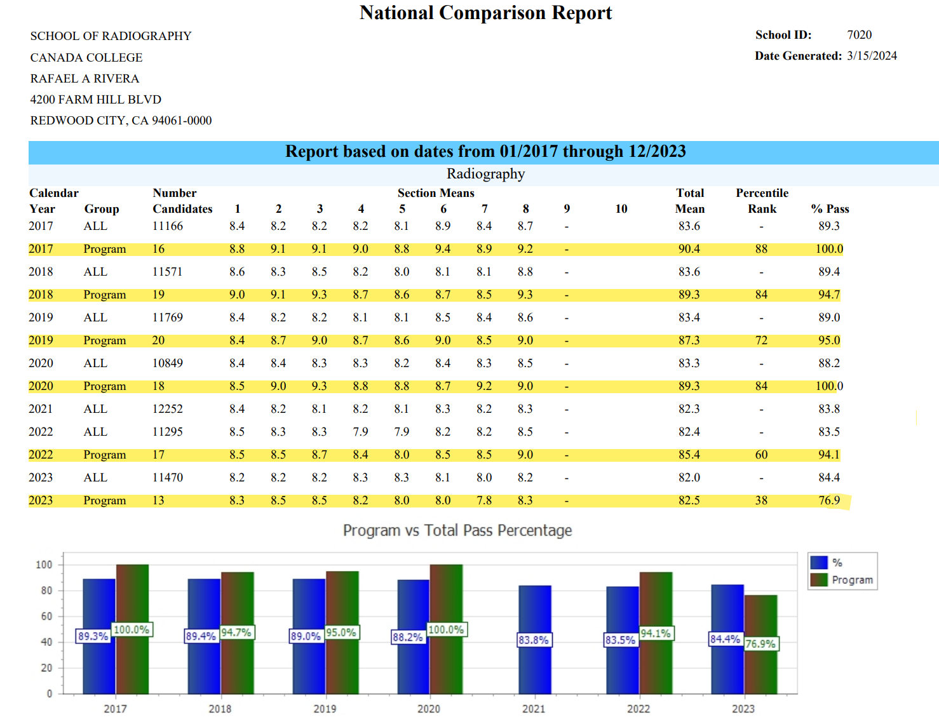

Slide 14
Radiologic Technology Program. Future
Building 23
  Take full advantage of new facilities
    New Digital Radiographic Unit (DR)
      Add new labs in radiation physics and image production
    New Digital Radiographic/Fluoroscopy Unit
    Expand our fluoroscopy offerings
      ARRT continuing Education
      PA fluoroscopy classes.

Slide 15
Radiologic Technology Program
Questions?

