Slide 1
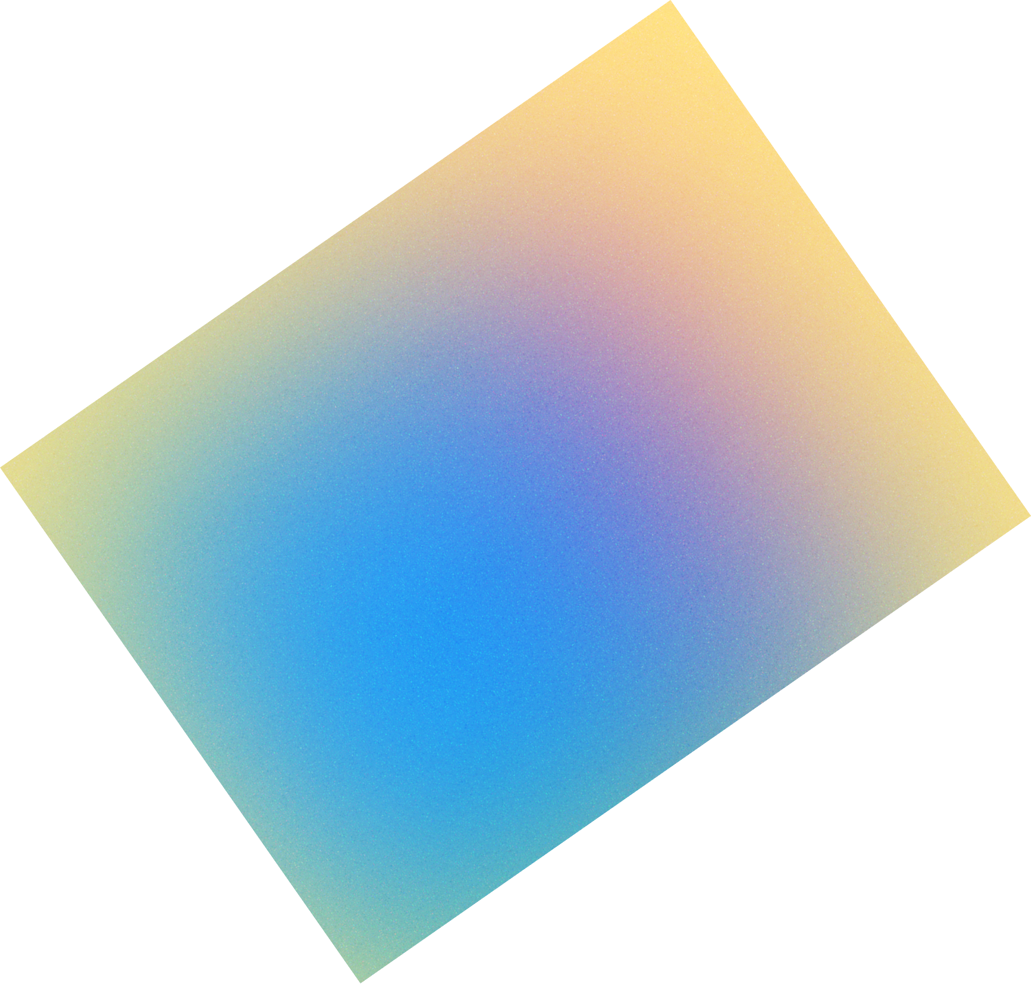
Digital Art &
Animation

Slide 2
Program Review
Where we were
Part 1
Digital Art & Animation Mission
04
March 21, 2025
History
05
Where we are
Part 2
Enrollment trends
07
One program, Three paths
17
Where we’re going
Part 3
Menlo Studio
55
Bachelor of Science in Interaction Design B.S. in IxD
58
Q&A
Part 4
2

Slide 3
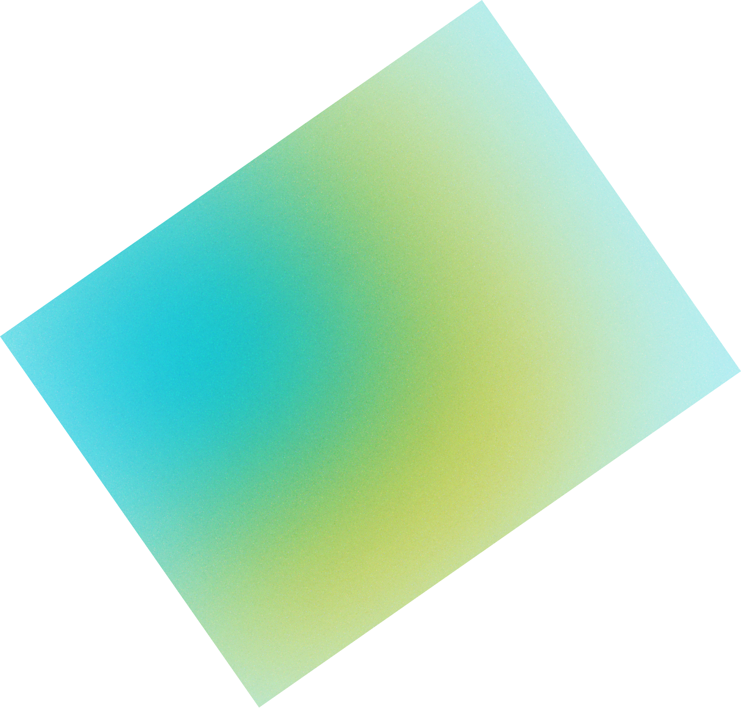
DA&A Program
3

Slide 4

DA&A Program
Mission
The Digital Art & Animation Program at Cañada College provides students with top-tier industry expert faculty and curriculum. We empower them to transform their lives and communities through access to living wage jobs in highly technical fields unique to our diverse Bay Area.
3

Slide 5
Industry Expert Faculty
The key to training students for jobs in emerging fields is having faculty who have worked in industry and continue to maintain industry relevance and credentials.
4

Slide 6
3D Design & Animation
Interaction Design & Games
Graphic Design & Photography
Paul Naas
Hyla Lacefield
Emanuela Quaglia
Paul Naas was the coordinator
of the Digital Art & Animation
Program for almost a decade
and a half.
His leadership made this program one of the most
prestigious in the West Coast. We regularly point out we compete with Academy of Art, not other community colleges.
Hyla Lacefield left the program January 1, 2020, just in time for the COVID pandemic to hit.
After 4 1/2 years as Dean of Business, Design, & Workforce, she gratefully returned to being faculty, and took over as coordinator in Fall of 2024.
Emanuela Quaglia is about to start her final year of tenure. She has been a great mentor to her students and has brought her instructional design skills to the department along with her photography and graphic design skills.
5

Slide 7
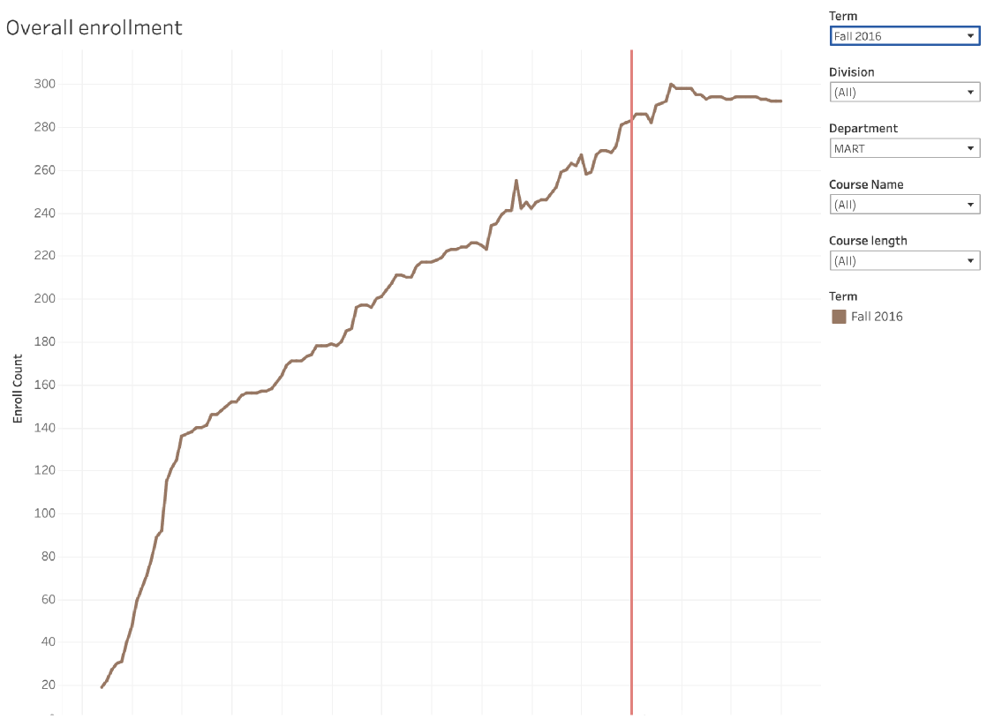

Slide 8
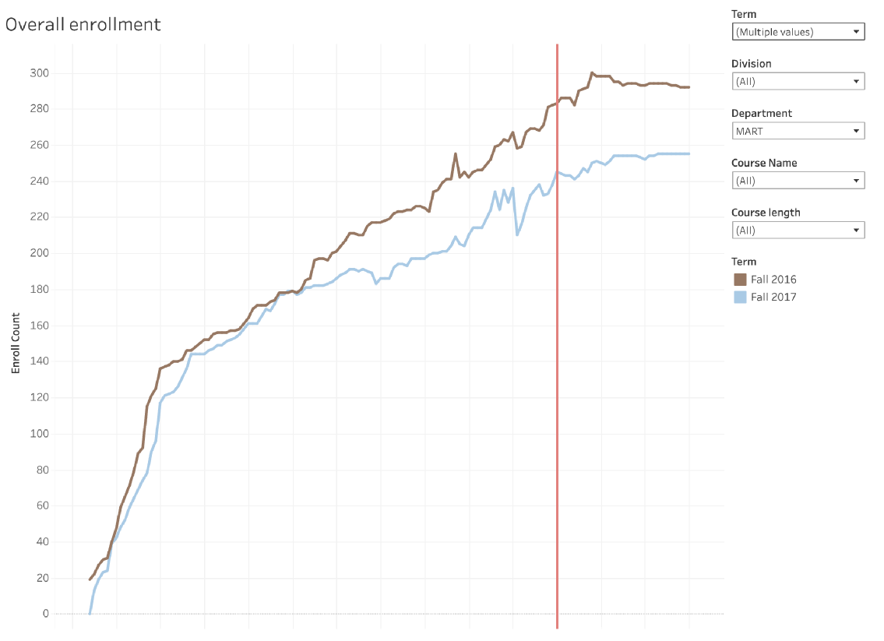

Slide 9
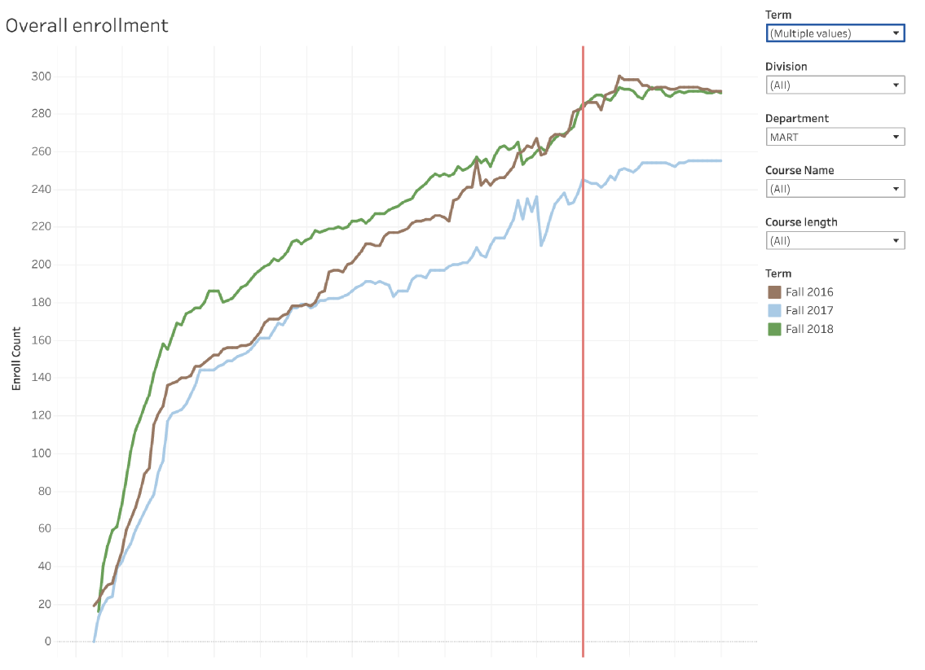

Slide 10
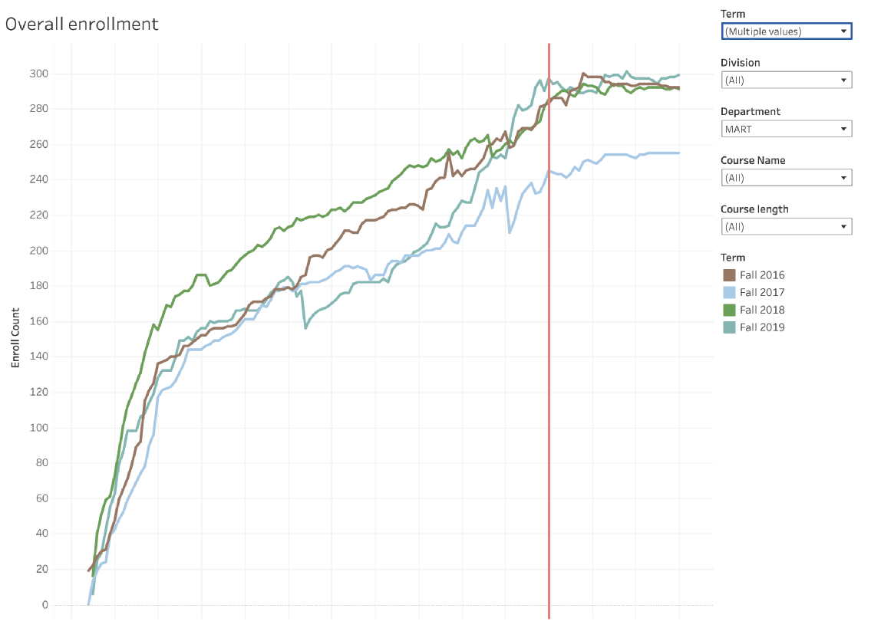

Slide 11
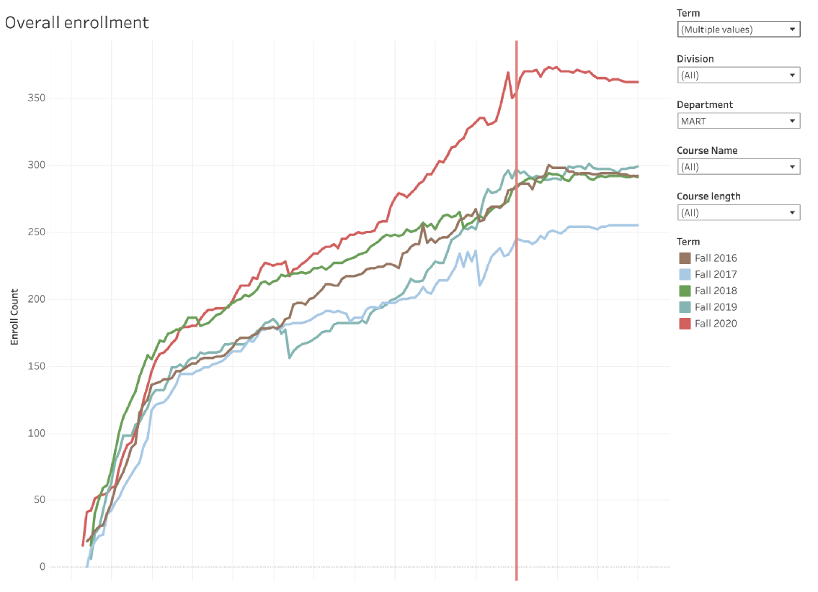

Slide 12
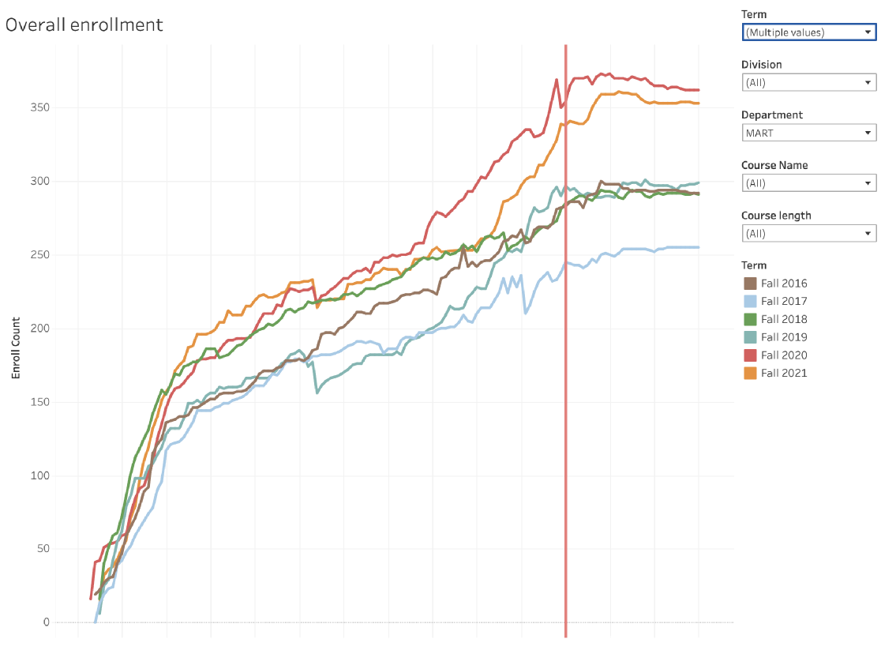

Slide 13
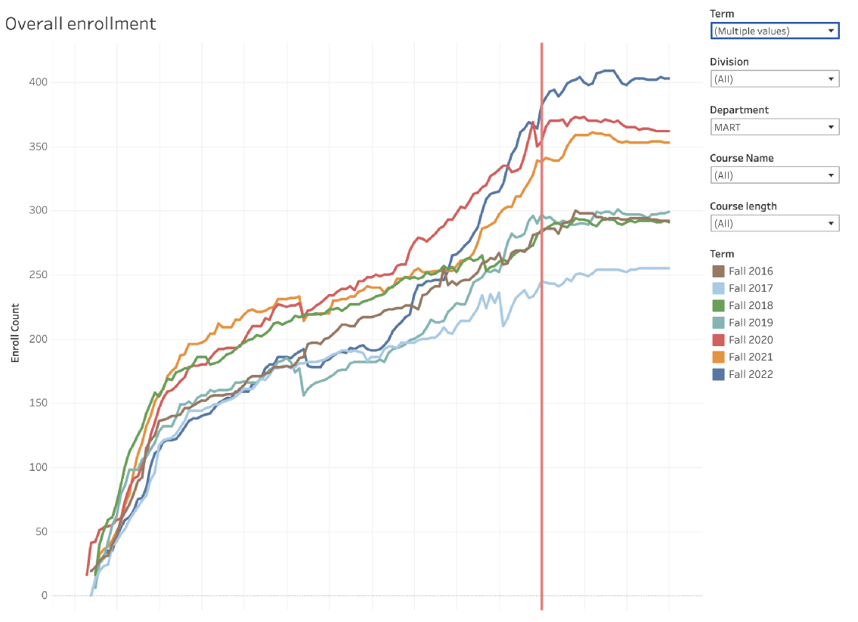

Slide 14
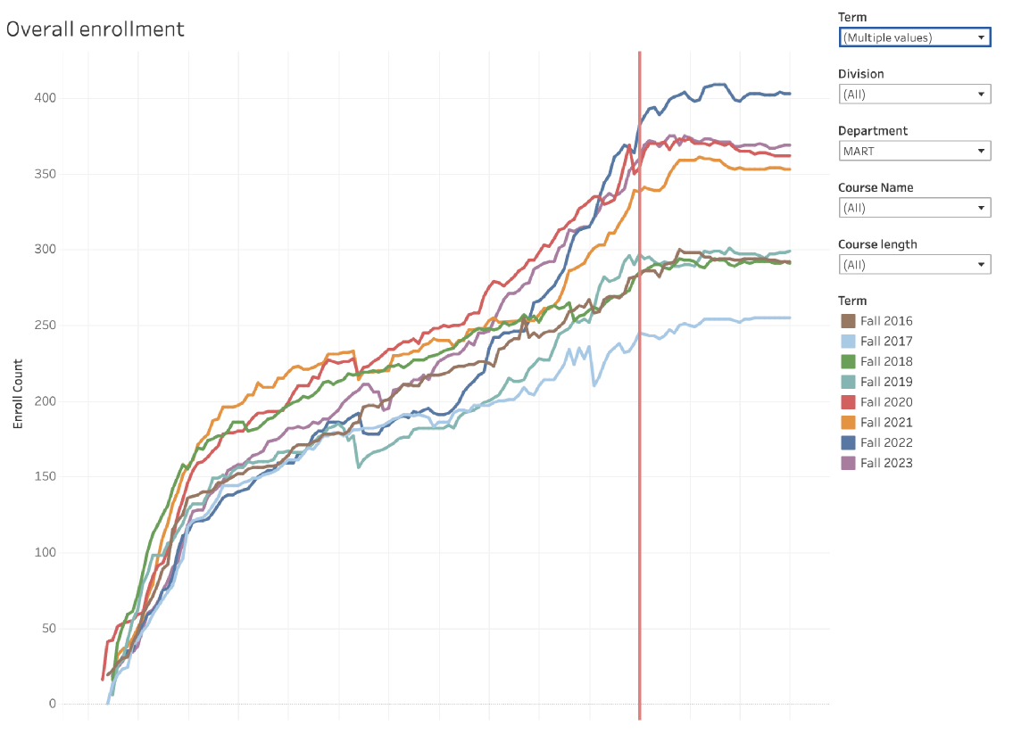

Slide 15
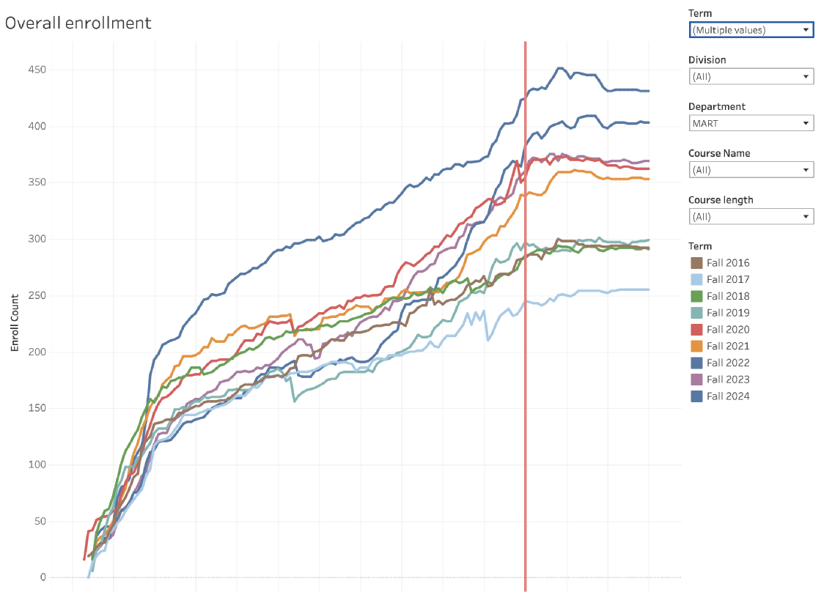

Slide 16
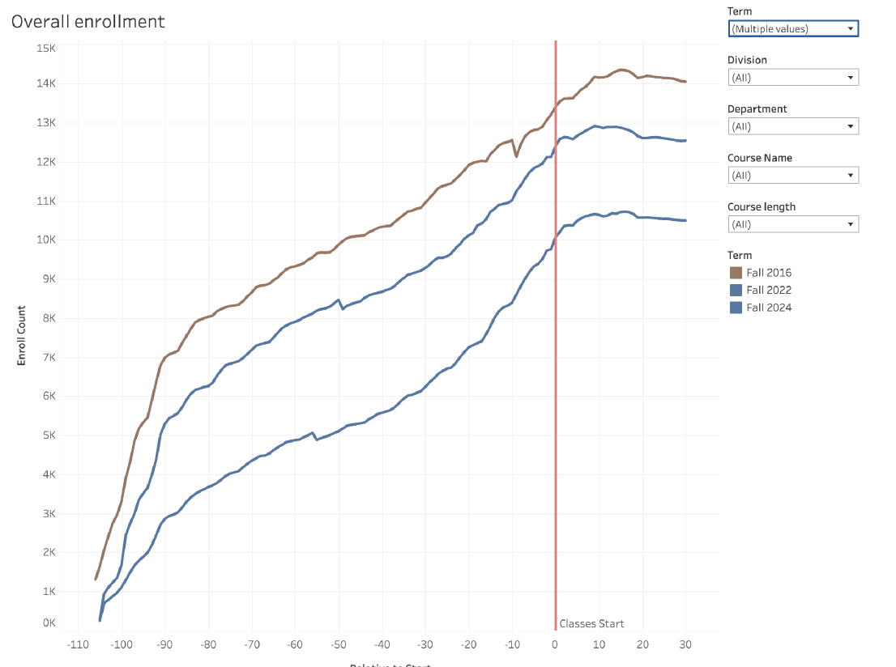

Slide 17

Three Paths
Digital Art & Animation is such a broad program, it is comparable to having a ‘Languages’ program covering everything from Spanish and Latin to C# and Java.
Disproportionate access compared to the college as a whole:
Female students -16%
Non-disabled students -7%
Less than part time -21%
6

Slide 18
Three Paths
Graphic Design & Photography
6

Slide 19
Three Paths
Graphic Design & Photography
FOUNDATION
6

Slide 20
Three Paths
3D Character Design & Animation
Graphic Design & Photography
FOUNDATION
6

Slide 21

Three Paths
3D Character Design & Animation
PROGRESSION
Graphic Design & Photography
FOUNDATION
6

Slide 22

Three Paths
Interaction Design & Games
3D Character Design & Animation
PROGRESSION
Graphic Design & Photography
FOUNDATION
6

Slide 23

Three Paths
Interaction Design & Games
INTEGRATION
3D Character Design & Animation
PROGRESSION
Graphic Design & Photography
FOUNDATION
6

Slide 24

Three Paths
Interaction Design & Games
INTEGRATION
3D Character Design & Animation
PROGRESSION
Graphic Design & Photography
FOUNDATION
6

Slide 25

Three Paths
3D Character Design & Animation
Graphic Design & Photography
PROGRESSION
FOUNDATION
6

Slide 26

Three Paths
Reviews / Mobile Strategy
Product review — Month XX
Mobile Strategy
6

Slide 27
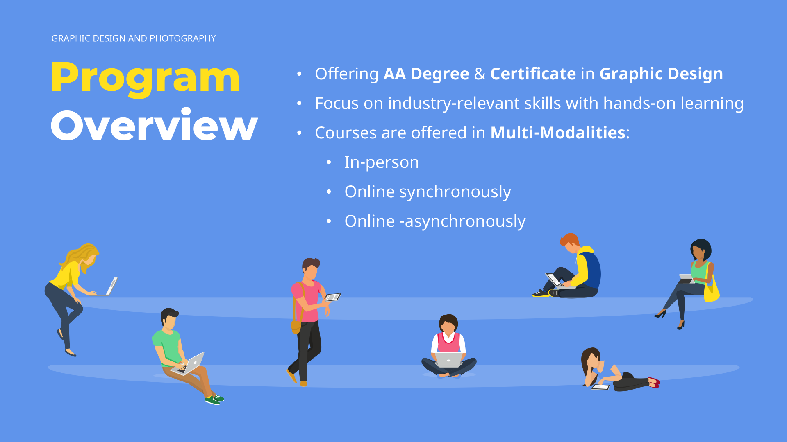

Slide 28
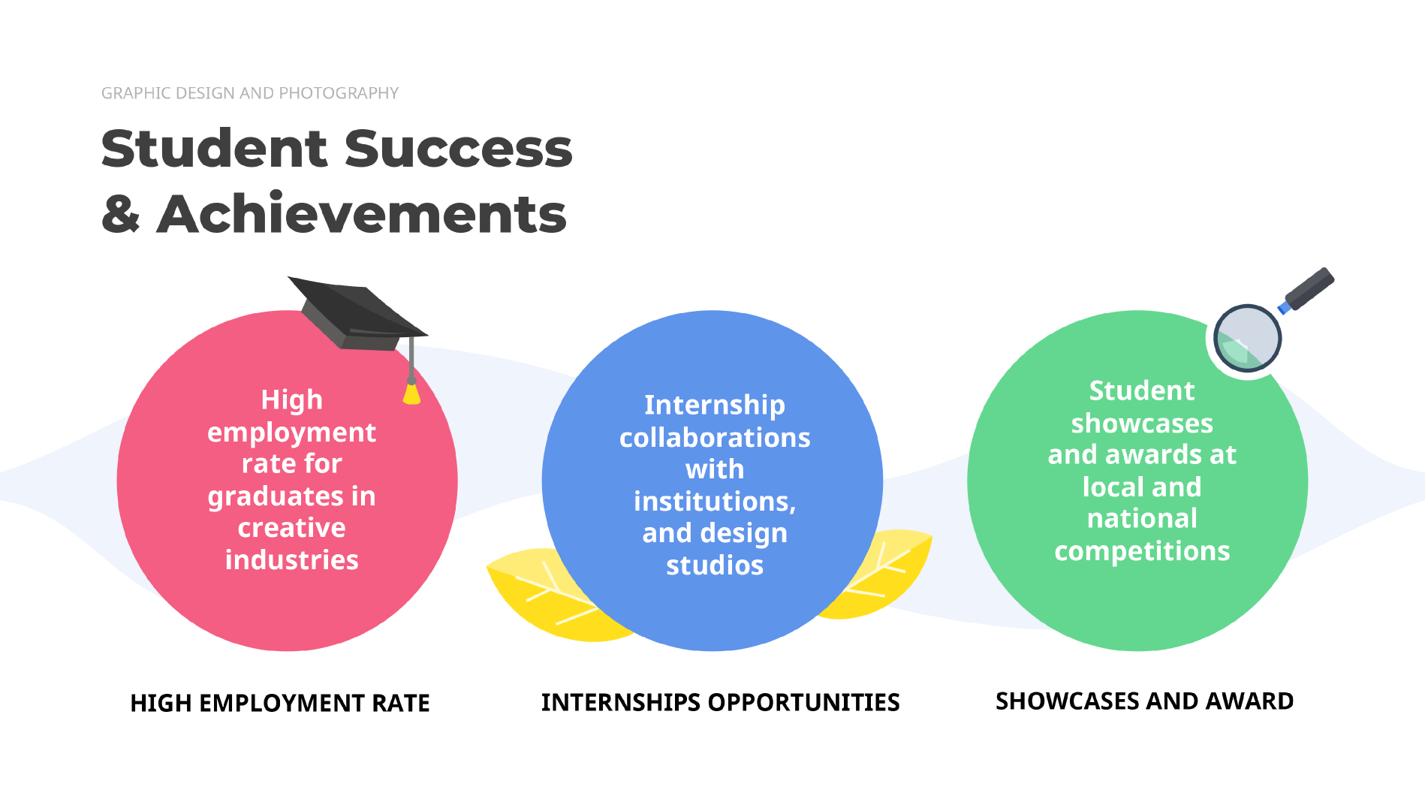

Slide 29


Slide 30
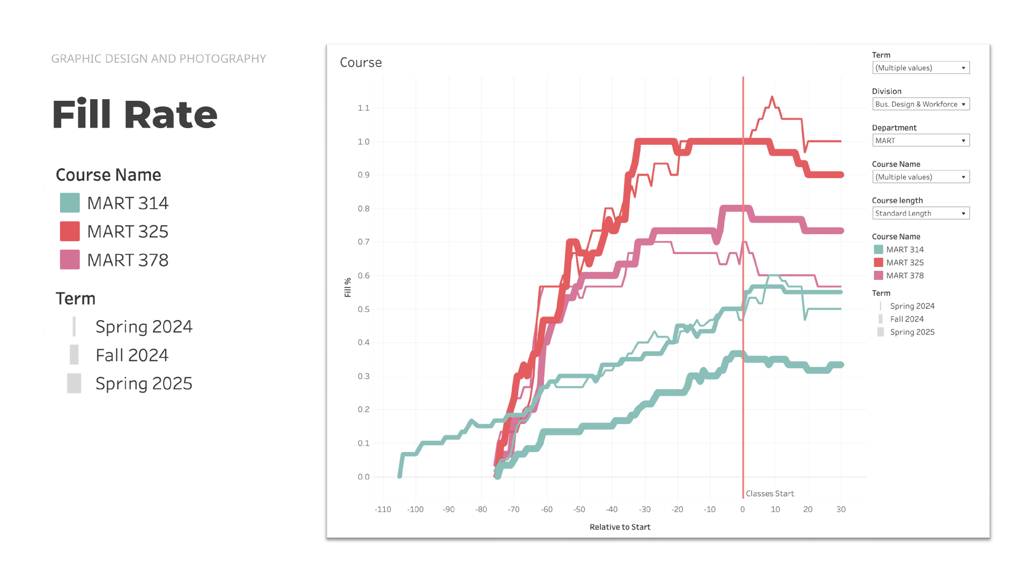

Slide 31
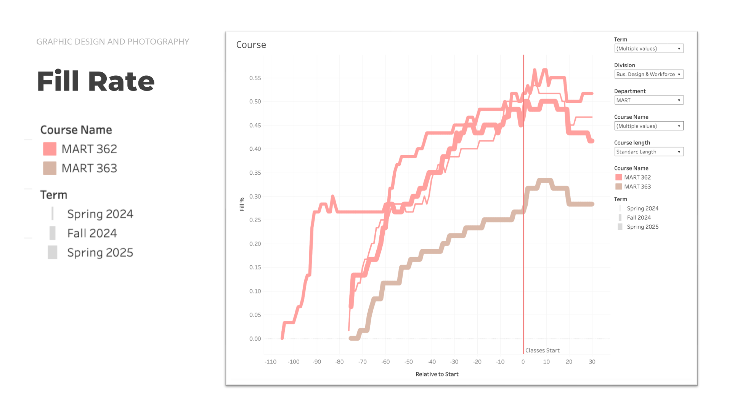

Slide 32
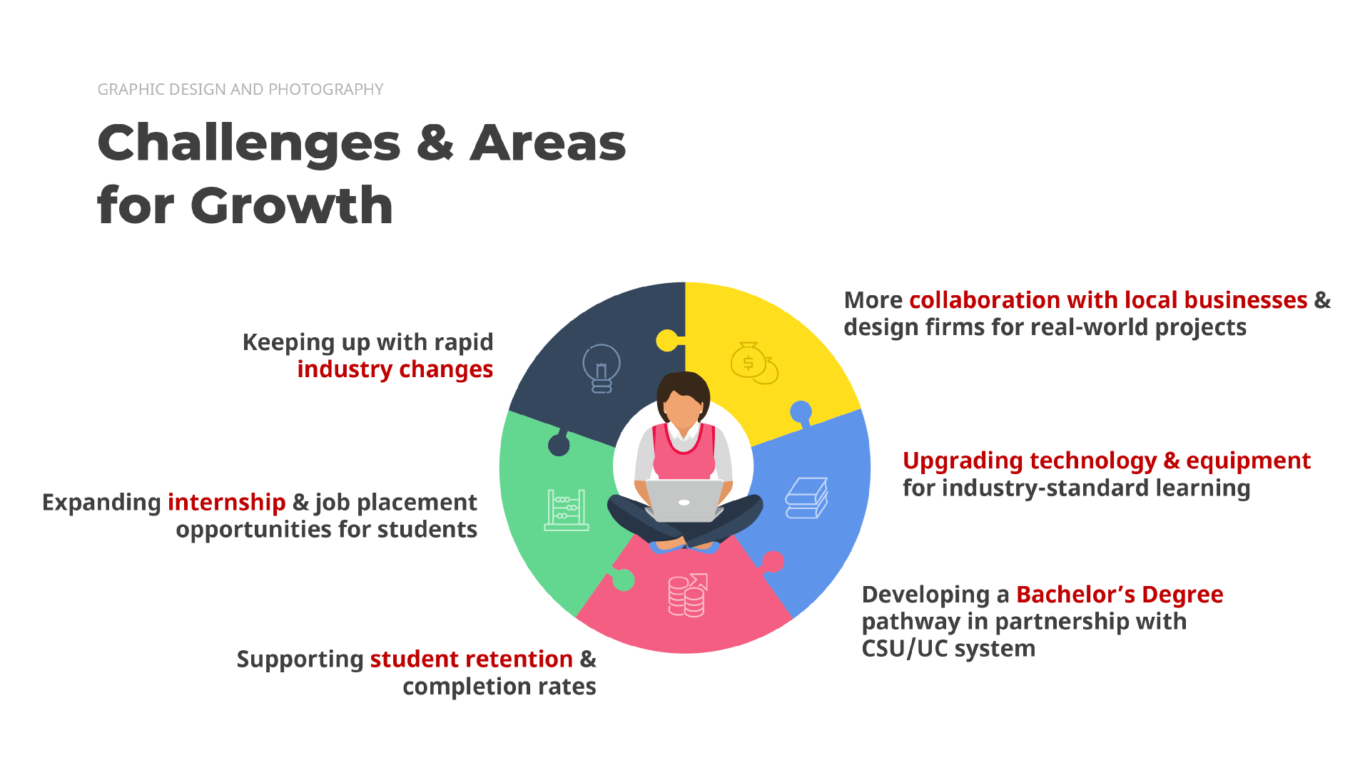

Slide 33
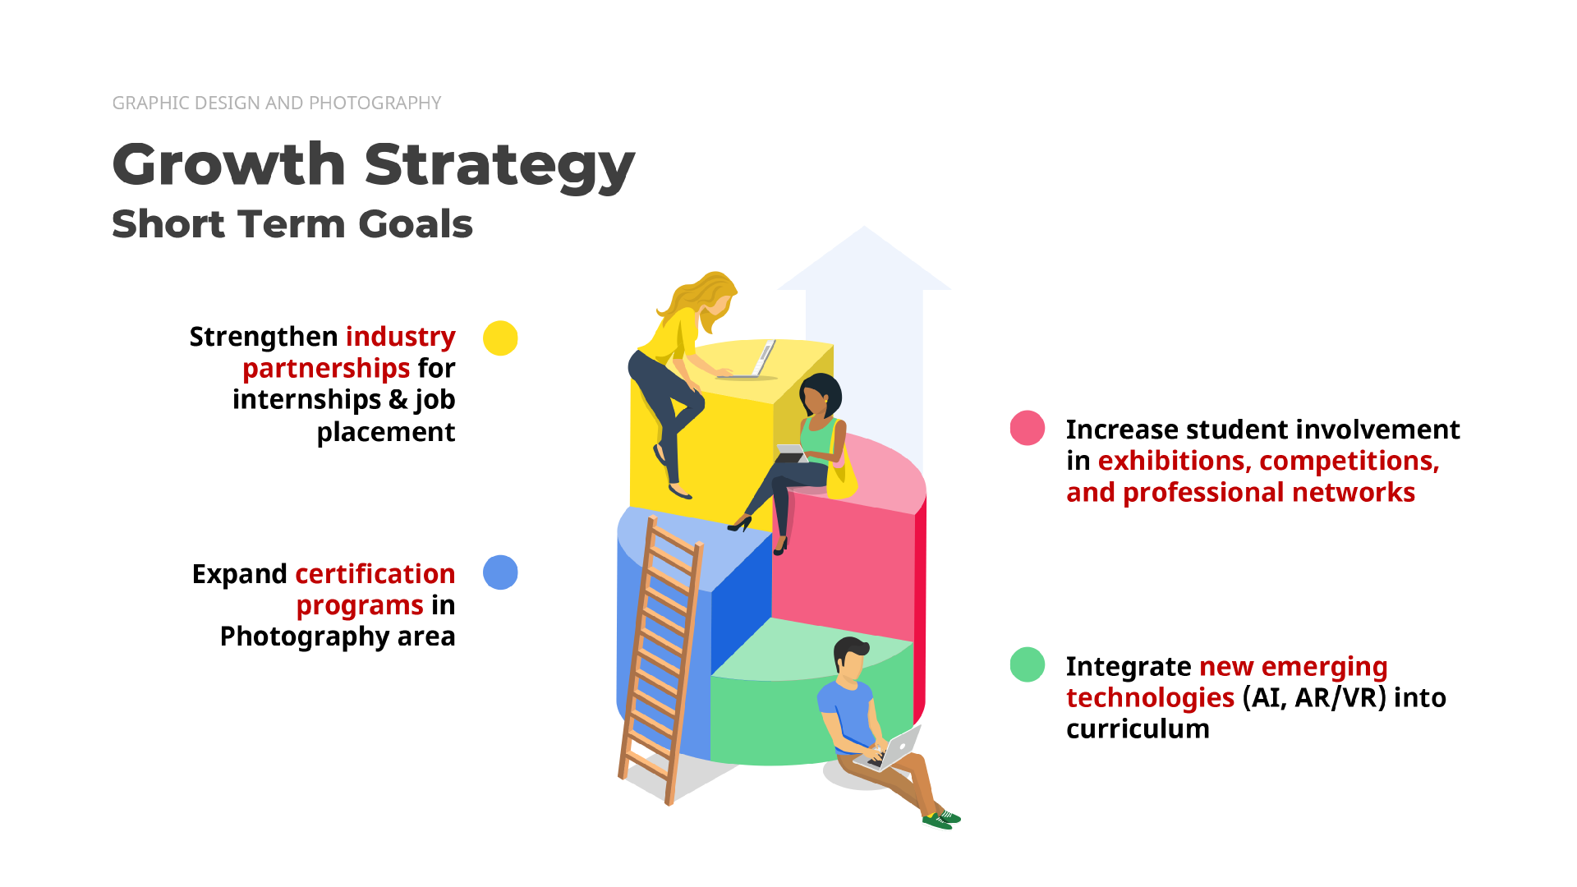

Slide 34


Slide 35

Three Paths
Interaction Design & Games
INTEGRATION
3D Character Design & Animation
PROGRESSION
Graphic Design & Photography
FOUNDATION
6

Slide 36

Three Paths
Interaction Design & Games
INTEGRATION
3D Character Design & Animation
PROGRESSION
Graphic Design & Photography
FOUNDATION
6

Slide 37
3D Character Design & Animation
PROGRESSION
6

Slide 38






6

Slide 39




Slide 40















Slide 41





Slide 42
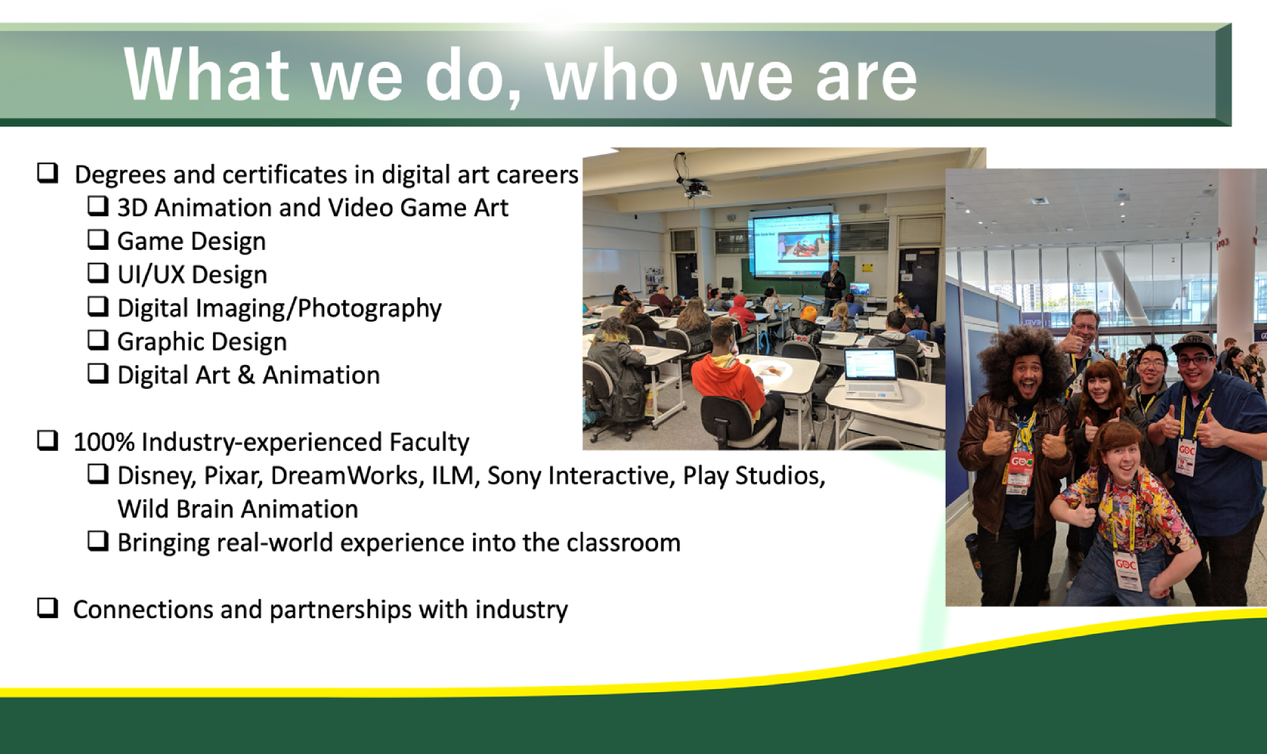

Slide 43


Slide 44
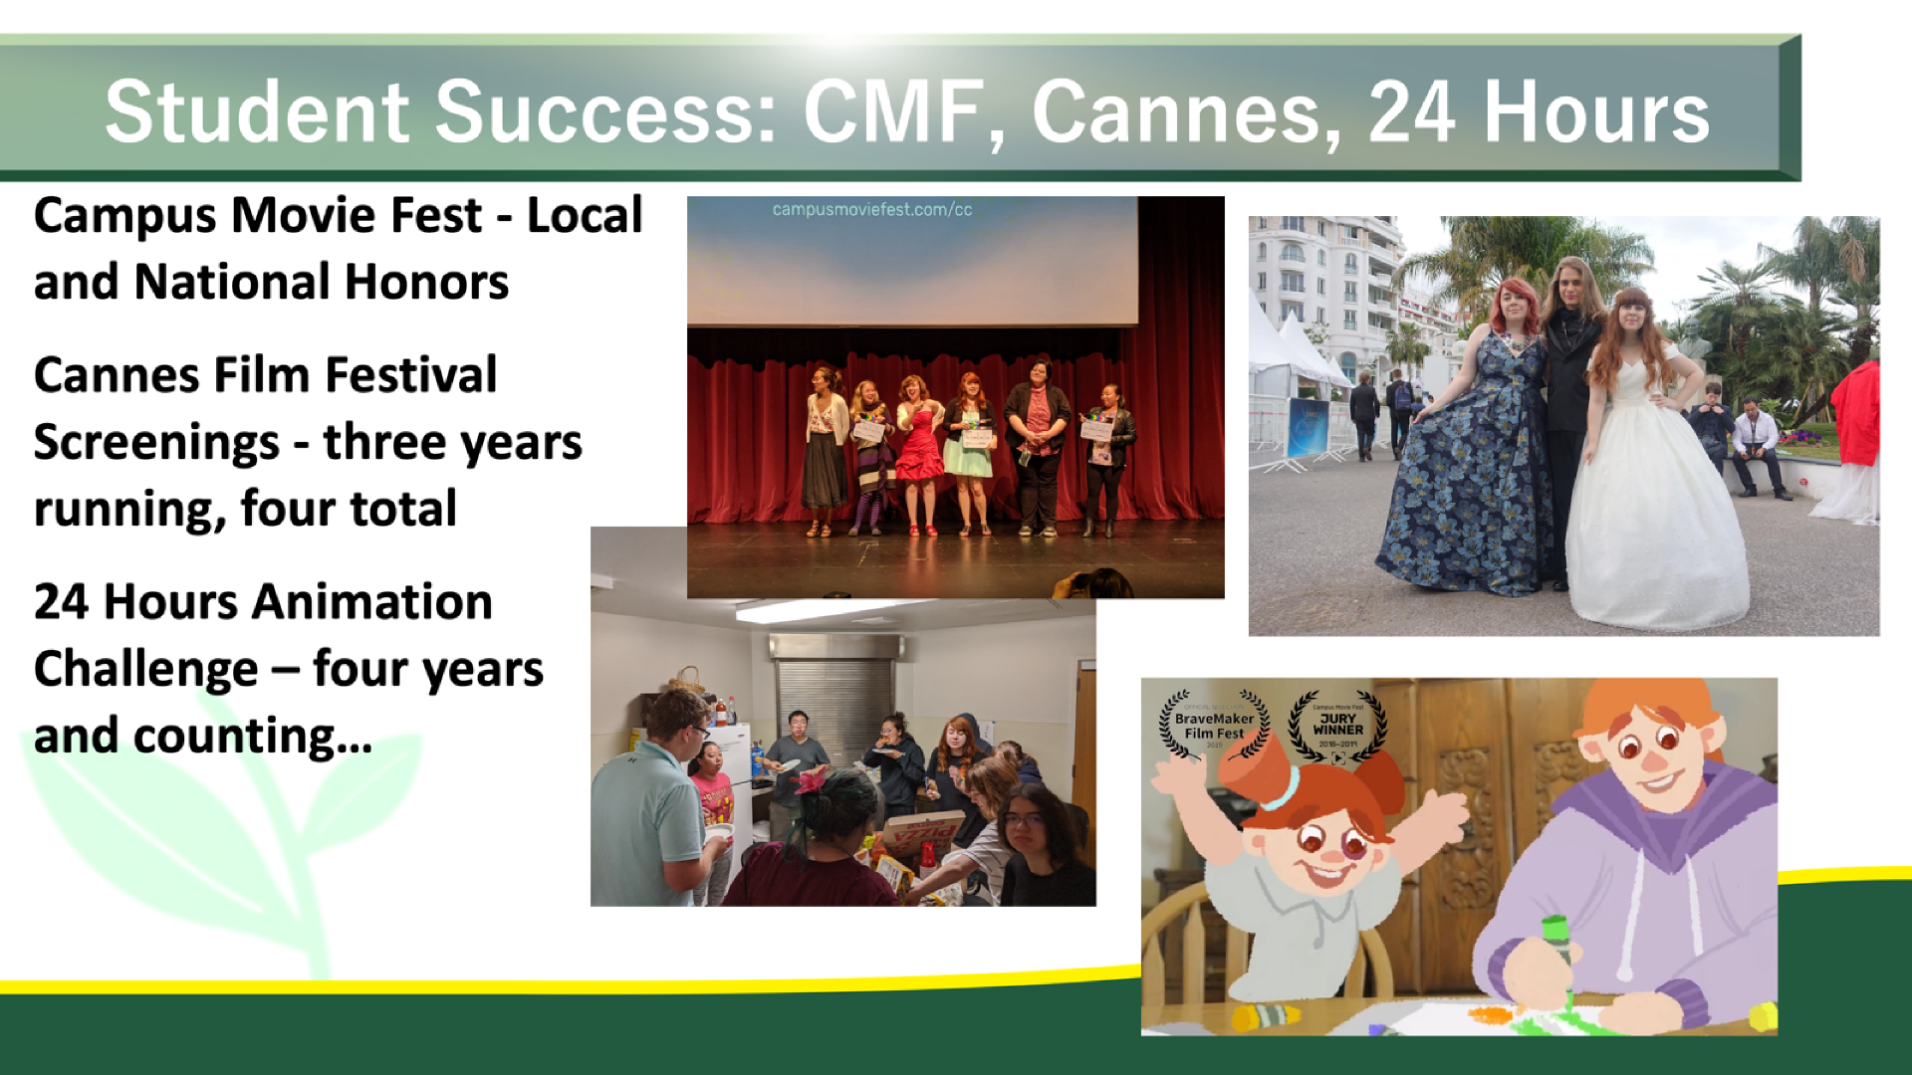

Slide 45

Three Paths
Interaction Design & Games
INTEGRATION
3D Character Design & Animation
PROGRESSION
Graphic Design & Photography
FOUNDATION
6

Slide 46
Three Paths
Interaction Design & Games
INTEGRATION
3D Character Design & Animation
PROGRESSION
Graphic Design & Photography
FOUNDATION
6

Slide 47

Three Paths
Interaction Design & Games
INTEGRATION
6

Slide 48
19

Slide 49
Strengthening the connection between industry and Community College students, Cañada offers classes that directly address the 4Cs of Jobs of the Future:
Creativity
Critical Thinking
Communication
Connection
19

Slide 50
Video Game Design
Working closely with high school
and external partners, we intend
to leverage our entirely online
Video Game Design offerings by
competing directly with for-profit art schools such as Academy of Art.
Strengthening the connection between industry and Community College students, Cañada offers classes that directly address the 4Cs of Jobs of the Future:
Creativity
Critical Thinking
Communication
Connection
19

Slide 51
Video Game Design
Menlo Studio
Apprenticeship
Working closely with high school
and external partners, we intend
to leverage our entirely online
Video Game Design offerings by
competing directly with for-profit art schools such as Academy of Art.
Since its inception in
2019, over 100 students have
benefitted from work-based
learning opportunities through
Menlo Studio.
Students have gone on to
work in FT jobs in their area,
some at this very institution,
as well as being hired into
animation studios and even
starting their own studio!
XR Apprenticeship
has benefitted greatly
from a presence at
industry conferences
such as AWE and GDC.
Strengthening the connection between industry and Community College students, Cañada offers classes that directly address the 4Cs of Jobs of the Future:
Creativity
Critical Thinking
Communication
Connection
19

Slide 52
Interaction Design Bachelors
Video Game Design
Menlo Studio
Apprenticeship
Working closely with high school
and external partners, we intend
to leverage our entirely online
Video Game Design offerings by
competing directly with for-profit art schools such as Academy of Art.
Since its inception in
2019, over 100 students have
benefitted from work-based
learning opportunities through
Menlo Studio.
Students have gone on to
work in FT jobs in their area,
some at this very institution,
as well as being hired into
animation studios and even
starting their own studio!
XR Apprenticeship
has benefitted greatly
from a presence at
industry conferences
such as AWE and GDC.
Application for permission to offer Bachelor’s
of Science in Interaction Design based on the one currently successfully being offered at Santa Monica College - August 2025
Strengthening the connection between industry and Community College students, Cañada offers classes that directly address the 4Cs of Jobs of the Future:
Creativity
Critical Thinking
Communication
Connection
19

Slide 53
Interaction Design Bachelors
Video Game Design
Menlo Studio
Apprenticeship
Working closely with high school
and external partners, we intend
to leverage our entirely online
Video Game Design offerings by
competing directly with for-profit art schools such as Academy of Art.
Since its inception in
2019, over 100 students have
benefitted from work-based
learning opportunities through
Menlo Studio.
Students have gone on to
work in FT jobs in their area,
some at this very institution,
as well as being hired into
animation studios and even
starting their own studio!
XR Apprenticeship
has benefitted greatly
from a presence at
industry conferences
such as AWE and GDC.
Application for permission to offer Bachelor’s
of Science in Interaction Design based on the one currently successfully being offered at Santa Monica College - August 2025
Digital Center
Strengthening the connection between industry and Community College students, Cañada offers classes that directly address the 4Cs of Jobs of the Future:
Creativity
Critical Thinking
Communication
Connection
The Digital Art &
Animation program is
actively working to develop the SMCCCD
Digital Center.
19

Slide 54
Interaction Design Bachelors
Video Game Design
Menlo Studio
Apprenticeship
Working closely with high school
and external partners, we intend
to leverage our entirely online
Video Game Design offerings by
competing directly with for-profit art schools such as Academy of Art.
Since its inception in
2019, over 100 students have
benefitted from work-based
learning opportunities through
Menlo Studio.
Students have gone on to
work in FT jobs in their area,
some at this very institution,
as well as being hired into
animation studios and even
starting their own studio!
XR Apprenticeship
has benefitted greatly
from a presence at
industry conferences
such as AWE and GDC.
Application for permission to offer Bachelor’s
of Science in Interaction Design based on the one currently successfully being offered at Santa Monica College - August 2025
Digital Center
Strengthening the connection between industry and Community College students, Cañada offers classes that directly address the 4Cs of Jobs of the Future:
Creativity
Critical Thinking
Communication
Connection
The Digital Art &
Animation program is
actively working to develop the SMCCCD
Digital Center.
What comes next?
Our program will continue to work to train our students for living-wage and thriving-wage jobs here in the Bay Area and elsewhere. Our students are already becoming leaders in industry in animation, game design, and elsewhere.
19

Slide 55
Menlo Studio
Menlo Studio has been a fantastically successful work-based learning initiative
helping students succeed by giving them
real experience in design fields while providing opportunities for portfolio growth and helping to keep them centered on campus life, limiting the necessity of working off-campus in an often unrelated field.
Reviews / Mobile Strategy
Product review — Month XX
Research insights
7

Slide 56

Creating immersive content for education is just the tip of the iceberg!
Besides creating VR and AR experiences, students are also creating apps that will be immediately useful to our campus and others.
Our goal is to provide our students an incubator on par with private for-profit universities.
8

Slide 57

DA&A for the future
11

Slide 58
Application to offer
Bachelor of Science in
Interaction Design IxD
The first stage is to get approved to be able
to offer a Bachelor of Science in Interaction Design IxD based on the current IxD Bachelor’s being offered at Santa Monica College.
Then there will be some curricular adjustments to
separate classes in the program into ‘lower’ and ‘upper’ division classes. The addition of 2 new upper level GEs will be required. Other existing classes will need to be brought into alignment with the program currently being offered at SMC, as we would need to mirror their program to be able to use the streamlined path.
We would start with a cohort of 30 the following Fall semester, assuming everything else falls into place.
Reviews / Mobile Strategy
Product review — Month XX
Concept 1
13

Slide 59
Curriculum Work
In Fall of 2025 we will be up for our 2-year curriculum review. This will provide us opportunity to update:
Refine Curriculum to be More Relevant
Create Stackable Certificates Leading to Degrees
Apply to offer Cañada’s First Bachelor of Science in Interaction Design
Many of our classes are highly
specific, but could be broadened to make them more useful and accessible to students.
Example: MART 455
Indie Game Development and Entrepreneurship
Due to high unit degrees, some students may have difficulty completing the full AA.
Stackable certificates allow students to specialize while still attaining certificates that lead to a degree.
Based on the Bachelor of Science
in Interaction Design (IxD) currently being offered at Santa Monica College, we are hoping to leverage existing classes with minimal curricular additions.
Reviews / Mobile Strategy
Product review — Month XX
Concept 1
14

Slide 60
The Digital Center
The State Chancellor is aggressively pursuing opportunities to expand the innovation and technology of California Community Colleges.
With Cañada’s Digital Art & Animation program leading the way,
San Mateo County Community College District has become one of the Founding Partners of the Digital Center initiative.
Due to our location in the Silicon Valley, our close relationship to major employers such as Google, Apple, and META, and the top-tier training we offer our students, it is natural for us to be leaders in helping advance technological innovation through the California Community College System.
Reviews / Mobile Strategy
Product review — Month XX
How we’ll win
9

Slide 61
Elements of the Digital Center
Menlo Studio
OER/ZTC
As we work closely with our colleagues across the district, we are helping to realize the vision of what the Digital Center can mean for our region and the state.
The SMCCCD Digital Center hopes to offer three distinct but interrelated areas.
Collaborating across the
state with faculty to create
OER/ZTC materials in needed areas.
paid work-based
learning opportunities
for students to create
immersive educational
experiences that will be made available to California Community Colleges for free via LibreNet platforms.
Technology Training
Helping CCC Faculty and
staff across the state have
access to the best in
classroom technology
training and innovation.
10

Slide 62

Q&A
20

