Slide 1
REDWOOD CITY, CA
Fashion Design & Merchandising
3/21/2025 Program Review by Jaleh Naasz

Slide 2
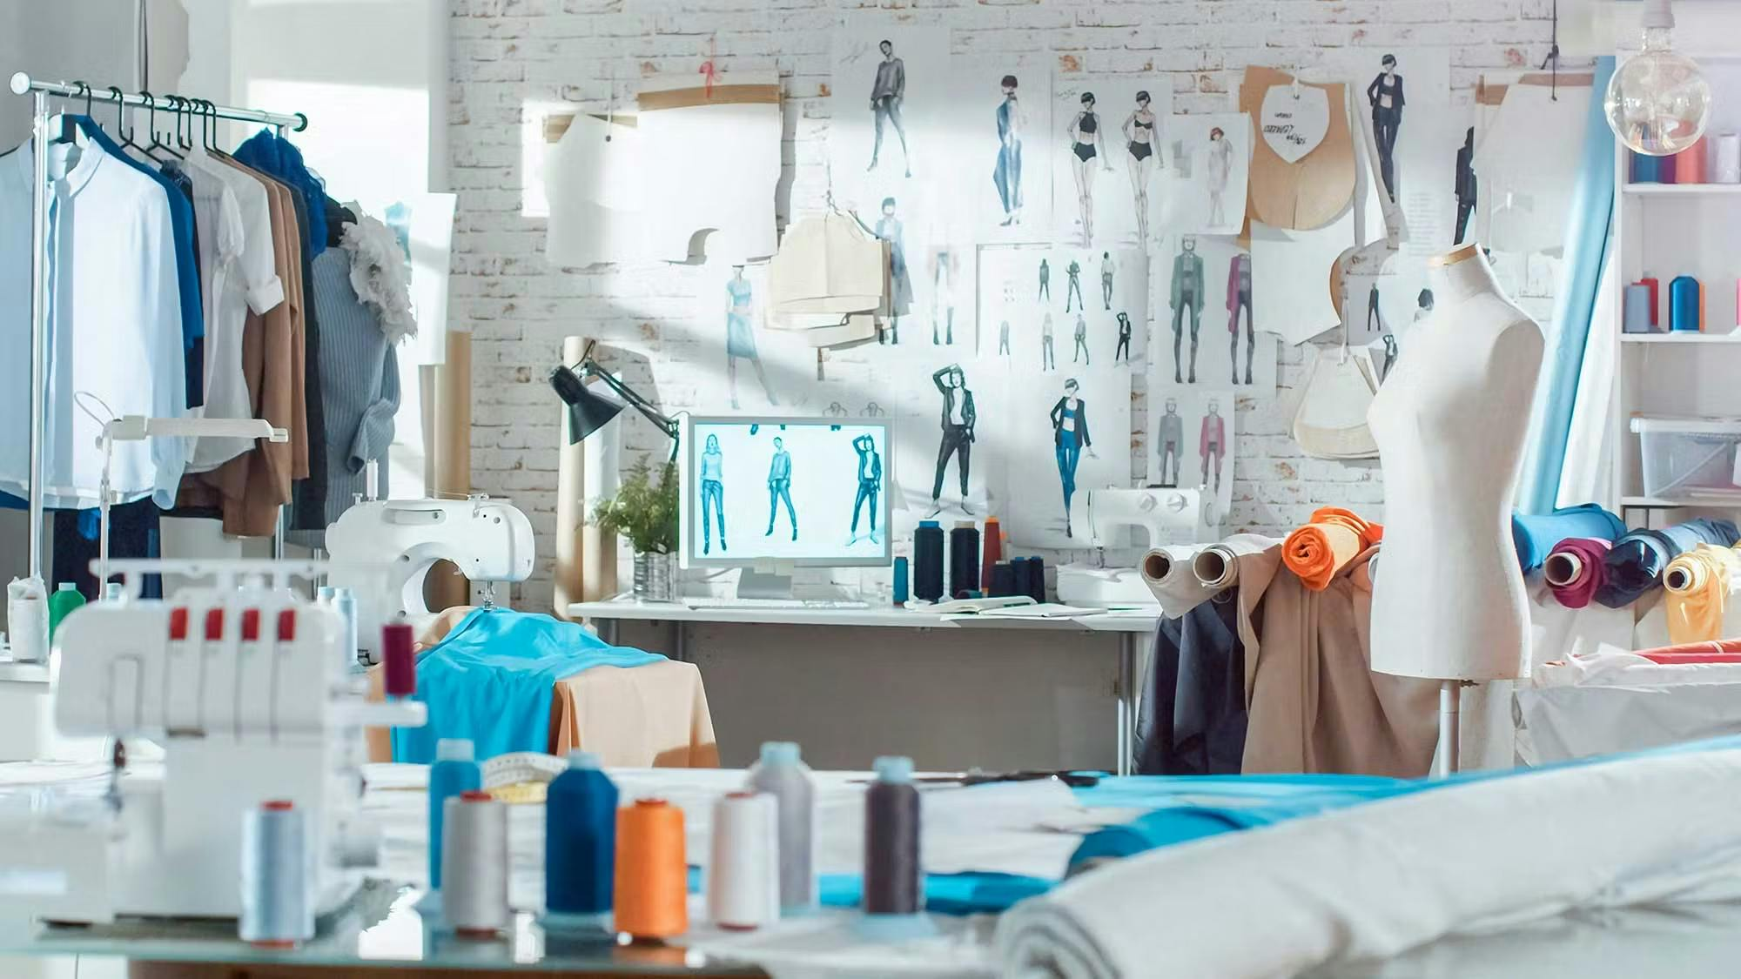
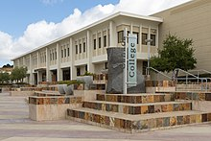
Mission
Fashion Design & Merchandising
Provide career technical training related to current trends and technologies in the fashion industry.
Instruct basic fashion related skills for those interested in the field.
Support perspective transfer students for the California State University system or other four-year public or private institutions by providing lower division and elective coursework.
Encourage and foster lifelong learners by offering a wide range of courses.
Recruit and serve a diverse student population.
College Goals
Student Access, Success and Completion: Fashion lab, instructional aides, varied modalities, upgrading machines
Equity-Minded and Antiracist College Culture: Opportunity for growth
Community Connections: DE, Social media presence, Updated avd. Board, upcoming fashion event
Accessible Infrastructure and Innovation : Improvement necessary

Slide 3
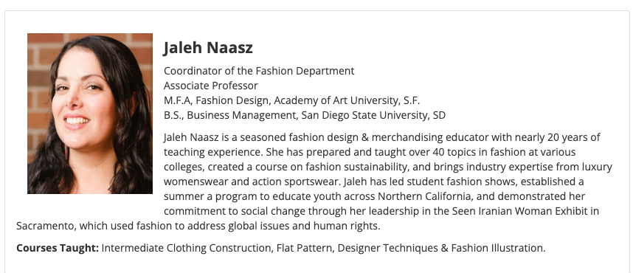
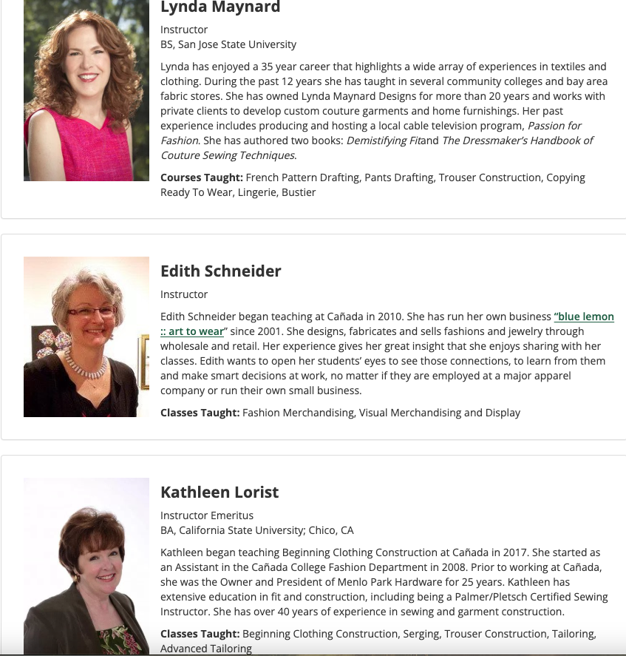
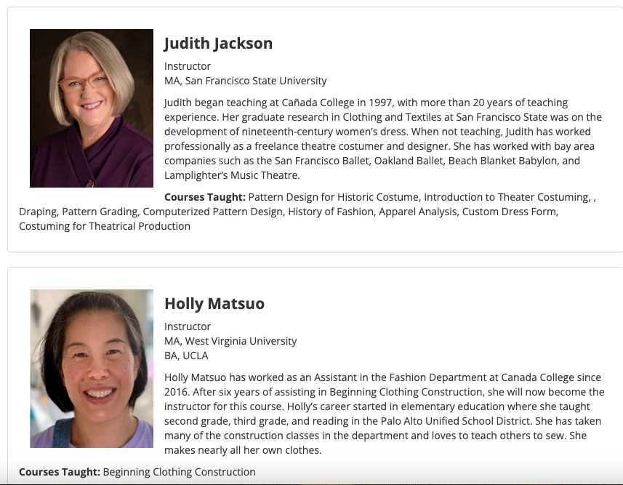
Faculty
Updates:
Retirement:
Ronda Chaney
Kathleen McCarney
Additions:
Jaleh Naasz, FT Tenure Faculty & Program Co.
Jane Garrino, Instructor
Instructional Aide II:
Jane Garrino
Holly Matsuo

Slide 4
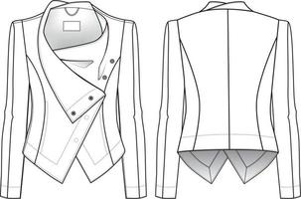
Industry Updates
Sustainability Focus
Legislation
Responsible Textile Recovery Act of 2024 (SB 707)
Fashion Environmental Accountability Act (AB 405)
Higher Ed. Programs
Private Industry focus
Integration of AI & Tech.
Style3D MAGIC Tradeshow
Adobe Creative Suites
Early Access to field
DE FASH 110

Slide 5
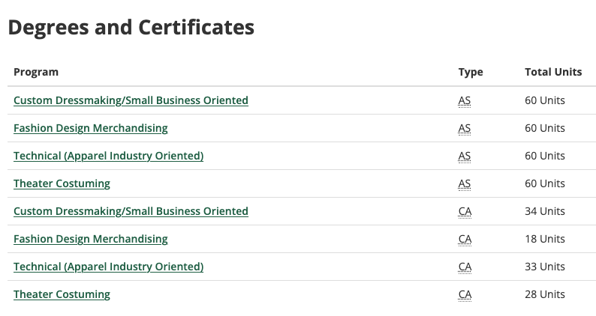
Certificates & Degrees
Updates & CTE Needs:
Custom Clientele
Capsule Collection
Alterations & DIY
Merchandising
Experience Based retail
Technical
CAD Integration
Industry Collaboration
Adv. Board Revamp
Costuming
Cosplay & VR

Slide 7
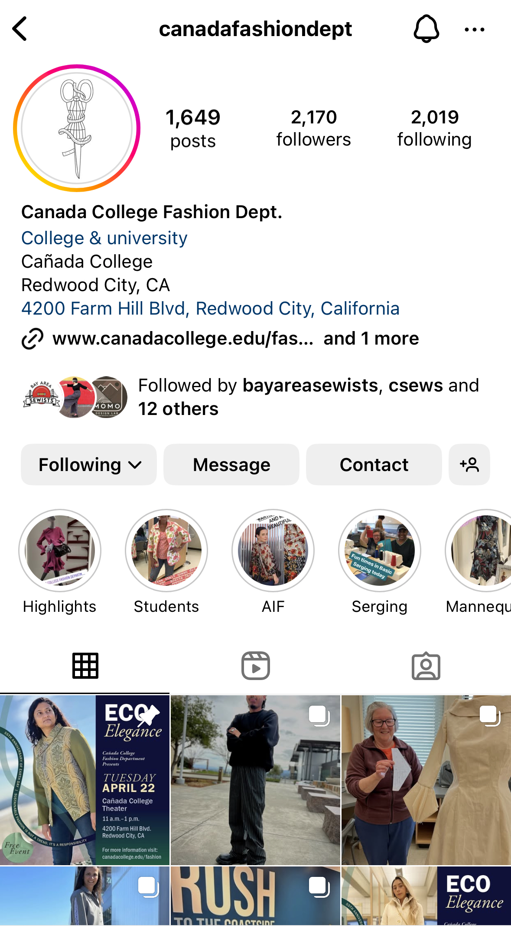
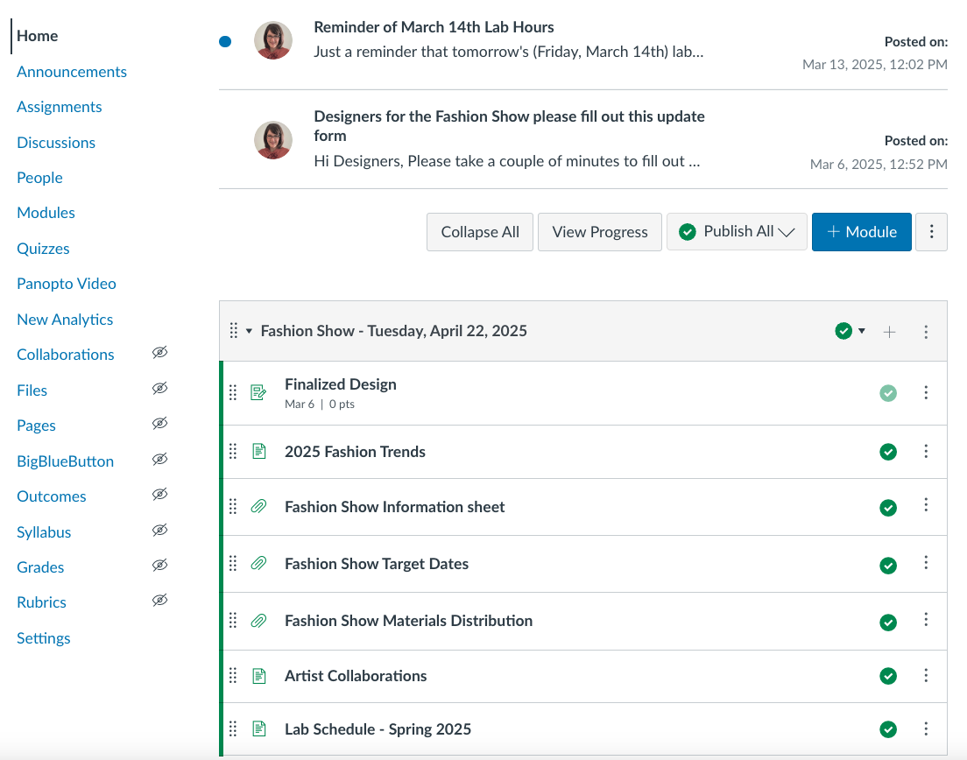
Classroom, Lab & Office Space
Curriculum updates

Slide 8
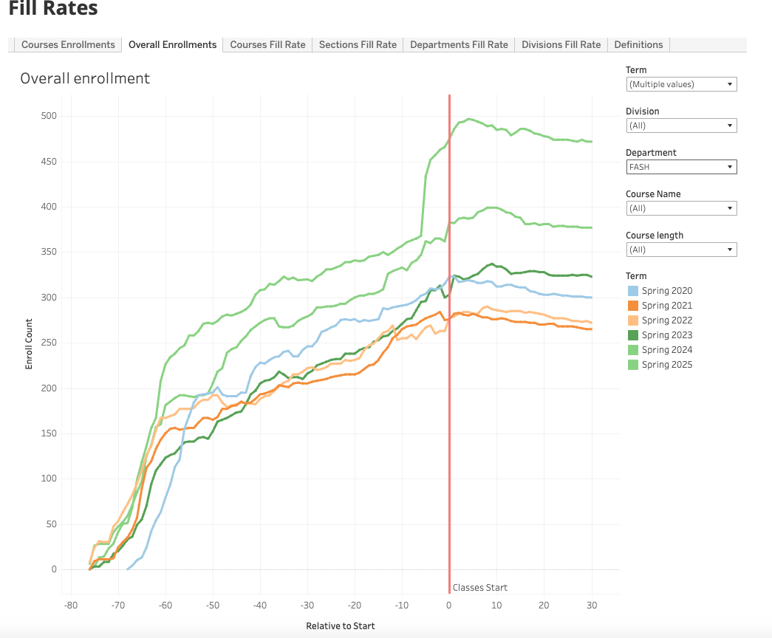
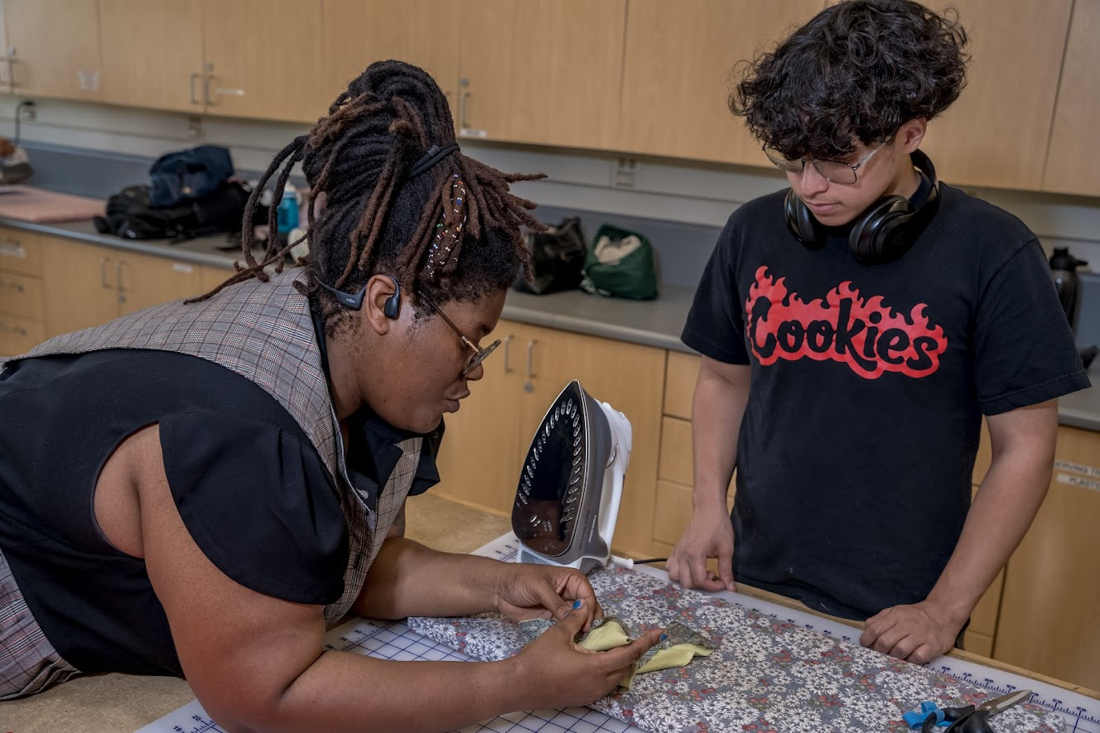
Student Overview
Enrollment Summary:
SP 2025: 472
20%+ 2024
Decline 2021 & 2022
Student Goals:
Post-retirement
Home Ec. Background
Occasional engagement
Hobby/skill dev.
Industry Focus
Transfer goals
Internship focus
Certificate Stacking
H.S./Homeschool Specialized training

Slide 9
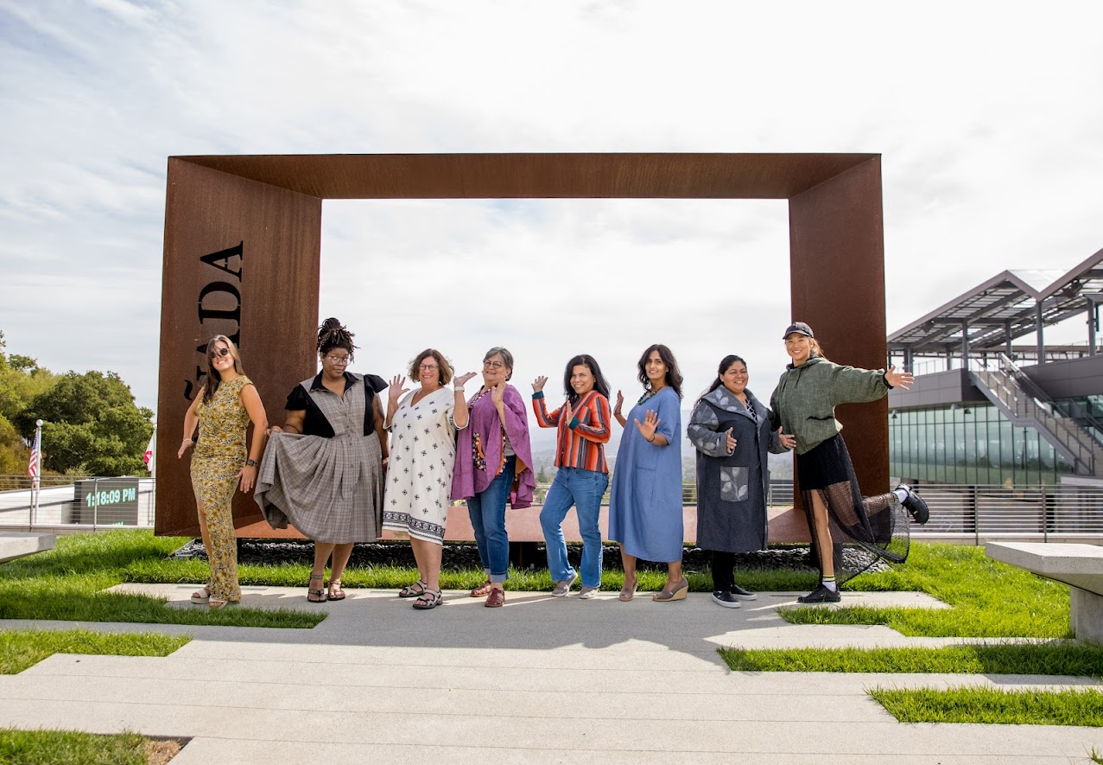
Questions?

Slide 10
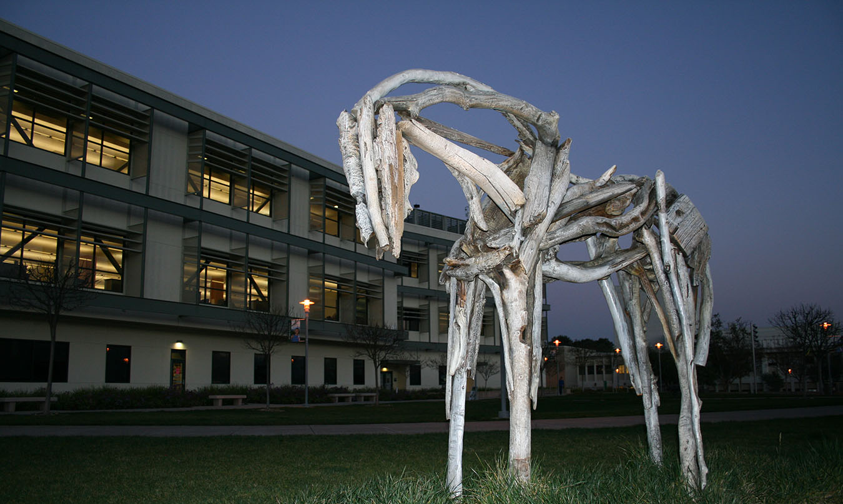
Thank you

