Slide 1

Course Enrollment and Modalities
Fall 2024
Present to IPC
From the Office of Instruction
September 6, 2024

Slide 2
EMP 1.3 Create a student-first course schedule
EMP 4.12 Offer key courses in multiple modalities
A student-first course schedule is the outcome of a thoughtful and collaborative process that prioritizes student success, minimizes disruptions, aligns programs, and balances faculty workload.
Student-first Scheduling and Modalities:
Offering diverse course modalities, including face-to-face, hybrid, asynchronous online, synchronous online, and multi-modalities, to cater to various learning preferences.
Considering the day of the week, time of day, and location to accommodate student needs and preferences.
We ensure course schedules are aligned to minimize conflicts, enabling students to plan and complete their educational goals efficiently.
ACCJC Standard 2.5: The institution holds itself accountable for students’ success by scheduling courses in a manner that ensures degree and certificate programs can be completed in the expected period of time.
ACCJC Standard 2.6:The institution uses delivery modes and teaching methodologies that meet student and curricular needs and promote equitable student learning and achievement.

Slide 3
Exceeded College Goals
 | Course Enrollment | Headcount | Fill Rate | FTES | FTEF | Load | # of Section (# of CRN)
College Goal | 11,000 | 5,337 | 80% |  |  | 450
Fall 2024 (Census Day, 9/3/2024) | 12,659 | 6,552 | 76% | 1530 | 107.2 | 429 | 490 (627)
F2F | 5,168 |  | 74% | 662 | 49 | 404 | 222 (302)
Online Asynchronous | 4,379 |  | 83% | 461 | 27.5 | 503 | 138 (155)
Hybrid | 2,067 |  | 75% | 290 | 23.4 | 372 | 91 (109)
Online Synchronous | 1,045 |  | 72% | 117 | 7.2 | 486 | 39 (61)
Notes:
These are the enrollment metrics that Canada is tracking and monitoring. We set our College goal for each of the enrollment metrics. Fall 2023, we exceeded our college goals.
Office of Instruction revisited its enrollment metrics goal on July 17:
Enrollment: 11,000
Fill Rate: 80%
Load: 450

Slide 4
Effective Management of Enrollment by Modalities at Census Day
Fall 2024
Notes:
Excellent job of Managing Modalities and Enrollment
Fill rate: how we gauge the capacity; how we meet the demands; We are in the sweet spot.
Note: depending on the department
42% of F2F sections (246) account for 31% of enrollment (3422).
40% of Online sections (241) both async and sync (157+84=241) count for 52% of enrollment (5740) (4305+1435=5740).
18% of hybrid (105) count for 17% of enrollment (1876).

Slide 5
Effective Management of Enrollment by Modalities at Census Day
Fall 2023

Slide 6
Point in Time Comparison and Course Success
Metric | Fall 2022 | Fall 2023 | Fall 2024 | % change FA2024-FA2023
Enrollments | 10,570 | 11,974 | 12,653 | +5.6%
Headcount | 5,337 | 6,159 | 6,552 | +6%
Headcount (First-Time) | 825 | 905 | 947 | +4.6%
Headcount (Int'l) | 69 | 80 | 109 | +36%
Concurrent K-12 Student | 498 | 549 | 639 | +16%
Continuing Student | 2,970 | 3,945 | 3,997 | 1%
Enrollments (Evening) | 508 | 703 | 991 | +41%

Slide 7
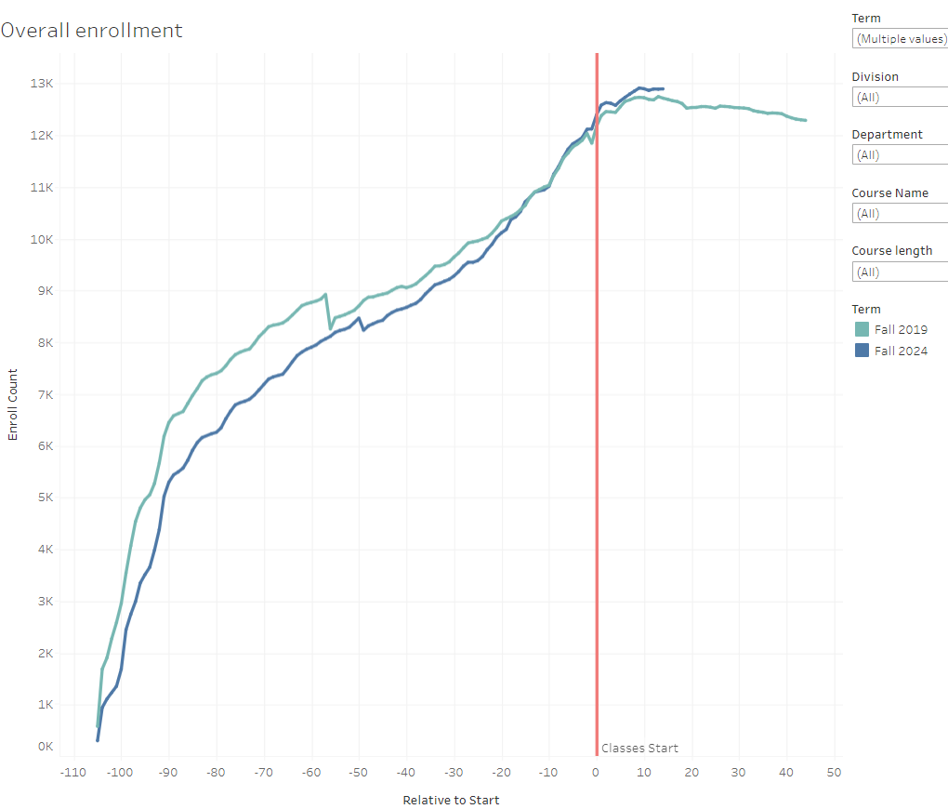
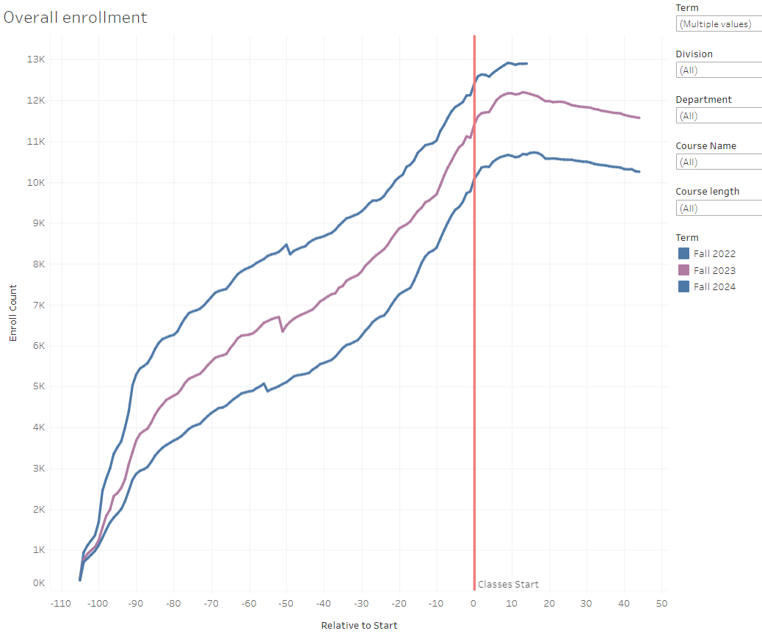
Enrollment Comparison: Fall 2019 (pre-pandemic) and Fall 2024
Enrollment Comparison: Fall 2022, Fall 2023, & Fall 2024 (post-pandemic)
Fall 2024

Slide 8
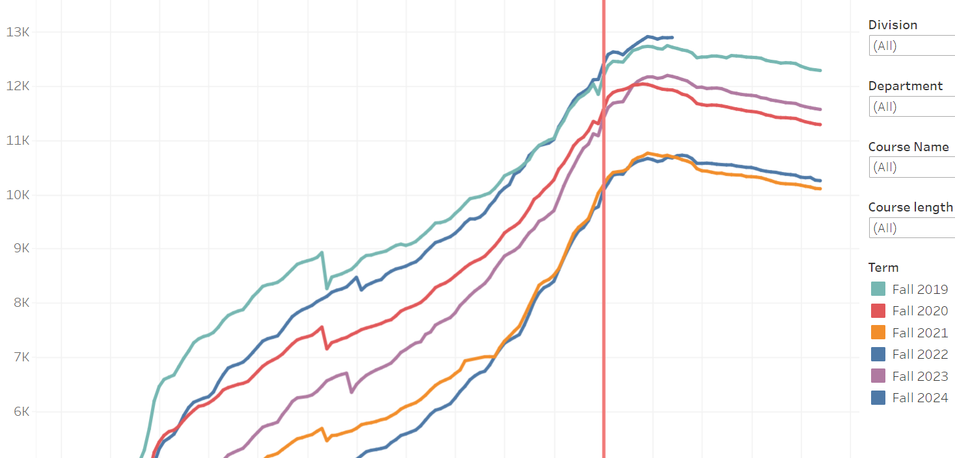
Six Semesters Enrollment Trend—Fall 2019 through Fall 2024
Fall 2024

Slide 9
Questions and Thoughts

