Slide 1

Streamlining the Program Review Process
September 5, 2018
Report and recommendations for the Planning & Budget Committee (PBC) from:
Mary Concha Thia, Interim VP of Administrative Services
Dayo Diggs, Director of Operations
Karen Engel, Dean of PRIE
Allison Hughes, Instructional Technologist

Slide 2
Recommendations from FCMAT & IEPI Teams:
Develop processes and procedures to ensure that decisions at all stages of budget development and updating, including resource allocations, are aligned with the results of institutional program review and the college's strategic plan. (FCMAT)
Connect program review to institutional planning and decision-making. (FCMAT)
Develop a college procedure that includes criteria for approving, creating and filling new permanent positions. (FCMAT)
Improve employees’ knowledge and skills related to planning and resource allocation integration (IEPI)

Slide 3
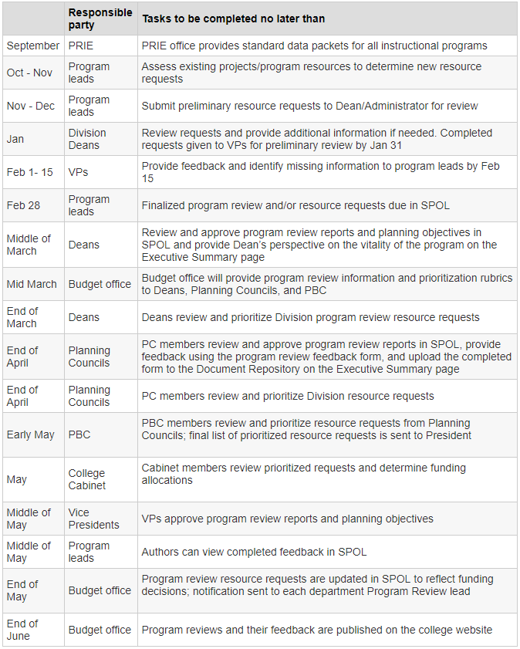
Last year, PBC adopted a new timeline for Program Review:

Slide 4
Timeframe for program review process is different this year:

Slide 5
CURRENT CHALLENGE | PROPOSED SOLUTION
SPOL is problematic | Clean up SPOL (or use TracDat)
Program goals not driving process | Set program goals first
Requests for people are handled separately from other resource requests | Request all resources at the same time
Planning Councils lack the “whole picture” | Provide more complete information to Planning Councils
PBC lacks “whole picture” when setting priorities | Provide more complete information to Planning Councils
Budget not driven by PBC’s priorities | Create budget based on PBC priorities
Programs don’t know if their requests got funded | Notify programs of funding in spring

Slide 6
Three Options:
Use existing SPOL platform “as is”
Clean up SPOL
Use TracDat

Slide 7
Demo SPOL clean-up and TracDat

Slide 8
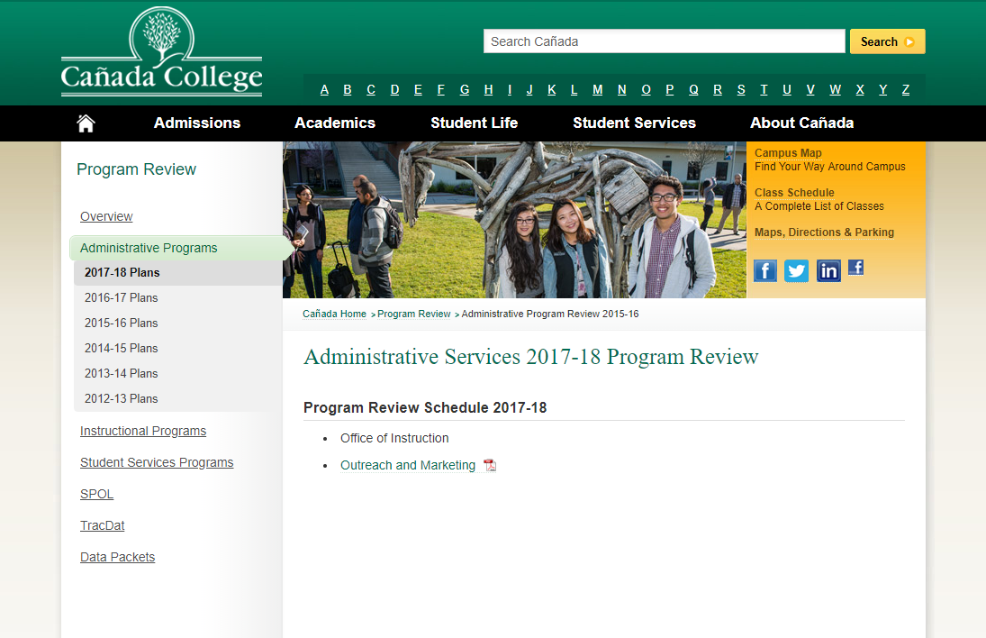
Make all program reviews are visible to everyone:

Slide 9
Timeline for this year:
September
November
December
February
March
April
May
October
January
President decides on positions after available funding announced
Nov. 2 - 16
Peer Review feedback happens in IPC, SSPC, and APC
November 19
Validation concludes. PRIE & Budget Office provide complete lists and rubric to PBC for prioritization
May 1-15
Programs notified of what is funded for following year
September 15
Process Begins
Oct. 30 –
Nov. 1
(Forums)
Feb - April
Budget developed
Sept- Oct
Deans provide real-time feedback
October 12
New position requests due
November 1
Programs submit complete program reviews and all resource requests
Nov. 2 - 16
Academic and Classified Senates provide position prioritization feedback.
December 5
PBC prioritizes requests and presents President with prioritized list.
April 15-30
VPA returns to PBC with funding proposal

Slide 10
Our recommendations
Streamline process this year to ensure we meet new timeline and goals for program review process
Conduct program review in TracDat this year
Evaluate changes in spring and plan for an even better cycle and systems for 2018-19
Provide lots of training and 1:1 assistance!

