Slide 1
SLAMMer Tutor & Faculty Training
Julian Taylor, Tutor Coordinator
Diva Ward, Director of Student Success

Slide 2
An Activity…

Slide 3
Outcomes
Gain an understanding of the SLAMMer Tutoring Program
Tutors to understand the complexity of their role and have strategies to be successful
Faculty and Tutors to understand their roles in the embedded tutor relationship
Gain tools to use in the classroom to better serve the student populations served
Faculty
SLAMmer

Slide 4
An Effective Tutor
Think of an effective tutor/mentor you’ve had. What did they do that helped you?

Slide 5
Goals of Tutoring
Foster Student Independence
Stimulate Active Learning
Foster Mastery of the Material
Increase Self Esteem

Slide 6
SLAMMer Role
Tutors and mentors have a common mission
To give students peer to peer support
Commitment to student success
How do we differentiate these roles?
Should these roles collide?
When would that happen?
SLAMMer
Tutor
Mentor

Slide 7
Definitions of Tutoring, Mentoring, and Teaching
All Three Roles are invested in the Student Learning Process!
TEACHERS | TUTORS | MENTORS
Content Experts - “Sage on the Stage” | Facilitate Learning - “Guide on the Side” (short term peer) | Foster Personal Growth - “Friend til the End” (long term peer)
Lecturing can lead to passive learning | Goal is to foster active, independent learning | Focus on Relationship-Building and Exploration of Resources
Professors Grade (Power) | Tutors help translate academic content | Mentors draw on personal experience to help students navigate academic culture
Professors seek to “reproduce themselves” | Tutors reinforce what they have learned through multiple strategies | Mentors strive to leave a lasting legacy - “each one, teach one”

Slide 8
Do’s and Dont’s - “When Roles Cooperate & Collide”
DO listen to your student’s/tutee’s/mentee’s needs - USE WAIT TIME!
DON’T play “Good Cop/Bad Cop” with the professor or a staff member
DO allow the student to ask questions and struggle with the material or a decision - “learning is in the struggle!”
DON’T ever say it was easy for you, or judge a student based on your own personal experience
DO validate a student’s progress and persistence - practice a “growth mindset”
DON’T ever say “I can’t help you” to a student, but “I know who can help”
BE SOLUTION-ORIENTED:)

Slide 9
Faculty-Embedded Tutor Relationship
Master/Apprentice Relationship
Head Coach/Position Coach
How is your tutor sold to your class?
Engrained in the syllabus
Communication
How well do you know each other?
Faculty
SLAMmer

Slide 10
Cultural Competency

Slide 11
Culture is Like an Iceberg
Surface
Hidden
Difficulties
Notes:
Surface: Above the surface are the visible aspects of culture which are easy to see such as language, food, greeting & dress.
Hidden: The biggest part of culture is below the surface, the invisible rules and values that define each culture.
Difficulties arise when the rules of one culture are used to interpret the behavior of another culture with a different set of cultural rules.

Slide 12
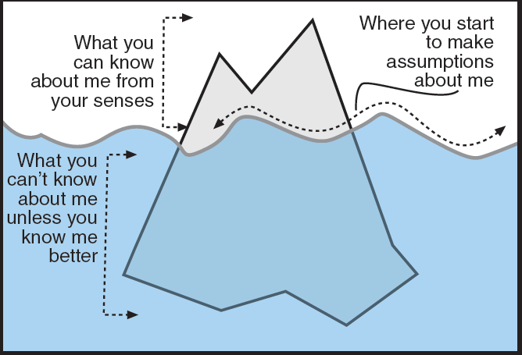
Iceberg Activity

Slide 13
Four Agreements
1. Be impeccable with your word.
2. Don’t take anything personally.
3. Don’t make assumptions.
4. Always do your best.
- Miguel Ruiz
Notes:
1. Be impeccable with your word. - To be impeccable with your word is to be truthful and to say things that have a positive influence on yourself and others.
2. Don’t take anything personally. - To not take anything personally is to acknowledge the unique identities of other people. We respect their subjective realities, realizing that their views do not necessarily describe us accurately.
3. Don’t make assumptions. - Ask for evidence before concluding what people are thinking.
4. Always do your best. - Your best is going to change from moment to moment, but under any circumstance simply do your best, and you will avoid self-judgment, self-abuse, and regret.

Slide 14
Everyday Duties
Be where you’re expected to be
Your job to manage your multiple responsibilities on and off campus
Student first - keep that in mind
Model good student behavior by going to class, communicating with your professors, studying, etc.
Remember that you represent your program, Cañada College, and the San Mateo Community College District at all times

Slide 15
Best Practices – Tutor Role
Learning happens in the struggle
Importance of balancing individual vs group support
Focus on strategies vs content
Tutor

Slide 16
Best Practices - Mentor Role
Remember you are not a counselor
Do more listening than talking
Report what needs to be reported
Be a resource
Mentor

Slide 17
13 Warning Signs Activity
Using what has been discussed today as a backdrop…

Slide 18
Questions?

