Slide 1
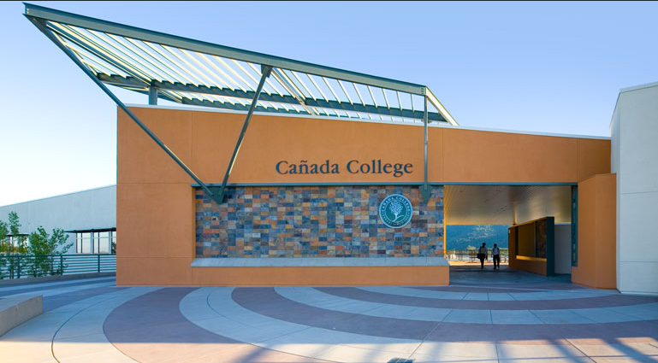
Cañada College Sustainability Plan - Update
Sustainability Committee
Vision & Goals
Programs/Status
www.canadacollege.edu/sustainabilitycommittee

Slide 2
Environmental Sustainability Committee
Susan Mahoney (Chair) – Faculty, Earth & Environmental Sciences
John Hashizume - Manager, Facilities Operations
Lisa Palmer – Faculty, English
Peggy Perruccio – Faculty, Fashion Design
Vacant Seat - Faculty
Jai Kumar - Manger, Bookstore
Krystal Johnson - Office Assistant, Disability Resource Center
Dr. Janet Stringer - Dean , Science and Technology Division
Jennifer Fitzgerald, Student
2

Slide 3
Cañada College Sustainability Vision
“Cañada College will be a model for environmental sustainability, inspiring and empowering our community to implement sustainable practices and promote social equity.”
3

Slide 4
Cañada College Sustainability Plan Goals
Campus and Community Awareness & Involvement
Curriculum Development
The Built Environment
Energy Conservation and Efficiency
Water Conservation and Efficiency
Solid Waste Management
Transportation
Sustainable Procurement
Renewable Energy and Onsite Generation
Climate Action Plan
Sustainability Plan Management

Slide 5
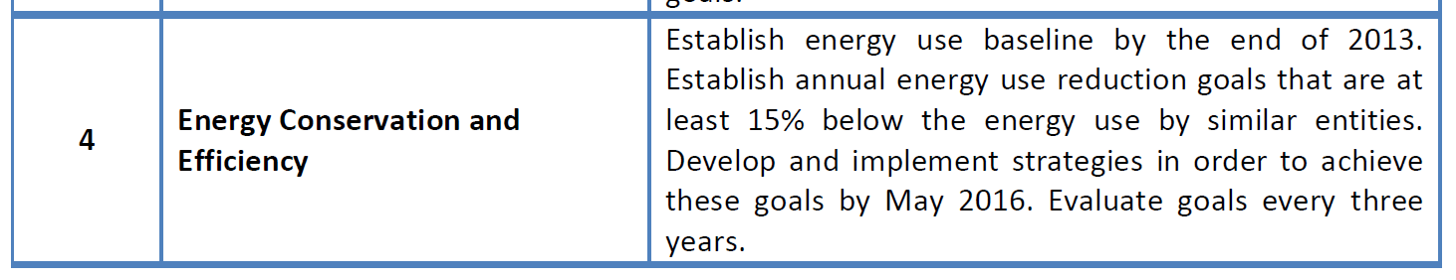
Goal Example

Slide 6
We were ambitious and we are making progress!

Slide 7
Highlights

Slide 8
Campus & Community Awareness & Involvement
Water Conservation Awareness: ongoing
EV Charging Station Event: 10-28-13
PV Groundbreaking Event: 4-10-14
Earth Day Event: 4-22-14
Lots more to do!
    Sustainability website
    Interpretive signage on all new projects
    Behavioral reminders and educational info
    New student, staff, faculty orientation
    Increased student involvement !

Slide 9
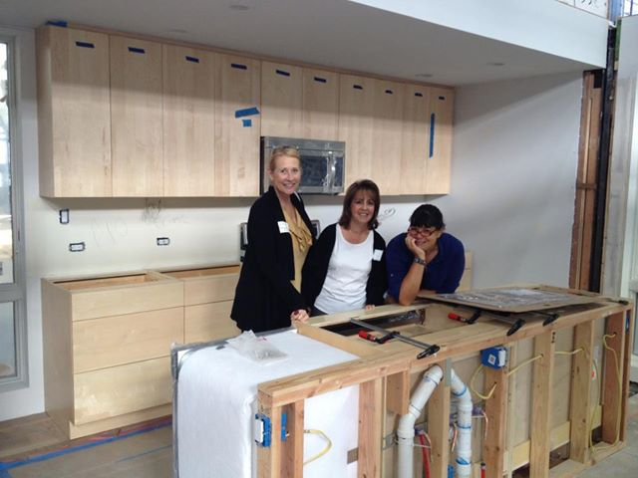
Curriculum Development
Sustainable Interior Design courses and certificate
Recycling and Resource Management certificate
Green Entrepreneurship short courses
Environmental Science GE course
Contextualized English courses
Student internships/training
Student research
Lots more to do!
  Environmental Science major
  Campus projects as part of the curriculum
  Events and speakers

Slide 10
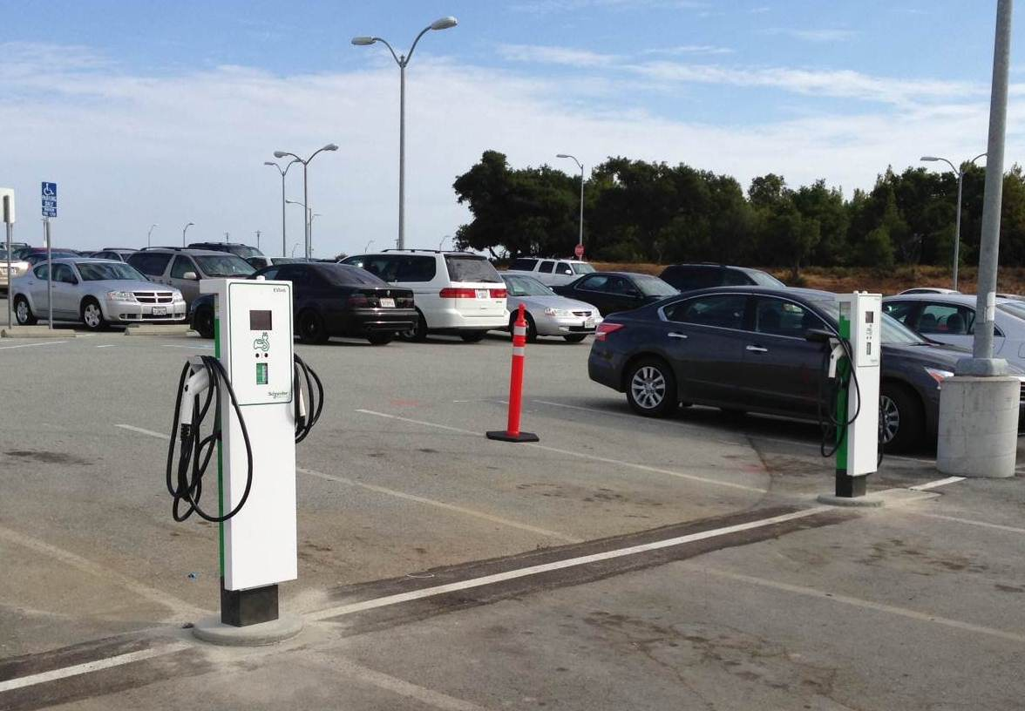
Energy Conservation & Efficiency
Energy audit
Electric vehicle charging stations
  Lots more to do!
  LED –exterior lighting
  Theater lighting
  Sub-metering project
  LED – interior lighting

Slide 11
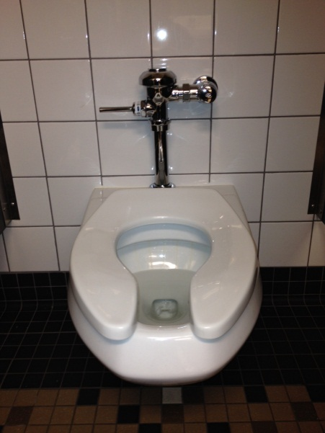
Water Conservation & Efficiency
Baseline established
Goals set (reduce by 25%) and exceeded
Announcements and signage to promote awareness
Training for facilities staff
Irrigation scheduling
Water bottle filling stations
Lots more to do!
  Educational signage
  Water metering
  Sewage discharge monitoring

Slide 12
Solid Waste Management
Onsite mulching of green waste for soil amendments
Garbage and recycling bin placement improvements
Water bottle filling station
Lots more to do!
  Establish waste baseline
  Composting?
  Bin placement study
  Recycling education, signage and outreach
  Procurement plan

Slide 13
Transportation
Electric vehicle charging stations
Distance Education
Lots more to do!!
    Transportation study/survey
    Carpooling and public transit incentives

Slide 14
Renewable Energy and Onsite Generation
1 MW Photovoltaic Project - in progress !

Slide 15
Our Strengths, Next Steps, and Our Needs
Strengths:
  College and District Commitment
  Momentum
Next
  Campus Awareness/Involvement
  Curriculum
  Solid Waste
Need
  More time and people-power!
  More student involvement

