Slide 1
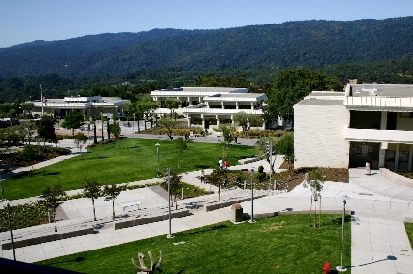
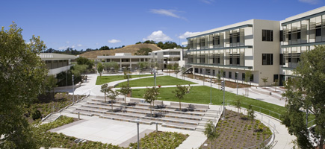
2015/2016
Tentative Budget Proposal
DRAFT 1
Presented by:
Michelle Marquez
Vice President, Administrative Services

Slide 2
Overview
FY 15/16 proposed college budget for unrestricted funds
Funding allocated to college through Resource Allocation Model
Unrestricted base allocation
International student funds
Proposition 30
Local revenues
This is a first draft of overall budget

Slide 3
Budget Development Process (through May 2015)
Review of budget assumptions
FTES and FTEF
Productivity levels
COLA, column and step increases
Funding changes (Measure G)
Review of regular employees (position control)
Salary Comparison by Classification – All Funds (2015/2016)
Job Classification | Budgeted Amount
College Administrators & Management | $2,752,472
Classified Staff | $5,358,940
Instructional Personnel | $7,242,728
Total (salaries only) | $15,354,140

Slide 4
Budget Development Process (through May 2015)
Review of FY 13/14 and 14/15 Adopted Budgets and Expenditures
Meetings with budget administrators to review department/division budgets
Verify regular positions
Confirm hourly employee needs
Review discretionary budget needs
Make changes, revise department/division budgets and positions
Aggregate department and division budgets to create overall college proposed budget

Slide 5
Factors Influencing College Budget
Impact of Measure G
$1.5 million
Variability of hourly employee costs
Productivity levels
Decreasing FTES (enrollment)
Build on work of Strategic Enrollment Group
5-Year Changes (2009/2010 - 2013/2014)
 | Change | % Change
FTES | -971.77 | -19.2%
Headcount | -1,175 | -10.1%
Enrollment | -3,799 | -9.9%
Sections | -35 | -2.3%
Source: California Community Colleges Data Mart, http://datamart.cccco.edu/

Slide 6
Proposed College Budget
Immediate known options to balance 15/16 Budget :
Review vacant funded positions
Identify opportunities to leverage our Fund 3 sources
Reduce hourly salaries (Short-term employees, hourly faculty, student workers)
Hourly Salary Distribution
Job Classification | Budgeted Amount
Hourly Classified | $117,656
Student Workers | $157,342
Hourly Faculty (non-teaching) | $285,069
Hourly Faculty | $3,712,911
Total | $4,272,978

Slide 7
Proposed College Budget
Cañada College 2015-2016 Tentative Budget Summary DRAFT 1: As of 05/01/15
 |  | Expenses | Revenue
Unrestricted Allocation |  |  | $ 20,066,025
Regular Employees (salaries & benefits) |  | $ 16,363,567
Hourly Salaries |  | $ 4,272,978
Discretionary |  | $ 703,797
 | Total Expenses | $ 21,340,341
 | Total Revenue | $ 20,066,025
 | Balance (Shortage) | $ (1,274,316.39)

Slide 8
Next Steps
May – June:
Governor’s May revise
Review budget implications and adjust college budget
Balance college tentative budget (DRAFT 2)
Continue work towards developing final budget
June – August:
Identify budget inputs based on adopted state budget, county tax assessments, legislative changes)
Final adjustments made to 15/16 college budget
Final budget submitted to District
September:
Final budget adopted by Board of Trustees
Presentation of adopted budget (and 14/15 year-end budget) to PBC

Slide 9
Moving Forward
Improving budget transparency
Budget development
Budget adoption
Budget monitoring
Optimizing our resources
Collaborative approach
Regular communication and feedback
Flexibility, receptiveness to ideas, adaptability
Increasing efficiency
Decision making processes
Communicating effectiveness
Continuous assessment and improvements

