Slide 1
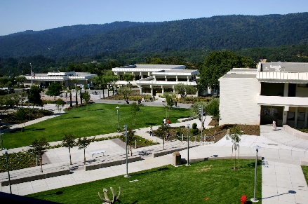

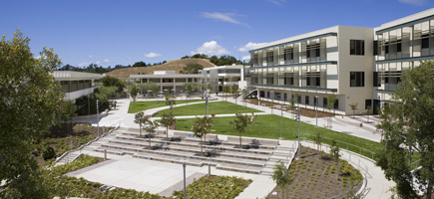

Budget Vision 2016: From Good to…..Better
Presented by:
Michelle Marquez
Vice President, Administrative Services

Slide 2
Overview
Review of 2014/2015 budget
Budget Vision 2016
2015/2016 college budget

Slide 3
Reflection of 2014/2015
Unrestricted Funding Allocations, FY 2014/2015
Revenue Source | Allocation
Fund 1 Allocation | $18,227,817
Prop 30 Allocation | $342,368
Measure G Allocation | $1,576,490
Total | $20,016,675
Unrestricted Funding Expenses, FY 2014/2015
Expense Category | Expenses
Salaries (Position Control) | $16,208,092
Salaries (Hourly) | $4,307,664
Discretionary (Supplies, travel, events, etc) | $724,695
Total | $21,240,451

Slide 4
Reflection of 2014/2015
Expiration of Measure G
  $1,576,490
  133 course sections
50% Law
  61.68%
Faculty Obligation (FON)
  Obligation = 328
  Actual = 334
Final budget report will be completed in late September

Slide 5
Budget Vision 2016
What is our Budget Vision?
  Leveraging what we have (Effectiveness)
  Building on what works (Focused Growth)
  Creating room for ideas and innovation (Supportive Energy)
What are our Budget Values?
  Transparency in process
  Optimization of resources
  Efficiency and effectiveness
We are all here for the same reason…Our students

Slide 6
2015/2016 Unrestricted Funds
What does “unrestricted funds” mean?
  Unrestricted funds are used to account for resources available for the general purposes of district/college operations and support of its educational programs (Budget and Accounting Manual)
Unrestricted funds are commonly referred to as “fund 1”
Our primary source of unrestricted funds comes from the district in the form of a “site allocation”
Other sources of unrestricted funds include indirect costs and contract revenue
Our college budget is meant to be an important tool to translate our plans into specific, action-oriented goals and objectives

Slide 7
FY 2015/2016 College Budget
Cañada College 2015-2016 Unrestricted Budget Summary
 |  | Expenses | Revenue
Unrestricted Allocation |  |  | $ 20,911,698
Regular Employees (salaries & benefits) |  | $ 16,824,767
Hourly Salaries |  | $ 4,167,310
Discretionary |  | $ 788,293
 | Total Expenses | $ 21,780,370
 | Total Revenue | $ 20,911,698
 | Balance (Shortage) | $ (868,672)

Slide 8
FY 2015/2016 College Budget
Prop 30, FY 2015/2016
  Allocation = $309,943
  Projected Expenses (Position Control) = $355,841
  Shortfall = $45,898 (to be covered by Fund 1)

Slide 9
FY 2015/2016 College Budget
Projected Hourly Teaching Budget, FY 2015/2016
FTES Goal | Convert to WSCH | WSCH/FTEF Prod Goal | TOTAL # FTEF Needed | # FTEF Available | # FTEF Needed (PT) | Average Cost per PT FTEF | 1310 Budget Needed
4195 | 62,925 | 500 | 125.85 | 58.17 | 67.68 | $56,963 | $3,855,256
Load | Amount | Additional Cost
525 | $ 3,513,885 | ($341,371)
520 | $ 3,579,533 | ($275,723)
515 | $ 3,646,456 | ($208,800)
510 | $ 3,714,691 | ($140,565)
500 | $ 3,855,256 | -
490 | $ 4,001,558 | $146,302
480 | $ 4,153,956 | $298,700
475 | $ 4,232,561 | $377,305
470 | $ 4,312,838 | $457,582
465 | $ 4,394,842 | $539,586

Slide 10
FY 2015/2016 College Budget – Good to Better
Dealing with the “shortfall”
  Apply carryover from 2014/2015 ($616,724)
  Apply growth revenue ($244,147)
The current fiscal climate provides us the opportunity to address necessary position and program needs and plan ahead for the next 3 years.
We need to think long-term
  Personnel funded through restricted funds
  PERS, STRS, COLA
“Now is the time to get your fiscal house in order” Chancellor Brice Harris

Slide 11
Next Steps
  Effectiveness
    Optimizing large categoricals (SSSP, SE)
    Looking at what works
  Focused Growth
    Scaling up effective practices
  Creating room for ideas and innovation
    Professional development
    College Innovation Program

Slide 12
Moving Forward
Quarterly budget updates at PBC
Other committees/councils?
Final Thought…
Managing a budget has more to do with managing needs and values than being proficient in Banner or Excel. How we allocate our resources (inclusion vs dark room approach) and what values influence these allocation decisions (do we fund administrative support vs. athletics vs. librarians?) is an indication of our fiscal competencies as an institution.

