Slide 1


Slide 2

By the Numbers – Why Focus on Grants Process
External Grants (e.g. HSI) and State Categorical (e.g. Student Equity, Basic Skills, SSSP)
# of active grants = 29
# of active categorical funds = 23
Total $ amount of grants = $7,792,683
Total $ amount as categorical = $5,232,605
# of FTE grant or categorically funded = 51.70
% of Total FTE grant or categorically funded = 22%
Total $ amount expended to cover reassigned time
# of students impacted by grants

Slide 3
Developing a Process for
Grant Development and Management
Inquiry Process
  Why do we seek grant funding?
  What are the criteria for applying?
  How do we determine that the money is worth it?
  Who knows what strings are attached?
  Who makes decisions to pursue grant funding?
  Who is responsible for implementation?
  Who is held accountable at the end of the day?
  What is the organizational capacity to effectively administer grants?
  Are we at a tipping point?
  What does the data show on student outcomes?
  How/when/where are conversations on institutionalization?

Slide 4
Thank you! Thank you!
Open doors, time, welcoming, expertise, honesty, suggestions, frustrations, generosity, ideas, sincerity, student focus!
Gregory Anderson Megan Rodriguez Antone Lizette Bricker Anna Camacho Jenny Castello Heidi Diamond Amelito Enriquez Doug Hirzel Michael Hoffman Chialin Hsieh Nenaji Jackson David Johnson | Debbie Joy Alex Kramer Adolfo Leiva Kim Lopez Michelle Marquez Erin Moore Janet Stringer Vickie Nunes Anniqua Rana Mary Chries Concha Thia Diva Ward

Slide 5
Analysis: Strengths, Weaknesses,
Opportunities, Threats
Strengths
  Talented faculty and staff
  Experienced grant seekers, developers, writers
  Experienced compliance officer
  History of success
  Hispanic Serving Institution (HSI) status
  College student and data profile fits with educational trends, mandates
  Institutionalization of practices (JAMS, College for Working Adults)

Slide 6
Analysis: Strengths, Weaknesses,
Opportunities, Threats
Weaknesses
  Not centralized system of coordination of effort (development to implementation)
  Little communication on processes and impact
  Inconsistent involvement of management
  Unclear and inconsistent understanding of roles and responsibilities
  Hard to find (if available) documentation on how to get things done
  Outdated forms and website
  Inconsistent institutional commitment & support for grants

Slide 7
Analysis: Strengths, Weaknesses,
Opportunities, Threats
Threats
  More money = more opportunity to fail
  Increasing scrutiny, audits on grants
  Change in federal policies, support to higher education initiatives, community colleges
  Unanticipated funding changes (e.g. mid-year cuts; federal admin changes)
  Increasing personnel costs and impact on grant budgets
  Loss of institutional knowledge with impending retirements

Slide 8
Analysis: Strengths, Weaknesses,
Opportunities, Threats
Opportunities
  Stable leadership
  Education Master Plan goals established
  Expected focus on integrated planning, organizational capacity and coherence
  District support – Strategic Goal #4
  Timing is right for alignment

Slide 9


What’s Next ?
Action Plan
  Agree on process for applying to grants
  Coordinate grant efforts
  Implement updated process
  Clarify roles and responsibilities
  Create and publish grants manual with procedures (pre-award to post-award)
  Initiate conversations on grant impacts and changes in practice to benefit students; institutionalization

Slide 10
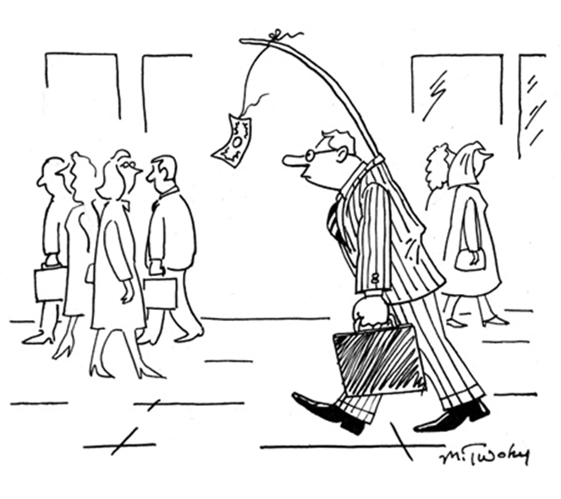
Developing a Process for Grant Development

Slide 11


Grant Life Cycle
PRE AWARD
POST AWARD
Identify Needs & Generate Project Ideas
Write Final Report & Close Award
Close Budgets
Find Funding Sources
Manage Award & Monitor Compliance
Develop Proposal and Budget
Implement Program
Submit Proposal
Hire Personnel & Staff Project
Receive Award
Establish Fund Accounts
Start Project

Slide 12
Pre-Award Process Matters
Comparing 3 Scenarios –
  President tells staff member to write grant for a specific project/initiative. Few persons in academic affairs or student services are consulted. Grant is received. What happens now?
  Faculty develop idea for grant proposal. Grant shared with department and vetted by Dean. Grant is received. What happens now?
  Project director develops idea for grant proposal. Grant vetted by Vice President. Grant is received. New project director is appointed. What happens now?
  ….depends on x, y, z factors.

Slide 13
Criteria for an Effective Pre-Award Process
Provide opportunities for increased collaboration
Ensure coordination of effort
Eliminate duplication of effort
Maximize impact on students
Leverage funding resources
Examine feasibility from multiple perspectives
Create opportunities for input
Increase communication and information sharing
Improve transparency
Reduce potential barriers for project success

Slide 14
Pre-Award Proposed Process
1.
Faculty and Staff initiate process | Identify needs, conceive project ideas, find funding sources, communicate with Dean
2.
Dean makes “go or no-go” decision to develop proposal by applying assessment principles; if “go” Deans must share with Cabinet and PBC for information and input | Approval of Concept & Program Development PRIOR to proposal development
3.
Faculty/Staff engage Dean(s), Budget Office, and PRIE Office for support | Proposal Development: Narrative, Needs, Objectives, Budget, Data, Evaluation
4.
Dean brings proposal summary to Cabinet and PBC; Cabinet and PBC makes recommendation to President | Proposal Development: Communication, Coordination, Recommendations
5.
Dean submits final proposal to VPI, VPSS, VPAS and President | Final Budget Review and Approvals
6.
President authorizes submission to District | Submission to District
7.
District Office reviews and hits send button | Final Submission to Grant Agency

Slide 15
Pre-Award Process:
Assessment Principles to Determine ‘Go or No-go’
(PRIOR to proposal development)
Alignment with mission, vision, program review, EMP? *
Adequate time to prepare and apply? *
Identified funder? *
Project director? Or other employee time to manage? *
Other required college resources available? E.g. space, match funds, IT *
Hire personnel?
Institutionalization required?
Sub-awards?
Post-award requirements reasonable given staff/resources?
Indirect?
Project team?
History with funder?
Consulted with PRIE? Professional Development? Other depts.?

Slide 16
Pre-Award Process:
Clarifying Roles and Responsibilities
Faculty/Staff – project conception, collaboration with other depts., finding funding, writing, development
Deans – apply Assessment Principles to determine feasibility of moving forward with ideas into proposal development, support faculty/staff efforts to develop proposal; provides notice & info to Cabinet and PBC
Cabinet – reviews Assessment Principles and Proposal Summary Form and coordinate efforts across college initiatives, address duplication of effort issues, maximize all resources, support across organizational segments; recommendation to President
Planning and Budgeting Council – reviews Assessment Principles and Proposal Summary Form and provides constituency input, identify points of integration with other plans, identify gaps and additional resources; recommendation to President
Resources:
  Budget Office – budget development, reviews for feasibility, compliance, coordinates with District
  Professional Development – integration and collaboration across organization
  Planning, Research, Institutional Effectiveness – data needs
Vice Presidents (VPI, VPSS, VPAS) - final approval of programming and budget
President – provides final review and authorizes proposal submission
District Office – reviews proposals for signatories/College authorization, feasibility, compliance, and submits to agency

Slide 17
Discussion
  To what extent is the proposed process for applying to grants effective?
  Does the process adequately address the issue of coordinating grant efforts?
  Are the roles and responsibilities adequately differentiated in the pre-award process?
  What’s missing?
  Can we publish the pre-award process and begin implementation in Spring 2017 with scheduled evaluation of the process in Spring 2018?

