Slide 1
2016-2017 Update

Slide 2
Align Efforts with District/College Goals
SMCCCD Strategic Plan Goal #2: Establish and expand relationships with school districts, 4-year college partners and community-based organizations to increase higher education attainment in San Mateo County.
Community Goals: Build and strengthen collaborative relationships and partnerships that support the needs of, reflect and enrich our diverse and vibrant local community.
College Strategic Plan
Educational Master Plan
Strategic Enrollment Plan

Slide 3
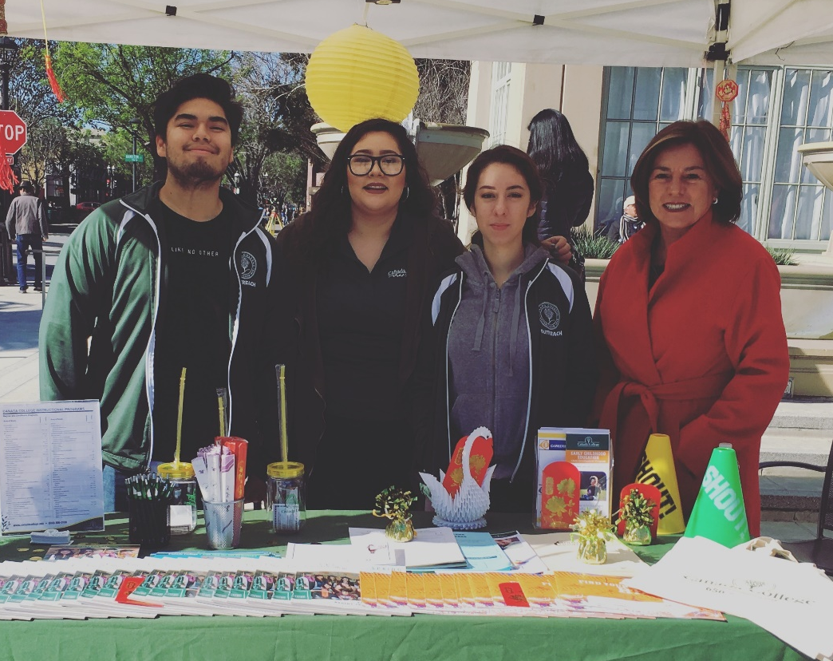
Success by the Numbers: July-Dec. 2016
The Outreach team attended 37 events, promoting Cañada College and connecting with 4,800+ members of greater San Mateo County and northern Santa Clara County.

Slide 4
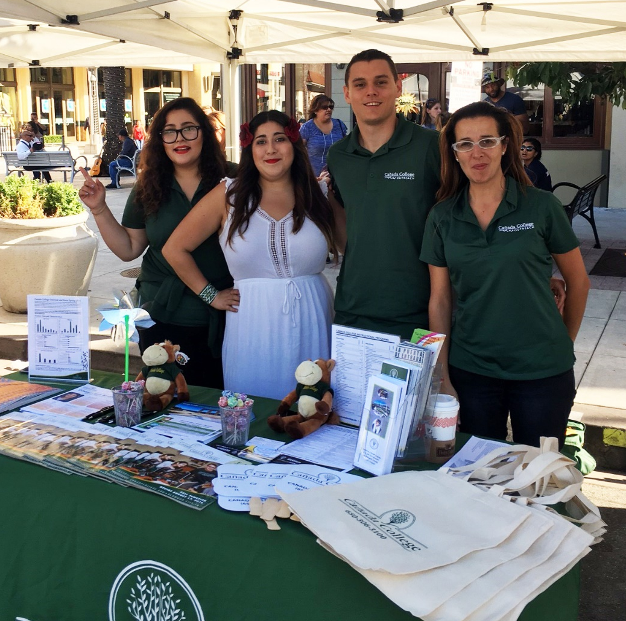
Success by the Numbers: July-Dec. 2016
Some of these events include:
4th of July Parade - Redwood City
Facebook Farmers Market - Menlo Park
Fiestas Patrias - Redwood City
Edgewood Back to School Fair - San Bruno
World Journal News College Fair - Milpitas
Sana Sana Health Fair - San Mateo
Puente Health Fair - Pescadero

Slide 5
New Community Partnerships
Facebook Farmers Market
Edgewood Drop-In Center
Boys and Girls Club of the Peninsula
Familia Unidas
Escuela Popular - San Jose
Dream Club at Menlo Atherton High School
PTSA at Sequoia High School

Slide 6
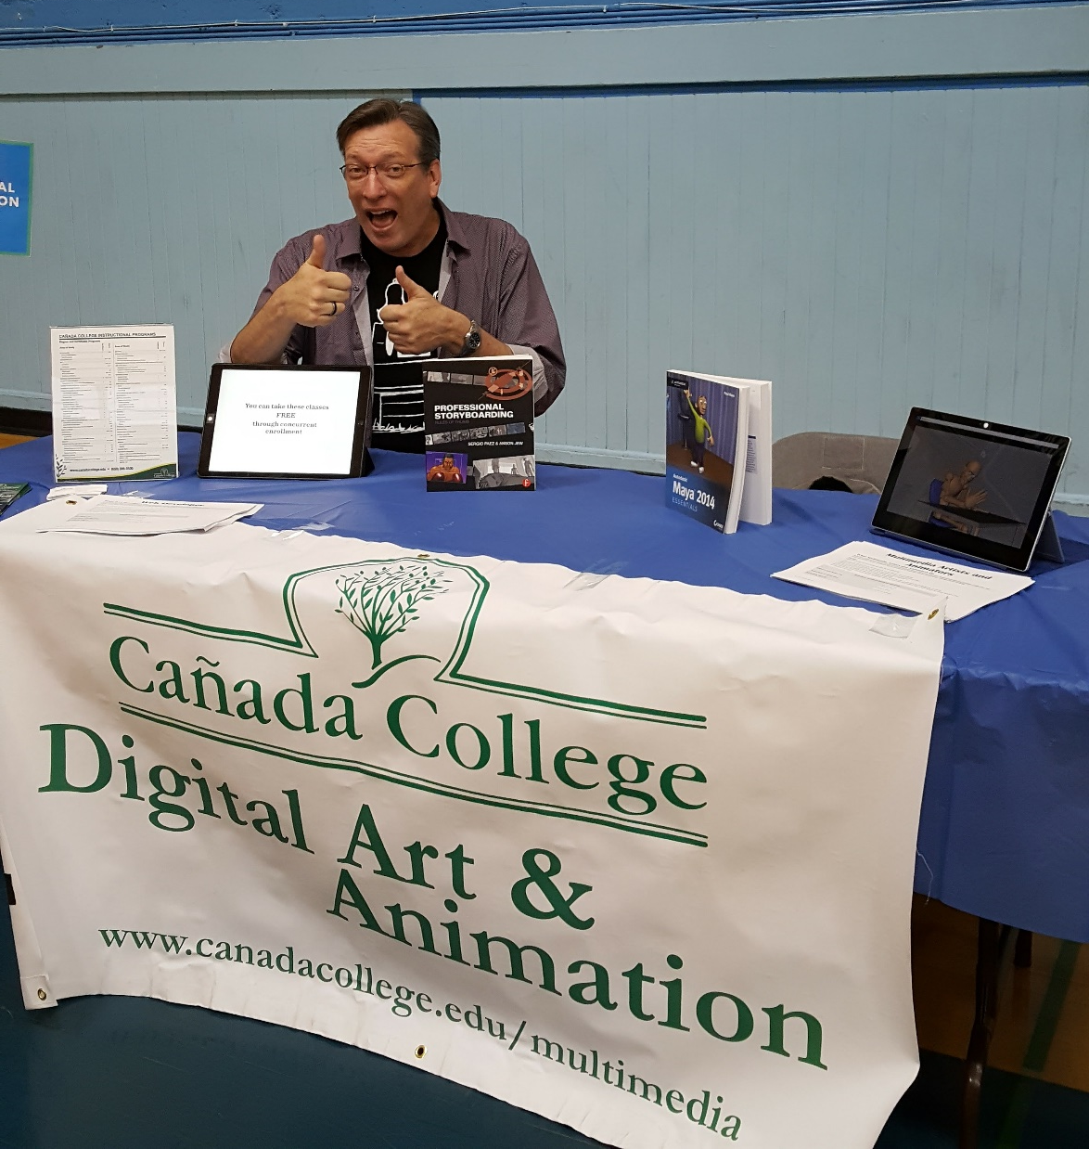
Campus-wide Collaborations
CTE Career Day
Priority Enrollment Program
Lunar New Year
STEM Day
Several HS and Career Fairs
DREAMer Task Force

Slide 7
Campus-wide Collaborations

Slide 8
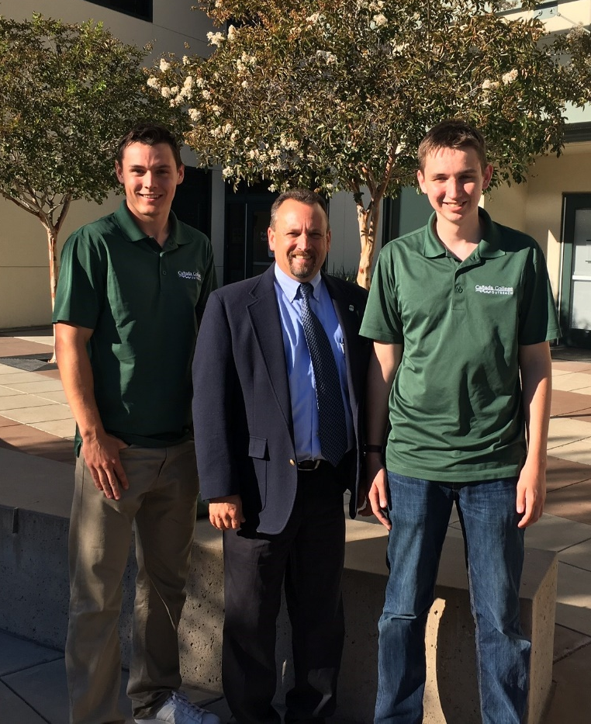
Campus Tours
21 campus tours were given to 642 potential students from 21 high schools and community organizations, including:
Redwood City Mayor, John Seybert
Woodside High School Summer Compass Program
Fusion Academy Tour
Sequoia Adult School
Homeschool Program
East Palo Alto High School
Redwood High School

Slide 9
Spring Outreach
This Spring, Cañada College will hold a presence in 95 Outreach events, including:
Lunar New Year Festival
Education Summit at CSU, East Bay
Dreamers Conference
Foster City Youth Jobs
Kermes Dia Del Niño
STEAM Fest 2.0

Slide 10
Upcoming Events

Slide 11
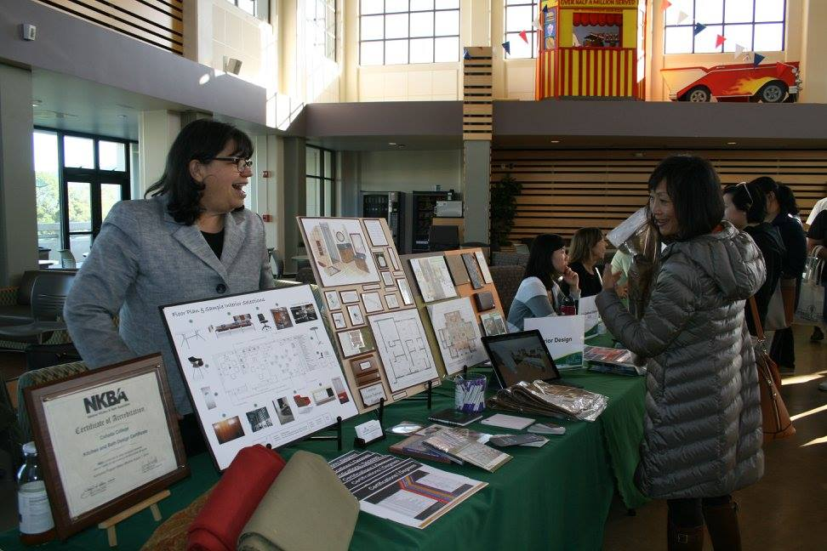
Connect to College Night: April 27
Cañada’s Annual Open House

Slide 12
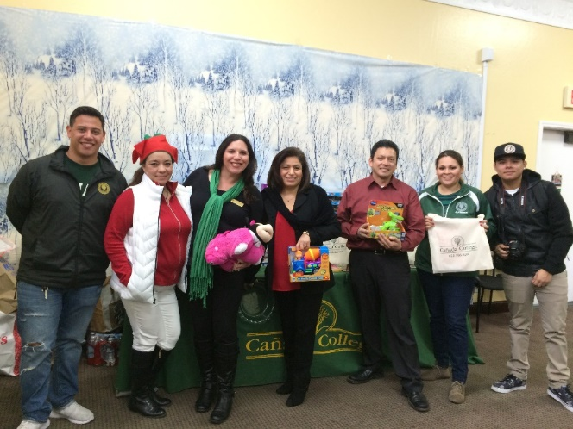
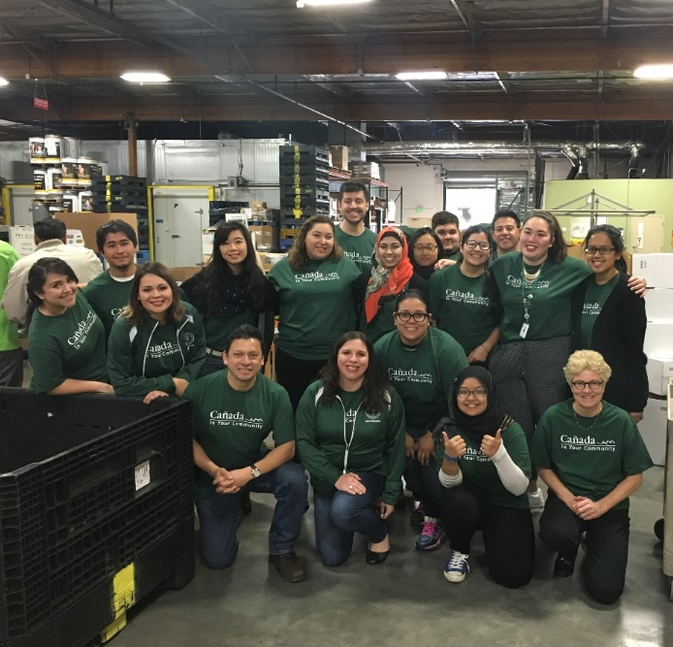
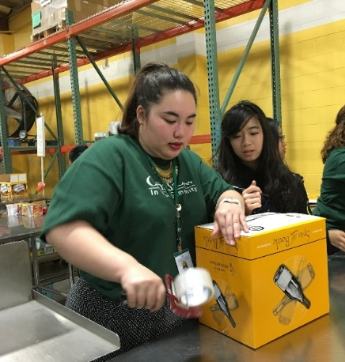
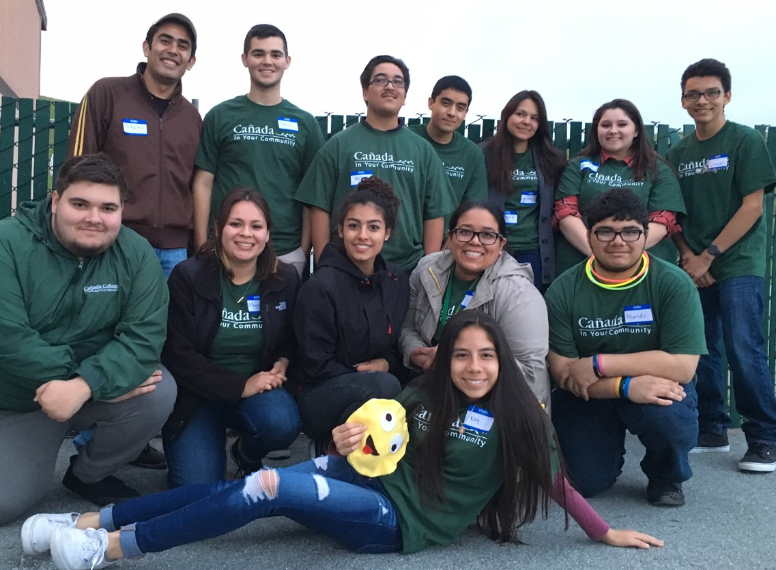
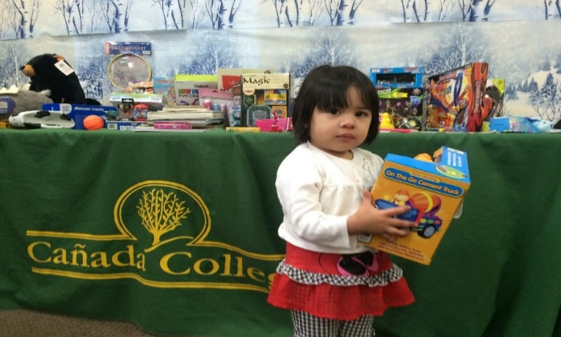
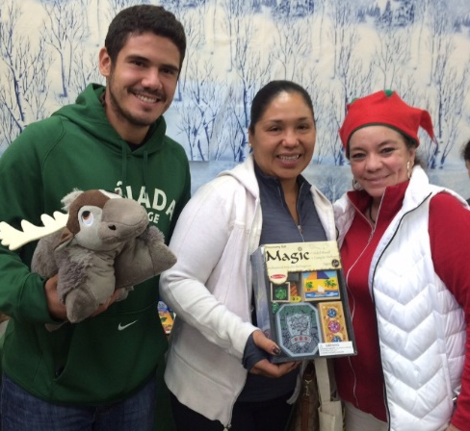
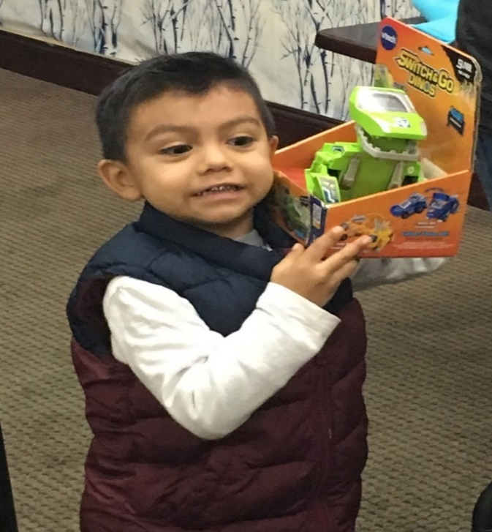
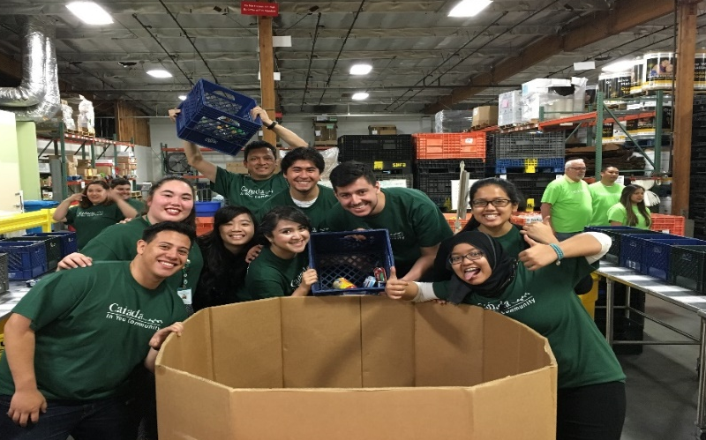
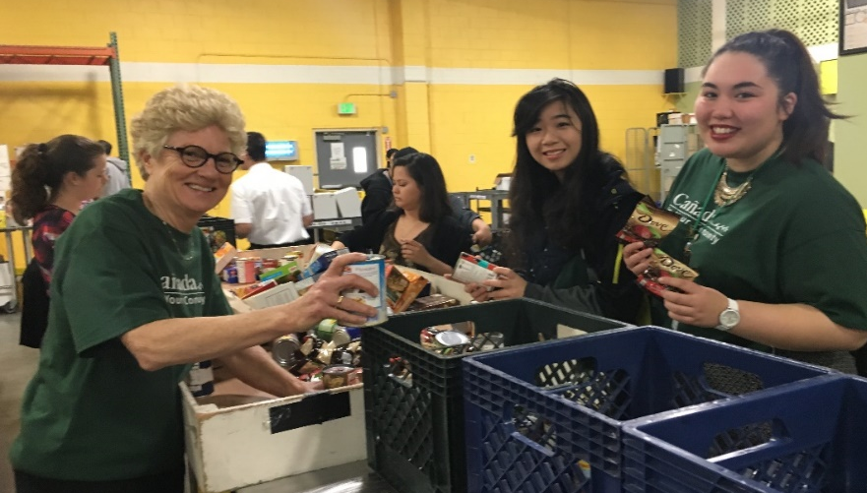
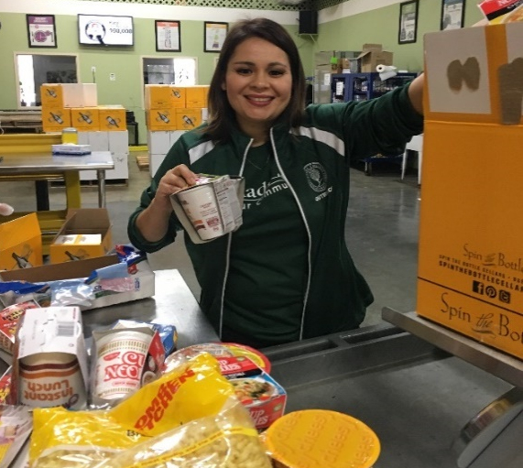
Cañada in Your Community

