Slide 1
CAÑADA COLLEGE PROFESSIONAL DEVELOPMENT FRAMEWORK
The Journey and the Draft

Slide 2
Leading From the Middle (LFM) Team
Team member
Alison Field | History Faculty - ACES, DREAMers Task Force
Melinda Ramzel | Early Childhood Education/Child Development Faculty - ACES, Teaching, Learning and Assessment (TLA)
Trish Guevarra | Program Services Coordinator for Bridge to Opportunities Peer Mentorship Program, and Veterans Resource and Opportunity Center - ACES, Communities of Practice
Erin Moore | Director of Professional Development and Innovation
Chialin Hsieh | Dean of Planning, Research, and Institutional Effectiveness, ACES, Teaching, Learning and Assessment (TLA)

Slide 3
LFM Team Task
Create a Professional Development Framework for Cañada College
Develop a clear picture of professional development at Cañada
Increase access and utilization of professional development
Improve communication about professional development
Build on what we do well and incorporate new practices and ideas
Increase collaboration and integration among groups across campus and beyond as related to professional development

Slide 4
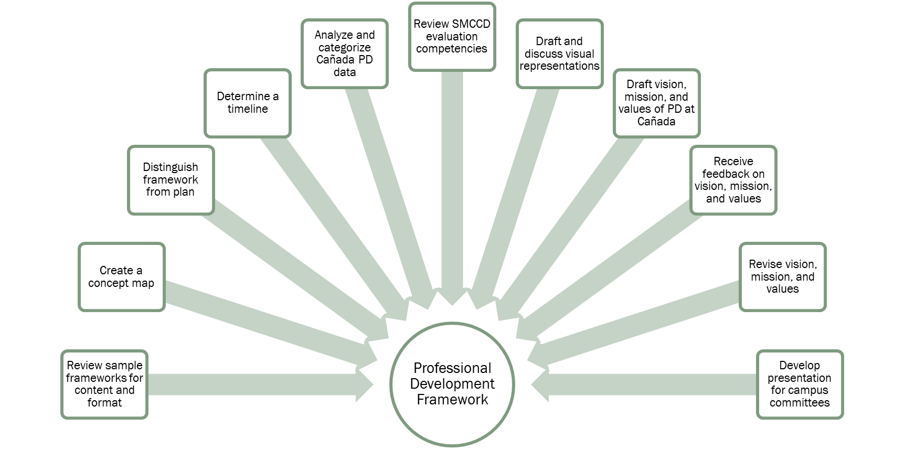
Creating a Professional Development Framework
Non-linear process
Many steps repeated
Notes:
We also benefited from the coaching we received and the things we learned at LFM Academy.

Slide 5
Campus-wide PD Input
Collected input from existing PD groups, campus committees and divisions
Determined information applicable to PD framework
Analyzed and sorted information into categories (mission, vision, values, core concepts)
Reviewed and revised categories
Tailored draft framework to our campus

Slide 6
Timeline for PD Framework
Date | Goal
February 2016 | Attend LFM workshop – developed concept map of professional development
March – May 2016 | Review samples and develop a first draft of the Cañada PD Framework (get informal feedback on the draft – update progress with Cabinet)
June 2016 | Attend LFM workshop – get external feedback on draft, refine, and revise framework, identify fall 2016 tasks
Summer 2016 | Present the PD framework draft to Cabinet for feedback
September – October 2016 | Present the PD framework draft to campus committees for feedback
September – October 2016 | Revise draft based on feedback and recommendations from IEPI.
October 2016 | Complete final draft of PD framework including final LFM convening
November 2016 | Present final PD framework to PBC for approval

Slide 7
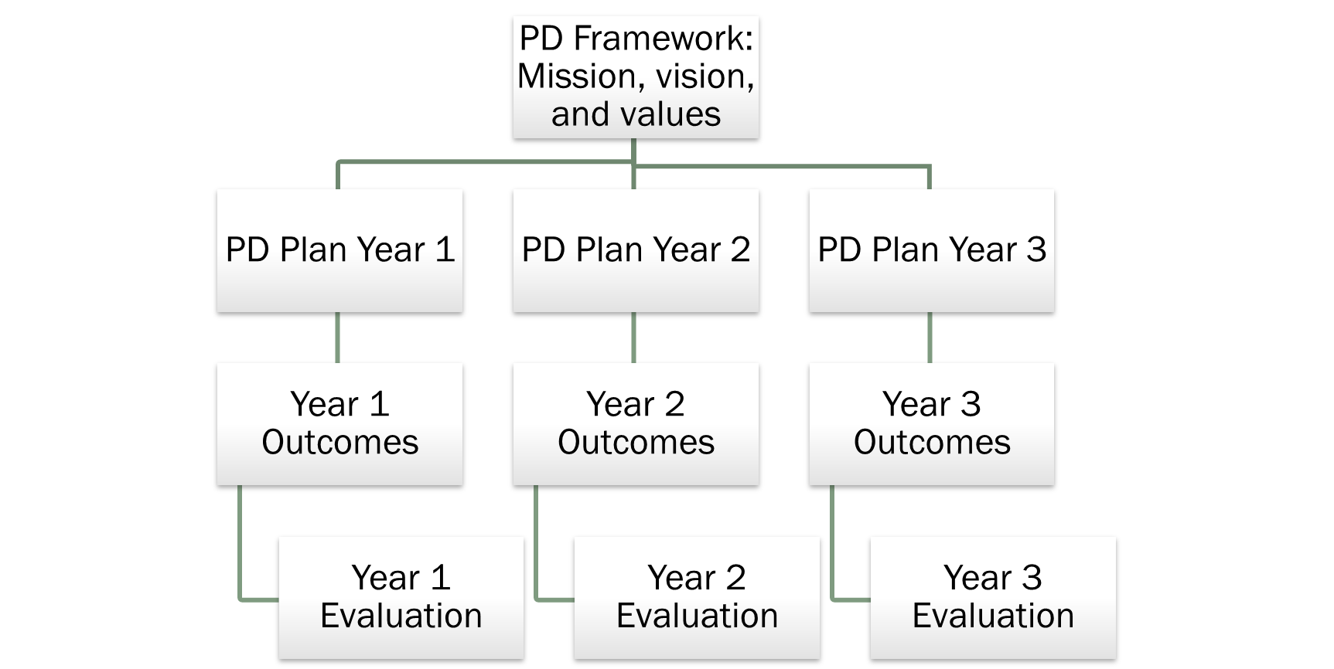
Connection between a Framework and a Plan

Slide 8
Revision Suggestions
Please review the 4 parts of the framework (Mission, Vision, Values, Framework) and provide feedback on the following:
How does this framework apply to your professional development work/experience?
What’s missing, repetitious, unclear, or inaccurate?
What’s logical, purposeful, exciting, or beneficial?
Does this capture our concept for Professional Development at Cañada College?
What other recommendations do you have for the framework?

Slide 9
Revision Process
Collected feedback from campus committees and through a campus-wide, online survey
Distributed feedback among the LFM Team
Reviewed feedback and made changes accordingly
Determined feedback appropriate for Framework and for the Plan
Identified areas to keep the same
Prioritized feedback received in multiple settings
Discussed methods for addressing feedback unrelated to the Framework
Developed a plan for sharing feedback
Provide draft, feedback, and final on the PD Framework webpage
Meet with the Campus-Wide PD Committee

Slide 10
Summary of feedback & revisions
Feedback | Revision
Appreciation for length of mission and values | Kept each statement at 1 sentence
Appreciation for the categories of PD | Kept the categories
What is the purpose of PD, to inspire, or to act? | Replaced “inspire” with “actively engage”
What does “sustainable” mean in the vision? | Replaced “sustainable” with “ongoing” in the vision
Learners and students are synonyms (values), make sure the statement is inclusive | Removed “students” from the values statement and changed “teachers” to “educators”
Ingenuity and creativity are synonyms (values) | Discovered these are not synonyms but part of the creative process and reordered the terms (values)
More details specific to an educational institution | Added details to the first item under Professional Learning and Teaching (also identified education-specific terminology)
Highlight the importance of choice and growth | Added details to the mission; added bullets to Career and Personal Growth and Development
Information on resource allocation (funds and time), implementation of framework | Developed a statement of intentionality

Slide 11
Lessons Learned/Reinforced- Campus
Collecting feedback
Meaningful
Informative
Developing a draft as a prototype
Ideal for collecting feedback
Encourages a transparent process
Involves multiple opportunities to engage the campus community
Everyone on campus is a stakeholder in professional development
Faculty
Staff
Administrators
Committees
Notes:
Feedback from campus groups essential, but also got feedback from LFM coach and other colleges (esp. Our Butte Buddies).

Slide 12
Lessons Learned/Reinforced -Leading from the Middle
Key Activities
Attended all convenings of LFM
Developed a logic model
Created a case study
Presented on our work
Feedback
Guidance from LFM coach
Specific ideas from Butte College
Sharing and Q &A from all LFM participants

Slide 13
Next Steps
Present to PBC for final approval – November 2016
Make revisions to the Framework
Meet with Campus-Wide PD Committee to discuss Framework and learning
Create the Cañada Professional Development Plan – Spring 2017
Design a visual representation for the Cañada Professional Development Framework – 2017-18 Academic year

