Slide 1
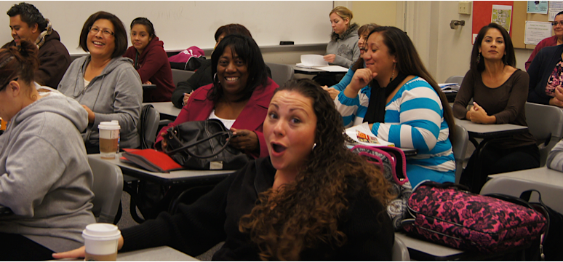
College for working adults counselor
y

Slide 2
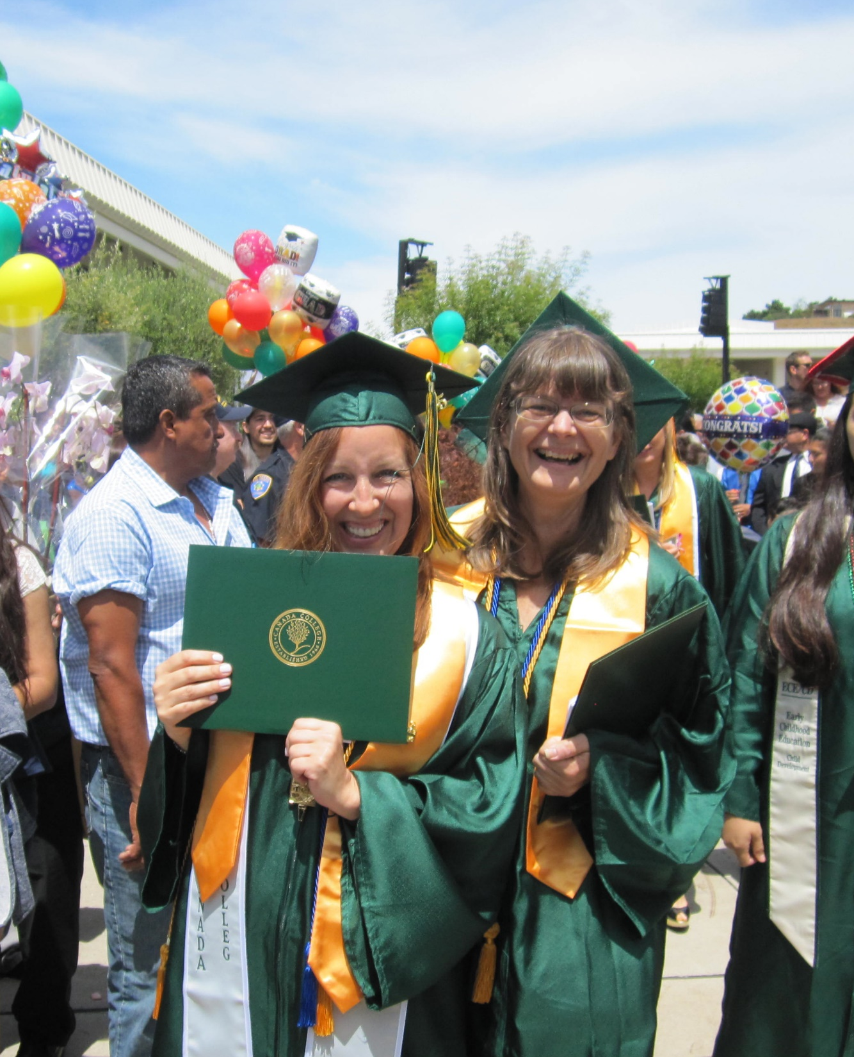
CURRENT STATUS OF program
The ONLY evening/weekend transfer program on the Peninsula
Currently serve over 280 students
Continuous growth every year since 2011
We offer a total of 5 majors (Two of them ADT degrees)
Challenges:
Staff continues to be on a temporary basis including our counseling position
  6 counselors in 7 years
  Elimination of faculty coordinator position
Although we continue to grow as a program, we have yet to be institutionalized

Slide 3
CWA dedicated Counselor
Counselor provides case management from 1st semester to transfer
  Works closely with faculty and retention specialist to create early intervention for students
Faculty coordination
Meets with EVERY student at least once per semester
  One-hour appointments for new students
  Meets with new students one month into the semester to progress
  Prepares comprehensive SEP
  Proactive registration. Prepares and submits course registration every semester
Works closely with CWA tutors to ensure students get additional support
Advises and assists with transfer

Slide 4
What is at risk?
RETENTION
  High turnover leads to gaps in service and loss of institutional knowledge
  Inconsistency in counselor prevents students rapport/trust/success
  High turnover prevents long-term planning, structure, and innovation of program
ENROLLMENT NUMBERS
  No permanent counselor = no proactive registration
Stability and sustainability of the program all together
  We need a dedicated tenure counselor to provide students will consistent support from the day they enroll with us
  Tenure contributes to institutional stability

Slide 5
OUR PROPOSAL/Budget
•A permanent counselor for a permanent program
•Position status change from temporary non-tenure to tenure-track
•A fully funded position with zero impact to Fund 1

