Slide 1

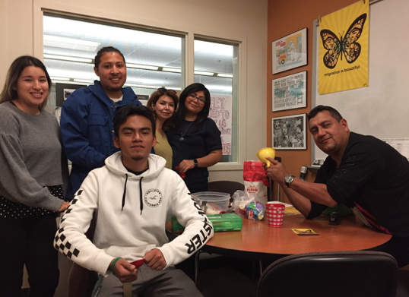
Mission
Dream Center Program Services Coordinator
2018-2019 New Position Proposals
Presentations and Discussions
November 1, 2018

Slide 2
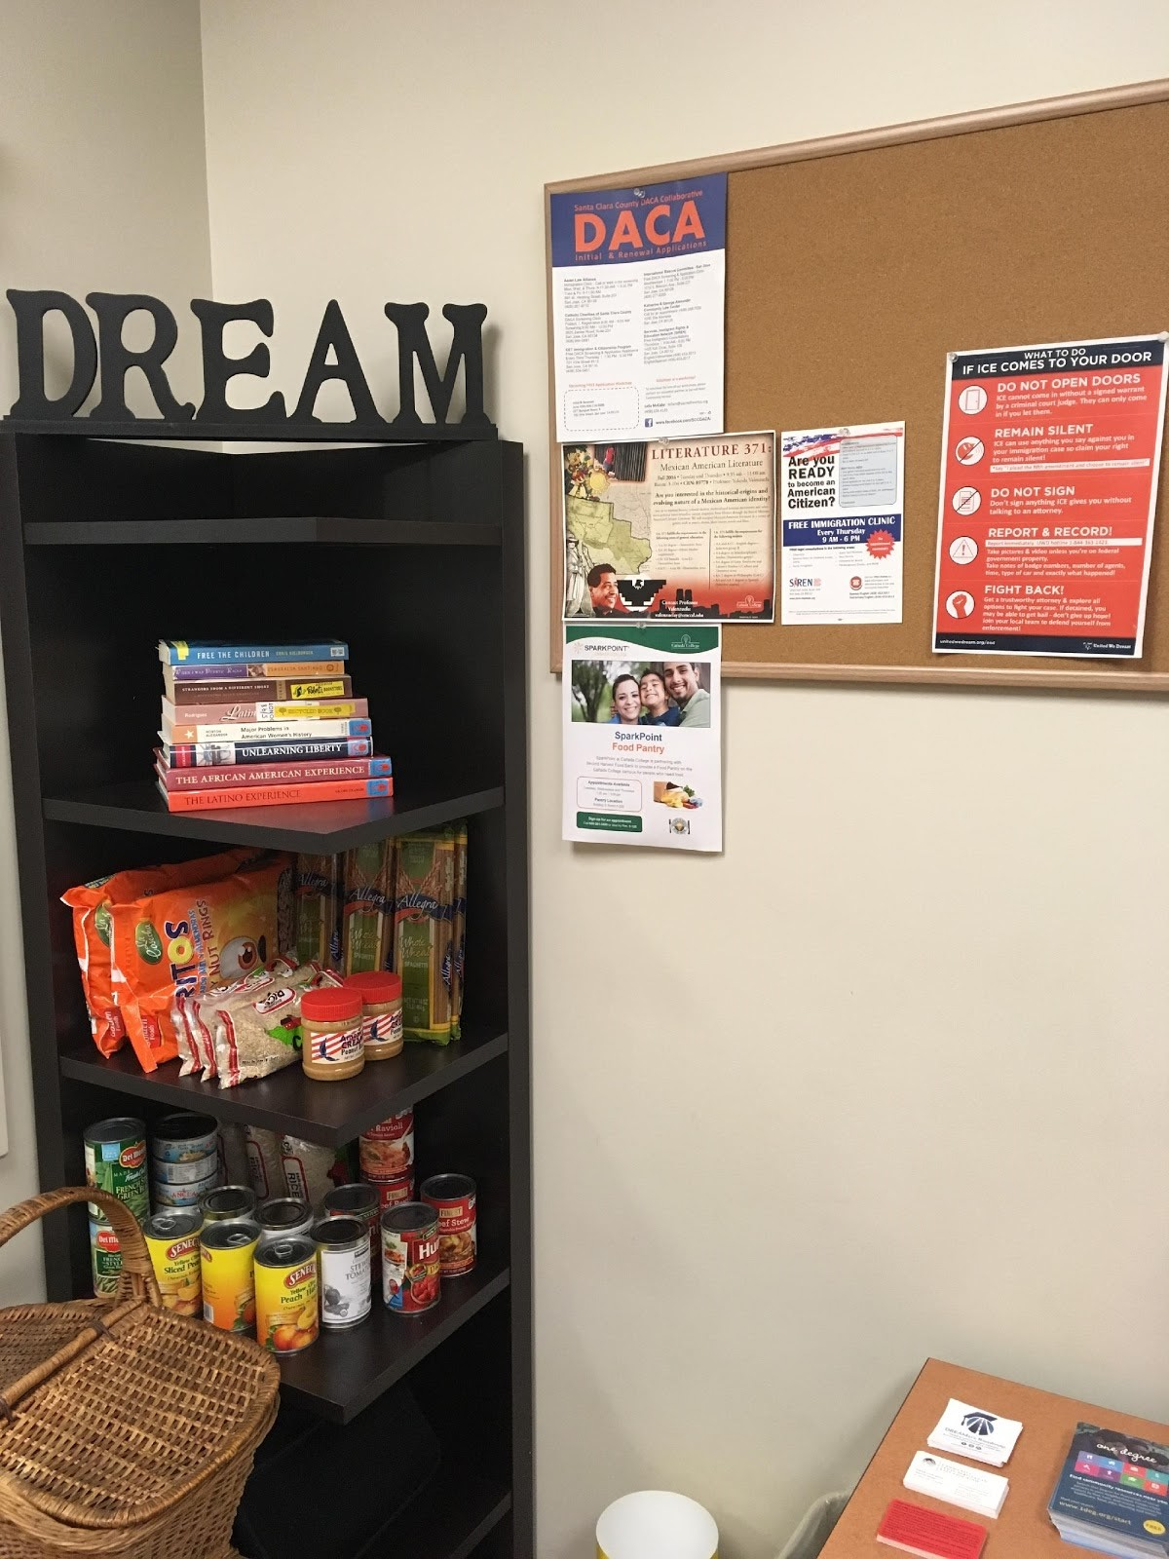

About the Cañada College Dream Center
The Cañada College DREAM Center is a resource center & safe space for undocumented students, community members & allies.
Services include:
Free legal consultations
Access to college and community resources
Free Printing
Confidential conversations
Assistance with AB 540, DREAM Act, DACA & scholarship applications
Notes:
----- Meeting Notes (2/20/17 01:53) -----
3 jobs are needed
survey =
55% > $1,000
20% > $10,000
3-4 years to complete an Assoc. Degree

Slide 3
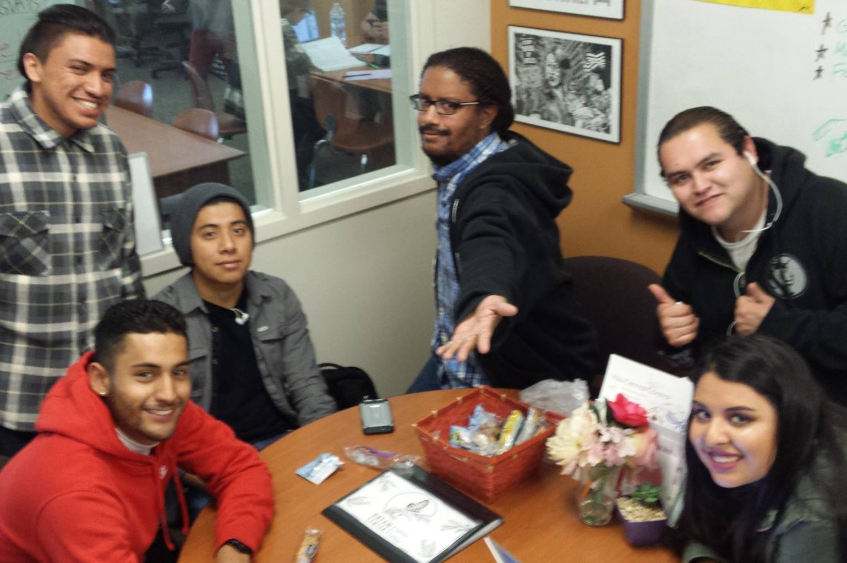
The Request & Current Staffing
The Request
1.0 FTE Program Services Coordinator
Current Staffing
Currently, there is a 0.48 FTE Short Term Staff Assistant
Notes:
----- Meeting Notes (2/20/17 01:53) -----
3 jobs are needed
survey =
55% > $1,000
20% > $10,000
3-4 years to complete an Assoc. Degree

Slide 4
2017 – 2019 Equity Goals
1. ACCESS: Increase full-time enrollments of new and continuing students from low-socio-economic backgrounds, in particular students coming to the college from North Fair Oaks and East Palo Alto
4. PERSISTENCE: Over the next two years, increase fall-to-spring persistence rates for disproportionately impacted students with a particular focus on African American and Latino/Hispanic students
5. COMPLETION RATE: Increase percentage of students who complete their educational goal (certificate, degree, and/or transfer) from 47.6% to 52.6%, with a focus on goal completion by underprepared students
Notes:
----- Meeting Notes (2/20/17 01:53) -----
3 jobs are needed
survey =
55% > $1,000
20% > $10,000
3-4 years to complete an Assoc. Degree

Slide 5
Dream Center Duties
The support the increased demand for services to our Dreamers, the PSC will:
Provide culturally relevant and equity-minded student support services to AB540, undocumented, & DACAmented students and community members
Deliver culturally relevant trainings to create a climate of understanding throughout campus regarding the undocumented community
Partner with the Financial Aid Office, Admissions and Records and Outreach to promote awareness and enrollment of state-level financial aid options for Dreamer students
Notes:
----- Meeting Notes (2/20/17 01:53) -----
3 jobs are needed
survey =
55% > $1,000
20% > $10,000
3-4 years to complete an Assoc. Degree

Slide 6
Dream Center Duties (continued)
Increase enrollment of AB540 students through partnerships with High Schools and Adult Schools (including increasing access and transfer under SB 68/ expanded AB540)
Provide up-to-date information and regular communication with undocumented community
Establishing strong campus and district-wide connections through the Dream Center Task Force and the SMCCCD Dream Centers Task Force
Create/Upkeep a network of undocumented community support
Connect students to SparkPoint services including financial coaching, healthy and nutritious food and access to the free Legal Clinic.
Notes:
----- Meeting Notes (2/20/17 01:53) -----
3 jobs are needed
survey =
55% > $1,000
20% > $10,000
3-4 years to complete an Assoc. Degree

Slide 7
On a Larger Scale…
California (as a state) has the greatest number of undocumented individuals
San Mateo County is one of the counties with the highest immigrant populations (estimated 50,000 – 70,000)
With the increasingly diversified population, it’s not just a Latino/a problem.
Notes:
----- Meeting Notes (2/20/17 01:53) -----
3 jobs are needed
survey =
55% > $1,000
20% > $10,000
3-4 years to complete an Assoc. Degree

Slide 8
AB 540/DACA Student Profile
265 enrolled in Fall 2017
232 enrolled in Spring 2018
Many more are part of mixed status families
80.2% Hispanic
60% intend to transfer
Equity gaps identified
Student Success (College / AB540) = 70.2% / 64.5%
Student Retention (College/AB540) = 80.3%/ 83.6%
Notes:
----- Meeting Notes (2/20/17 01:53) -----
3 jobs are needed
survey =
55% > $1,000
20% > $10,000
3-4 years to complete an Assoc. Degree

Slide 9
Why do we need a 1.0FTE PSC
18 hours a week is not enough for the current staff assistant to meet the growing needs of our Dream Center student population
The developing coordination needs are aligned with PSC classification
Alignment with our sister colleges’ Dream Center staffing (SKY = 1.0 FTE Fund 1 PSC) (CSM = 1.0 FTE Innov. Funded Retention Specialist + additional support by Multi-cultural Center Fund 1 PSC)
Staff Turnover - With a short-term .48 FTE position, staff will leave for other permanent opportunities
Students are asking for a safe and supportive space
Notes:
----- Meeting Notes (2/20/17 01:53) -----
3 jobs are needed
survey =
55% > $1,000
20% > $10,000
3-4 years to complete an Assoc. Degree

Slide 10
A Sense of Urgency
Student Concerns
What internships are available (paid and unpaid)
Financial support for college
Work/ entrepreneurial opportunities
They’re scared of not having enough money to afford staying in school
SMCCCD Board of Trustee and Chancellor’s Office Support
The SMCCCD Board of Trustees adopted a resolution
The CCCCO has expressed a sense of urgency
Notes:
----- Meeting Notes (2/20/17 01:53) -----
3 jobs are needed
survey =
55% > $1,000
20% > $10,000
3-4 years to complete an Assoc. Degree

Slide 11
Supports Mission & Strategic Goals
Dream Center Mission Statement
Improve access to college for undocumented students
Provide supportive services and referrals to undocumented students and families
Cultivate and undocufriendly campus culture and raise awareness
Alignment with Mission Statement
Ensures that all students have equitable opportunities to achieve their transfer, career education, and lifelong learning educational goals, regardless of their immigration status
Alignment with Strategic Goals
provides student services programs that highlight inclusivity, diversity, and equity in their mission to help students meet their unique educational goals.
Notes:
----- Meeting Notes (2/20/17 01:53) -----
3 jobs are needed
survey =
55% > $1,000
20% > $10,000
3-4 years to complete an Assoc. Degree

Slide 12
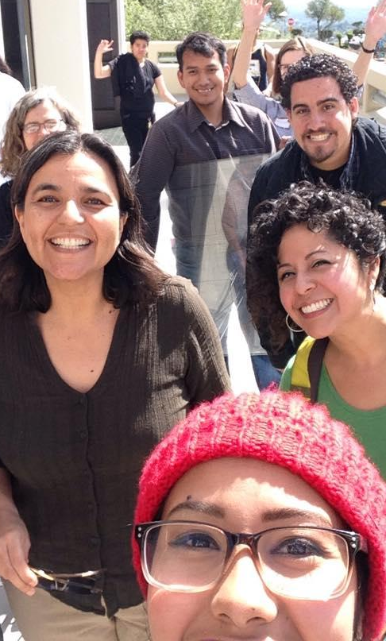
College DREAMers Taskforce
Part of ACES (Academic Committee for Equity and Success) since 2015
Group of faculty, staff, students and administrators
Mission is to provide a welcoming and equitable environment for the undocumented community
Notes:
----- Meeting Notes (2/20/17 01:53) -----
3 jobs are needed
survey =
55% > $1,000
20% > $10,000
3-4 years to complete an Assoc. Degree

Slide 13
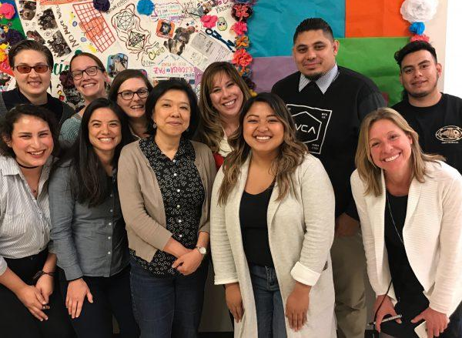
District DREAM Taskforce
Founded to institutionalize equitable pathways for undocumented students
Regular meetings to collaborate and advocate across campuses
Notes:
----- Meeting Notes (2/20/17 01:53) -----
3 jobs are needed
survey =
55% > $1,000
20% > $10,000
3-4 years to complete an Assoc. Degree

Slide 14
Outcomes
Direct services
Legal Clinic (154 appointments met, 134 unduplicated)
Confidential Conversations (new)
Events
Reached over 900 students, faculty, staff in 2016-2017
Professional development
Flex day trainings
Resource binder
Notes:
----- Meeting Notes (2/20/17 01:53) -----
3 jobs are needed
survey =
55% > $1,000
20% > $10,000
3-4 years to complete an Assoc. Degree

Slide 15
If This Position is Not Funded…
Limited (and insufficient) resources would be available for our DREAMers and allies.
Needed campus events (workshops, presentations, resources, guest speakers) would be limited.
We anticipate rapid staff turnover as qualified staff seek permanent and full-time positions at neighboring institutions with developing Dream Centers
We may be prevented from re-hiring a short-term staff member because we will exceed the number of semesters that we can request a short-term for this position.
This marginalized population will once again not receive needed services
Increases in enrollment and transfer of AB 540 students under expanded AB 540 (SB 68) will not be realized
Notes:
----- Meeting Notes (2/20/17 01:53) -----
3 jobs are needed
survey =
55% > $1,000
20% > $10,000
3-4 years to complete an Assoc. Degree

Slide 16

Questions?
Notes:
----- Meeting Notes (2/20/17 01:53) -----
3 jobs are needed
survey =
55% > $1,000
20% > $10,000
3-4 years to complete an Assoc. Degree

