Slide 1


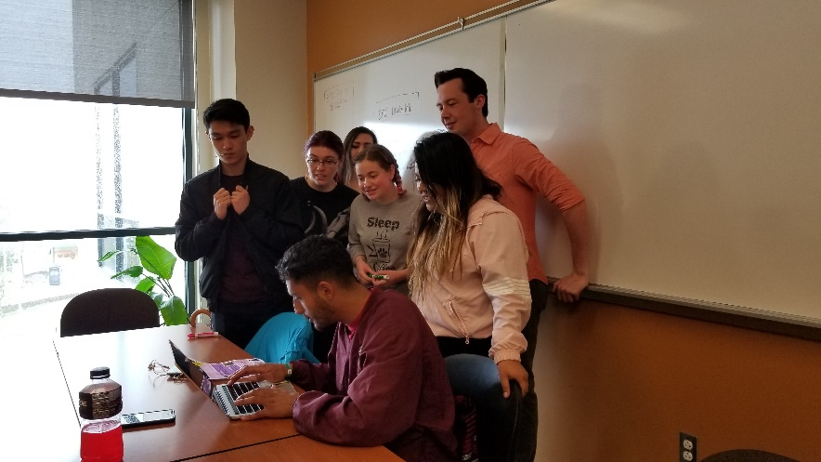
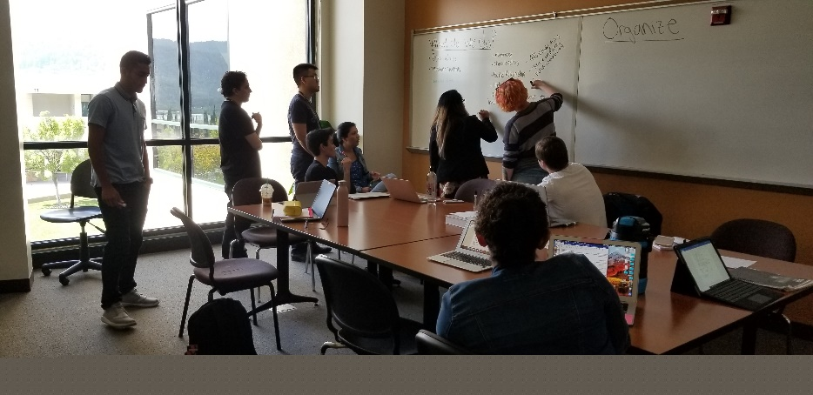


New Position Proposal:
EPIC Coordinator
October 31, 2018

Slide 2
Embedded Peer Instruction Cohort (EPIC)
Successful students that are re-integrated into a class
Serve as model students and embedded tutors
Hold weekly sessions outside of class to support instruction
Discuss study strategies and practice problem-solving
Build a community of students that work together

Slide 3
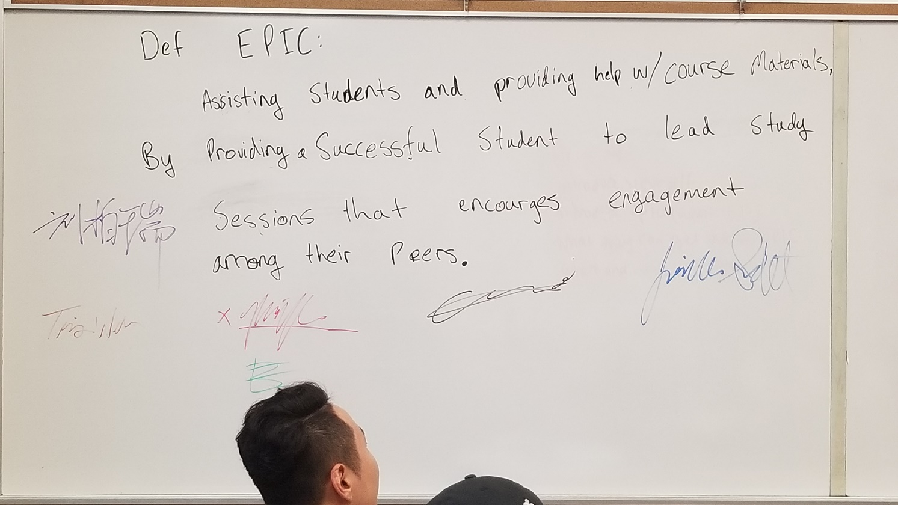
Embedded Peer Instruction Cohort (EPIC)
Def(ining) EPIC:
Assisting students and providing help with course materials, by providing a successful student to lead study sessions that [encourage] engagement among their peers.

Slide 4
EPIC Coordinator
Recruits, screens and interviews tutors for specific courses
Trains, supervises and evaluates EPIC and drop-in tutors
Coordinate with faculty to maximize program effectiveness
Coordinate with the Learning Center’s tutoring program
Collect and analyze data for program improvement
Participate in college-wide academic support plan

Slide 5
Campus Impact of the EPIC Program
Currently supports gateway math and science courses, due to limitations of grant
57% of supported students are non-STEM majors (EPIC and/or drop-in tutoring)
Institutionalization will allow expansion into new areas, specifically gateway biology courses and statistics

Slide 6
Campus Impact of the EPIC Program

Slide 7
Effectiveness of the EPIC Program
Consistently improved success rates in supported courses
Greatest improvement in groups with traditional achievement gaps

Slide 8
Effectiveness of the EPIC Program – Overall

Slide 9
Effectiveness of the EPIC Program – Equity

Slide 10
Future Applications of EPIC
Expansion beyond current grant limitations (BIOL, statistics)
Compliance with AB 705
Model for further application beyond STEM

Slide 11
Consequences of Denial
Grant funding diminishes next year, gone by 2020
Unable to reapply for this grant again
Tutor Coordinator in Learning Center already has a full load of tutors, supporting Basic Skills classes and writing
EPIC Program would likely be cancelled, tutoring support would be lost from STEM

Slide 12
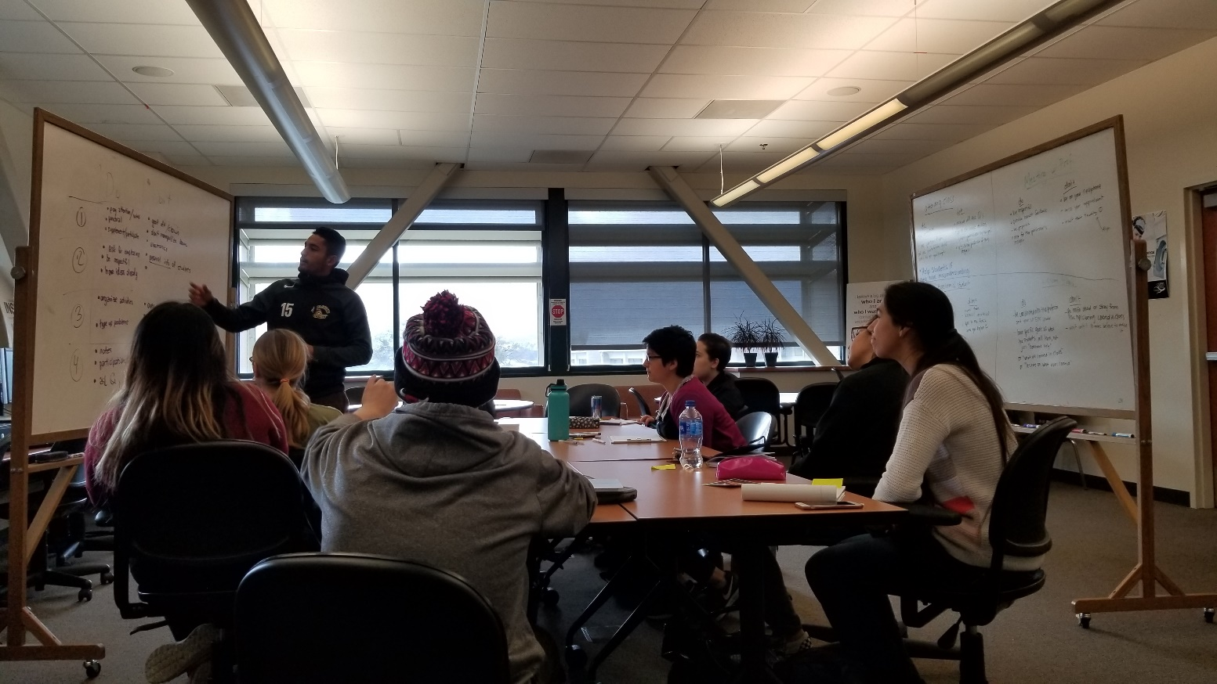
Thank You for Your Time and Consideration
Questions?

