Slide 1



Cañada College Full-Time Equity Director Position
Presented by ACES Co-Chairs:
Rebekah Taveau, ACES Faculty Coordinator
David Reed, Interim Dean of Academic Support & Learning Technologies

Slide 2

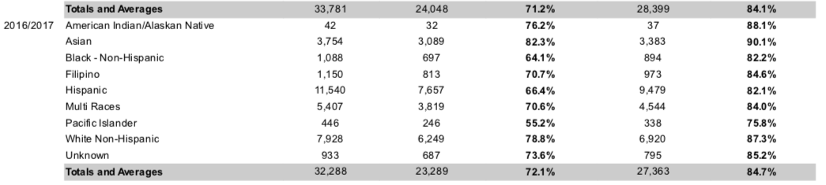
Cañada Equity Data
2016/2017 College Success and Retention Gaps

Slide 3
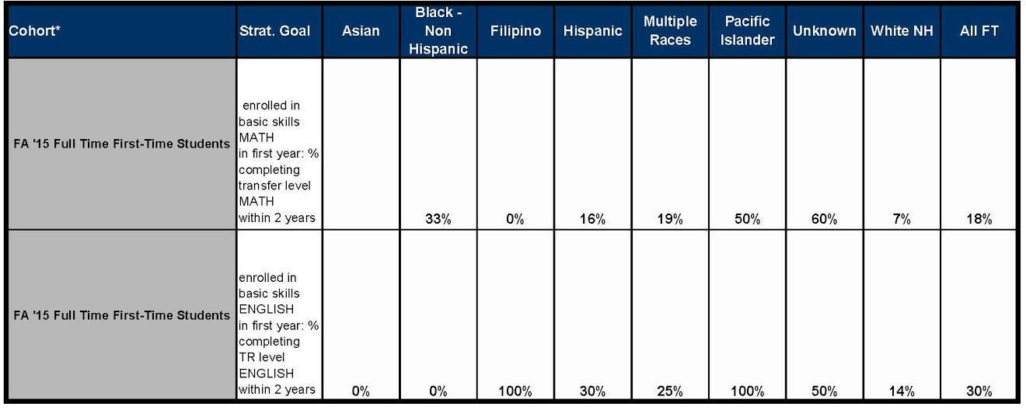
Cañada Equity Data

Slide 4
Equity Director for Campus-wide Equity
Design a clear vision and equity framework for our college
Connect equity work across the campus to strengthen it
Collaboratively address systems hindering student success and completion
Lead professional development to foster equity-mindedness

Slide 5
Alignment with College Mission
Supports College Mission:
  to ensure that “all students have equitable opportunities to achieve their transfer, career, education, and lifelong learning educational goals.”
  Values of “Diverse and Inclusive Environment”...
  “Student Success in Achieving Educational Goals”

Slide 6
Alignment with College Strategic Goals
#1
Student
Completion and Success
#2 Community Connections
#3 Organizational Development

Slide 7
Needs and Duties: Professional Development
Provide sustained, equity-focused professional development for faculty, staff, and administrators
Faculty:
Research-based best practices
Equity minded teaching approaches
Staff/Admin:
Supporting students outside the classroom
Overcoming non-academic barriers

Slide 8
Needs and Duties: Equity Campus Wide
Provide leadership,management, and co-development of equity
Initiatives:
Programs, supports, activities, events
Regular equity lecture series and bi-annual equity summit
Enact Equity Resolution: document, implement, and expand work
Support and collaborate with equity supported programs

Slide 9
Needs and Duties: Co-Chair ACES
Co-chair ACES with Faculty Coordinator
  Co-plan and chair meetings
  Elicit regular feedback and assessment of committee needs
  Assist writing, enacting, and assessing College Integrated Plan

Slide 10



Needs and Duties: Promotion & Communication
Collaborate with Skyline Dean of Equity and CSM Director of Equity on development and promotion of district events
Identify college, district, and state equity related PD Opportunities for all
Coordinate publicity for equity events & activities

Slide 11
Needs and Duties: Assess Equity Across Campus
Collaborate closely with Planning Research and Institutional Effectiveness (PRIE)
Inform evaluative methodology, research, statistical reports, and other outcome measures
Identify DI student populations & their unique needs
Monitor Retention and Success Goals & Progress

Slide 12
Summary
Equity Director will provide key leadership on equity at multiple levels
Priorities and specific roles were identified collaboratively with input from faculty, staff, administrators, and students across campus over a year-long period
This position is vital towards meeting our institutional equity goals and current staffing is not able to adequately support these needs

