Slide 1

Financial Aid Assistant
Improving student access, success and completion….

Slide 2



Need
Permanent fulltime Financial Aid Assistant who….
  Professionalizes service provided to our students
  Addresses diverse student needs and challenges – particularly those unique to Bay Area economy
  Is a knowledgeable first point of contact
  Staffs high volume-high stress service area
  Translates complex eligibility and regulatory requirements for families
  Is part of a larger support team that can triage and refer students to other services
  Provides additional staffing for multiple outreach events

Slide 3
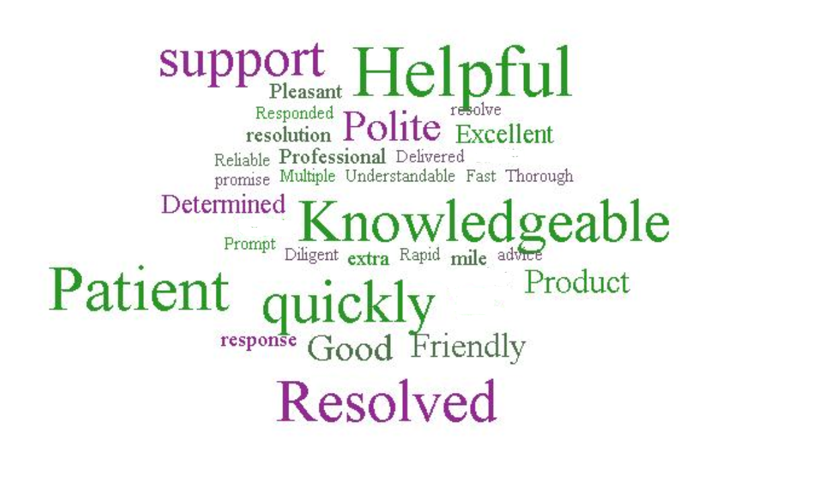


Provides Excellent Customer Service
  Elevates expectations
  Excellent interpersonal skills
  Culturally competent & social justice frame of reference
  Consistent, accurate and complete information
Timely response to student inquiries
Builds trust, removes barriers and expedites processing
Triages and refers
Supports retention and completion efforts

Slide 4
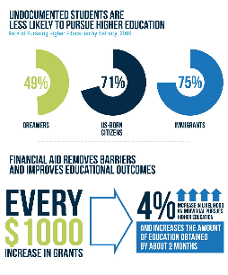
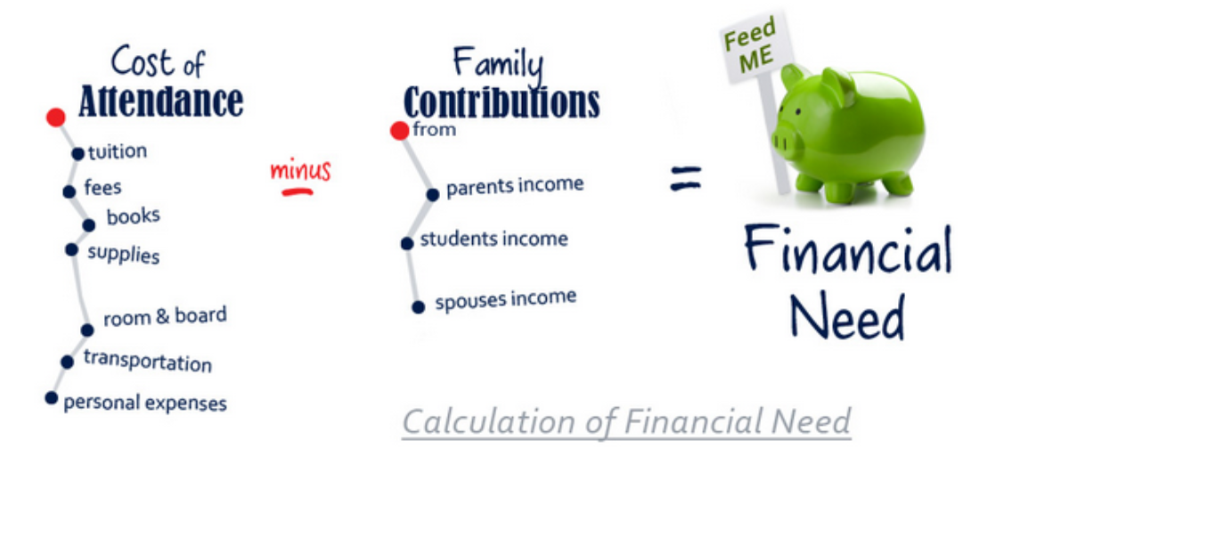
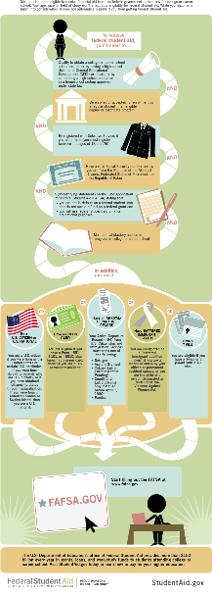

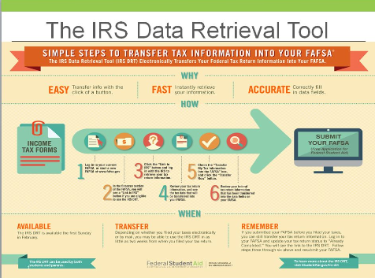

Complicated Processes
Need professional staff as first point of contact
    Average over 7,500 visits to office
    Manage email and phone inquiries
    Overreliance on students to fill gap
  Requires training, expertise, ethics
    IRS Regulations, Promise, Foster & Homeless Youth. SAP, Loss of CCPG, DACA/AB 540, Appeals…
Ability to de-escalate stressful situations, debunk myths, and clarify procedures
Provides more targeted student follow-up

Slide 5
Questions?
Financial Aid Mission:
To aid students and prospective students in their understanding, application, and timely receipt of all eligible financial aid resources they need to reduce the significant barriers the costs of higher education present.

