Slide 1
Financial Aid Program Services Coordinator
Fall 2018 Position Justification

Slide 2
Need
Permanent Fulltime Financial Aid PSC will…
Realign and balance complex work
Align staffing with Skyline and CSM
Provide program oversite
Coordinate Financial Aid Outreach
Maintain website, social media and forms
Develop FA marketing and outreach materials
Support special populations/case manage
Partner with Outreach, Promise and others

Slide 3
Liaison
Promise
Homeless Students
Foster Youth
Outreach
Dream Center
Marketing/Website/Communications
SMCCC Foundation

Slide 4
Coordination
Scholarship Program
Application system maintenance
Schedules and conducts workshops
Trains other users and resolves access issues
Promotes opportunities
Year-end Student Recognition awards
Financial Aid Presentations and Workshops
Point of contact for all internal & external requests
Planning
Staffing
Scheduling (10-12 workshops/15-20 presentations)

Slide 5
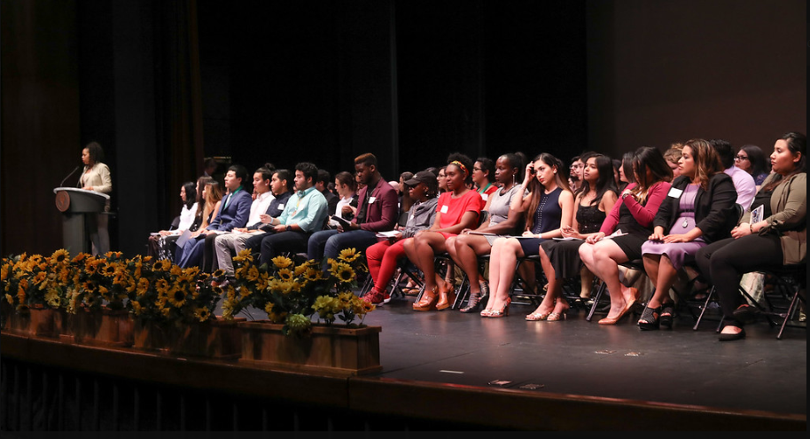
Student Recognition Event

Slide 6
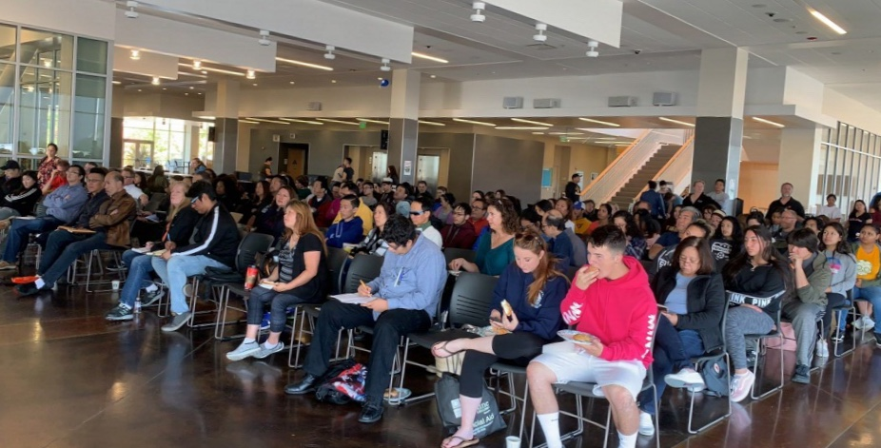
SMCCCD Cash for College

Slide 7
Expands Access & Completion
Off Campus
Trained staffing for Cash for College Workshops
Participation in Enrollment teams/Guided Pathways
On Campus
Supports Retention efforts Promise, EOPS, CARE, CalWORKs & FFYSI, TRiO, DRC, etc.
Follows up with incomplete/not awarded students
Case manages high need, SAP, other at risk groups
Schedules and conducts multiple workshops FAFSA, CADAA, Scholarship and tailored content for special populations, tabling for student events, etc.

Slide 8
Consequences if not filled…
Scholarship Program will suffer
Reputation with donors will suffer
Financial aid outreach will be limited
Undermines department, director and college
Lead to student complaints
Inability to effectively support high need students
Inability to expedite processing for Promise
FA limited in helping YOU/YOUR program

