Slide 1

Kinesiology, Athletics, & Dance Department
Position Proposals 2018
Director of Wellness & Planning, Program Services Coordinator, Office Assistant II

Slide 2
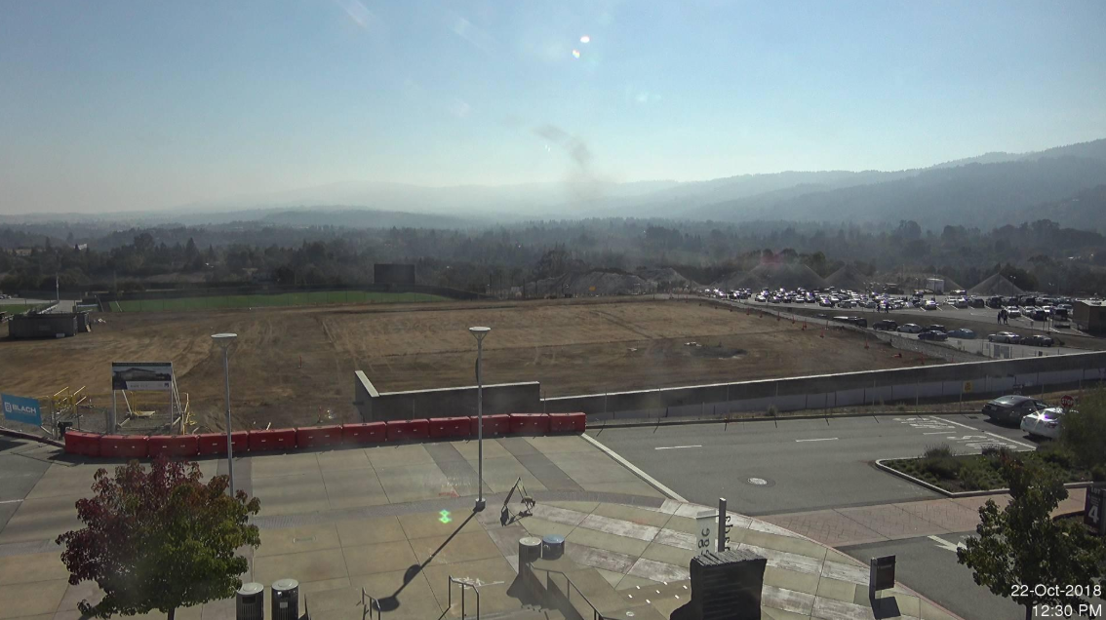
Where Are We
Notes:
The B1 Kinesiology & Wellness project consists of the demolition of an existing athletics building of approximately 41,000 SF, followed by the construction of a new 85,000 SF Kinesiology and Wellness building on the same site, and the transformation of the existing Parking Lot 4 to a new south squad landscaped plaza.
The new building will be the home of the Cañada College Physical Education Department. The new building will be a two story structure with rooftop activities and will house both academic and enterprise facilities, including classrooms for wellness activities, an extensive area for fitness equipment, a completion basketball gymnasium, lock and shower facilities, offices and auxiliary facilities. An instructional aquatics pool and a competition pool will be constructed on the flat part of the site to the east of the structure, complete with spectator areas and auxiliary buildings for associated support facilities and equipment.

Slide 3
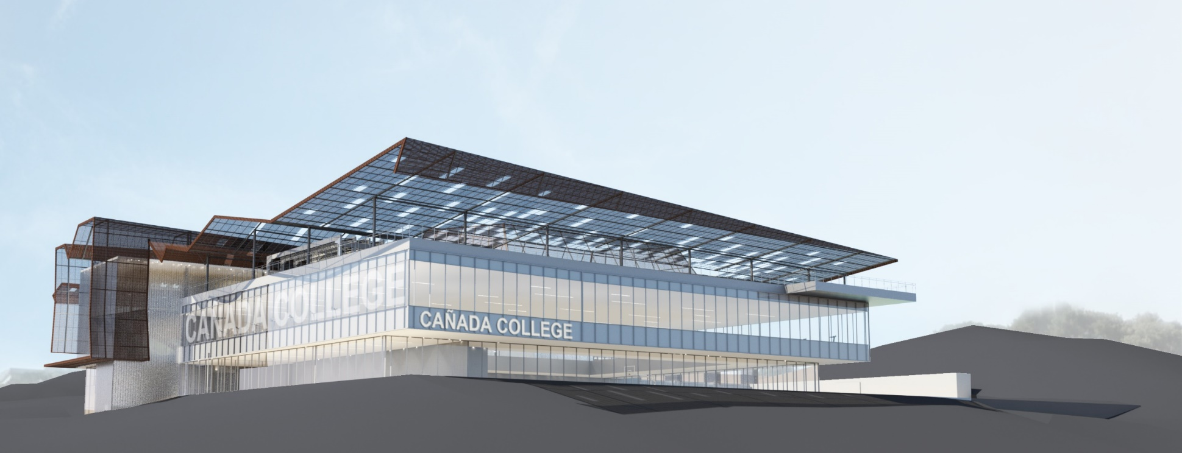
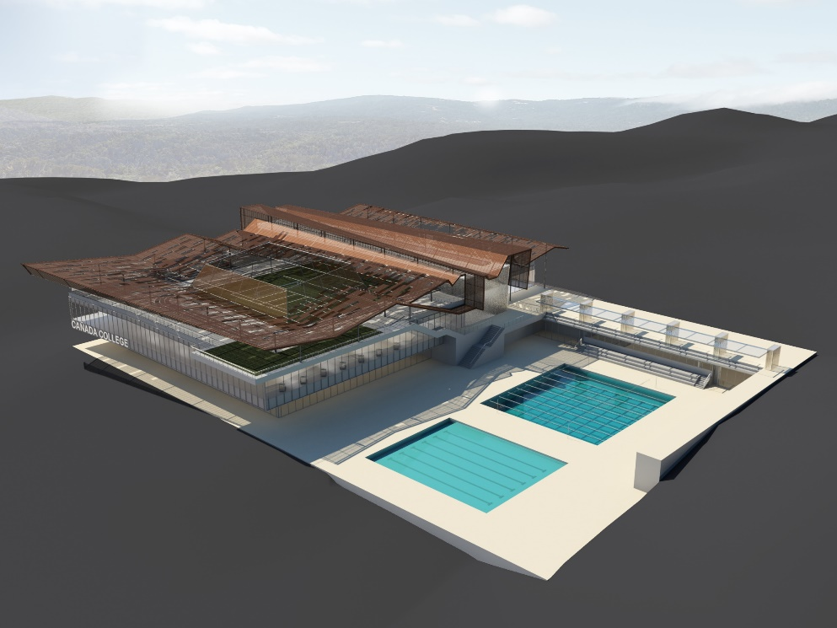
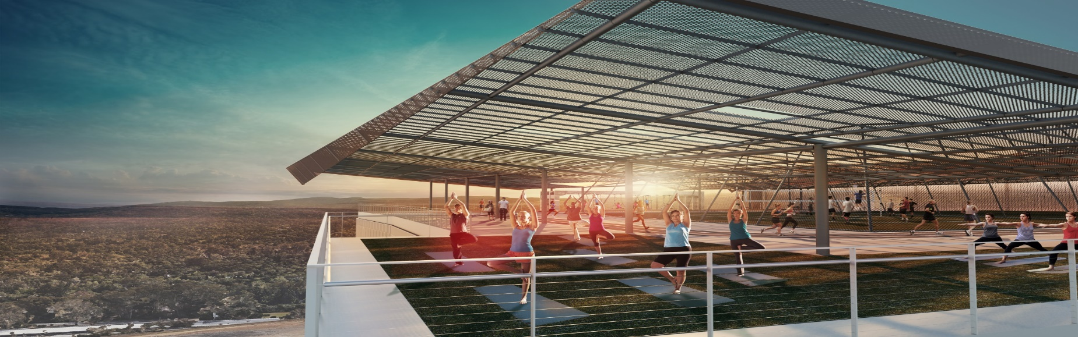
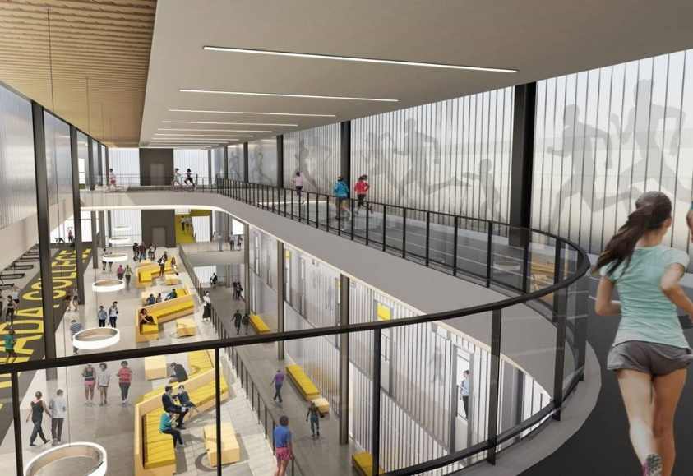
Where We Are Going
Notes:
The new building will be the home of the Cañada College Kinesiology, Athletics, and Dance Department.
B1 is a two story structure with rooftop activities and will house both academic and enterprise facilities
Included are classrooms for wellness activities, an extensive area for fitness equipment, a completion basketball gymnasium, lock and shower facilities, offices and auxiliary facilities.
An instructional aquatics pool and a competition pool will be constructed on the flat part of the site to the east of the structure, complete with areas and auxiliary buildings for associated support facilities and equipment.

Slide 4
How Do We Get There
Programming
Future Curriculum
Staffing
Expansion of curriculum offerings now and with opening of B1:
Research CC Athletic Interest Survey of Sport offerings
Fall Dance Show
Hall of Fame Ceremony & Induction Banquet
4 FT Faculty
1 Program Director
Spinning, Survey of Sport, Sports Psychology, Sports Management, First Aid/CPR-AED, Hiking/ Backpacking, Trail Running, Swing, Tap-Dance, Argentine Tango, Zumba, Dance Folklorico, Badminton, Weight Training/ Body Conditioning
Review all KINE, VARS, TEAM, INDV, FITN, DANC sections and its method of instruction
1 Full-Time Athletic Trainer
1 Part-Time Athletic Trainer
1 Instructional Aid II (50% ATH – ASLT)
Community of Learning Through Sports (COLTS)
Title IX / EADA
Prepare for an increase of Student Athletes
Currently 130-160 Full-Time Student Athletes
Conference realignment
1 Athletic Director (NIA)
4 Adjuncts
Director of Wellness and Planning
Program Services Coordinator
Office Assistant II
Director of Wellness, Program Services Coordinator, Office Assistant II

Slide 5
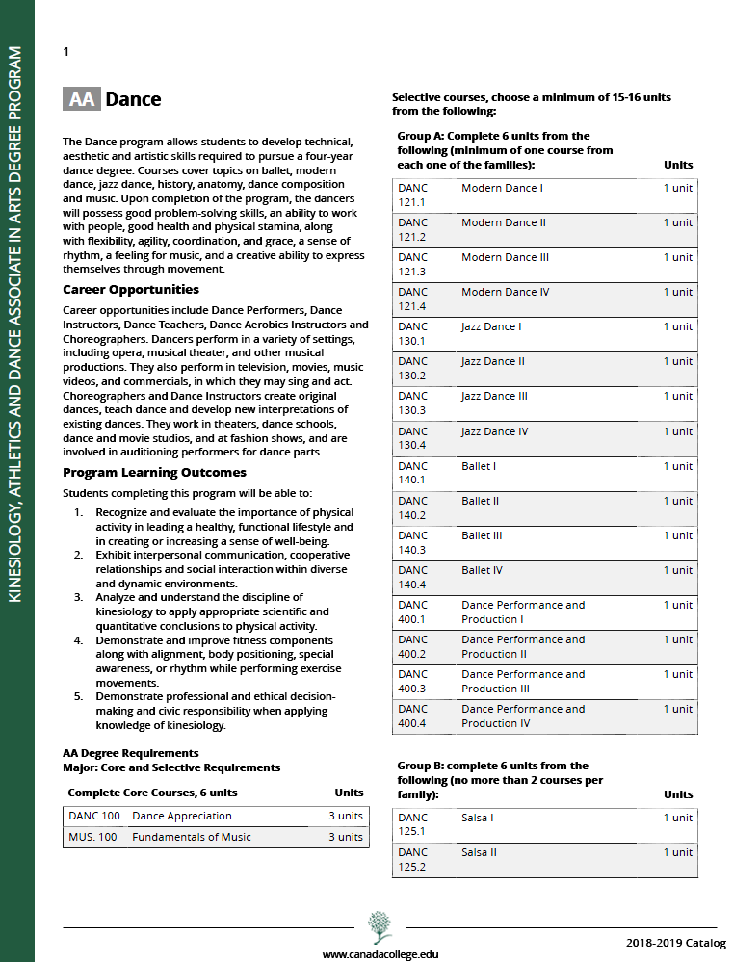
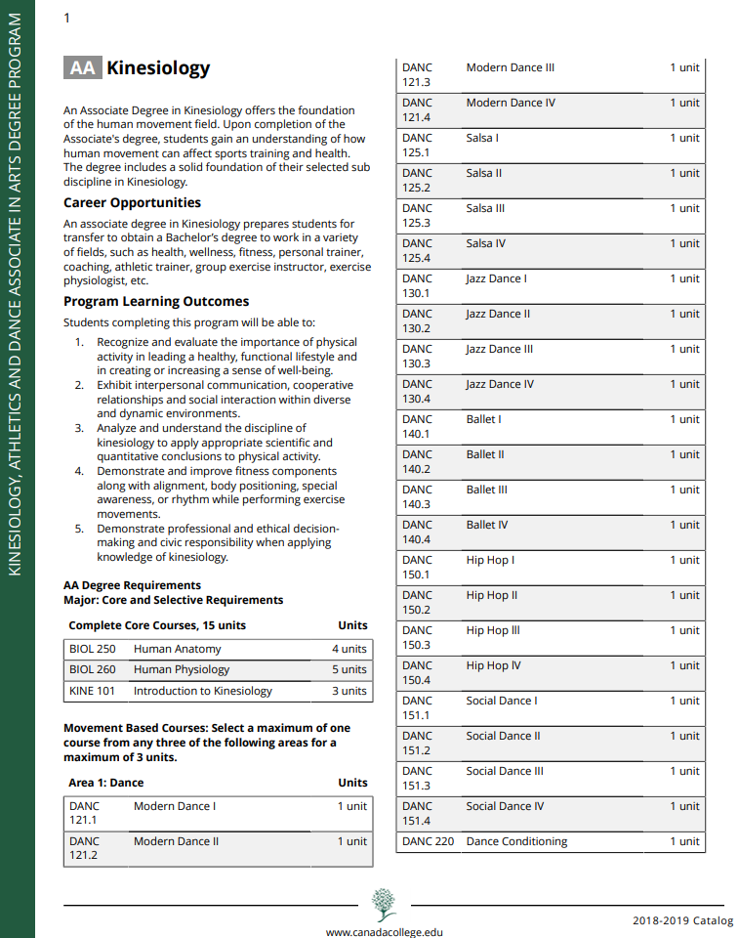
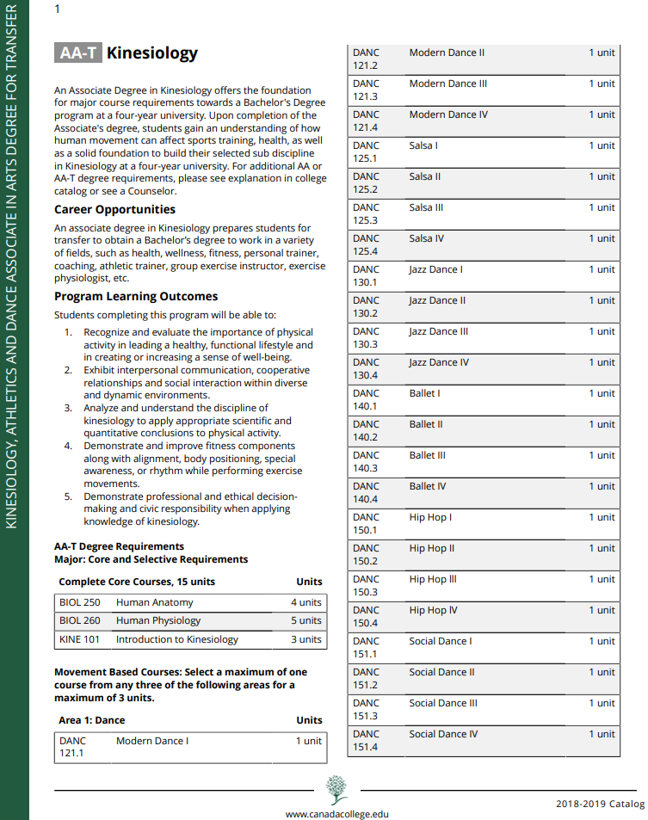
KAD Degree & Certificate Programs
Notes:
AA DANC:
Career opportunities include Dance Performers, Dance Instructors, Dance Teachers, Dance Aerobics Instructors and Choreographers. Dancers perform in a variety of settings, including opera, musical theater, and other musical productions. They also perform in television, movies, music videos, and commercials, in which they may sing and act. Choreographers and Dance Instructors create original dances, teach dance and develop new interpretations of existing dances. They work in theaters, dance schools, dance and movie studios, and at fashion shows, and are involved in auditioning performers for dance parts.
AA-T KINE:
An associate degree in Kinesiology prepares students for transfer to obtain a Bachelor’s degree to work in a variety of fields, such as health, wellness, fitness, personal trainer, coaching, athletic trainer, group exercise instructor, exercise physiologist, etc.

Slide 6
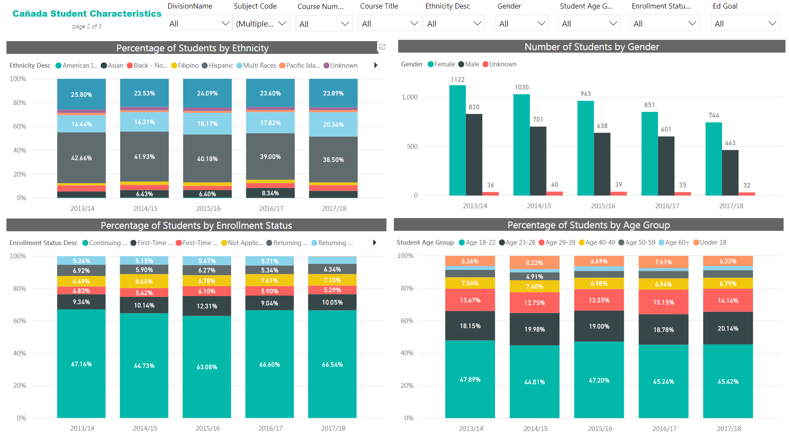
KAD Student Characteristics

Slide 7
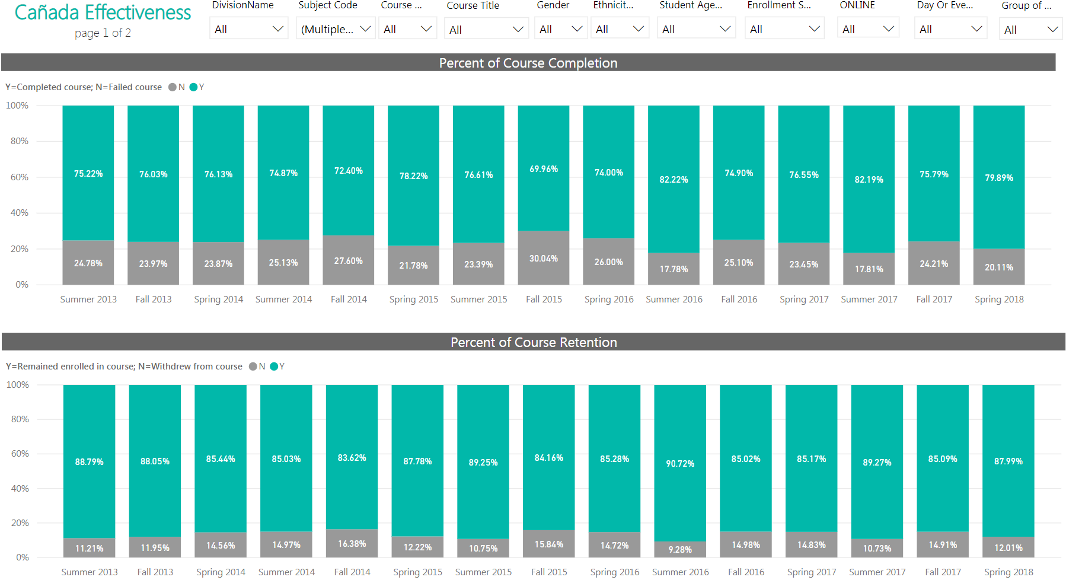
KAD Effectiveness

Slide 8
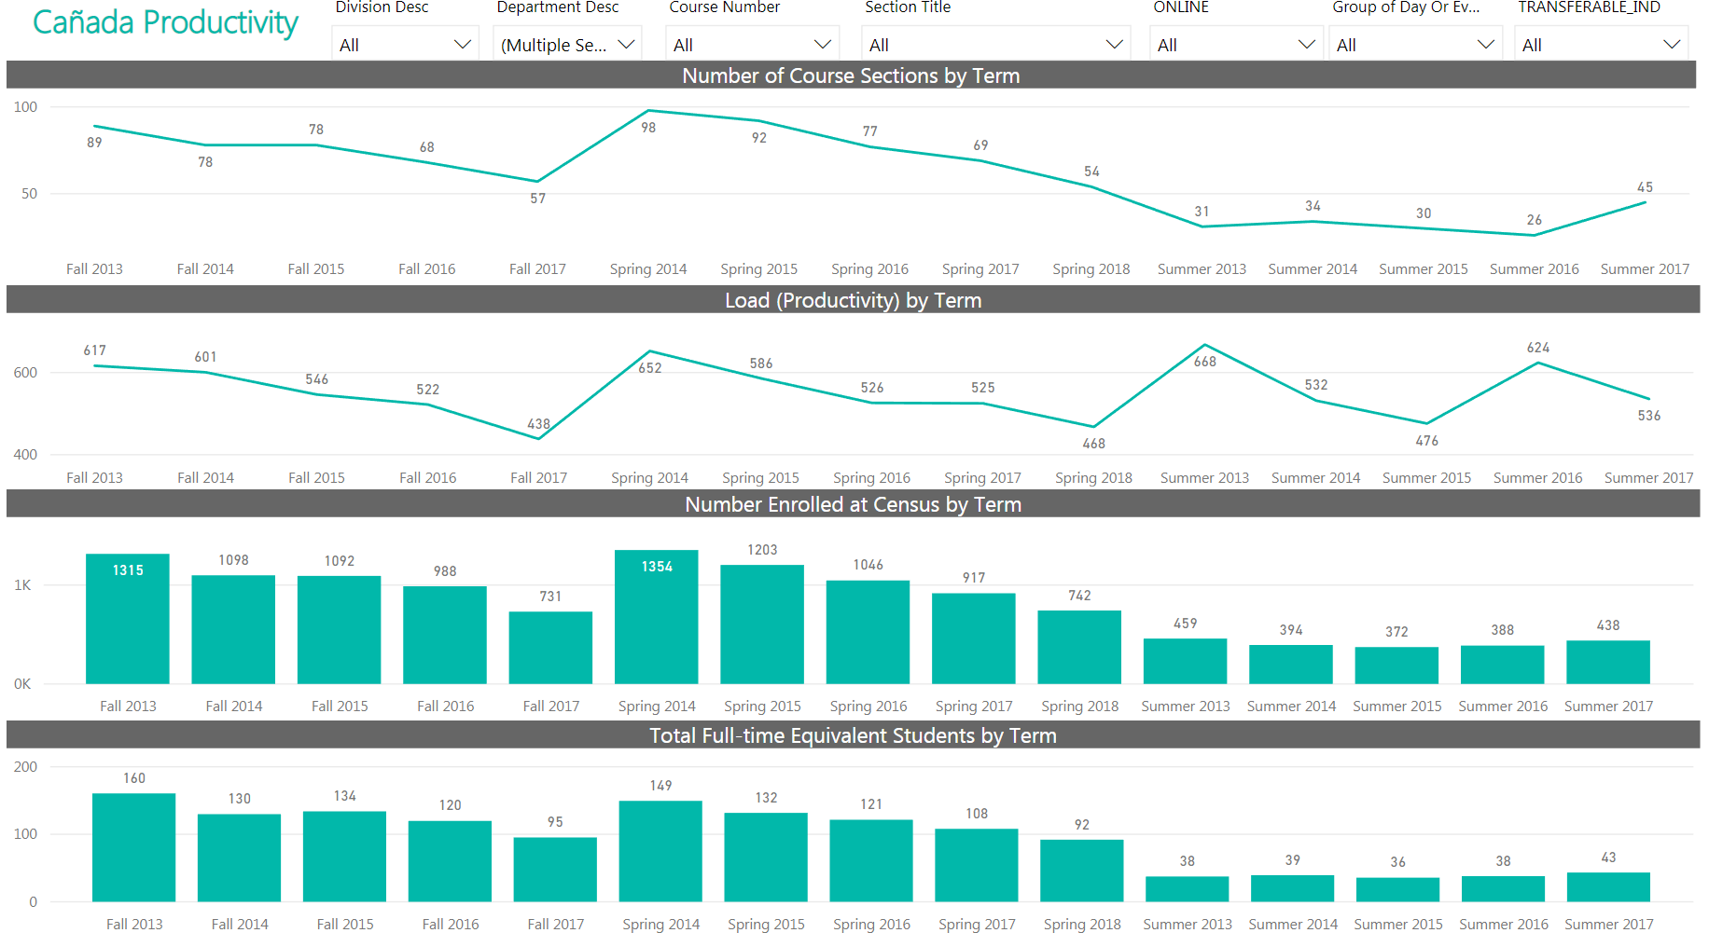
KAD Productivity

Slide 9
From KAD Department into KAD Division
Library
Learning Center
Kinesiology, Athletics, Dance, Fitness, Varsity, Team, Individual
2013: Reporting to the Office of Instruction - Athletics, Library, Learning Center (ALL)
Library
Learning Center
Kinesiology, Athletics, Dance, Fitness, Varsity, Team, Individual
2014 - 2017: Becomes an Instructional Division - Athletics, Library, Learning Center (Div. of ALL)
Athletics
Dance
Kinesiology
2018: Becomes an Instructional Department - Kinesiology, Athletics, & Dance
Lead by Office of Instruction
Not a stand alone Instructional Division
Becomes an Instructional Division grouped with Library & Learning Resources
Becomes an Instructional KAD Department
Preparing to become an Instructional Division

Slide 10
Kinesiology, Athletics, & Dance Department
Program Services Coordinator - Position Proposal 2018
Thank You

