Slide 1
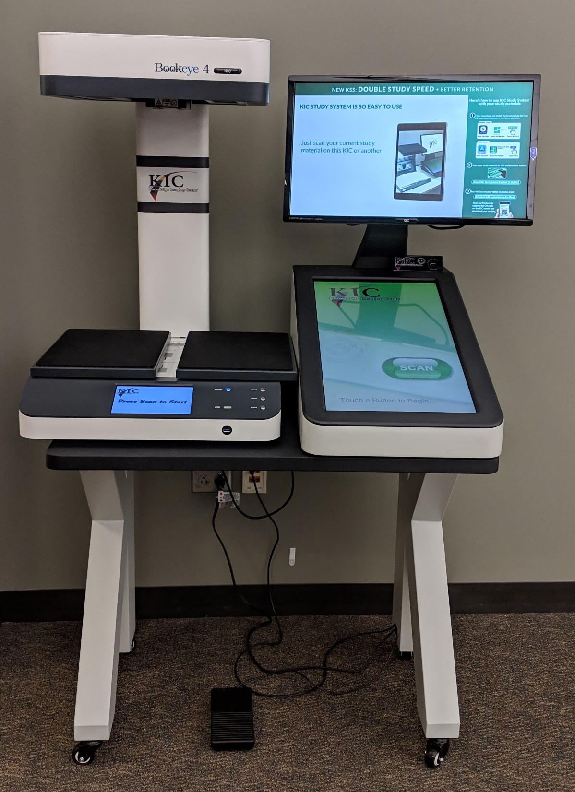



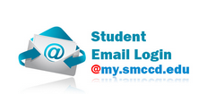



New Position Request:
Part-Time Library Support Specialist/Technology Assistance Support

Slide 2
What does this Position Do?
● Point of contact for the Canvas LMS, including login issues and navigation within the course shell
● Assistance with Websmart & Student Email: navigation, login and other account issues
● Assistance with MS Office, Google Drive and other commonly used software applications.
● Technology Basics Workshops offered throughout the semester
● Library Technology Help: using computers and printing, using the book scanner, using Library technology available for check-out (laptops, Chromebooks, WiFi Routers)
● Circulation duties: helping resolve issues with fines and late items, training student workers, managing group room reservation system, assisting students with TLC program.

Slide 3
Justification
With Canvas migration and increasing reliance on technology, more and more staff time is being re-directed to individual tech support requests – we need to have a more focused approach to supporting student technology needs
The three current Library Support Specialists are increasingly unable to focus on their main duties (reserves, cataloging, budgeting, processing, TLC, etc.) due to increasing demands for tech support and the Textbooks, Laptops & Calculators (TLC) program
Position will also support Library outreach efforts to departments such as ESL, CTE, STEM, and for initiatives such as Open Educational Resources (OER) and Zero Textbook Cost (ZTC) programs
Notes:
On-the-fly, individual assistance is a very inefficient way to support most student tech support needs. Through strategic workshop scheduling that is aligned with college orientation and specific courses, we can provide much better support to a large number of students. This position would be able to lead those efforts.
TLC program – this program requires direct support to individual students as well as the tracking and management of equipment and materials
Initiative such as ZTC and OER have a strong tech component, for example they often are integrated into Canvas. This position would also help bridge the gap for faculty who want to increase the Library presence in their Canvas courses.

Slide 4
Justification
Currently over 30% of help librarians provide consists of circulation, directional questions, and printing help - all tasks that can be handled by student workers and/or Library Support Specialists
Existing Library Support Specialists spend a total of 5.5 hours of their work day directly interacting with patrons (students, staff, and faculty)
In order to continue our TLC (semester-length loan textbook, graphing calculator, and laptop lending collection) program, we need additional support
Notes:
When Librarians divert their time to tasks that should be handled by students or classified staff, it decreases the time they can spend on core Librarian duties.
The LSS position is already the main point of contact with students and other Library patrons, so this is a natural place to house tech support
The TLC program was launched fairly quickly and it has become clear that staffing needs are greater than may have been anticipated

Slide 5
Data Points
Circulation stats: 4,209 items checked out in 2017
Reserve stats: 4650 items checked out in 2017
95% of TLC student survey respondents indicated TLC Program is very important to their academic success
74% of survey respondents indicated that they would not be able to take their course if they were not part of the TLC program:
TLC Spring 2016: 70 students
TLC Fall 2016: 140 students
TLC Spring 2017: 77 students
TLC Fall 2017: 101 students
Notes:
Data shows a strong demand for items, which requires the staff time to support
TLC program has been very well-received by students but needs more support in order to maintain and/or to expand

