Slide 1


Mission
SparkPoint Coordinator
2018 – 2019 New Position Proposals
Presentations and Discussions
November 1, 2018

Slide 2


SparkPoint at Cañada College
Mission Statement
To provide students and the community with one-on-one financial coaching and education designed to increase their financial stability and attainment of academic goals.
Notes:
----- Meeting Notes (2/20/17 01:53) -----
3 jobs are needed
survey =
55% > $1,000
20% > $10,000
3-4 years to complete an Assoc. Degree

Slide 3

SparkPoint Outcomes
Livable income that reaches the Self Sufficiency Standard
Good credit score of 700 or above
Savings equal to three months of living expenses
Reduced (revolving) debt
Increased Student Persistence
Notes:
----- Meeting Notes (2/20/17 01:53) -----
3 jobs are needed
survey =
55% > $1,000
20% > $10,000
3-4 years to complete an Assoc. Degree

Slide 4
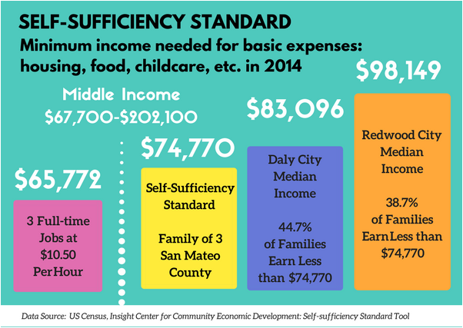
Rising Cost of Living
In 2016 Housing averages
1-bedroom unit =$2,684
2-bedroom unit = $3,318
http://www.sustainablesanmateo.org/home/indicators/key-indicator-cost-of-living/shifting-economic-equity/
Notes:
----- Meeting Notes (2/20/17 01:53) -----
3 jobs are needed
survey =
55% > $1,000
20% > $10,000
3-4 years to complete an Assoc. Degree
----- Meeting Notes (10/27/17 04:15) -----
Rising 3

Slide 5
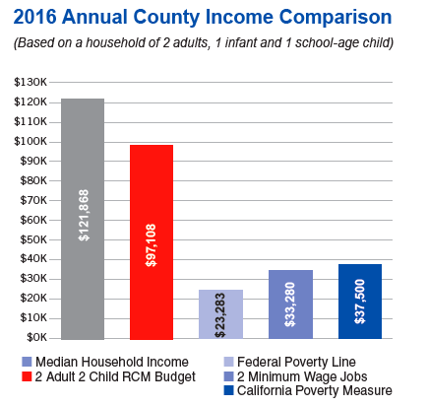
The Real Cost Measure - San Mateo County
The Real Cost Measure (RCM) estimates the amount of income required to meet basic needs (the “Real Cost Budget”) for a given household type in a specific community. The Real Cost Measure builds a bare-bones budget that reflects constrained yet reasonable choices for essential expenses: housing, food, transportation, health care, taxes and child care.
Notes:
----- Meeting Notes (2/20/17 01:53) -----
3 jobs are needed
survey =
55% > $1,000
20% > $10,000
3-4 years to complete an Assoc. Degree

Slide 6
How Are Outcomes Achieved?
SparkPoint clients work one-on-one with a coach who assists to:
Identify (financial) goals
Develop a step-by-step action plan
and keep clients on track
Services focus on three key elements of financial prosperity:
Managing credit
Increasing income
Building assets
Notes:
----- Meeting Notes (2/20/17 01:53) -----
3 jobs are needed
survey =
55% > $1,000
20% > $10,000
3-4 years to complete an Assoc. Degree

Slide 7
Specific Needs
The SparkPoint Coordinator provides:
financial coaching and education
performs data collection and entry
and coordinates SparkPoint activities.
Currently, there is 1.25FTE of financial coaching by permanent employees but secured funding for only 1.0FTE.
With the rising cost of living (a family of 4 requires almost $126,000 a year for basic sustainability), increased food insecurity and homelessness rates and growing financial barriers facing students, there is a sense of urgency to deliver upfront financial education as a strategy for increasing retention.
Notes:
----- Meeting Notes (2/20/17 01:53) -----
3 jobs are needed
survey =
55% > $1,000
20% > $10,000
3-4 years to complete an Assoc. Degree

Slide 8
Specific Needs (continued)
Current grant funding for SparkPoint has decreased and with the low unemployment rate in San Mateo County there is also a shortage of individuals with financial literacy experience who are willing to accept short-term, non-benefited temporary positions
When SparkPoint does hire short-term employees for this position, there is usually a 4-month learning curve and these employees have only remained at Cañada for an average of 8 months
Additional support will be needed to increase SparkPoint services across campus to provide equitable access
Notes:
----- Meeting Notes (2/20/17 01:53) -----
3 jobs are needed
survey =
55% > $1,000
20% > $10,000
3-4 years to complete an Assoc. Degree

Slide 9
SparkPoint Coordinator Duties
Coordinates SparkPoint services, collects and manages data for SparkPoint activities, and delivers financial coaching
Delivers on-campus one-on-one financial coaching and workshops
Travels off-site locations (high schools, adult schools, partner agencies) to conduct outreach and deliver financial literacy workshops
Coordinates SPCC Food Pantry efforts including staffing the pantry, supervising staff, scheduling, ordering food, and maintaining quality controls
Notes:
----- Meeting Notes (2/20/17 01:53) -----
3 jobs are needed
survey =
55% > $1,000
20% > $10,000
3-4 years to complete an Assoc. Degree

Slide 10
SparkPoint Coordinator Duties
Delivers presentations to small and large groups as a SparkPoint and college representative
Participates in planning and implementation meetings for college-wide events
Plans, conducts and participates in tours, job fairs, and program services in conjunction with administration, faculty and staff
Coordinates logistics and establishes timelines, required materials, online support services, facilities, publicity and other program and event needs
Notes:
----- Meeting Notes (2/20/17 01:53) -----
3 jobs are needed
survey =
55% > $1,000
20% > $10,000
3-4 years to complete an Assoc. Degree

Slide 11
SparkPoint Coordinator Duties Also Include:
Cañada Cash
260 unduplicated students, 187 met with a coach; 22 completed (FY19)
Second Harvest Food Bank
73,682 lbs. of food with a total value of $94,390 distributed
Grab and Go (2365 meals for FA19)
Legal Clinic
Outreach efforts
Notes:
----- Meeting Notes (2/20/17 01:53) -----
3 jobs are needed
survey =
55% > $1,000
20% > $10,000
3-4 years to complete an Assoc. Degree

Slide 12
Low Touch & High Touch Services
High-touch students served last fiscal year
Education and Employment = 108 individuals served 268 unique times
Income and Work Supports = 237 individuals served 1644 unique times
Financial Literacy = 104 individuals served 599 unique times
Notes:
----- Meeting Notes (2/20/17 01:53) -----
3 jobs are needed
survey =
55% > $1,000
20% > $10,000
3-4 years to complete an Assoc. Degree

Slide 13
Alignment with Mission & Strategic Goals
Mission Statement
SparkPoint provides access to services, and equitable opportunities for students to achieve their transfer, career education, and lifelong learning educational goals.
Strategic Goals (Goal #1)
Minimizes financial barriers to success which leads students towards increased retention rates
Notes:
----- Meeting Notes (2/20/17 01:53) -----
3 jobs are needed
survey =
55% > $1,000
20% > $10,000
3-4 years to complete an Assoc. Degree

Slide 14
Strengthening ALL Departments/Divisions
Addressing the multiple financial barriers facing students
Educating students on positive money behaviors and strategies
Working with students to increase their income, build their credit, reduce their debt and grow their savings
Reducing students’ time to completion
Students learn how to better manage their money so they can afford to stay in school
Increased retention, success, and persistence & lifelong money management skills across ALL disciplines
Notes:
----- Meeting Notes (2/20/17 01:53) -----
3 jobs are needed
survey =
55% > $1,000
20% > $10,000
3-4 years to complete an Assoc. Degree

Slide 15
If This Position is Not Filled
Current deliverable are being met largely due to having an additional short-term coordinator
Long-term planning is challenging without sustainable funding
Finding qualified staff to deliver financial literacy in a non-benefited position is challenging in this region with low unemployment rates
Although SparkPoint has secured additional short-term funding this year, SparkPoint will have to reduce its scope of services to both on-campus and underserved off-campus students
SparkPoint will have to reduce outreach efforts designed to increase enrollment
SparkPoint may soon be unable to continue requesting the short-term position
SparkPoint will have the resources to fully assist the college in it’s efforts to increase retention rates and decrease time to completion.
Notes:
----- Meeting Notes (2/20/17 01:53) -----
3 jobs are needed
survey =
55% > $1,000
20% > $10,000
3-4 years to complete an Assoc. Degree

Slide 16

Be SMART with SparkPoint!
S pend less than your income
M ap out your income and expenses
A dopt a savings plan
R epair / build your credit
T arget dates for financial goals
Notes:
----- Meeting Notes (2/20/17 01:53) -----
3 jobs are needed
survey =
55% > $1,000
20% > $10,000
3-4 years to complete an Assoc. Degree

