Slide 1
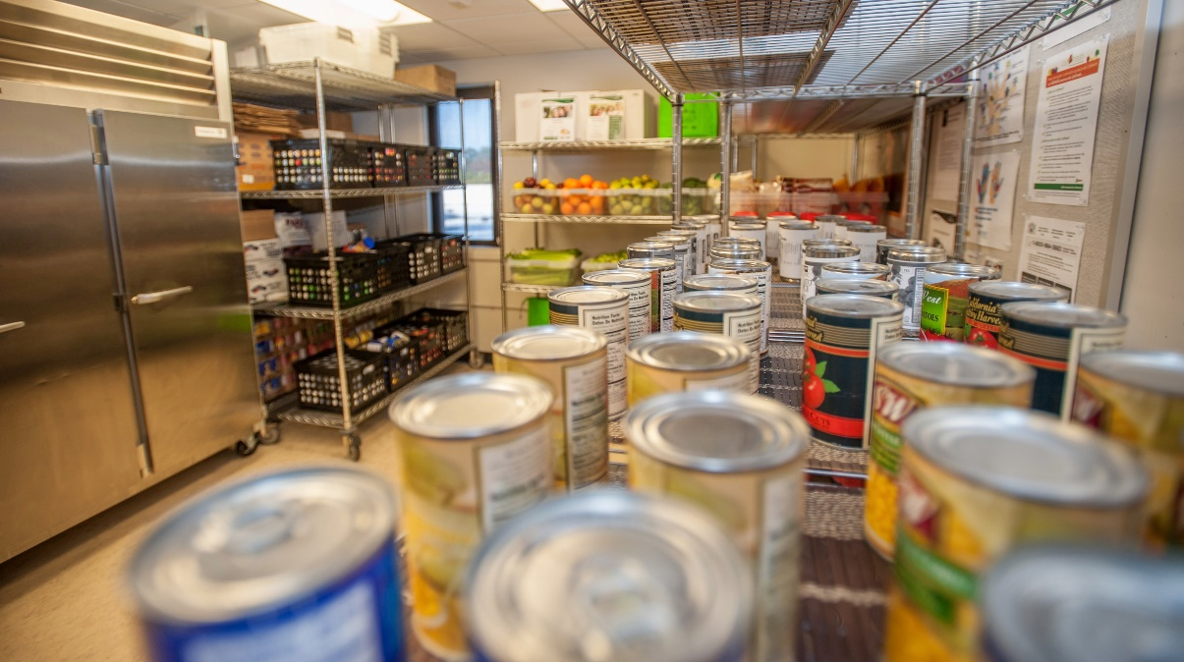
Mission
SparkPoint Pantry Office Assistant II
2018-2019 New Position Proposals
Presentations and Discussions
November 1, 2018

Slide 2

About the Cañada College Food Pantry
The Food Pantry is a partnership between SparkPoint, Cañada College and Second Harvest Food Bank of Santa Clara and San Mateo Counties.
Individuals can receive two grocery bags of food per person once a week
The Pantry is open on Tuesday, Wednesday and Thursday from 1:00 pm to 3:00 pm and Thursday evenings from 5:00 pm to 6:30 pm
The OAII is assisted by a combination of 4 other staff members who rotate assisting to cover during open hours
In 2017, the Pantry distributed 73,682 lbs. of food ($94,390)
Notes:
----- Meeting Notes (2/20/17 01:53) -----
3 jobs are needed
survey =
55% > $1,000
20% > $10,000
3-4 years to complete an Assoc. Degree

Slide 3
Specific Needs
The Self-Sufficiency standard for a family of 4 is $125.995 per year
73,682 lbs. of food distributed to both day and evening students
That’s $94,390 of savings going back to students to offset other living expenses
SparkPoint has funded salaries, benefits and general expenditures for the pantry for the past four years using a soft money that has ended
SparkPoint’s current discretionary funding for pantry expenditures has decreased and will not be able to cover the entire current annual cost
Student Assistants are not a good fit to staff the pantry because of their need to have flexible schedules
Notes:
----- Meeting Notes (2/20/17 01:53) -----
3 jobs are needed
survey =
55% > $1,000
20% > $10,000
3-4 years to complete an Assoc. Degree

Slide 4
2018 SMCCCD Food and Housing Insecurity Survey
Survey results revealed the following challenges experienced by students with regard to their basic food needs due to income limitations:
55% indicated that the food they purchased, “just didn’t last and I didn’t have money to get more.”
12% reported this as “often true”;
33% reported this as “sometimes true”
28% of students reported, “cutting the size or meals or skipping meals” because there wasn’t enough money for food.
Beyond the literal lack of food, the level of psychological insecurity is high: 41% of students report that, “I am worried whether my food would run out before I got money to buy more.”
Notes:
----- Meeting Notes (2/20/17 01:53) -----
3 jobs are needed
survey =
55% > $1,000
20% > $10,000
3-4 years to complete an Assoc. Degree

Slide 5
Day to Day Duties of the Food Pantry
Provides food pantry support (customer service, ordering, stocking, inventory control, food rotation, outreach, screening for public benefits, tabling, maintaining the pantry and assisting with workshops)
Manages data entry by entering food pantry efforts into the SparkPoint database, running reports and submitting monthly reports to Second Harvest Food Bank.
Maintains the Food Pantry to California Food Safety Standards
Trains and supervises the work of students assistants
Refers students to campus and community resources
Makes referrals to SparkPoint for financial coaching
Notes:
----- Meeting Notes (2/20/17 01:53) -----
3 jobs are needed
survey =
55% > $1,000
20% > $10,000
3-4 years to complete an Assoc. Degree

Slide 6
Alignment with Mission & Strategic Goals
Mission Statement
Provides healthy and nutritious food to students, access to SparkPoint services, and equitable opportunities for them to achieve their transfer, career education, and lifelong learning educational goals
Strategic Goals (Goal #1)
Minimizes financial barriers to success which leads students towards increased retention rates
Notes:
----- Meeting Notes (2/20/17 01:53) -----
3 jobs are needed
survey =
55% > $1,000
20% > $10,000
3-4 years to complete an Assoc. Degree

Slide 7
Strengthening ALL Departments/Divisions
This position will increase students’ access to healthy & nutritious food.
Clients will benefit from increased food pantry hours, expanded CalFresh enrollment efforts, & increased connection to SparkPoint services
SparkPoint is experiencing an increase in panty use by student athletes, international students, evening students and staff and faculty
Increased and sustainable staffing means increased access to food
These expanded services will increase student retention by reducing student hunger and food insecurity as a barrier to student success.
Notes:
----- Meeting Notes (2/20/17 01:53) -----
3 jobs are needed
survey =
55% > $1,000
20% > $10,000
3-4 years to complete an Assoc. Degree

Slide 8
If This Position is Not Filled
Food pantry efforts will be decreased from current levels
Qualified individuals may not enroll in CalFresh
The bulk of hours needed to schedule, stock, bring in deliveries, clean and maintain the Pantry will be covered by a short-term OAII and students
We may be prevented from re-hiring short-term staff because we will exceed the number of semesters that we can request this position
Cañada College will be unable to adequately address food insecurity for our own students
Notes:
----- Meeting Notes (2/20/17 01:53) -----
3 jobs are needed
survey =
55% > $1,000
20% > $10,000
3-4 years to complete an Assoc. Degree

Slide 9
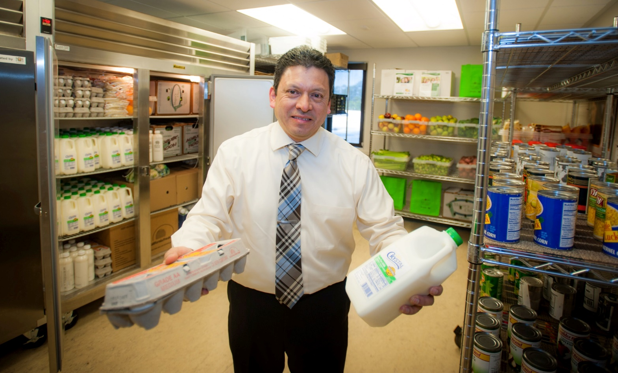

Visit the Cañada College Food Pantry!
Notes:
----- Meeting Notes (2/20/17 01:53) -----
3 jobs are needed
survey =
55% > $1,000
20% > $10,000
3-4 years to complete an Assoc. Degree

