Slide 1


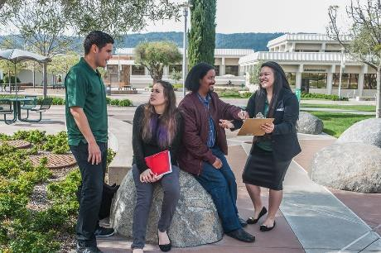
Adopted Budget
FY 2018/2019
Planning and Budgeting Council 09/19/2018
Presented by:
Mary Chries Concha Thia
Interim Vice President, Administrative Services

Slide 2
Overview
Budget Process
Budget Assumptions
Budget goals/priorities for 2018/2019
2018/2019 budget

Slide 3
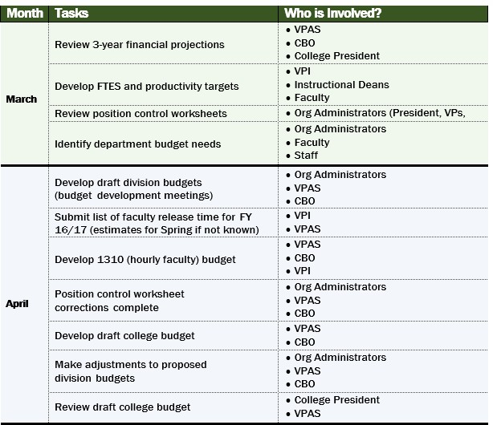
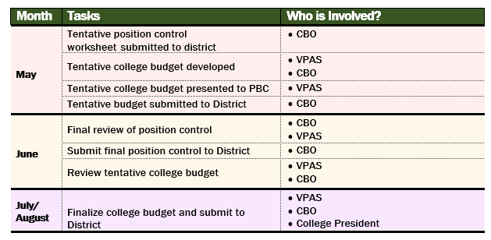
College Budgeting Process, FY 18/19
More information available on the Administrative Services webpage: http://canadacollege.edu/adminservices/resources.php

Slide 4
Budget Assumptions – General Fund
Our primary source of unrestricted funds is our Site Allocation
Site allocation determined through the District Resource Allocation Model
Property Tax Increase: 8.03%
Enrollment Fees
RDA: Continue ongoing, no one-time
EPA: Ongoing $100/FTES

Slide 5
Budget Goals and Priorities for 18/19
Our college budget is a tool to support our plans into specific,
action-oriented goals and objectives
Goals
Effectiveness (leveraging existing resources)
Focused Growth (building on what works)
Supportive Energy (creating
room for ideas and innovation)
Priorities
Transparency in process
Resource optimization
Efficiency and effectiveness

Slide 6
2018/2019 Final Budget
General Fund Revenue Source | Amount
SMCCCD Site Allocation | $27,676,351
Prop 30 | $270,275
Total | $27,946,626

Slide 7
Tentative to Final Budget Changes
Expense Category | Tentative Budget | Final Budget | Change
Salaries and Benefits | $20,584,817 | $21,366,844 | $782,027
Hourly Salaries and Benefits | $4,016,294 | $5,149,057 | $1,132,763
Discretionary | $1,176,716 | $1,430,725 | $254,099
Total Expenses | $25,777,827 | $27,946,626 | $2,168,799
Revenue | $25,777,827 | $27,946,626 | $2,168,799

Slide 8
PERS & STRS Increases
Notes:
PERS going up somewhat differently than originally projected; STRS is in law and less likely to be changed.

Slide 9
18/19 Hourly Salary Budget

Slide 10
Budget Considerations
Impact of COLAs on this year’s budget
  Timing of retroactive COLAs, step increases,
  College will have to cover the adjustment for all hourly employees, special projects, and employees funded by federal grants (federal fiscal year ends September 30th)
Declining enrollment impacts Prop 30 and certain categorical programs (e.g., SSSP)

Slide 11
Moving Forward
Regular budget updates to PBC throughout the fiscal year
Long Range Budget Projections
2019/2020 budget planning starts in late fall/early spring

Slide 12
Interested in More Information?
Visit the Administrative Services webpage for info about:
  Budget Office (resources, trainings)
  Business Office (cashiers, mail room, facility use)
  Facilities
  Safety
Visit the Admin Services SharePoint site for even more info:
  18-19 Tentative Budget
  18-19 Adopted Budget

Slide 13

Q&A

