Slide 1

Planning & Budging Council
Technology, DEAC & Instructional Technology Committee Comparison
February 20, 2019

Slide 2
What We Currently Have – Missions & Visions
The Technology Committee
The Distance Education Advisory Committee (DEAC)
The Cañada College Technology Committee is a subcommittee of the Planning and Budgeting Committee and is composed of representatives from every division of the college including staff, faculty, administrators, and the District Information Technology Services staff.
The Technology Committee meets a minimum of two times per year and will provide an update to the Planning and Budgeting Committee on technology issues, such as:
Progress made regarding replacement and new technology implemented on campus
Changing technology needs for instruction, student services, and business operations
Consultation with the PRIE Department that assess the technology needs of the College
Review of the yearly allocation for technology
The mission of the distance education initiative is to increase opportunities for our diverse student population by offering flexible and innovative instruction via technology. In keeping with the mission of the College, the distance education initiative is committed to meeting the changing needs of our community by developing distance learning opportunities that increase student access, support student success, and provide quality instruction in general, transfer, career, and basic skills education, while also fostering relationships between faculty, staff and students.

Slide 3
What We Currently Have – Membership
The Technology Committee
The Distance Education Advisory Committee (DEAC)
Committee Member | Classification & Title
Dr. Tammy Robinson | Vice President of Instruction
Leonor Cabrera | Dean, Business, Design and Workforce (Co-Chair)
Dr. Nathan Staples | Faculty, Biology (Co-Chair)
Carlos Luna | Classified, Library Support Specialist
Jose Garcia | Classified, Visual Communications Coordinator
Robert Haick | Classified, Program Supervisor Career Center/Adjunct Faculty
Max Hartman | Dean, Counseling
Dr. Karen Engel | Dean of Planning, Research and Institutional Effectiveness
Maria Huning | Director, TRIO Upward Bound
Dr. David Meckler | Faculty, Music
Allison Hughes | Classified, Instructional Technologist
Dr. Lezlee Ware | Faculty, Political Science & DE Coordinator
Ray DeCasas | IT Support Technician III, Information Technology Services
Anthony Lim | IT Support Technician II, Information Technology Services
Jasmine Witham | Director of Web Services
Angelica Mendoza & Lina Tsvirkunova | Student Representation
Yoseph Demissie | Director, Technical Support Services, IT Services
Julian Branch | Director, Workforce Development
The current members of DEAC are:
David Reed, Dean of ASLT & Lead Administrator for DE (Co-Chair & Division Representative)
Lezlee Ware, Professor of Political Science and Faculty DE Coordinator (Co-Chair & Division Representative)
Adam Windham, Dean of Science & Technology (Division Representative)
Allison Hughes, Instructional Technologist
Ana Miladinova, Associate Professor of Athletics (Division Representative)
Sarita Santos, Associate Professor of Early Childhood Education (Division Representative)
Sandra Mendez, Counselor (Counseling Representative)
Julian Taylor, Tutor Coordinator (Learning Center Representative)
Don Lariviere, Alternative Media Specialist (DRC Representative)

Slide 4
What We Currently Have – Goals
The Technology Committee
The Distance Education Advisory Committee (DEAC)
Goal 1: Optimize the use of new and existing technologies throughout the College by providing technology- related professional development resources to faculty and staff.
  Objective 1.1: The instructional designer, CIETL, and the Professional Development Committee will promote and increase training opportunities (internal and external) for faculty and staff to learn to use technology more effectively.
  Objective 1.2: Develop and administer instruments that survey and assess the technology training needs of faculty and staff.
  Objective 1.3: Determine the necessity for new or expanded technology to ensure professional development training is provided to faculty and staff.
  Activity 1: Technology committee members meet with CIETL coordinators and Instructional Designer to review results from annual Technology survey and agree on specific trainings to be offered through CIETL for faculty and staff and ensure the availability of a dedicated training room specifically with computers.
Goal 2: To establish the technology infrastructure to continually improve the operations and services of the college.
  Objective 2.1: Work closely with District ITS to assess the needs of the college and determine its ability to support current and new technology.
  Activity 1: Review the College’s computer/equipment inventory spreadsheet and recommend purchases based on the replacement criteria.
  Activity 2: Explore and evaluate pilot programs for new technologies at the College.
  Activity 3: Ensure that ITS and the College Business Office continue to track and monitor progress.
Goal 3: Ensure that compliant and current adaptive and assistive technology is available to all students possessing any form of learning and or physical difference.
  Objective 3.1: Evaluate the present use of adaptive technology by students, faculty and staff who have a documented disability that prevents access to standard computer hardware and software.
  Objective 3.2: Determine the necessity for new or expanded technology that is more likely to satisfy special learning needs.
  Objective 3.3: Survey the need to provide training for faculty who teach hybrid and on-line courses in the use of adaptive and assistive technology.
  Activity 1: (students only as District HR is responsible for faculty & staff disability accommodations) Review the DRC student's disability documentation for any prescriptive recommendation of hardware/software and use of technology. Review the educational limitations on learning caused by a DRC student’s disability diagnosis to determine if the student would benefit from use of alternate media or adaptive technology.
  Activity 2: Continue professional development activities and educational workshop attendance for the Alternate Media Specialist through the CCC High Tech Center located at DeAnza College and/or national or regional providers. Coordinate with the District ITS to continue to replace outdated computers located in the Alternate Media Lab, DRC office, Library and Learning Center so that the computers sufficiently support alternate media software.
  Activity 3: Provide confidential memos to DRC students upon their request each semester so that professors of lecture, hybrid and/or on-line classes are aware of a DRC student's academic accommodation and needs.
Distance Education Goals for 2017-2019
Goal #1: Iteratively design, develop, and implement faculty training related to instructional technology.
  Objective 1.1: Continue collaboration with sister colleges to build and launch a District-wide online teaching certification course
  Objective 1.2: Implement ‘We’re Learning Too’ and ‘Make & Take’ training series each semester, and continue offering ‘just in time’ and one-on-one training to faculty. Collect feedback from faculty after each training and after each semester to inform future training programs.
  Objective 1.3: Add a collection of DE conferences to the Distance Education website and encourage faculty to attend.
  Objective 1.4: Annually update and share the Distance Education Handbook with faculty.
Goal #2: Increase on-campus student support for Canvas and increase distance education student support services.
  Objective 2.1: Determine how to better provide Canvas and general technology support to students on campus.
  Objective 2.2: Adopt online tutoring, counseling, and proctoring solutions that will serve distance education and non-distance education students.
  Objective 2.3: Provide training for online tutors, counselors, and faculty offering online proctoring and counseling services.
  Objective 2.4: Launch QUEST for Success as a tool for prospective and current DE students to assess their online readiness.
Goal #3: Expand & Enhance the Distance Education program to meet the needs of Cañada students, both in quantitative and qualitative terms.
  Objective 3.1: Analyze DE enrollment rates each semester to determine where the DE program can expand. Focusing especially on expanded summer offerings as student demand for online courses is still not being met.
  Objective 3.2: Offer the online teaching certification course and other DE trainings regularly throughout the academic year to keep faculty up-to-date on distance education pedagogy and instructional technology.
  Objective 3.3: Survey DE and Canvas students each semester to identify student needs in terms of online pedagogy and course design.

Slide 5
What Was Proposed
The Instructional Technology Advisory Committee
Membership
Mission
Dean of ASLT (Co-Chair)
Faculty Online Education Coordinator (Co-Chair)
Instructional Technologist
College DEAC Faculty Representative
Students Services Classified Representative
Guided Pathways Faculty Representative
Adjunct Faculty Representative
IT Support Technician
Student Representative
Dean of PRIE
The Cañada College Instructional Technology Advisory Committee (ITAC) is a subcommittee of the college Technology Committee through which faculty, staff and administrators discuss and review ideas and strategies that best utilize advances in technology to enhance instruction, student support services and distance education in accordance with the Collegeʼs Strategic Plan, Strategic Priorities, and annual College Goals. This committee will identify the priority needs of the college as they relate to: Instructional technology, Student engagement and support technologies, Distance education, and Data Collection and assessment technologies
Mission: The mission of the Instructional Technology Advisory Committee is to ensure that the college provides and maintains adequate technological resources to support teaching, student learning, distance education and the professional needs of all college employees.

Slide 6
What Was Proposed
The Instructional Technology Advisory Committee
Goals
The Instructional Technology Advisory Committee accomplishes its mission by:
Developing a long-term technology plan that is aligned with the long-term goals of the college and the district.
Developing an annual assessment of the collegeʼs future technological needs in light of advances in technological capabilities, and technological needs created by new pedagogical approaches.
Working with the Planning and Budget Committee to create and to finance a Total Cost of Ownership model, which includes identifying funding sources for the replacement of outdated technology.
Working with ITS staff to set and maintain minimum technological standards.
Working with the Professional Learning Committee to determine professional development needs with respect to the use of technology.
Working with Distance Education Advisory Committee to ensure that adequate technological resources exist to support the collegeʼs distance education and other technology-mediated efforts.
Ensuring that both long-term and short-term technology planning is integrated into institutional planning at all levels.
Participating in the creation of policies concerning appropriate use of technological resources at both a college and district level.
Making recommendations to the Instructional Planning Council and Planning and Budgeting Committee with respect to technological needs

Slide 7
A Combination Proposal:
The Technology Committee “2.0”
Mission & Vision
The Cañada College Technology Committee is a subcommittee of the Instructional Planning Committee and is composed of representatives from pertinent college groups, including staff, faculty, administrators, students and the District Information Technology Services staff. The Technology Committee meets regularly (twice per month during each semester) and will alternately convene to discuss and address each of its three focus areas: Instructional & Student Services Technology Needs, Online Instructional Pedagogy, and Technology Hardware, Facilities & Budget. The Committee Tri-Chairs will ensure that members of each focus area are notified in advance of agenda items and meetings days and times for their area. See below for resulting meeting structure.
The Technology Committee will provide regular advisory updates to the Instructional Planning Council, including an annual update during the spring semester on topics related to:
Provide progress reports on the Technology Committee goals and objectives outlined in the Technology Committee Strategic Plan.
Review the yearly budget allocation for technology, replacement of existing technology and acquisition of new technology.
Increase opportunities for our diverse student population by intentionally offering flexible and innovative instruction via technology.
Ensure that students receive high quality online education by offering learning management system (Canvas), online education and accessibility professional development opportunities for faculty and staff.
Review and evaluate online education retention, success and enrollment data.
Maintain records of online teaching training status for all faculty.
Continuously improve the Technology Committee structure, mission, plan, goals and objectives in order to adapt to the changing technology needs for instruction, student services, and business operations.
Assess and evaluate technology usage, needs and professional development at the College.

Slide 8
A Combination Proposal:
The Technology Committee “2.0”
Membership
Tri-Chairs
  Dean of Academic Support and Learning Technologies
  Faculty Online Education Coordinator
  Instructional Technologist
Director of Information Technology Support Services, District ITS
IT Support Technician III, Cañada ITS
Student Services Representative, Classified
Associated Students of Cañada College representative, Student
Vice President of Administrative Services

Slide 9
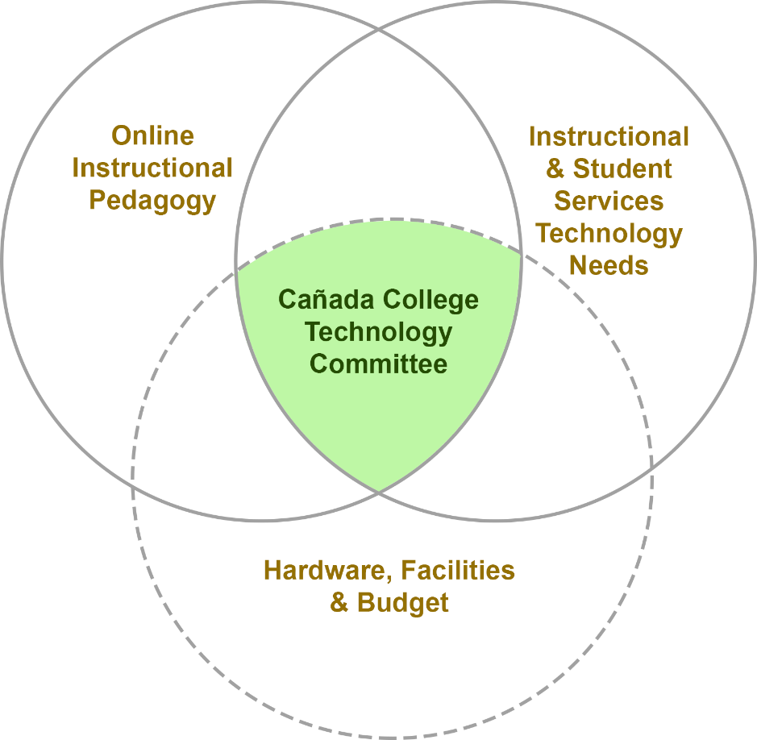
A Combination Proposal:
The Technology Committee “2.0”
Committee Structure
The Technology Committee has three areas of focus: Instructional & Student Services Technology Needs, Online Instructional Pedagogy, and Technology Hardware, Facilities & Budget. These areas of focus overlap and influence one another, so it is the task of the Technology Committee to bring these areas together for cohesive and collegial communication and decision making related to technology.
Committee Meeting Structure
In order for the Technology Committee to effectively address each of the distinct, but related, areas of focus in its purview, it will meet frequently, alternating which focus area it will address during each meeting. A sample meeting schedule would look like this:
  September 10: Technology Committee focused on Online Instructional Pedagogy
  September 24: Technology Committee focused on Instructional & Student Services Technology Needs
  October 7: Technology Committee focused on Hardware, Facilities and Budget
  October 14: Technology Committee focused on Online Instructional Pedagogy
  October 28: Technology Committee focused on Instructional & Student Services Technology Needs
  November 4: Technology Committee focused on Hardware, Facilities and Budget
The meeting schedule will be published at the start of each semester. Agendas will be provided at least one week prior to each meeting to ensure that the appropriate stakeholders for each topic are present during the meeting. All meeting agendas, minutes, and related materials will be posted to the Technology Committee website.

