Slide 1

Planning & Budging Council
Institutional Learning Outcomes
Examples from other Colleges
Prepared by PRIE
February 27, 2019

Slide 2
Summary of Findings
Common Approaches:
  Ask faculty to map SLOs and PLOs to ILOs
    Identify course and program level assessments which would assess the ILO competency
    Establish rubrics for assessing how a course assignment is representative of ILO competency – Skyline
  Assess SLOs and PLOs that align with ILOs during a regular, intermittent cycle:
    Select programs to do it during the full program review cycle – Skyline (A sub-set of programs should do it across the campus (representative of the whole) - Laney
    Assess one ILO per year across courses - Laney
  Surveys
    Survey college graduates on ILO competencies only (self-assessment) – Foothill
    Use the CCSSE survey (every other year) - Skyline
Some college have an Assessment Committee facilitating the entire process: (SLO, PLO, and ILO) – Laney, Foothill, DeAnza

Slide 3
CSM ILO’s
Independent Learning and Development - The ability of students to develop, evaluate, and pursue personal, academic, and/or career goals. Students will be able to:
  Demonstrate effective study strategies;
  Articuluate realistic and achievable academic and/or career goals;
  Identify and make use of college and community resources (academic and student support services)
Effective Communication - The ability of students to write, read, speak, and listen in order to communicate effectively. Students will be able to:
  Comprehend, interpret, and analyze written and oral information;
  Express ideas and provide supporting evidence effectively in writing and in speaking;
  Express ideas creatively through verbal and non-verbal media (e.g. music, art, dance, etc.)
  Communicate effectively in a group or team situation
Quantitative Reasoning - The ability of students to perform quantitative analysis, using appropriate resources. Students will be able to:
  Solve a variety of problems that require quantitative reasoning;
  Interpret graphical representations of quantitative information
Critical Thinking - The ability of students to think creatively, analytically, and logically, in order to assess ideas, formulate arguments, develop multiple perspectives, and solve problems. Students will be able to:
  Develop and evaluate arguments;
  Analyze, synthesize and evaluate ideas as part of the creative process;
  Assess the validity of both qualitative and quantitative evidence;
  Apply diverse disciplinary approaches and perspectives;
  Employ the scientific method
Social Awareness and Diversity - The ability of students to recognize cultural traditions and to understand and appreciate the diversity of the human experience, past and present. Students will be able to:
  Identify the benefits of diversity and respect the range of diversity;
  Work effectively with others of diverse backgrounds;
  Recognize the importance and analyze the interconnectedness of global and local concerns, both past and present
  Identify and analyze a diversity of artistic and cultural traditions
Ethical Responsibility/Effective Citizenship - The ability of students to make judgments with respect to individual conduct, based on systems of values. Students will be able to:
  Recognize ethical principles;
  Identify possible courses of action in response to ethical dilemmas and evaluate their consequences;
  Behave ethically and respectfully when working with students, instructors, and the campus community

Slide 4
CSM Assessment Method:
ILO-specific flex day workshops
every fall, there's an ILO workshop on flex day where a group of faculty take 3/6 ILOs and think of a way to assess it (this august, we made rubrics which are published on our SLO site).
every spring, there's a follow-up workshop (should be Jan, but this year it's march - also will be published on flex activity) where we discuss our assessment.
Embedded Learning Community activity
Year One Promise & the other LCOMMS are going to hold focus groups around the ILOs. The assessment committee will be fashioning questions next week at our meeting. The activity will be held April 25 this year.
Campus Climate & Satisfaction survey
We will be adding this into our survey.
Promoting interdisciplinary collaborations around shared ILOs
ASGC will be reading all the program reviews, and one goal is to see what challenges faculty have in common. We will have a flex session, or brainstorm some sort of pedagogical intervention.
Encourage disciplines to look at their own curriculum "maps" for Program Review
If your courses/program supports ILOs, how well do you think you're doing? How well are students doing in their ILO-related work? What questions do you have? Prog Rev is a place to reflect on and report this.
Communication
How does everyone hear about this? In the First Great Annual Assessment Report! due to be published in May. This communicates Our Year In Student Learning.
What we DON'T do: Using mapping to gauge ILOs.

Slide 5
Skyline ILO’s
Critical Thinking
Students will be able to demonstrate critical thinking skills in problem solving across the disciplines and in daily life.
Effective Communication
Students will be able to communicate and comprehend effectively.
Citizenship
Students will be able to use knowledge acquired from their experiences at this college to be ethically responsible, culturally proficient citizens, informed and involved in civic affairs locally, nationally, and globally.
Information Literacy
Students will be able to demonstrate skills central to information literacy.
Lifelong Wellness
Students will be able to demonstrate an understanding of lifelong wellness through physical fitness and personal development.

Slide 6
Skyline: Assessment Method
The ISLOs are assessed with a direct and indirect measure.
The direct measure involves the use of a common rubric (see below), which enables faculty to have a common language and criteria around assessment. Each of the ISLOs is scheduled to be assessed on a given semester, with one to two per academic year, until each of the five is assessed by faculty across the disciplines. Select faculty whose courses map up to the ISLO that is scheduled to be assessed that semester use the common rubric to evaluate students’ work within their disciplinary framework. The data resulting from the assessment is then analyzed and discussed by the Institutional Effectiveness Committee and departments as they complete their program review. A campus-wide forum is also held on an annual basis to discuss ISLO assessment results.
The indirect measure is through the Community College Survey of Student Engagement (CCSSE). The CCSSE is a tool used to measure how students perform on standards relative to student engagement. The data resulting from this assessment is then analyzed and discussed by the Institutional Effectiveness Committee.
http://www.skylinecollege.edu/sloac/assets/islos/updating%20mapping%20to%20islos%20matrix%20.pdf

Slide 7
DeAnza: Institutional Core Competencies
Communication and Expression: Students will communicate clearly, express themselves creatively, interpret thoughtfully and logically, and engage actively in dialogue and discussion, while paying attention to audience, situation, and (inter) cultural context. Communication and expression may be written or oral, verbal or nonverbal, informational or artistic.
Information Literacy: Students will recognize when information is needed and locate, critically evaluate, synthesize, and communicate information in various formats. They will use appropriate resources and technologies while understanding the social, legal, and ethical issues for information and its use.
Physical/Mental Wellness and Personal Responsibility: Students will recognize lifestyles that promote physical and mental well-being, engage in self-reflection and ethical decision-making, explore career choices and life goals, practice effective individual and collaborative work habits, and demonstrate a commitment to ongoing learning.
Civic Capacity for Global, Cultural, Social and Environmental Justice: Students will recognize their role as local, national, and global citizens. They will participate in a democratic process, respect social and cultural diversity, appreciate the complexity of the physical world, and understand the significance of both environmental sustainability and social justice.
Critical Thinking: Students will analyze arguments, create and test models, solve problems, evaluate ideas, estimate and predict outcomes based on underlying principles relative to a particular discipline, interpret literary, artistic, and scientific works, utilize symbols and symbolic systems, apply qualitative and quantitative analysis, verify the reasonableness of conclusions, explore alternatives, empathize with differing perspectives, and adapt ideas and methods to new situations.

Slide 8
DeAnza: Assessment Method(s)
Each ICC assessed is conducted on multiple levels simultaneously, including:
Assessment of SLO statements for relevant courses
Campus-wide direct assessment tools and methods
Other relevant assessments conducted within particular departments and programs

Slide 9
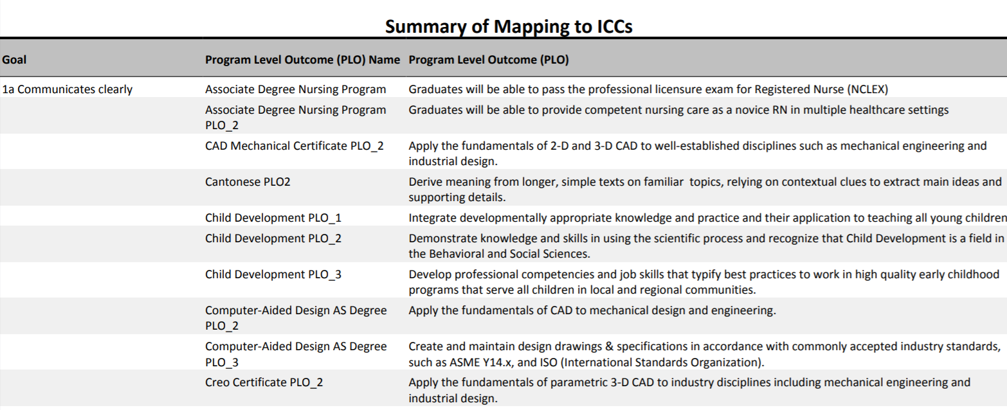
DeAnza: example of ICC mapped to PLOs

Slide 10
Foothill College: 4-C’s
Skills include written and oral communication in English, mathematics, critical and analytical thinking, creativity, teamwork, responsibility, and other proficiencies. Foothill has defined four core competencies (4-Cs) as its Institutional Learning Outcomes:
Communication
Demonstrate analytical reading and writing skills including evaluation, synthesis, and research; deliver focused and coherent presentations; demonstrate active, discerning listening and speaking skills in lectures and discussions.
Download the Communication Draft Rubric (pdf, 58KB)
Computation
Complex problem-solving skills, technology skills, computer proficiency, decision analysis (synthesis and evaluation), apply mathematical concepts and reasoning, and ability to analyze and use numerical data.
Download the Computation Rubric (pdf, 52KB)
Creative, Critical, and Analytical Thinking
Judgment and decision making, intellectual curiosity, problem solving through analysis, synthesis and evaluation, creativity, aesthetic awareness, research method, identifying and responding to a variety of learning styles and strategies.
Download the Critical Thinking Rubric (pdf, 58KB)
Community/Global Consciousness and Responsibility
Social perceptiveness, including respect, empathy, cultural awareness, and sensitivity, citizenship, ethics, interpersonal skills and personal integrity, community service, self-esteem, interest in and pursuit of lifelong learning.
Download the Global Consciousness & Citizenship Rubric (pdf, 50KB)
Learn more about the FRAMES and 4cs here.

Slide 11
Foothill: Assessment Method
Foothill also administers an annual survey to allow students to self-assess their “Four C’s”: https://foothill.edu/staff/irs/ILO_Disaggregation.pdf

Slide 12
Laney: Assessment Method – 1 ILO per year
You will be doing one assessment that will count for both the course and the institution.
Decide on the assignment and the assignment description/prompt that you will give your students. Discuss this with your colleagues that are teaching the same class.
Create a rubric or scoring guide to evaluate student work or use one of the Communication Assessment rubrics. If you need help with this, contact David Mitchell (Djmitchell@Peralta.Edu) or Cheli Fossum (Mfossum@Peralta.Edu).
At some point during the semester, give the assignment and evaluate student work.
Please submit three samples of student work. We’d like to create a campus-wide portfolio of a variety of student work to showcase what Laney students are learning about the skills represented in ILO #1. (David or Cheli can help with the photocopying of samples.) We also plan to post anonymous samples of student work to the Laney College website as evidence of our ILO #1 assessment. The Learning Assessment Committee will provide permission forms so that you can easily obtain permission from your students to copy and use their work without their names. (The permission form can be found Here.)

