Slide 1

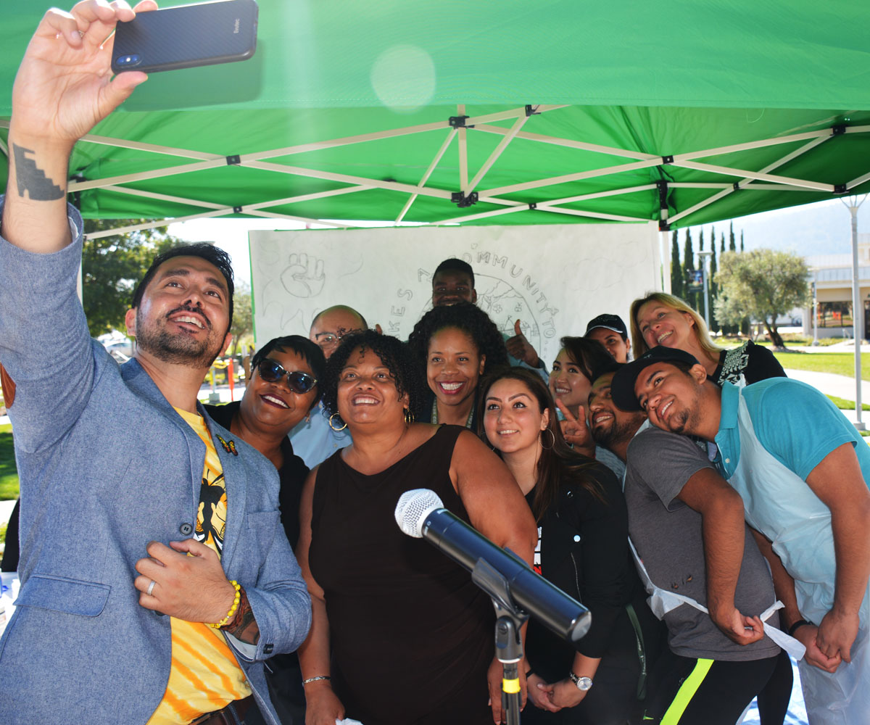
Mission
Dream Center Program Services Coordinator
2019-2020 New Position Proposals
Presentations and Discussions
October 31, 2019

Slide 2
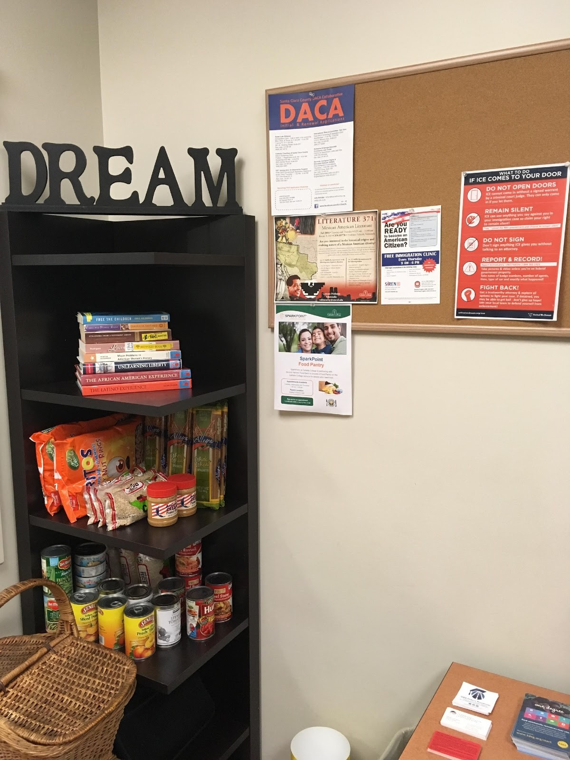

About the Cañada College Dream Center
The Cañada College DREAM Center is a resource center & safe space for undocumented students, community members & allies.
Services include:
Assistance with AB 540, DREAM Act, DACA & scholarship applications
Access to college and community resources – SparkPoint, Financial Aid, PCC
Free Legal Clinic – 207 clients served 242 times
Informational and community building events for students and staff – Undocumented Student Week of Action
Computer access and free printing
Notes:
Resources: Financial Aid, SparkPoint, Food Pantry, Legal assistance, PCC
Legal: we served 200300
Events: USWofA, Know Your rights, Policy Briefs, professional development

Slide 3
2017 – 2019 Equity Goals
1. ACCESS: Increase full-time enrollments of new and continuing students from low-socio-economic backgrounds, in particular students coming to the college from North Fair Oaks and East Palo Alto
2. PERSISTENCE: Over the next two years, increase fall-to-spring persistence rates for disproportionately impacted students with a particular focus on African American and Latino/Hispanic students
5. COMPLETION RATE: Increase percentage of students who complete their educational goal (certificate, degree, and/or transfer) from 47.6% to 52.6%, with a focus on goal completion by underprepared students
Notes:
Increasing ACCESS to full time enrollments for new and continuing students from low socio-economic backgrounds
Increasing PERSISTENCE particularly for Latino / Hispanic students
Increasing COMPLETION RATES with a focus on goal completion by underrepresented students

Slide 4
Dream Center Duties
Educate our students and community with updated and correct information about changing policies that impact Dreamer students
Provide an opportunity for dialogue and expression about the Dreamer experience
Connect Dreamers to appropriate resources and services (internal & external)
Provide professional development including information workshops for students and staff to understand challenges and resources.
Increase enrollment of AB540 students
Notes:
Provide Dreamers and allies with updated and correct information
Increase enrollment of AB540 students through partnerships with High Schools and Adult Schools
Establish strong campus and district-wide collaborations through the campus and District Dream Centers Task Forces
Maintain a network of undocumented community support
Connect students to student supports including SparkPoint (financial coaching, food pantry and free Legal Clinic - 154 appointments met, 134 unduplicated)

Slide 5
Who Is Served 2017/18 AB540 Student Characteristics - data packet
There has been a downward trend in the Annual Unique Headcount of registered AB540 students since 2015/16
2015/16 ➔ 422
2016/17 → 399
2017/18 → 387
Not all AB540 students are undocumented but almost all are.
Not all undocumented students register as AB540
74% are Hispanic, 75% intend to transfer, 58% are between 18-22 years old

Slide 6
Why do we need a Permanent 1.0FTE PSC
We are a Hispanic Serving Institution (HSI)
AB1645 – CCCCO’s mandates Dream Center Liaisons
The developing coordination needs are aligned with PSC classification
Alignment with our sister colleges’ Dream Center staffing (SKY = 1.0 FTE Fund 1 PSC) (CSM = 1.0 FTE Innov. Fund Retention Specialist + support by Multi-cultural Ctr. Fund 1 PSC)
Staff Turnover - With a short-term .48 FTE position, staff will leave for other permanent opportunities
Notes:
We are a HSI
AB1645 now mandates that Community Colleges have Dream Center Liaisons
The growing needs require a FT PSC
Alignment with our sister colleges
Staff Turnover

Slide 7
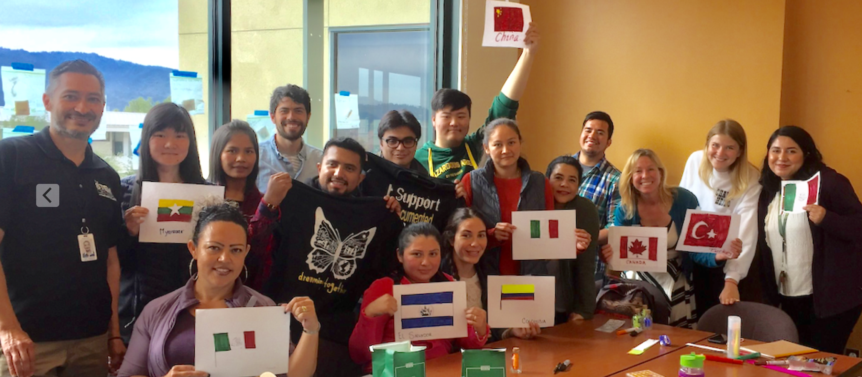
College, District and Chancellor’s Office Support
Support at Every Level
Students
DREAMers Club
College
ACES
District
Contemporary Conversation Regarding Race, Class, Gender, Privilege, and Equity: Undocumented Student Week of Action Presentation
CCCCO
AB1645 – CCCCO mandates CC’s to have Dream Center Liaisons to expand resources for undocumented immigrant students.

Slide 8
Supports Mission Statement & Strategic Goals
Alignment with College Mission Statement
The Dream Center ensures that all students have equitable opportunities to achieve their transfer, career education, and lifelong learning educational goals, regardless of their immigration status
Alignment with College Strategic Goals
The Dream Center provides student services programs that highlight inclusivity, diversity, and equity in their mission to help students meet their unique educational goals.

Slide 9
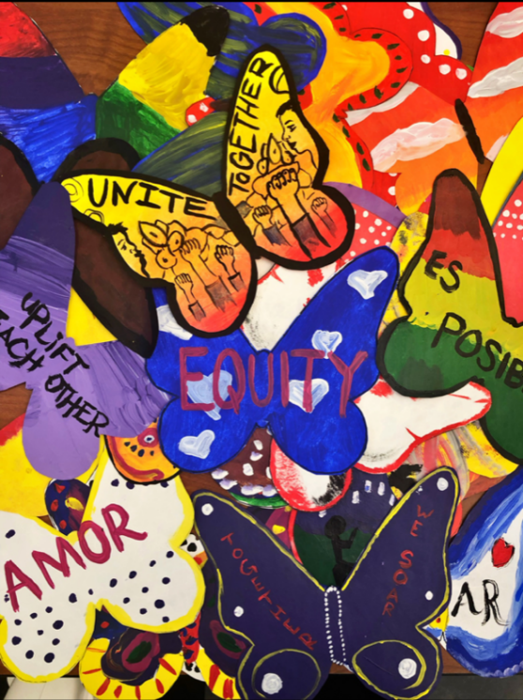

If This Position is Not Funded…
Cañada College will be out of compliance with AB1645 – State mandate
Limited (and insufficient) resources would be available for our DREAMers and allies. (workshops, presentations, resources, guest speakers)
We may be prevented from re-hiring a short-term staff (repeatability)
As an HSI, Cañada has a responsibility to support DREAMers with success, retention and transfer rates
Notes:
Staff turnover will negatively impact student success
This marginalized population will once again not receive needed services

Slide 10
If This Position is Not Funded… Who Will Do This Work?
Immigration changes are constant even with different administrations and require specialized knowledge
What do I do if my family member has been deported?
Where do I find information about DACA, TPS, or Public Charge rules?
My boss does not pay me. What can I do?
Who can I ask about DACA, CA Dream Act, and FAFSA?
I’m finding it difficult to find work. What can I do?
The Dream Center provides supports our students!
Notes:
Staff turnover will negatively impact student success
This marginalized population will once again not receive needed services

Slide 11
And…who Will Meet the Growing Demand of Dream Center Needs?
The Dream Center receives requests from faculty and staff regarding:
Flex Day Presentations
Requests to hold community events (i.e. Undocumented Student Week of Action, Know Your Rights, Student Workshops, Confidential Conversations, Student Community Building)
Assistance for students who have been detained by ICE
Assistance for student questions about ICE & Immigration
Yet, there has not been institutionalized support
to collect needed data and
deliver timely services
Notes:
Close to 200 students, faculty and staff attended a variety of supportive events including a collaborative art project, story sharing, and a know your rights event with community organization Immigration Institute of the Bay Area. The DREAMers Club student leaders were central to the planning and executing of the week. The Club designed and gave away t-shirts, facilitated a story sharing event, and spoke messages of support and inspiration throughout the week. Their leadership is to be commended. Attendance at opening day by Cañada College President Jamilla Moore and all campus Vice Presidents solidified that supporting all students regardless of immigration status is not just something we say at Cañada, but something we do. All of the work for this week could not have been possible without the support of the California Community Colleges Chancellor’s Office, the Community College League of California, the Foundation for California Community Colleges, Immigrants Rising, and the Student Senate for California Community Colleges. Together we can create a system that truly serves all students, regardless of immigration status.

Slide 12
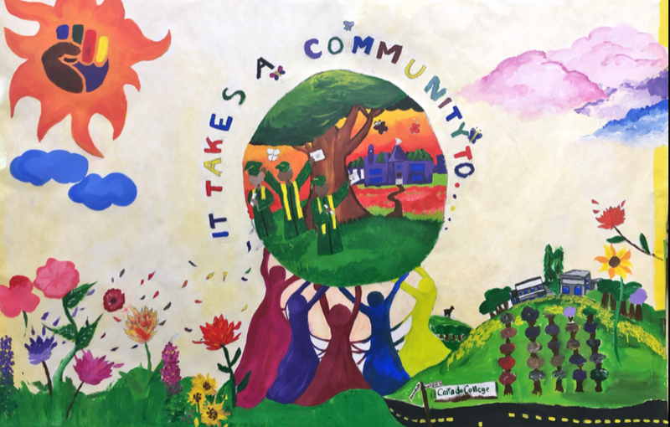
Questions?

