Slide 1


Mission
SparkPoint Coordinator
2019 – 2020 New Position Proposals
Presentations and Discussions
October 31, 2019

Slide 2


SparkPoint at Cañada College
Mission Statement
To provide students and the community with one-on-one financial coaching and education designed to increase their financial stability and attainment of academic goals.
Notes:
----- Meeting Notes (2/20/17 01:53) -----
3 jobs are needed
survey =
55% > $1,000
20% > $10,000
3-4 years to complete an Assoc. Degree

Slide 3

SparkPoint Outcomes
Livable income that reaches the Self Sufficiency Standard
Good credit score of 700 or above
Savings equal to three months of living expenses
Reduced (revolving) debt
Increased Student Persistence
Notes:
----- Meeting Notes (2/20/17 01:53) -----
3 jobs are needed
survey =
55% > $1,000
20% > $10,000
3-4 years to complete an Assoc. Degree

Slide 4

Notes:
Cañada is located in an area w/low poverty. However, we serve a population in high to very high poverty regions
3 jobs are needed
survey =
55% > $1,000
20% > $10,000
3-4 years to complete an Assoc. Degree
----- Meeting Notes (10/27/17 04:15) -----
Map 2

Slide 5
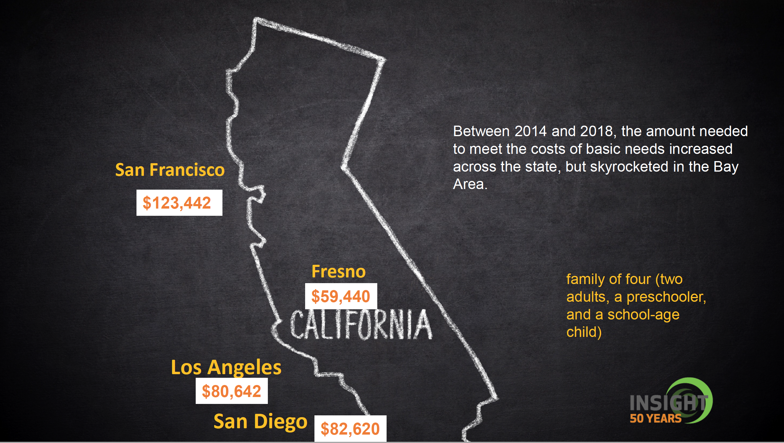
Notes:
Cañada is located in an area w/low poverty. However, we serve a population in high to very high poverty regions
3 jobs are needed
survey =
55% > $1,000
20% > $10,000
3-4 years to complete an Assoc. Degree
----- Meeting Notes (10/27/17 04:15) -----
Map 2

Slide 6
How Are Outcomes Achieved?
SparkPoint clients work one-on-one with a coach who assists to:
Identify (financial) goals
Develop a step-by-step action plan
and keep clients on track
Services focus on three key elements of financial prosperity:
Managing credit
Increasing income
Building assets
Notes:
----- Meeting Notes (2/20/17 01:53) -----
3 jobs are needed
survey =
55% > $1,000
20% > $10,000
3-4 years to complete an Assoc. Degree

Slide 7
SparkPoint Coordinator Duties
Delivers on-campus one-on-one financial coaching and workshops (on and off campus)
Coordinates SparkPoint services, collects and manages data for SparkPoint activities, and delivers financial coaching
Coordinates SPCC Food Pantry efforts including staffing the pantry, supervising staff, scheduling, ordering food, and maintaining quality controls
Notes:
----- Meeting Notes (2/20/17 01:53) -----
3 jobs are needed
survey =
55% > $1,000
20% > $10,000
3-4 years to complete an Assoc. Degree

Slide 8
SparkPoint Coordinator Duties Also Include:
Cañada Cash – Incentives for Positive Financial Behaviors
103 unduplicated students currently are enrolled for FY20 – “High Touch”
Second Harvest Food Bank
87,797 lbs. of food with a total value of $105,505 distributed
Grab and Go (2365 meals for FA19)
Legal Clinic - 207 clients served 242 times
Outreach efforts – Connect to College, Awareness Summit, class presentations
Notes:
----- Meeting Notes (2/20/17 01:53) -----
3 jobs are needed
survey =
55% > $1,000
20% > $10,000
3-4 years to complete an Assoc. Degree

Slide 9
Specific Needs
* https://insightcced.org/2018-family-needs-calculator/
The rising cost of living (a family of 4 requires $125,995* a year for basic sustainability)
Currently, there is 2.25FTE of financial coaching by permanent employees but secured funding for only 1.0FTE.
There is secured funding for 1.0FTE
Grant funding for 0.25FTE
Permanent Grant Funding for 1.0FTE
Notes:
----- Meeting Notes (2/20/17 01:53) -----
3 jobs are needed
survey =
55% > $1,000
20% > $10,000
3-4 years to complete an Assoc. Degree

Slide 10
Specific Needs (continued)
Grant funding for SparkPoint has decreased
There is a 4-6 month learning curve to train short-term financial coaches
Additional support will be needed to increase SparkPoint services across campus to provide equitable access
SparkPoint may not be able to continue to request short term staff (repeatability)
Notes:
----- Meeting Notes (2/20/17 01:53) -----
3 jobs are needed
survey =
55% > $1,000
20% > $10,000
3-4 years to complete an Assoc. Degree

Slide 11
High Touch Services
SparkPoint measurable clients demonstrate 27%+ higher retention rates
Fall 2018 to Spring 2019 = 27.3% increase
Spring 2019 to Fall 2019 = 32.3% increase
During FY19, SparkPoint Financial Coaches met with 460+ students for High-Touch services
SparkPoint exceeded it’s FY19 United Way Deliverables
124 Clients; 105 measurable clients, 30 receiving benefits
Notes:
----- Meeting Notes (2/20/17 01:53) -----
3 jobs are needed
survey =
55% > $1,000
20% > $10,000
3-4 years to complete an Assoc. Degree

Slide 12
Alignment with Mission & Strategic Goals
Mission Statement
SparkPoint provides access to services, and equitable opportunities for students to achieve their transfer, career education, and lifelong learning educational goals.
Strategic Goals (Goal #1)
Minimizes financial barriers to success which leads students towards increased retention rates
Notes:
----- Meeting Notes (2/20/17 01:53) -----
3 jobs are needed
survey =
55% > $1,000
20% > $10,000
3-4 years to complete an Assoc. Degree

Slide 13
Strengthening ALL Departments/Divisions
Addressing the multiple financial barriers facing students
Educating students on positive money behaviors and strategies
Working with students to increase their income, build their credit, reduce their debt and grow their savings
Reducing students’ time to completion
Students learn how to better manage their money so they can afford to stay in school
Increased retention, success, and persistence & lifelong money management skills across ALL disciplines
Notes:
----- Meeting Notes (2/20/17 01:53) -----
3 jobs are needed
survey =
55% > $1,000
20% > $10,000
3-4 years to complete an Assoc. Degree

Slide 14
If This Position is Not Filled
There are growing financial needs that SparkPoint will be unable to meet
Homelessness, Food Insecurity and Transportation challenges
Students’ financial needs are increasing as the cost of living increases and solutions are becoming more and more challenging for students
Students facing financial barriers to accessing education will have reduced access to financial education and literacy
Long-term planning is challenging without sustainable funding
SparkPoint will not have the resources to fully assist the college in it’s efforts to increase retention rates and decrease time to completion.
Notes:
----- Meeting Notes (2/20/17 01:53) -----
3 jobs are needed
survey =
55% > $1,000
20% > $10,000
3-4 years to complete an Assoc. Degree

Slide 15

Be SMART with SparkPoint!
S pend less than your income
M ap out your income and expenses
A dopt a savings plan
R epair / build your credit
T arget dates for financial goals
Notes:
----- Meeting Notes (2/20/17 01:53) -----
3 jobs are needed
survey =
55% > $1,000
20% > $10,000
3-4 years to complete an Assoc. Degree

