Slide 1
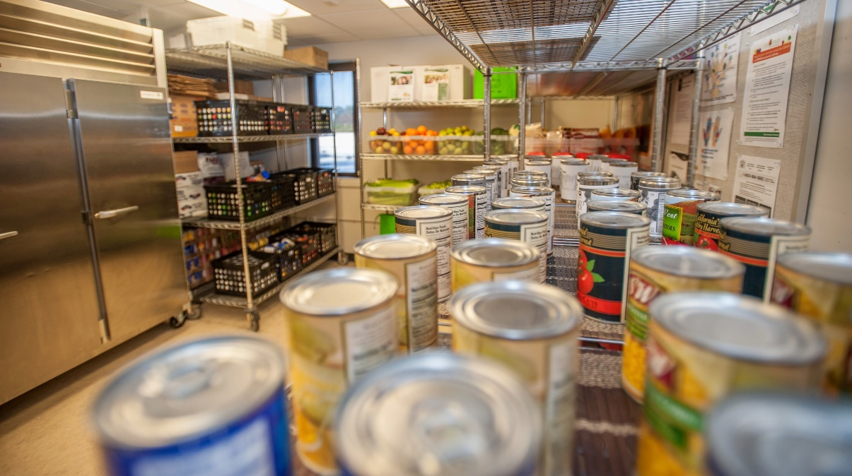
Mission
SparkPoint Pantry
Office Assistant II
2019-2020 New Position Proposals
Presentations and Discussions
October 31, 2019

Slide 2

About the Cañada College Food Pantry
  The Food Pantry is a partnership between SparkPoint, Cañada College and Second Harvest Silicon Valley.
  Individuals can receive two grocery bags of food per person once a week
  The Pantry is open on Tuesday, Wednesday and Thursday from 12:30 pm to 3:30 pm and Thursday evenings from 5:00 pm to 6:30 pm
  Pantry coverage: 9 individuals (Primarily Ingrid, Joshua, Manny, Karla (student) with support form Julie, Klaressa, Yesenia, Adolfo and now even Saúl)
Last academic year the pantry served had over 12,000 visits
Notes:
----- Meeting Notes (2/20/17 01:53) -----
3 jobs are needed
survey =
55% > $1,000
20% > $10,000
3-4 years to complete an Assoc. Degree

Slide 3

Highlights From This Past Year - I
This position was approved through the 2018-19 New Positions Proposal Process based upon funding availability and current need.
However, due to lack of funding, this position was not opened.
Food insecurity continues to be a topic addressed at the 2019 Cañada College Awareness Summit
Notes:
----- Meeting Notes (2/20/17 01:53) -----
3 jobs are needed
survey =
55% > $1,000
20% > $10,000
3-4 years to complete an Assoc. Degree

Slide 4
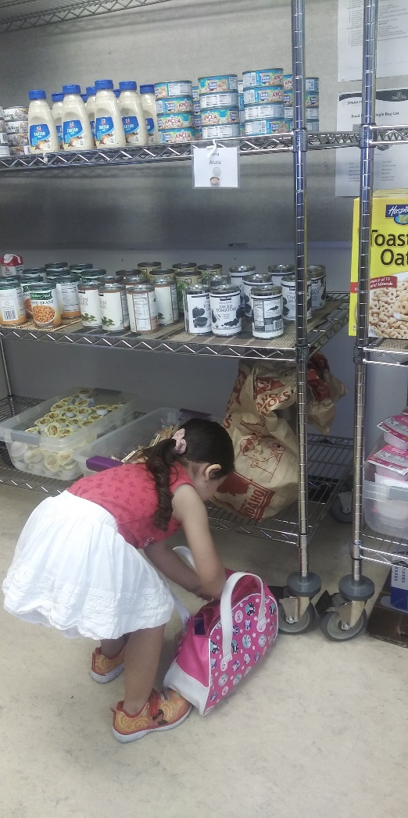
Highlights From This Past Year - II
The Pantry, ASCC and the Bookstore launched Grab n’ Go Meals and now Hot and Cold Meals
SparkPoint offered two successful Community Markets (and 2 Pop-Up Markets) with more scheduled monthly
Study Snacks were launched in May 2019
Expanded hours are now available to serve additional customers

Slide 5
Specific Needs
The Self-Sufficiency standard for a family of 4 is over $127,000 per year
87,797 lbs. of food distributed to both day and evening students
  That’s $106,504 of savings going back to students to offset other living expenses
SparkPoint has funded salaries, benefits and general expenditures for the pantry for the past four years using a soft money that has ended
Our sister colleges have institutionalized Pantry Staffing
  Skyline has a Staff Assistant and an OAII, CSM has part of a Staff Assistant
  Both pantries are located adjacent to their Centers
Notes:
----- Meeting Notes (2/20/17 01:53) -----
3 jobs are needed
survey =
55% > $1,000
20% > $10,000
3-4 years to complete an Assoc. Degree

Slide 6
2018 SMCCCD Food and Housing Insecurity Survey
Survey results revealed the following challenges experienced by students with regard to their basic food needs due to income limitations:
  55% indicated that the food they purchased, “just didn’t last and I didn’t have money to get more.”
  28% of students reported, “cutting the size or meals or skipping meals” because there wasn’t enough money for food.
Beyond the literal lack of food, the level of psychological insecurity is high:
  41% of students report that, “I am worried whether my food would run out before I got money to buy more.”
Notes:
----- Meeting Notes (2/20/17 01:53) -----
3 jobs are needed
survey =
55% > $1,000
20% > $10,000
3-4 years to complete an Assoc. Degree

Slide 7
Day to Day Duties of the Food Pantry
Provides food pantry support (customer service, ordering, stocking, inventory control, food rotation, outreach, screening for public benefits, tabling, maintaining the pantry and makes classroom presentations)
Manages data entry by entering food pantry efforts into the SparkPoint database, running reports and submitting monthly reports to Second Harvest Food Bank.
Maintains the Food Pantry to California Food Safety Standards
Trains and supervises the work of students assistants
Refers students to campus and community resources
Makes referrals to SparkPoint for financial coaching

Slide 8
Alignment with Mission & Strategic Goals
Mission Statement
  Provides healthy and nutritious food to students, access to SparkPoint services, and equitable opportunities for them to achieve their transfer, career education, and lifelong learning educational goals
Strategic Goals (Goal #1)
  Minimizes financial barriers to success which leads students towards
  increased retention rates

Slide 9
Strengthening ALL Departments/Divisions
This position will increase students’ access to healthy & nutritious food.
Clients will benefit from increased food pantry hours, expanded CalFresh enrollment efforts, & increased connection to SparkPoint services
SparkPoint is experiencing an increase in panty use by student athletes, international students, evening students and staff and faculty
These expanded services will increase student retention by reducing student hunger and food insecurity as a barrier to student success.
  Increased and sustainable staffing means increased access to food

Slide 10
If This Position is Not Filled
SparkPoint at Cañada College will be unable to adequately address growing food insecurity for our own students
  Decreases/no growth in Community Markets, Pop-up Markets and Study Snacks
We may be prevented from re-hiring short-term staff (repeatability)
Qualified individuals may not enroll in CalFresh and offset expenses
We will have hungry students. This will impact:
  Students ability to realize their academic potential
  Term to completion, success, persistence & retention rates

Slide 11
Future Cañada Student
"She looks forward to coming to the pantry and she prepares her bag before she comes"
Today she helps her mom select groceries
In a few years, she is a Cañada College Student
Help make her dream a reality
This is all made possible by the wonderful and caring staff that works the pantry and makes a difference in students’ lives

Slide 12
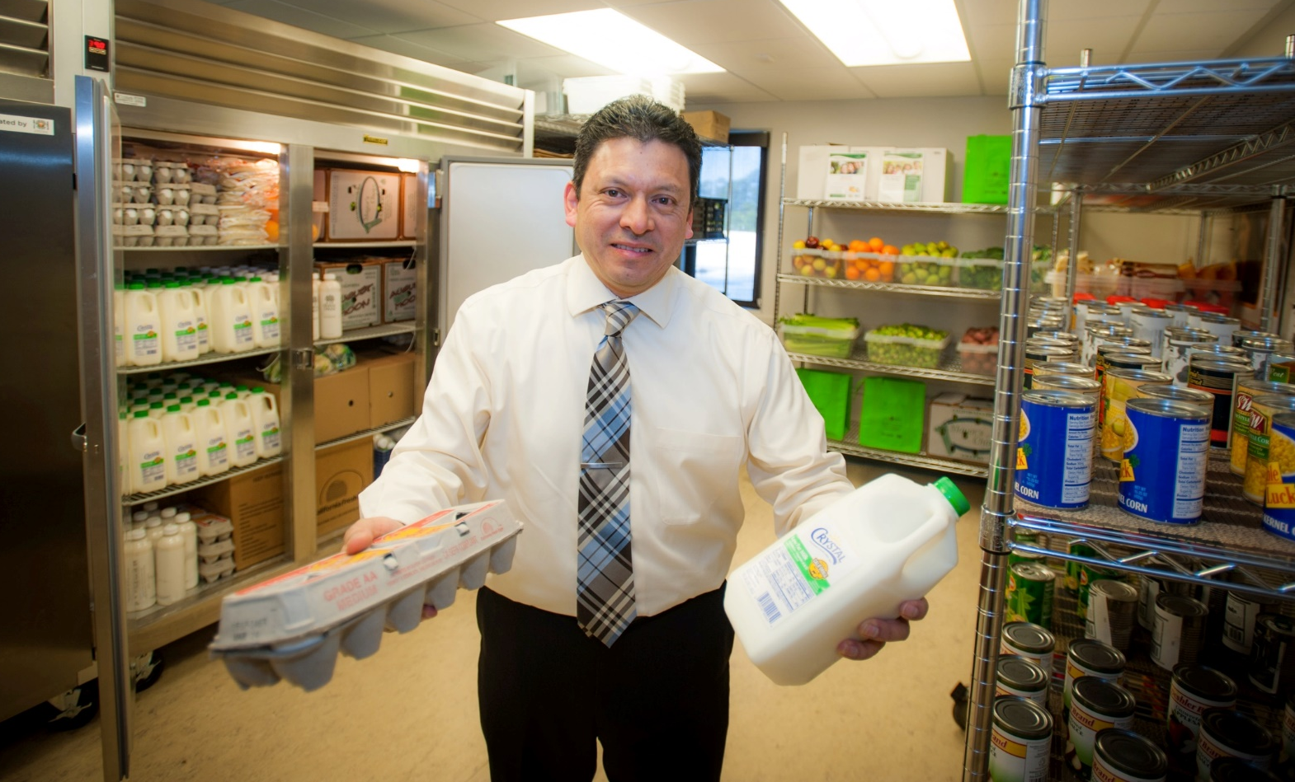
Visit the Cañada College Food Pantry!

