Slide 1

Annual Plan
2019-20
Approved by the Planning & Budgeting Council
DRAFT AS OF August 30, 2019

Slide 2
The College Annual Plan
Sets forth the activities to be implemented in one year to support the achievement of the five-year goals articulated in the Education Master Plan, which are in support of achieving the College Mission.
Is a synthesis of objectives, strategic initiatives, and activities of other college plans, grant deliverables, and recent mandates from the State Chancellor’s Office.

Slide 3
FOCUS THIS YEAR:
Guided Pathways Strategic Priority Projects
Redesign College Processes:
  Constituent Relationship Management (CRM) System Design and Implementation
Interest Areas, Program Maps, and Schedule Optimization
Redesign Academic Support & First Year Experience
Early College Experiences
Online Education
Career Exploration & Job Placement

Slide 4
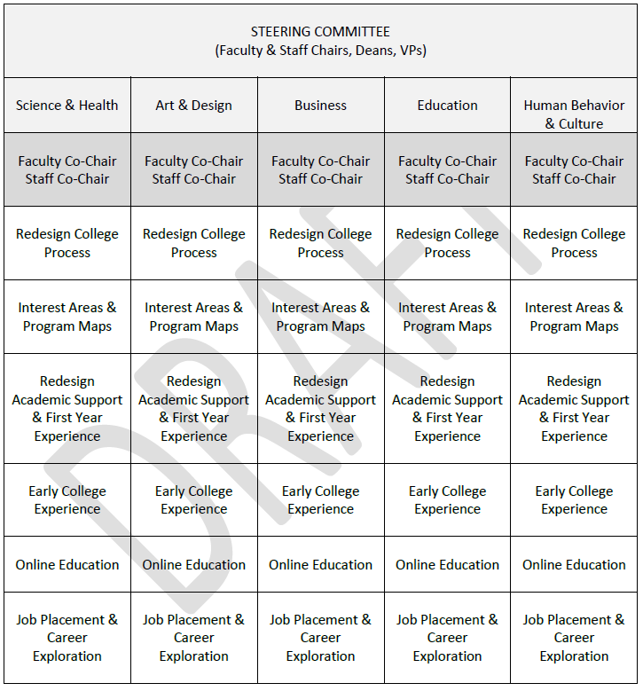

Slide 5
Proposed Annual Plan/Guided Pathways Reporting Structure: 2019-20
PBC
IPC
SSPC VP
APC
Guided Pathways Steering Committee

Slide 6
Re-Design College Processes: CRM
Streamline the matriculation process
Organize student “Success Teams” aligned with Interest Areas
Build data dashboards and train data coaches to support these efforts
Scale the number of Peer Mentors aligned with Interest Areas and programs
TEAM LEAD(S): Max
TEAM MEMBERS: Margie, Ruth, BPA Team

Slide 7
Establish Interest Areas and Program Maps (implement Program Mapper)
  Create draft Interest Areas and Program Maps for faculty review and refinement in August – October. First draft of Interest Areas by July 30.
  Division leads help programs review draft maps on August 13
  Use the program mapping exercise to optimize the course schedule for student completion
  All interest areas and program maps loaded into Program Mapper by October 31 (in time for Spring enrollment)
TEAM LEAD(S): James
TEAM MEMBERS: Maureen, Carol Rhodes, Hyla Lacefield, Denise Erickson, David Eck, Chris Rico, Gloria Darafshi, Alex Claxton, Karen E., Mayra (HS Counselors)
DIVISION LEADS: Maureen, Carol Rhodes, Hyla Lacefield, Denise Erickson, David Eck

Slide 8
Re-design Academic Support & First Year Experience programs aligned with Interest Areas
  Inventory of “what is”
  Examine the effectiveness and return on investment of current practices/programs
  Create vision of what could be
  Create resource allocation to support new vision
  Launch Writing Center, scale peer mentoring and EPIC supplemental instruction programs and integrate retention programs into larger academic support structure
Launch this project at October Flex Day
Establish a vision (what will this look like at Canada?)
Align with Interest Areas to form them early in the student journey (a class? Cohort?)
Develop curriculum to support. A sampler course?
Align with COLTS CON, JAMS, Promise
Scale peer mentoring and align with this and Success Teams
Embed financial literacy
Utilize a case management approach to tracking “touch points” – like Promise
TEAM LEAD(S): David Reed, Marisol Quevedo, and Carol Rhodes
TEAM MEMBERS: Georganne, Librarians, Diva, Diana T and Sarah H, Yolanda V., Deans, , Alison (+DE Coord), (Promise), Adolfo, Ada, Hyla, Maureen

Slide 9
Expand opportunities for Early College experiences (dual enrollment; Middle College)
Work with SUHSD to identify best ways to expand dual enrollment and Middle College opportunities for high school students
TEAM LEAD(S): Tammy and Marisol
TEAM MEMBERS: Maria, Mayra, Ruth, David R., Marisol

Slide 10
Create an equitable experience for Online Students to support student success
As part of program mapping and schedule optimization process, determine which courses should be online to maximize student success and completion
TEAM LEAD(S): Tammy
TEAM MEMBERS: Deans, program leads

Slide 11
Develop Career Exploration & Job Placement opportunities for students that are aligned and integrated with Interest Areas
  An inventory of what IS now (coop, STEM, Sparkpoint)
  Identify Holland Code(s) for every program on campus
  Change Orientation to embrace Holland Codes and embed career exploration
  Build systems for managing and scaling (Salesforce)?
  Look at the role of career exploration counseling classes
  Leverage industry relationships and employer outreach activities
  Align with Outreach in general
  Inventory “what is”: Puente Mentors, CTE practices
  Scale mentors and train them on career exploration tools
  Establish support networks aligned with Interest Areas
  Look at STEM Center Job Shadowing program and possibly scale
  Create an awareness brochure
  Make better use of LinkedIn
TEAM LEAD(S): Julian
TEAM MEMBERS: Max, Mayra, Georganne, Annie Nicholls, Adolfo, Bob Haick

