Slide 1
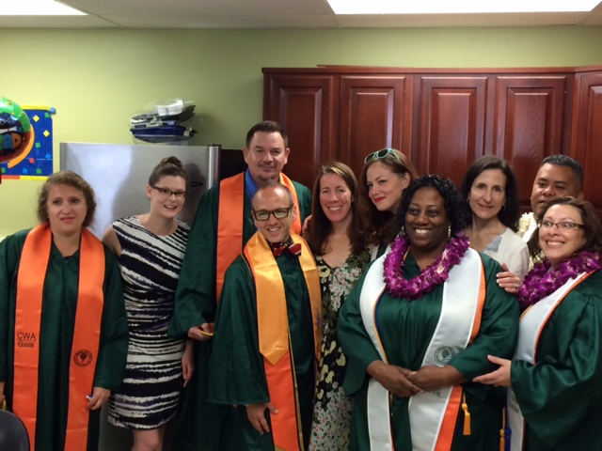
Cañada College College for Working Adults

Slide 2
The College for Working Adults Story
Fall of 2011 the College for Working Adults program was launched
CWA became the very first Guided Pathways program in our district and possibly in the state
In three years students earn three of the six liberal arts degrees CWA offers (3 of the 6 degrees are AA-T)
We enrolled 29 students that first semester, 11 graduated within three years
By 2015 enrollment grew to 250+ students and we have maintained that enrollment ever since
Additional highlights:
Over 60% of our students transfer to four-year colleges including:
In March 2019, the CCC Vice Chancellor of Instruction requested a site visit to see if the success of the CWA program could be replicated throughout the state. Steve D. Boilard, Ph.D., was sent to meet with our administrators, deans, faculty, staff, and students. A very complimentary report was prepared for the CCC Chancellor’s Office.
Over the past four years, several colleges in the state have asked for our help in instituting their own evening degree program. Our CWA Project Director has made site visits to the following colleges to assist in implementation of an evening degree program.

Slide 3
College for Working Adults Program Growth & Success
Average Results Over the past five semesters:
Average new/returning CWA students per semester 67
Average number registered CWA students per semester 262
Average number of FTE CWA students per semester 180
Over the past six academic years CWA has graduated 175 students and awarded 328 diplomas.
Results Spring 2019 Results
Graduates 38 (10% college wide)
ADT Degrees Earned 83 (15% college wide)
FTE students 207 (including Non-CWA)

Slide 4
The College for Working Adults Program Needs
Staffing:
2011 CWA staffing with 29 students enrolled:
1 – Part-Time Project Director (75% time)
1 – Adjunct Dedicated CWA Counselor (4 hrs. per wk.)
1 – Part-time Faculty Coordinator (4 hrs. per wk.)
2016 CWA staffing with 250+ students enrolled:
1 – Part-Time Project Director (80% time)
1 – FT Adjunct Dedicated CWA Counselor (30 hrs. per wk.)
1 – FT Faculty Coordinator (50% time)
2018 (June) we lost our Faculty Coordinator and no replacement was authorized bringing our staffing back to pre-2016 levels. Our counselor and project director picked up the additional workload.
2018 (July), we were authorized to hire a short-term temporary Retention Specialist (48% time). This allowed our Counselor to better meet the counseling needs of our students and to implement several much needed services.
Budget
Two-thirds of the cost to reclassify our Retention Specialist to full-time would be derived from our current funding allocation and it would allow CWA to maintain the important services that has made the College for Working Adults a celebrated model in the district and the state.

