Slide 1
Dean of Enrollment Services and Support Programs
New Management Hiring/Position Justification
Friday, November 1, 2019

Slide 2
Who are we talking about here?
Why do we need this position?
. . . Yeah, yeah, but why right now?

Slide 3
Crafton Hills College (Yucaipa, CA) – 6,200 students
Dean of Student Services & Student Development
Dean of Student Services, Counseling & Matriculation
LA Southwest College (Los Angeles, CA) – 6,937 students
Dean of Special Programs (TRIO)
Dean of CalWorks & EOPS
Dean of Student Services
Napa Valley College (Napa, CA) – 6,881 students
Dean of Enrollment & Outreach Services
Dean of Disability Support Programs and Services/Testing
Associate Dean of MESA/STEM Services
Sr. Dean of Counseling Services & Student Success
Sr. Dean of Financial Aid/EOPS/Vets/ETS
Sr. Dean of Student Affairs
California Community Colleges
Student Services

Slide 4
College of San Mateo – 10,000 students
Dean of Counseling
Dean of Enrollment Services
Skyline College – 16,000 students
Dean of Counseling
Dean of Enrollment Services
Dean of Student Equity & Support Programs
Cañada College – 6,400 students
Dean of Counseling
San Mateo Community College District

Slide 5
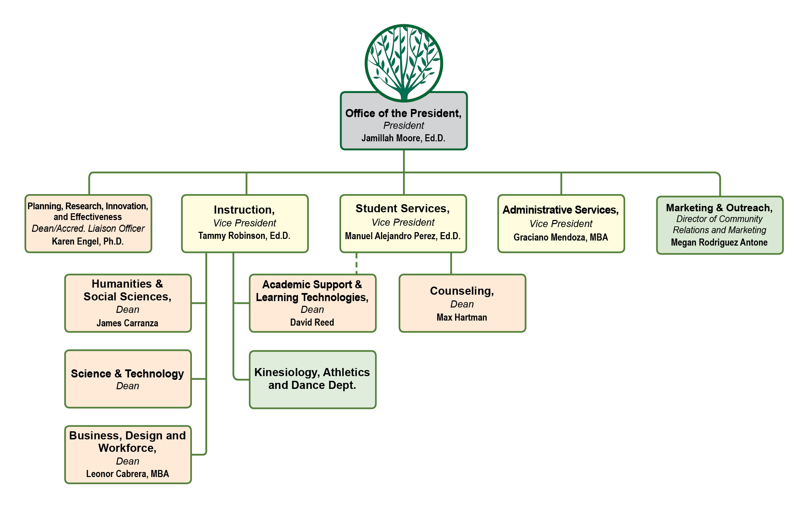
Cañada College Cabinet

Slide 6
Student Services

Slide 7
14 Direct Reports
(Programs, Services)
7 Areas, Programs,
Services within Counseling
Student Services

Slide 8
Brought to you by
…your friendly, neighborhood College Redesign

Slide 9
Coltivate: Guided Pathways
Redesign College Process:
Customer Relationship Management
Interest Area & Program Maps:
Changing the way students define academic pathways
Redesign Academic Support | First Year Experience:
Linking communities of support to courses

Slide 10
Coltivate: Guided Pathways
Early College Experiences:
Dual & Concurrent Enrollment, Middle College
Expansion of Middle, HS, and community partnerships
Online Education:
All operations and support fully functional at a distance
Job Placement | Career Exploration:
Linking career info early in a pathway

Slide 11
Coltivate: AB 705
AB 705 is a bill signed by the Governor on October 13, 2017 that took effect on January 1, 2018. The bill requires that a community college district or college maximize the probability that a student will enter and complete transfer-level coursework in English and math within a one year timeframe and use, in the placement of students into English and math courses, one or more of the following:
HS coursework, HS grades, and HS GPA.

Slide 12
Strengthening support for you.
All college operations involve Enrollment Services
Application, Registration, Certifications, Transfers, Degrees & Cert.
Financial Aid, Financial Literacy, Pre-college & Matriculation Support
Strategic Enrollment Management
(increase FTES, align systems, etc.)
Statewide Strategic Planning
Districtwide Alignment & Strategic Planning
Vision and direction for college redesign

Slide 13
What happens if we do not support
this position right now?
ADA 504 Compliance
Guided Pathways (Year Three of 5-year Plan)
AB 705 (one year clock for transfer level placement)
Changes in local procedures, including State and Federal Legislation
(e.g., Transcript Holds, Dream Liaisons, Food & Housing Insecurity)
Expansion of services and support without expansion of leadership support
in Student Services
Notes:
Reference OCR and desk audits

Slide 14
Questions?
…your friendly, neighborhood College Redesign

