Slide 1


EOPS COUNSELOR

Slide 2

Funding Request
EOPS – 20%
SEAP – 55%
Fund 1 – 25%

Slide 3
EOPS helps educationally disadvantaged Cañada students acquire the academic, social and cultural capital needed to succeed in college
Mission
Notes:
Students must be BOGW eligible and take 12 units (unless in DRC)

Slide 4
Background

Slide 5
Faculty Assignments
1 - 50% EOPS Counseling, 50% EOPS & CARE Coordination
Since 2016 we have been approved for additional adjunct EOPS counseling hours. These hours fluctuate from year to year, depending on funding and availability. Since it is not consistent year to year, it becomes challenging to do program development.
For 2019-20:
1 - reassigned time 8 – 14 hours a week
1 - adjunct 6 hours a week
1 - adjunct 17.5 hours a week
1 - reassigned time 9 hours a week

Slide 6
Program Goals

Slide 7
Increase
EOPS enrollment

Slide 8
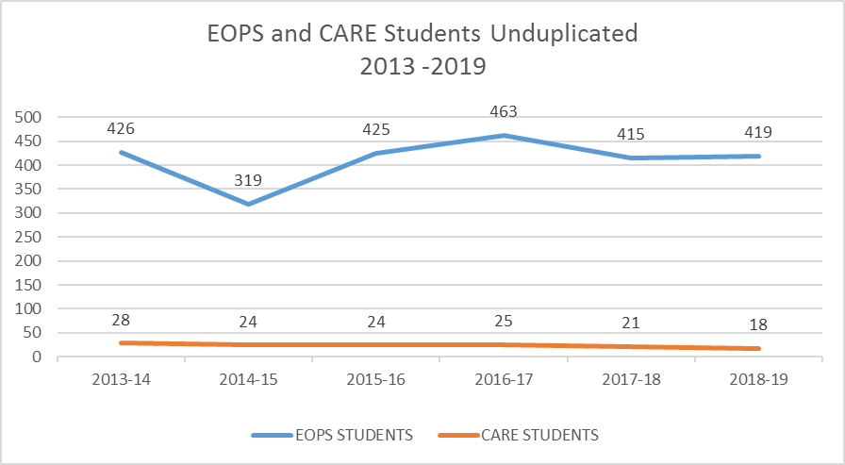

Slide 9
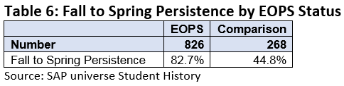
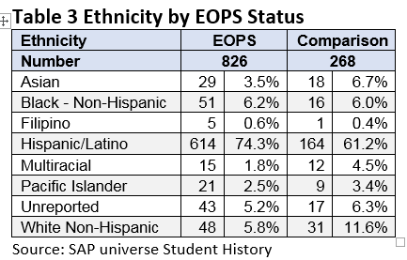
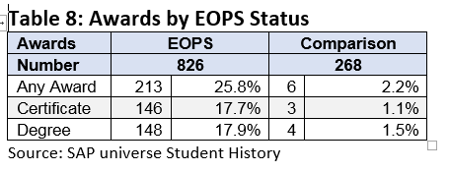
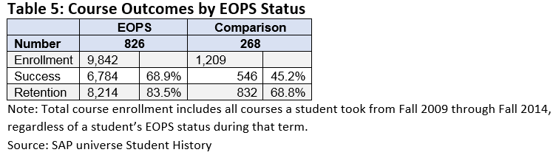
Key Findings:
EOPS students tend to be slightly older than the comparison group
EOPS students perform better academically with higher course success, course retention, Fall to Spring persistence, and Dean’s List attainment
EOPS students are far more likely to attain a degree or certificate than the comparison group

Slide 10
Expand programming

Slide 11
Comprehensive Counseling

Slide 12
Crisis intervention
Follow up
Academic
Financial
EOPS COUNSELOR
Career
Foster Youth
Dreamers
Personal
Goal setting

Slide 13
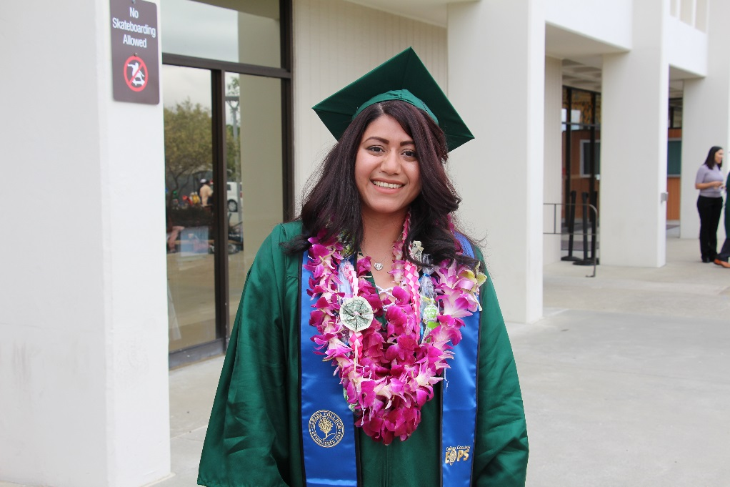
Provide more stability to the program and students

Slide 14
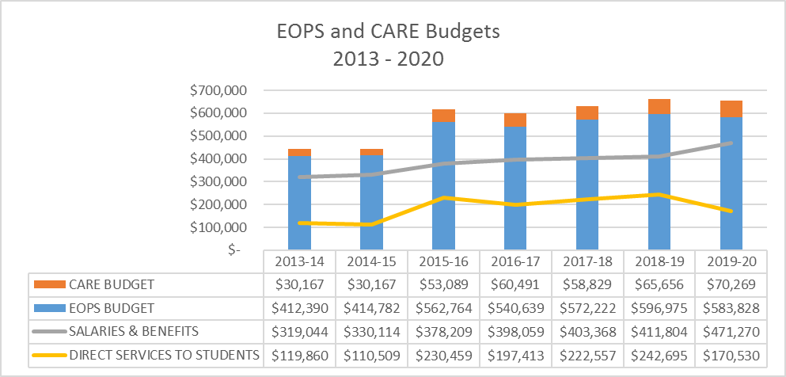

Slide 15
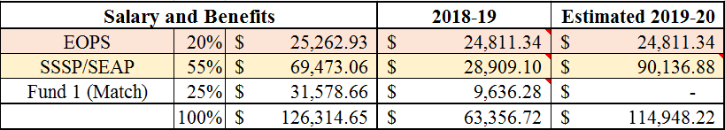
Funding Request
EOPS – 20%
SSSP – 55%
Fund 1 – 25%

Slide 16
