Slide 1
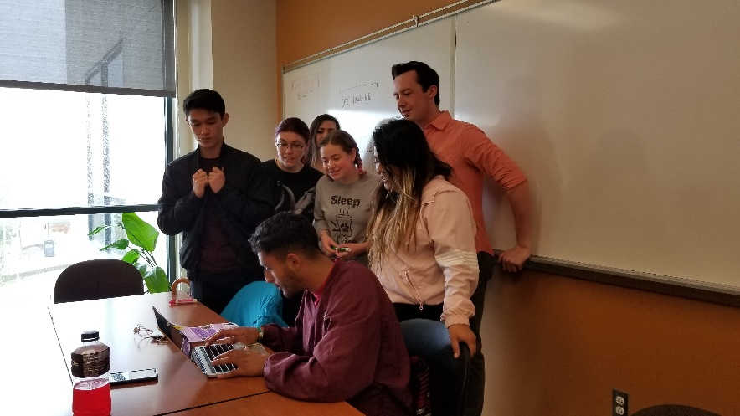
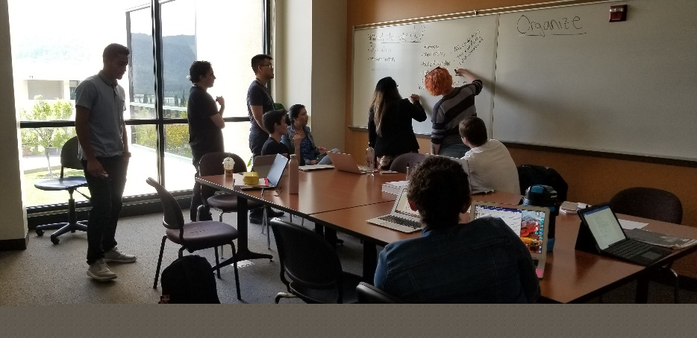
New Position Proposal:
EPIC Coordinator
October 31, 2019

Slide 2
Embedded Peer Instruction Cohort - EPIC Student Leaders
Successful students that are re-integrated into a class
Serve as embedded tutors and assist instructor
Lead weekly sessions outside of class to support instruction
Discuss study strategies and practice problem-solving
Build a community of students that work together
Notes:
Students are identified by instructors as good candidates for EPIC Leader positions. Academically successful in the course and able to work well with other students.
They attend class, modeling what a good student does, and can circulate to help groups problem-solving work.
EPIC Leaders lead scheduled study groups outside of class, presenting background material provided by instructor, reviewing class topics for that week. Topic is developed in conjunction with instructor.
Major portion of sessions are aimed at teaching study skills and problem-solving strategies for that discipline. NOT simply solving that week’s homework assignment. Part of training of EPIC Leaders; includes Reading Apprenticeship techniques.
Could supplement a college success course or catch students who won’t take a dedicated Success course.
Very Importantly: builds a community of students. Cohorts that are a key part of FYE.

Slide 3
EPIC Coordinator
Recruits, screens and interviews tutors for specific courses
Trains, supervises and evaluates EPIC and drop-in tutors
Coordinates with faculty to maximize program effectiveness
Coordinates with the Learning Center’s tutoring program
Collects and analyzes data for program improvement
Participates in college-wide academic support plan
Notes:
The tasks of Recruiting, hiring are constant, as the students transfer each year.
Supervising and Evaluation requires close monitoring of EPIC sessions; make sure Leaders are following best practices for getting students to take ownership of their own learning. Currently, this position does this for both EPIC and drop-in tutors for STEM courses.
Faculty need to understand how EPIC sessions differ from drop in tutoring, and how to best use the EPIC leader within the classroom and in study sessions.
Of course, data is collected and analyzed to improve this program.
This position would coordinate with Guided Pathway Success teams and other support programs at Canada.

Slide 4
Campus Impact of the EPIC Program
57% of supported students are non-STEM majors
(EPIC and/or drop-in tutoring)
Notes:
Currently supports gateway math and science courses. Pre-calc, calc I, Physics I
Institutionalization will allow expansion into new areas, specifically gateway biology courses (human biology, taken by med asst, kinesiology, and pre-nursing).

Slide 5
Impact: EPIC program improved retention and success
QEM matching of EPIC and Control students in MATH 251
Notes:
Comparison using QEM analysis in which students are paired for demographics and then outcomes compared.
Retention p=.021, Success p=.035 (NT=40, NC=80)
Consistently – across 4 semesters of data.

Slide 6
Impact of EPIC – Equity
Greatest improvement in groups with traditional achievement gaps
Notes:
Substantial gains in success rates for first gens, for minority students, for females. All groups that traditionally have underperformed in math and often struggled with lower expectations (from themselves and from others).

Slide 7
Consequences of Denial
Grant funding diminishes to 25% of FT next year, gone by 2020/21.
Unable to reapply for grant funding for this program.
Tutor Coordinator in Learning Center already has a full load of tutors, supporting non-STEM classes and writing.
EPIC Program would likely be cancelled, tutoring support would be lost for STEM and for MATH college-wide.
Notes:
Our students would lose tutoring support, cohort formation, lose out on learning and practicing study skills with their peers.

Slide 8
EPIC Program promotes equity
Consistently improved success rates in supported courses
Greatest improvement in groups with traditional achievement gaps
Promotes formation of student cohorts
Notes:
cohort formation is key part of Guided Pathways intiative. This offers another way of doing that.

Slide 9
Future Applications of EPIC
Expansion beyond current grant limitations (BIOL, statistics)
Compliance with AB705
Incorporate college success topics in lieu of separate course
EPIC Leaders serve as FYE Peer Mentors
Notes:
This position fits perfectly with Guided Pathways and getting our Promise Scholars off to a good start.
1. Logistics of setting up and running an EPIC program have been developed.
Can now Serve as model for GP student support.
2. Establish cohorts of students. GP FYE team identified this step of cohorting as important, and this program supports that goal.
3. Delivers college success strategies to students via EPIC sessions. Avoids the struggle with getting students to enroll in a separate course that they don’t think they need.
4. EPIC leaders could potentially serve as Peer Mentors, another vital piece of GP.

Slide 10
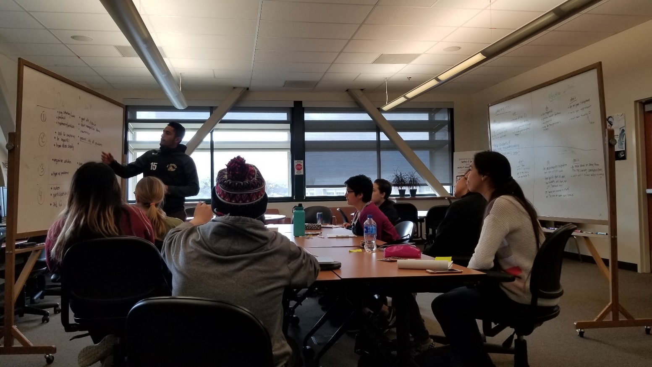
Thank You for Your Time and Consideration
Questions?

