Slide 1

Financial Aid Assistant
Improving student access, success and completion….

Slide 2
Current Challenges
STUDENT EXPERIENCE:
Inconsistent information being received
“Why didn’t someone tell me before, I’ve been here three times”
Students advised incorrectly on completing FA applications and forms
Complex forms and procedures without clear communication/support
Money left on the table - # of incomplete/closed files
No one to greet students consistently at the front counter
Student’s insecure with the confidentiality/security of their information
“I don't feel comfortable sharing my information with my classmate”
Unable to address the current economic and political issues
Homelessness; Residency status; Foster Youth; Formerly Incarcerated
STAFF EXPERIENCE
Extra time correcting FA applications and forms delays awarding students
Wheelhouse Report –
2017-2018 40% of Pell files completed
2018-2019 50% of Pell files completed
2019-to date 30% of Pell files completed
Informing and expediting services/resources to increase student equity and completion
Prescribed services vs. Equitable student centered services
Emergency Loans
Bookstore authorization
Professional Judgment
Referrals – Food Pantry, SparkPoint, Wellness Center, etc.
Notes:
- Public charge instilling fear and causing students to refuse to accept grant aid

Slide 3
Additional Upcoming Challenges
Unable to sustain current level of service
Increase in Cal Grant B and C independent students
Competitive Cal Grant Eligibility for DREAMers
Awarding Cal Grant A
Cal Grant extended timeframe for Foster Youth
CRM
Detailed case management by FA Technicians
Guided pathways
Formstack
WebXtender (Document imging/indexing as part of business model)
Outreach initiatives to address current issues (verification, Federal work study & SSCG)
Keeping up with college initiatives (Promise Scholars Programs, Proactive Reg., Colts-Con, STEM, EOPS, Committees & Task Forces, etc.)

Slide 4
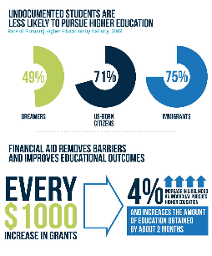
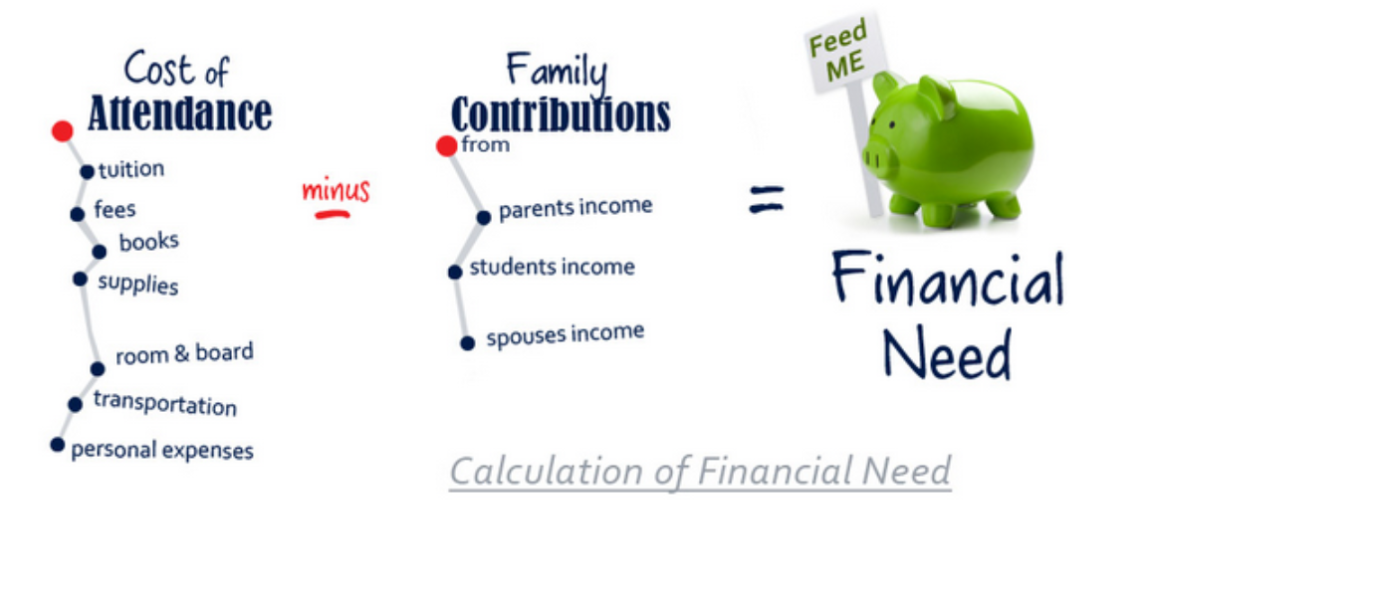
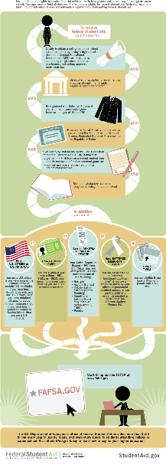

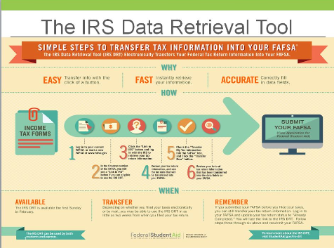

Complicated Processes
Need professional staff as first point of contact
Average over 7,500 visits to office
Manage email and phone inquiries
Average 500 – 560 student initiated email per technician within an academic year
Overreliance on students to fill gap
Requires training, expertise, ethics
IRS Regulations, Promise, Foster & Homeless Youth. SAP, Loss of CCPG, DACA/AB 540, Appeals…
Ability to de-escalate stressful situations, debunk myths, and clarify procedures
Provides more targeted student follow-up

Slide 5



Solution (aka FA Assistant!)
Permanent fulltime Financial Aid Assistant who….
Professionalizes equitable services with a knowledgeable first point of contact
Translates complex eligibility and regulatory requirements for families
Able to address student/parent’s economic situations that are unique to living in this high cost area
Address students unique needs
Staffs high volume-high stress service area
Provides much needed staffing for the increase in number of outreach events
Example: MA Cash4College – 45 families from marginalized population. Unable to provide equitable services with only 2 financial aid staff available

Slide 6
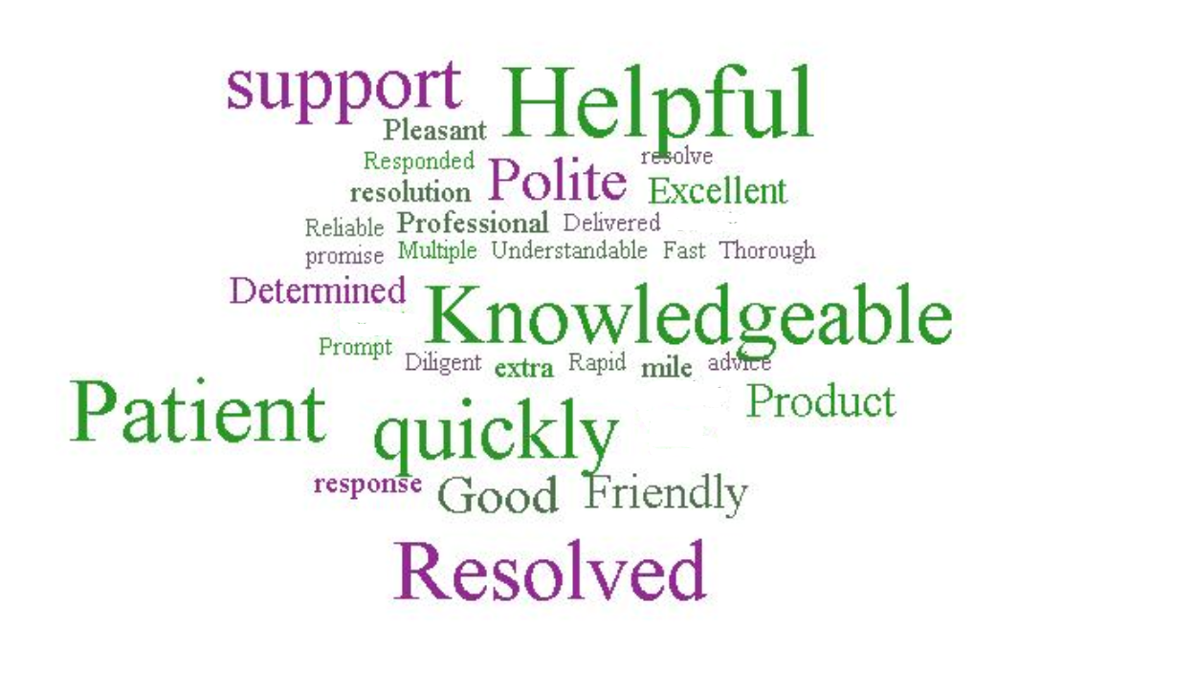


Provides Excellent Customer Service
Elevates expectations
Excellent interpersonal skills
Culturally competent & social justice frame of reference
Consistent, accurate and complete information
Timely response to student inquiries
Builds trust, removes barriers and expedites processing
Supports retention and completion efforts
Align with Skyline and CSM Staffing

Slide 7
Questions?
Financial Aid Mission:
To aid students and prospective students in their understanding, application, and timely receipt of all eligible financial aid resources they need to reduce the significant barriers the costs of higher education present.

