Slide 1
Financial Aid Program Services Coordinator
Fall 2019 Position Justification

Slide 2
Need
Permanent Fulltime Financial Aid PSC will…
  Realign and balance complex work
  Align staffing with Skyline and CSM
  Provide program oversite
  Coordinate Financial Aid Outreach
  Maintain website, social media and forms
  Develop FA marketing and outreach materials
  Support special populations/case manage
  Partner with Outreach, Promise and others

Slide 3
Liaison
Promise
Homeless Students
Foster Youth
Outreach
Dream Center
Marketing/Website/Communications
SMCCC Foundation

Slide 4
Coordination
  Scholarship Program
    Application system maintenance
    Schedules and conducts workshops
    Trains other users and resolves access issues
    Promotes opportunities
    Year-end Student Recognition awards
    National Science Foundation
    Additional Outside Scholarships (High School, PIVOTAL, etc.)
  Financial Aid Presentations and Workshops
    Point of contact and coordination for all internal & external requests
    Planning
    Staffing
    Scheduling (20-30 workshops/presentations)
    Outreach
  Other
    CHAFEE Grant
    CA National guard
    Americorp

Slide 5
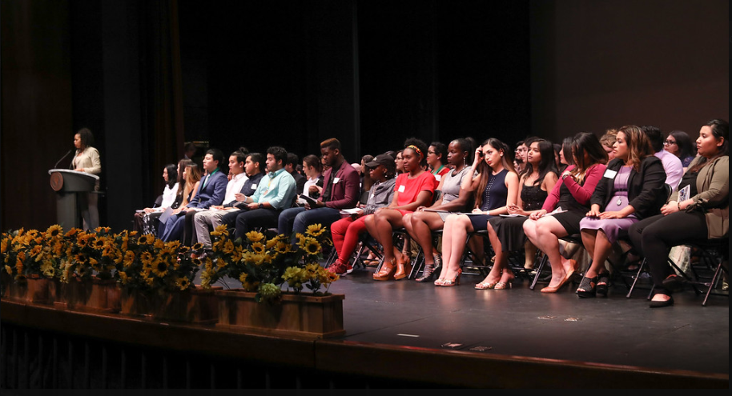
Student Recognition Event

Slide 6
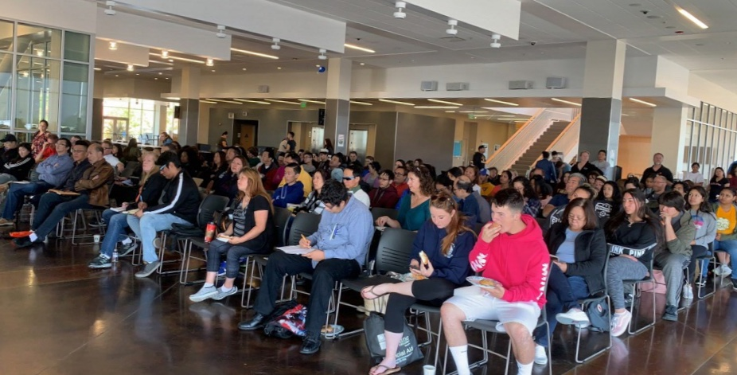
SMCCCD
Cash for College

Slide 7
Expands Access &
Completion
Off Campus
  Trained staffing for Cash for College Workshops
  Participation in Student Success “Enrollment Teams” (Guided Pathways)
On Campus
  Supports Retention efforts
  Promise, EOPS, CARE, CalWORKs & FFYSI, TRiO, DRC, etc.
  Follows up with incomplete/not awarded students
  Case manages high need, SAP, other at risk groups
  Schedules and conducts multiple workshops
  FAFSA, CADAA, Scholarship and tailored content
  for special populations, tabling for student events, etc.

Slide 8
Consequences if not filled…
Scholarship Program will suffer
Reputation with donors will suffer
Financial aid outreach will be limited
Undermines department, director and college
Lead to student complaints
Inability to effectively support high need students
Inability to expedite processing for Promise
FA limited in helping YOU/YOUR program

