Slide 1



International Student Counselor
Full-Time Tenure Track Proposal

Slide 2
History and Current Situation
AY 2016/17 Part-Time Adjunct International Counselor hired
AY 2017/18 2nd Part-Time Adjunct International Counselor hired to meet demand
Both adjuncts left in Spring 2018 for full-time positions at CSM, including the new CSM International Student Counselor position.
AY 2018/19 Full-time, Short-term (non tenure track) International Counselor hired
AY 2019/20 Full-time, Short-term (non tenure track) International Counselor rehired; teaching CRER 137 section for international students
Position funding is from International Program Budget and does not require additional expense. Retention and permanency in the position is critical.

Slide 3
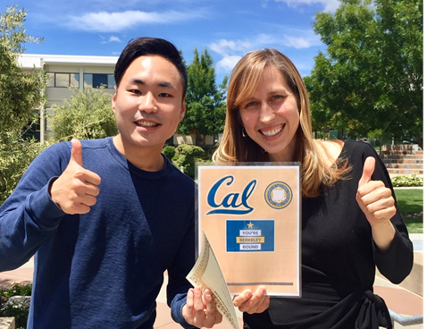
International Student Program At a Glance
135 students from 40+ countries. Annual headcount of 135-155
+17% increase Fall 2019 vs Fall 2018. SMCCD saw a -15% decrease
Students pay $319 per unit or $7,700 per academic year
F-1 Student Visa holders follow strict academic regulations to maintain legal visa status
Age range from 16 years old
International Program known for very friendly, personal, and knowledgeable support

Slide 4
Critical Need for International Counselor
1. The International Counselor provides specialized expertise to navigate complex F-1 Visa regulations in a changing political climate. | Misinformation and incorrect visa advice can result in termination of status.
2. Support from the Intl Counselor is crucial to strong transfer applications and retention. | Cañada International students have an outstanding academic and transfer success record.
3. The Intl Counselor is critical to acceptance of late applicants and students who struggled at other colleges. | 40% of new Fall students were accepted after the admissions deadline of July 1st and required significant registration help.
4. Competition for international students in the Bay Area is high. Position is required to remain competitive and meet district needs. | Skyline College established the international counselor position in 2016 and College of San Mateo in 2017. Nearby colleges have had the position for years.

Slide 5
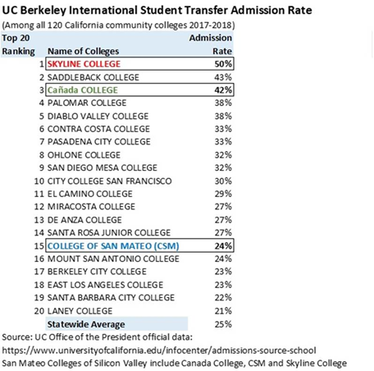
Outstanding Academic Performance OF Canada InterNational STudents
Ranked #3 in California for UC Berkeley transfer acceptance
60% of 2019 transfers were accepted at one or more UCs
Average International GPA is 3.0
90% of 2019 International scholarship applicants received an SMCCD scholarship

Slide 6
What can WE do with a Permanent Position?
Better address the unique needs of intl students, including aggressive graduation and transfer goals, study timeframe, cultural adjustments and visa requirements
Maintain the outstanding GPA and transfer acceptance rate of Cañada international students
Increase our international student population while remaining flexible, accurate, and efficient with personalized services
Be competitive in a challenging, declining Bay Area international market

Slide 7

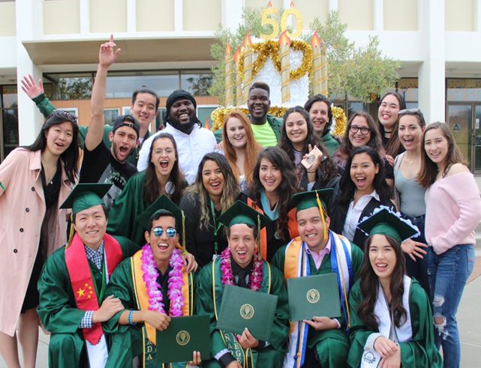

Thank you!

Slide 8
Other Benefits…
Provide an annual CRER 137 section (or similar class) to create an academic community of International students
Continue the rigorous process of collecting and following up on International student progress reports each semester
Provide additional academic workshops for International students to enhance the program services
Position does not require additional funding; paid from International budget

